Slide 1
Beyond the Impossible: Science Supporting Food Safety Policy Making and Consumers
March 2020

Slide 2

Innovation in Industry
Animal welfare
Biologic hazards
Physical hazards

Slide 3
Innovation in Animal Welfare
Fundamental Approach to Research
Allow for the expression of preference, through applied research, when given choice in different situations.
Use a science-based approach to evaluate the impact of the different choices on measurable outcomes.
Use a science-based approach to define/refine standards to drive continuous improvement in outcome-based measures of welfare.
Transparently share the results of our progress with our stakeholders.

Slide 4
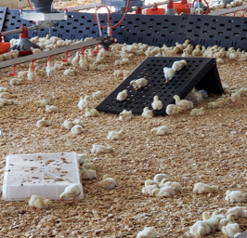
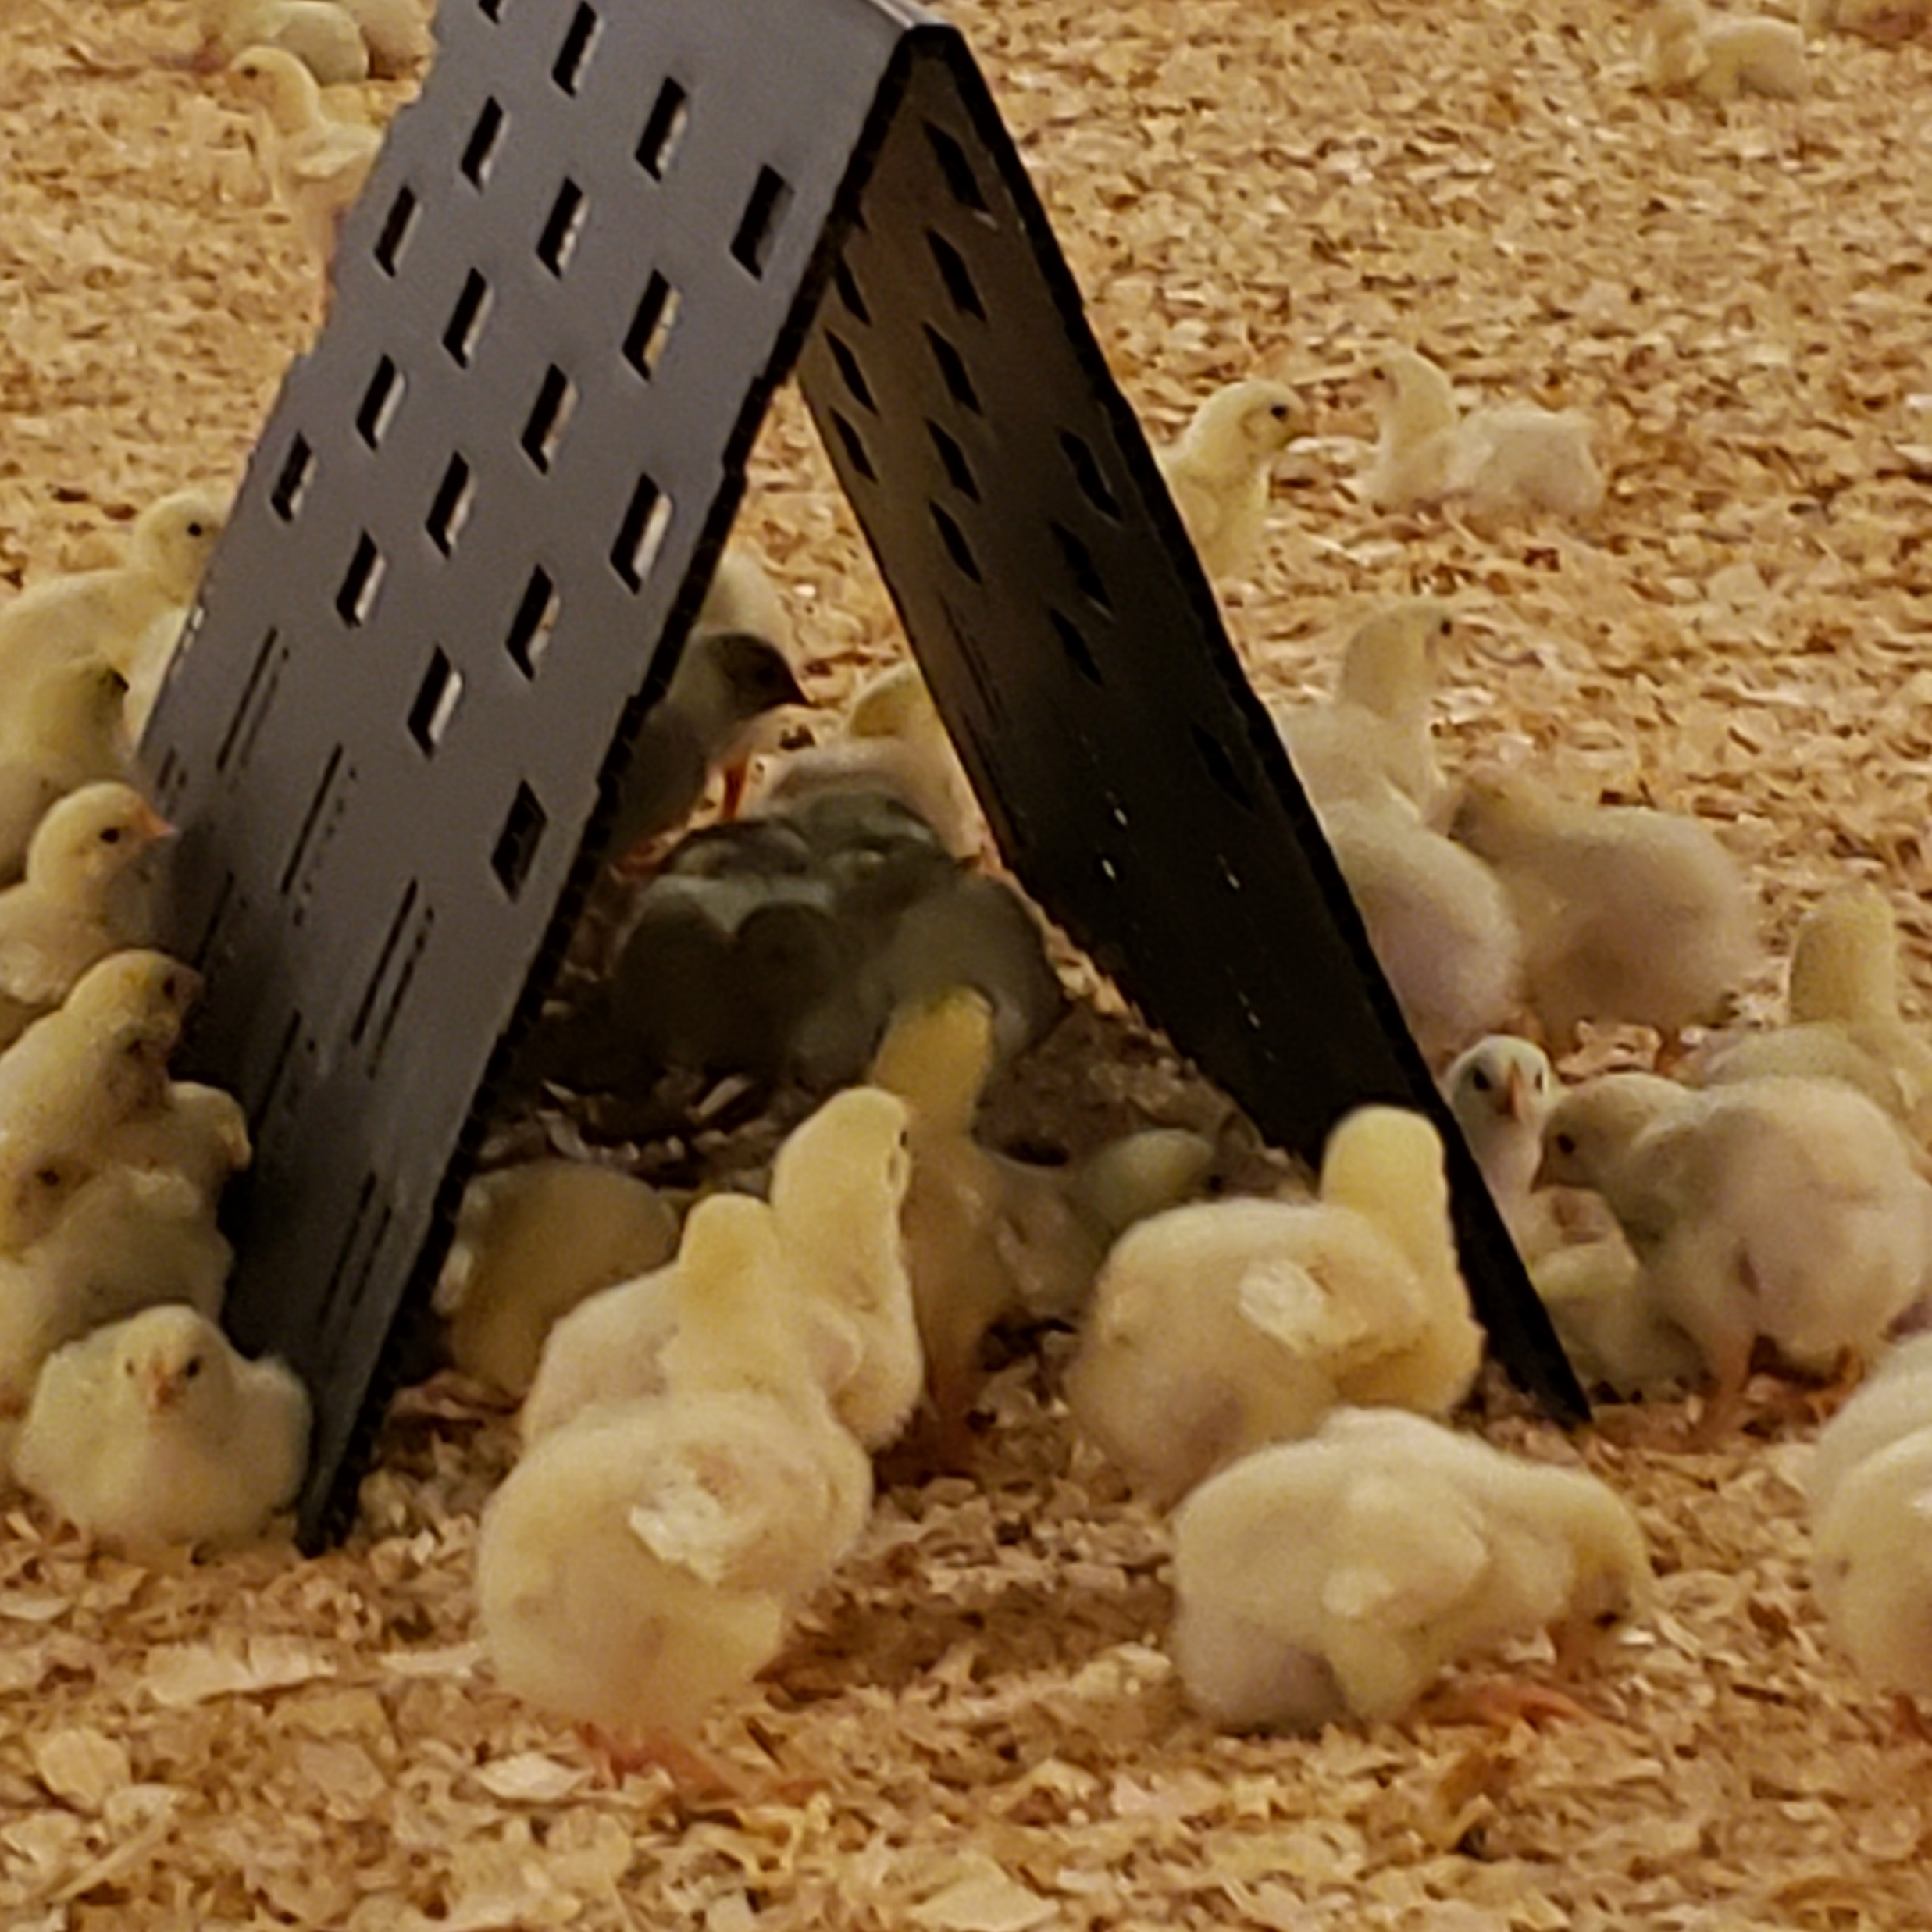
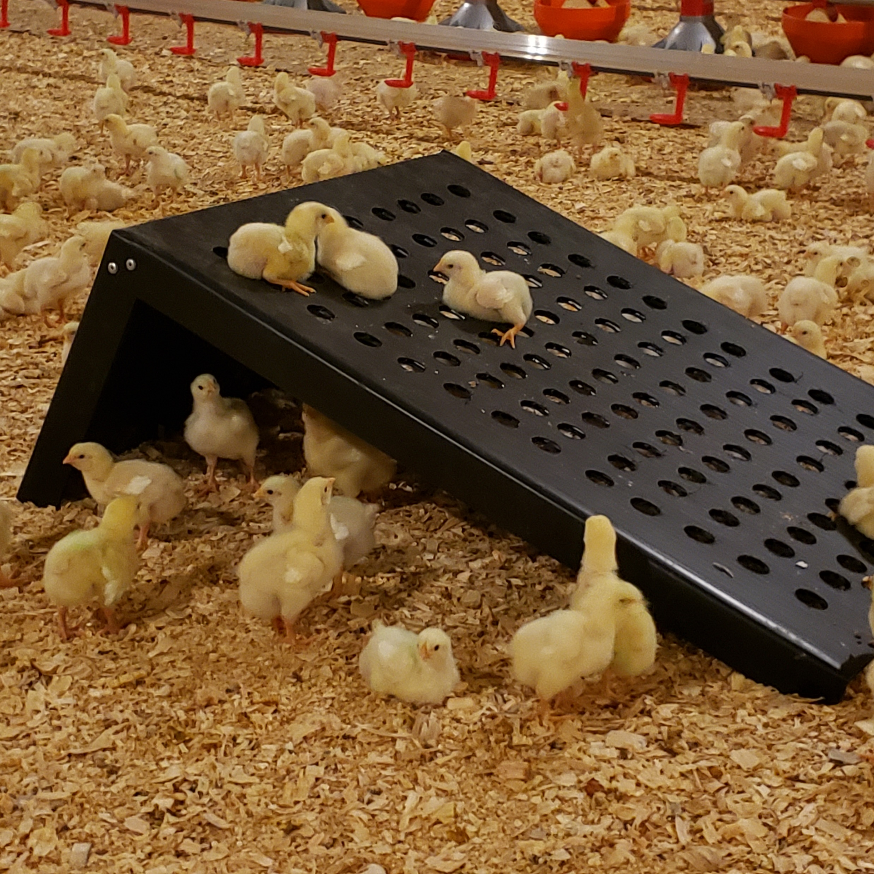
Enrichment Preference Trials
Allowing broilers to choose the enrichments that they will engage with for the length of the flock.
Consideration for recycled material, safe for birds and growers, biosecure and easy to store and deploy.

Slide 5
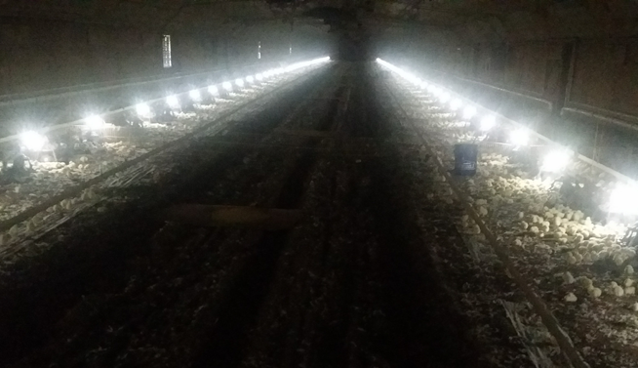
Choice Lighting Trials
Ongoing research to determine best lighting program for welfare
Birds prefer choice in light intensity to display natural behaviors
Research confirms better welfare
Research confirms better performance

Slide 6
Food Safety is Non-Competitive
Innovation is key to improving food safety at all companies
Innovation leads the way in improving risk management for all risks

Slide 7
Innovation for Biological Hazards
Industry collaboration has begun against Highly Pathogenic Salmonella
Industry platform that can be applied to any process that focuses on the risks presenting in a given region, plant or process.
  This approach is in it’s beginning stages, but work within the next year will establish an approach designed to identify emergence or presence of highly pathogenic salmonella [HPS].
  Industry is working on identifying the analysis, data collection/ sharing for food safety approaches and the research that is beginning to take place in multiple sectors that includes producers.
  Beef industry will likely have agreed to way forward to aggregate data very soon and use it in the battle similar to approaches used in the battle against E. coli O157.

Slide 8
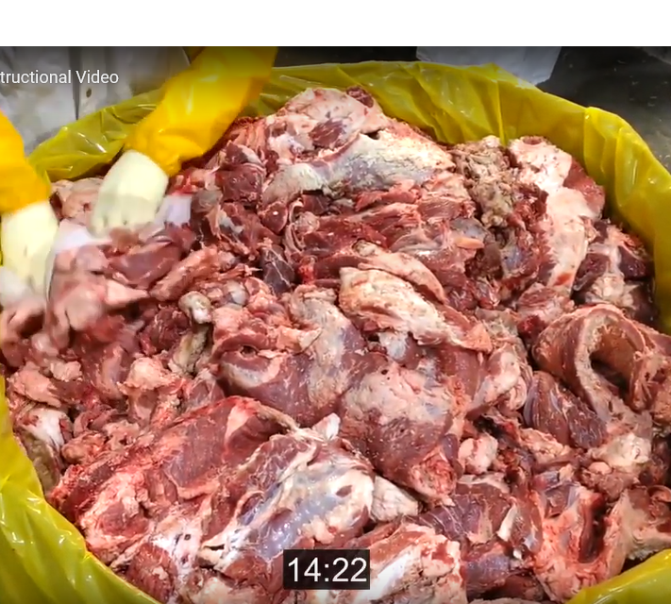
Industry collaboration on alternative sampling systems- Microtally™ cloths.
  Tyson worked with researchers, vendors and industry partners to develop and validate this new method with the intention of providing valid options to the industry.
  Microtally™ cloths permit the ability to collect non-destructive samples that have been validated for an organism recovery rate greater than, or equivalent to, the typical N60 or N60 Plus method for detection.

Slide 9
Innovation for Biological Hazards
Recirculated beef carcass systems.
  The carcass wash has been around for many years. However, the use of high volume carcass washes can place a burden on water use and water waste management.
  Tyson Fresh Meats has installed recirculated carcass washes in beef and pork processes that have led to increased microbial reductions, while at the same time reducing the water consumption.

Slide 10
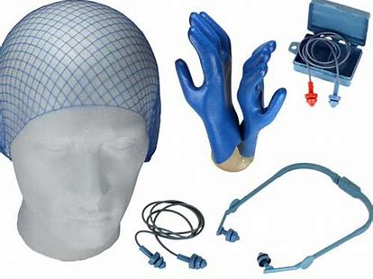
Innovation for Physical Hazards
Foreign Material Control
Detection has been the long-standing tool in industry
  FSQA inspection of received goods
  Employee belt and equipment inspection
  Metal detection and x-ray
New materials for belting and personnel protection equipment
  Detectable PPE
  Detectable plastics
Industry has re-trained, removed, re-done… looking for what else can be done in the future….

Slide 11
WHAT’S IN YOUR FOOD?
PPO Smart Imaging:
What’s in Your Food?
Visit ppo.ca
Notes:
New technology that may be a game changer
Very expensive, requires visualization of both sides of product
PPO’s Smart Imaging System easily finds extraneous materials like plastic, rubber and bone. PPO Smart Imaging System always knows exactly what and where each contaminant is, so you can take immediate action on the line. Even when it’s never seen an object before, the system can find the contaminant and let you know it’s there, so nothing unexpected ends up in your products.

Slide 12
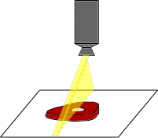
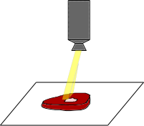
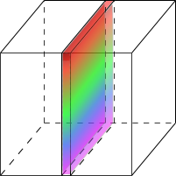
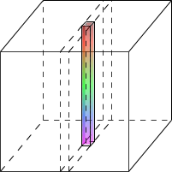
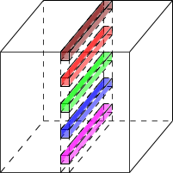
Hyperspectral vs. Multispectral Imaging
COMPARING VISION SYSTEMS
Belt Motion
λ
λ
λ
y
y
y
x
x
x
PPO Smart Imaging
Scanning System
Filter System
PPO sees more chemistry, more precisely than other vision systems.

Slide 13
Hyperspectral Imaging vs.
Other Vision Systems
COMPARING VISION SYSTEMS
 | Typical Vision | Multispectral Imaging | Hyperspectral Imaging
# of Light Bands | 3 - 4 (in visual spectrum) | 3 - 10 (mix of spectra) | 100's to 1000's (mix of spectra)
Spectral Resolution | Discrete colours Simulates human vision | Discrete colours Separated by gaps | Continuous colours No gaps
Information per Pixel | Very low | Isolated data points only | Full spectrum from each pixel
Identifiable Features | Visual features only like shapes and high contrast objects | Simple, few components Identified chemistry only | Complex, multi-component Known and unknown
Trainability of System | Low due to very limited spectral differentiation | Low due to limited data capture | High, due to rich data capture

Slide 14


PPO Smart Imaging sees more
SEE ALL THE INFORMATION
Other Systems
PPO Smart Imaging

Slide 15
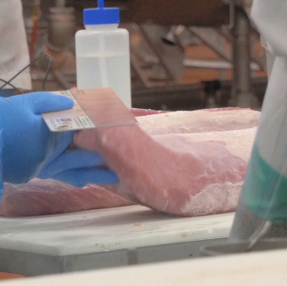
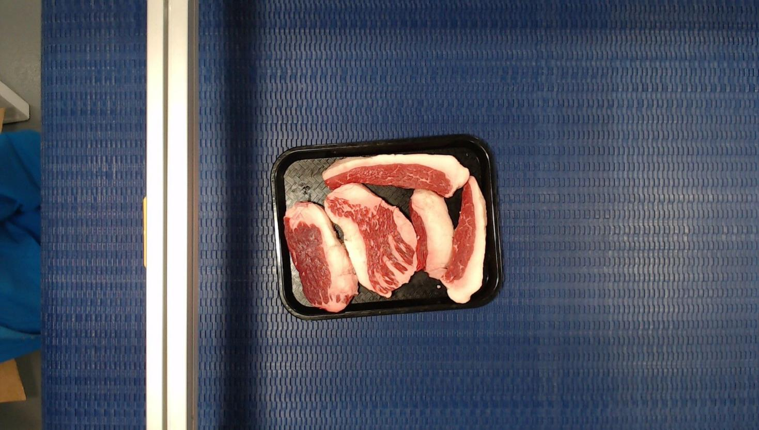
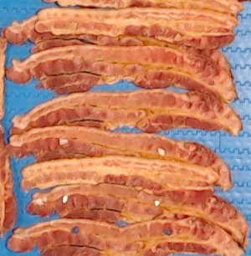
What Can PPO Smart Imaging Do?
PPO SEES MORE
SAFETY
TRANSPARENCY
MARGINS
Find and identify foreign objects
Continuous measurement of quality
In-line process monitoring
©2019 P&P Optica Inc. Not for distribution.

Slide 16
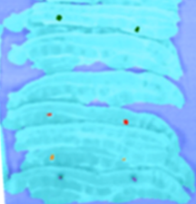
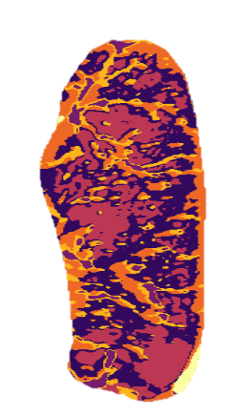

What Can PPO Smart Imaging Do?
PPO SEES MORE
SAFETY
TRANSPARENCY
MARGINS
Find and identify foreign objects
Continuous measurement of quality
In-line process monitoring
©2019 P&P Optica Inc. Not for distribution.

Slide 17
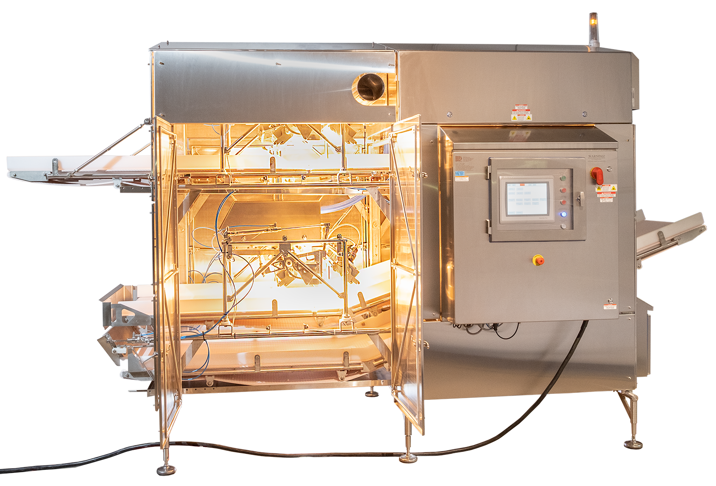
PPO Smart Imaging sees more
PPO SMART IMAGING SYSTEM IN PRODUCTION
Hyperspectral imaging
  Identifies chemical bonds
  Plastics, metal, organics etc.
Patented spectrometers
  Deliver unmatched data quality and speed
Modular design
  Drops into production lines
Machine learning
  Analyzes spectral data

Slide 18




PPO Data Analytics Offerings
DATA INSIGHTS
Tier 1
(Readily Available)
Tier 2
(Readily Available)
Tier 3
(Under Development)
Tier 4
(On Roadmap)
Detect foreign objects
Frequency of events/findings
Fat/Lean analysis
Moisture
Large concentrations of compounds
Some allergens
Shelf life
Flavour
pH
Complex chemistry
Low concentrations of compounds

Slide 19

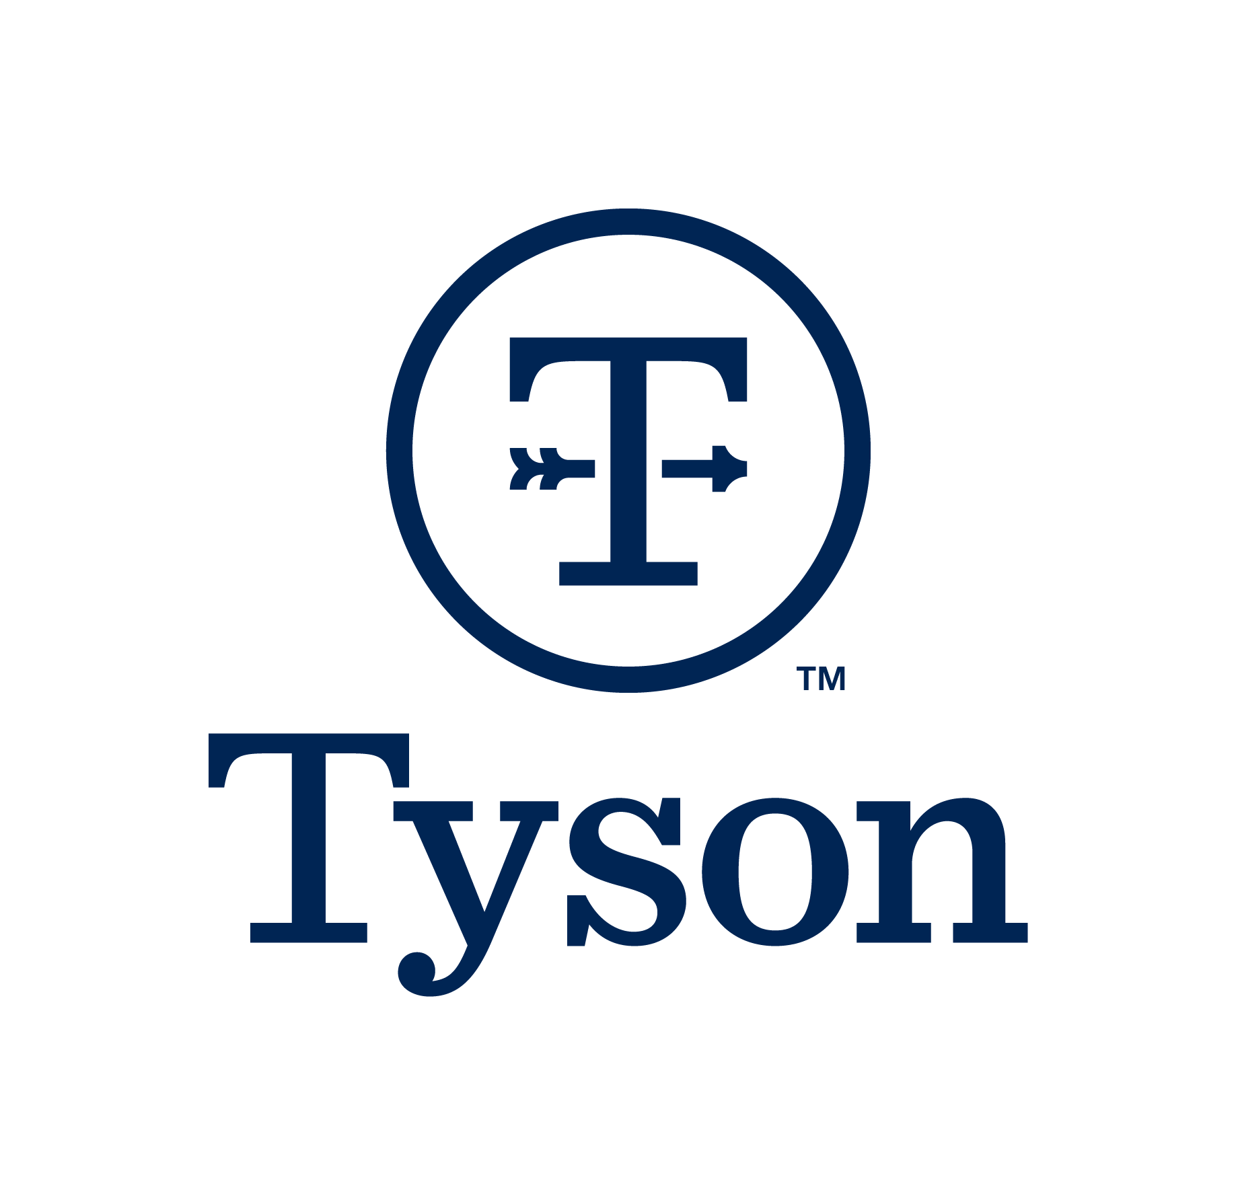
Intro to Innova Zones

Slide 20

Our Mission
“Revolutionize complex industry processes through simplified, intuitive technology.”
Foreign Materials Management Program

Slide 21
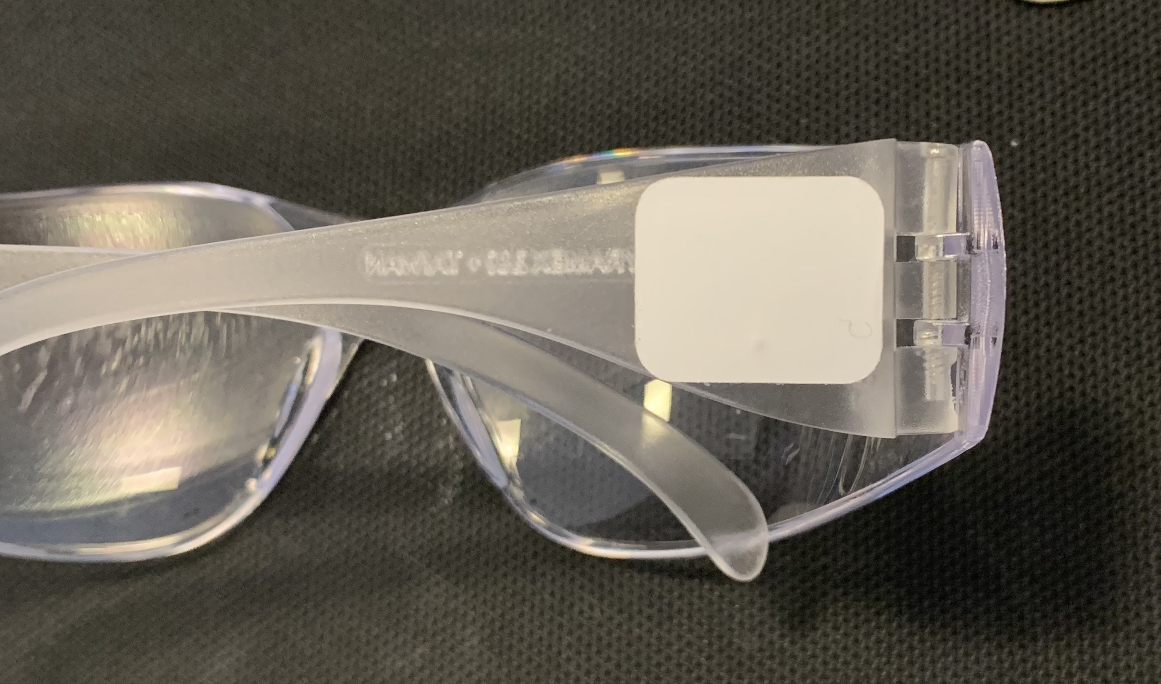
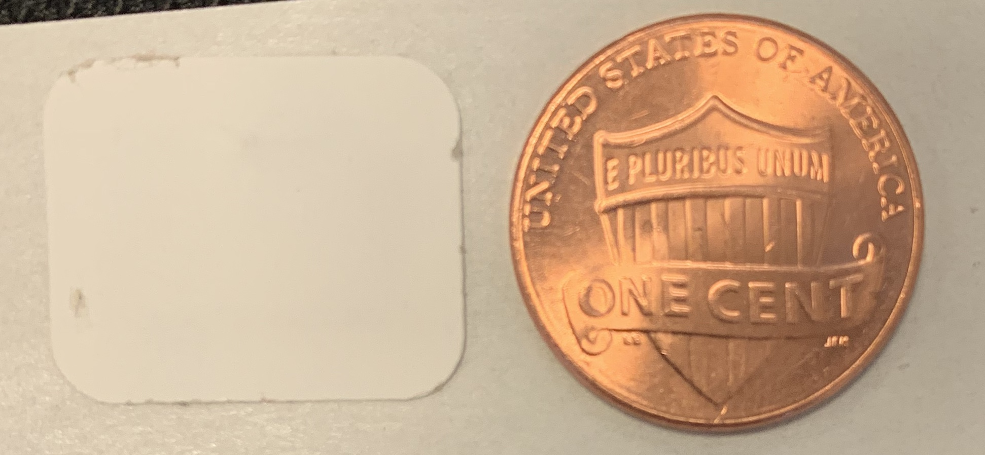
UHF RFID sticker tag HIGH RISK assets
Example: UHF RFID tag on Safety Glasses

Slide 22
Foreign Materials Management
Program
Step 1
Issue HIGH RISK asset item to Employee

Slide 23
Foreign Materials Management Program
Step 2
Employee ENTERS Plant Floor

Slide 24
Foreign Materials Management Program
Step 3
Employee EXITS Plant Floor

Slide 25


Slide 26
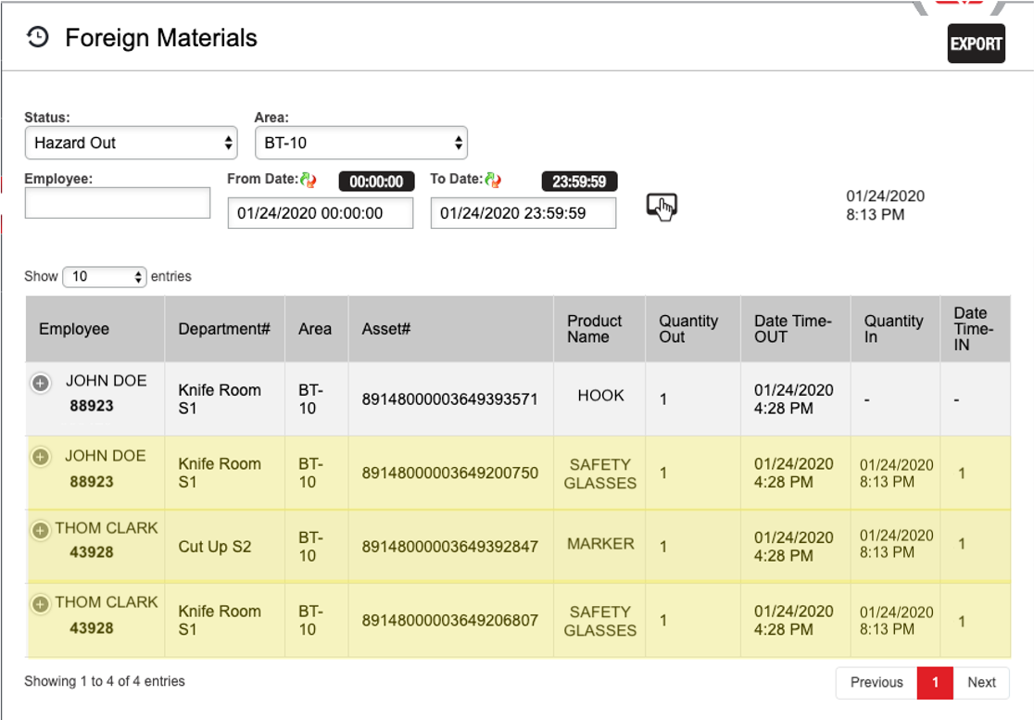
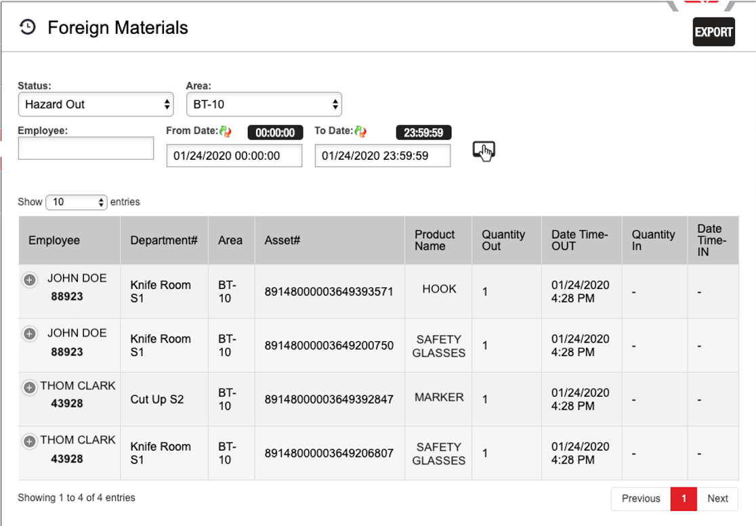
Foreign Materials Report Confirmation

Slide 27
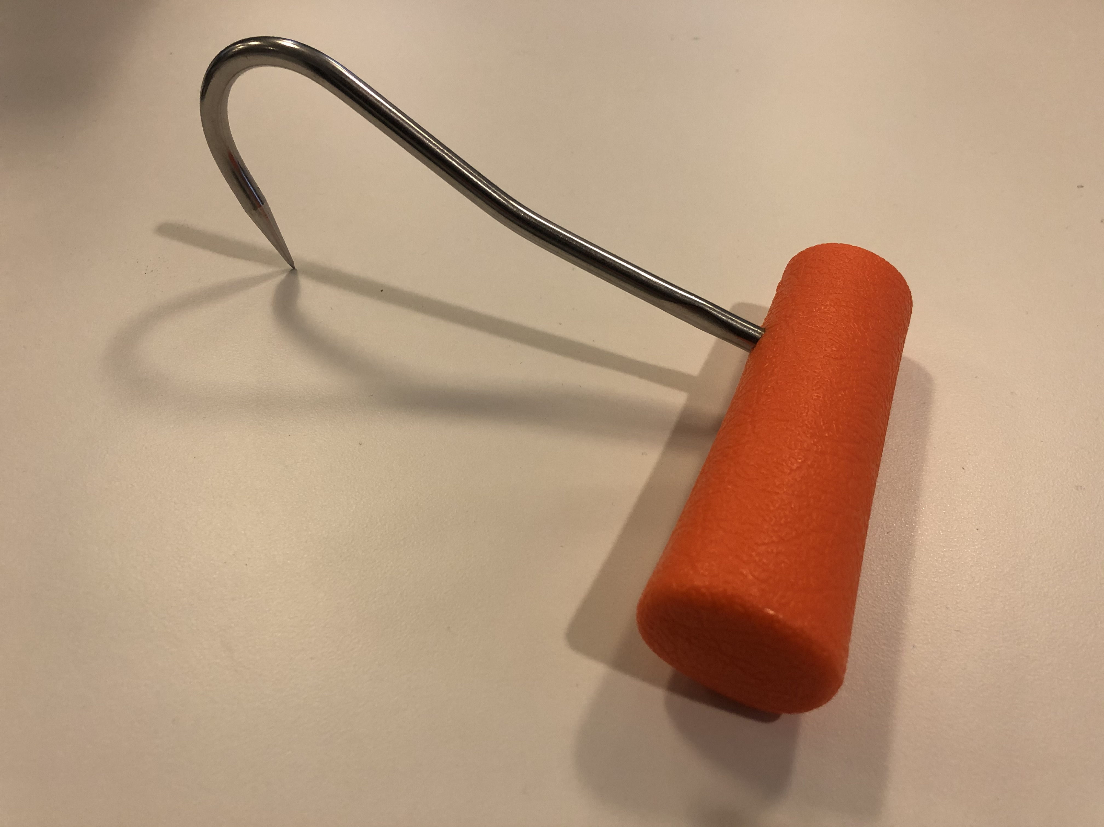
Missing Hook!
Hook #89148000003649393571 issued to John Doe (#88923) in BT-10 area on 1/24/2020 at 4:28 PM

Slide 28
Benefits of Foreign Materials Management Program
Full visibility of ALL hazardous items
Realtime checks and balances
Move away from detection to prevention!
Automated email alerts
  Down to:
    Employee
    Line
    Department

Slide 29
Thank You For Your Time!

Slide 30
Innovation for Physical Hazards
Future needs
  PREVENTION systems need to continue to be the developed that can be implemented in plant systems
  Must be able to accommodate
    Size and shape of finished goods on line
    Plant conditions
    Varying entry points for potential contaminants
    Affordable for implementation at all facilities

Slide 31
Innovation in the Food Industry
Quality is Expected- Food Safety is Required
Work closely with regulators and customers
Training and education
Conduct applied research
Develop technologies to reduce risk
Validate efficacy of technology
System implementation and verification (audit oversight) and
Always striving to develop innovative and effective food safety systems and applications

Slide 32
Raise the world’s expectations for how much good food can do.

