Slide 1
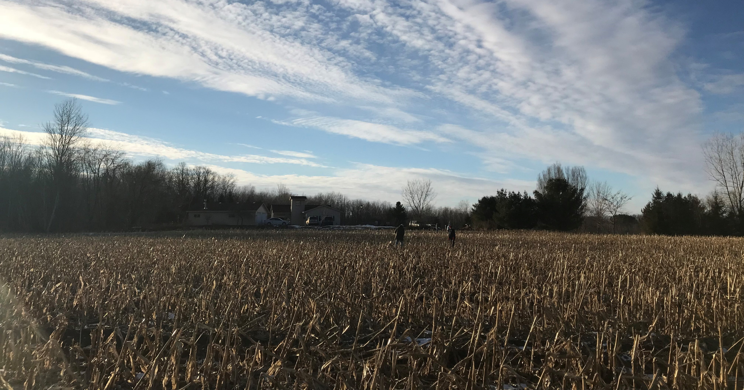

Rural mental health
Notes:
Title Slide
Introduce yourself - Rob Larew, President of National Farmers Union

Slide 2
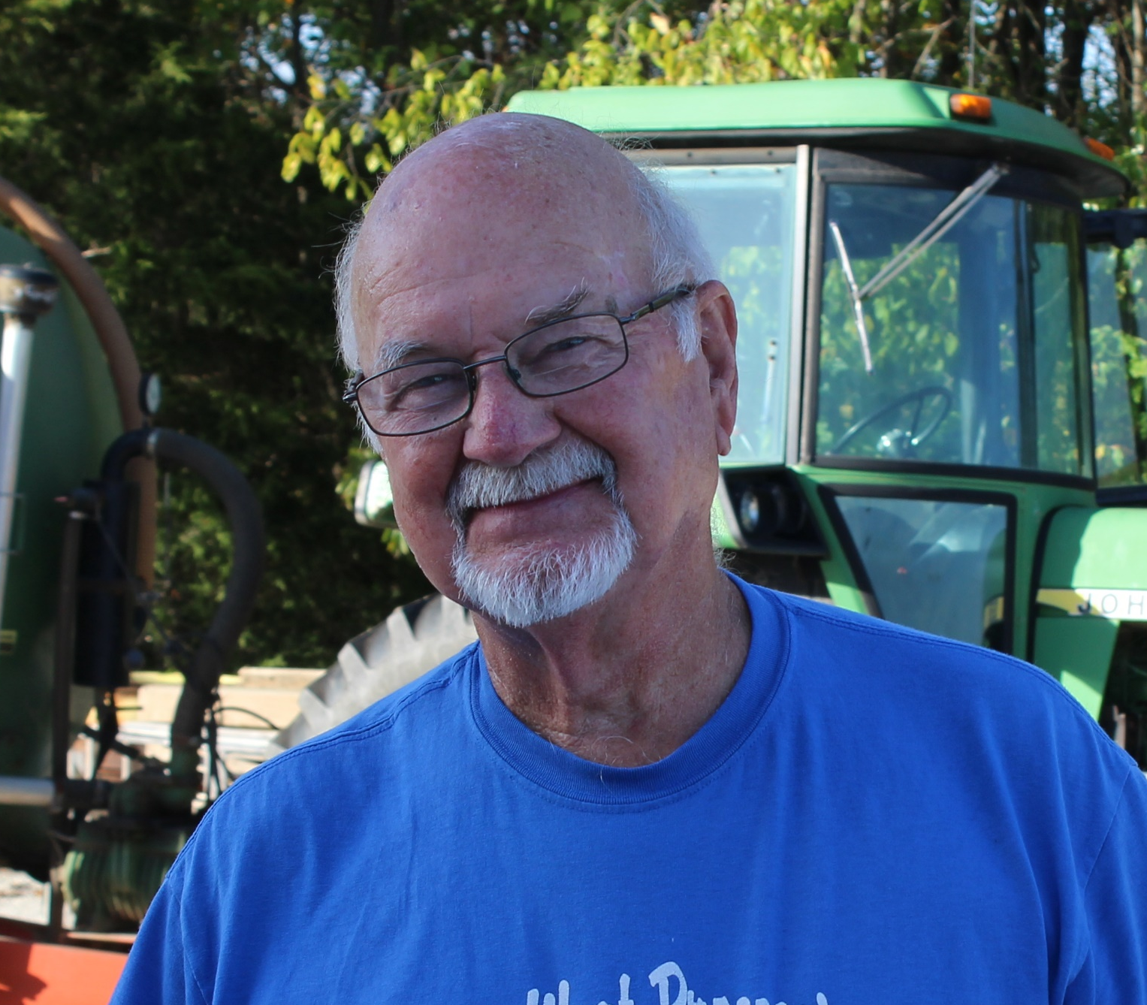
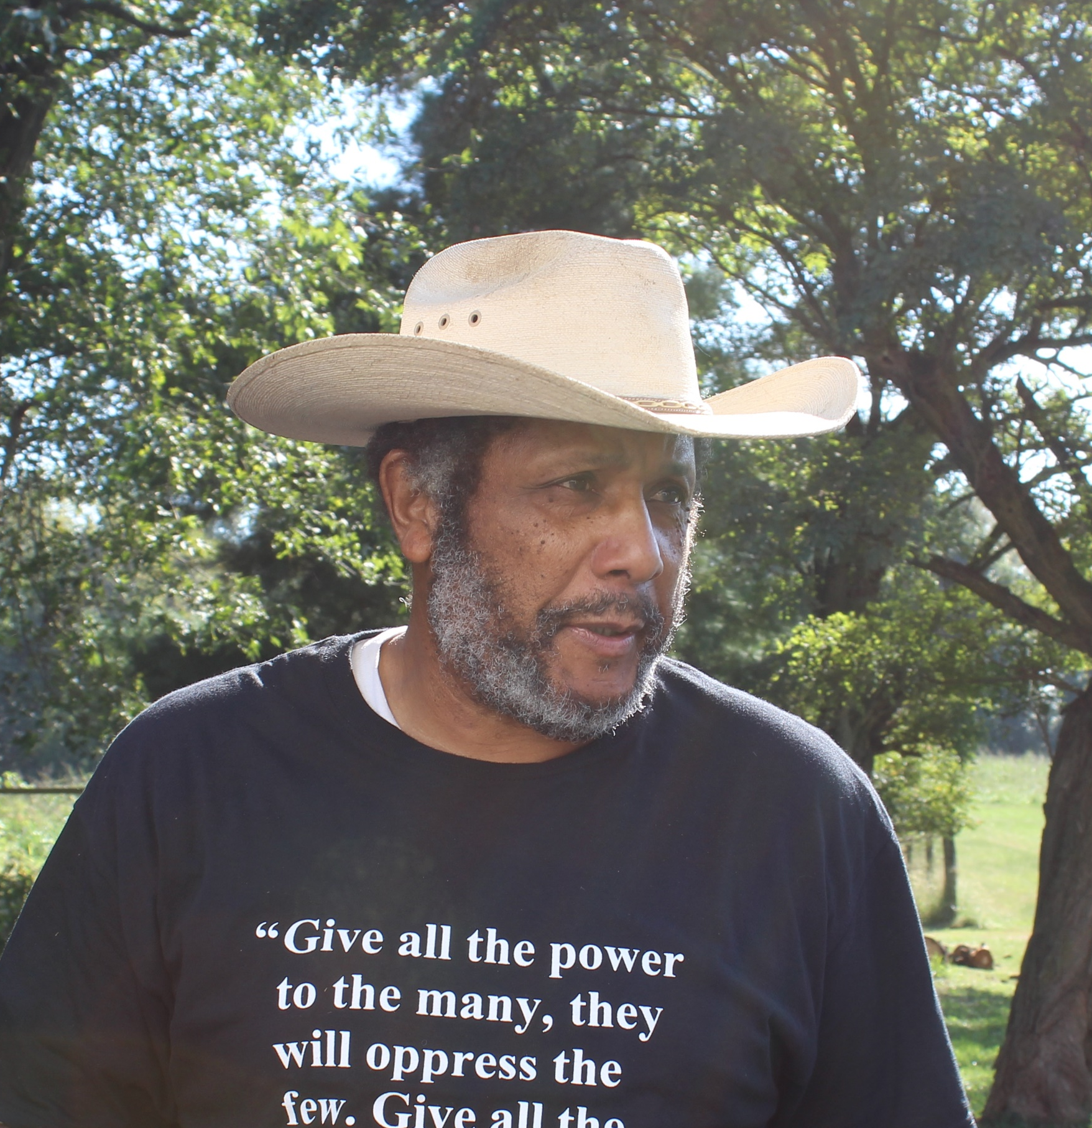
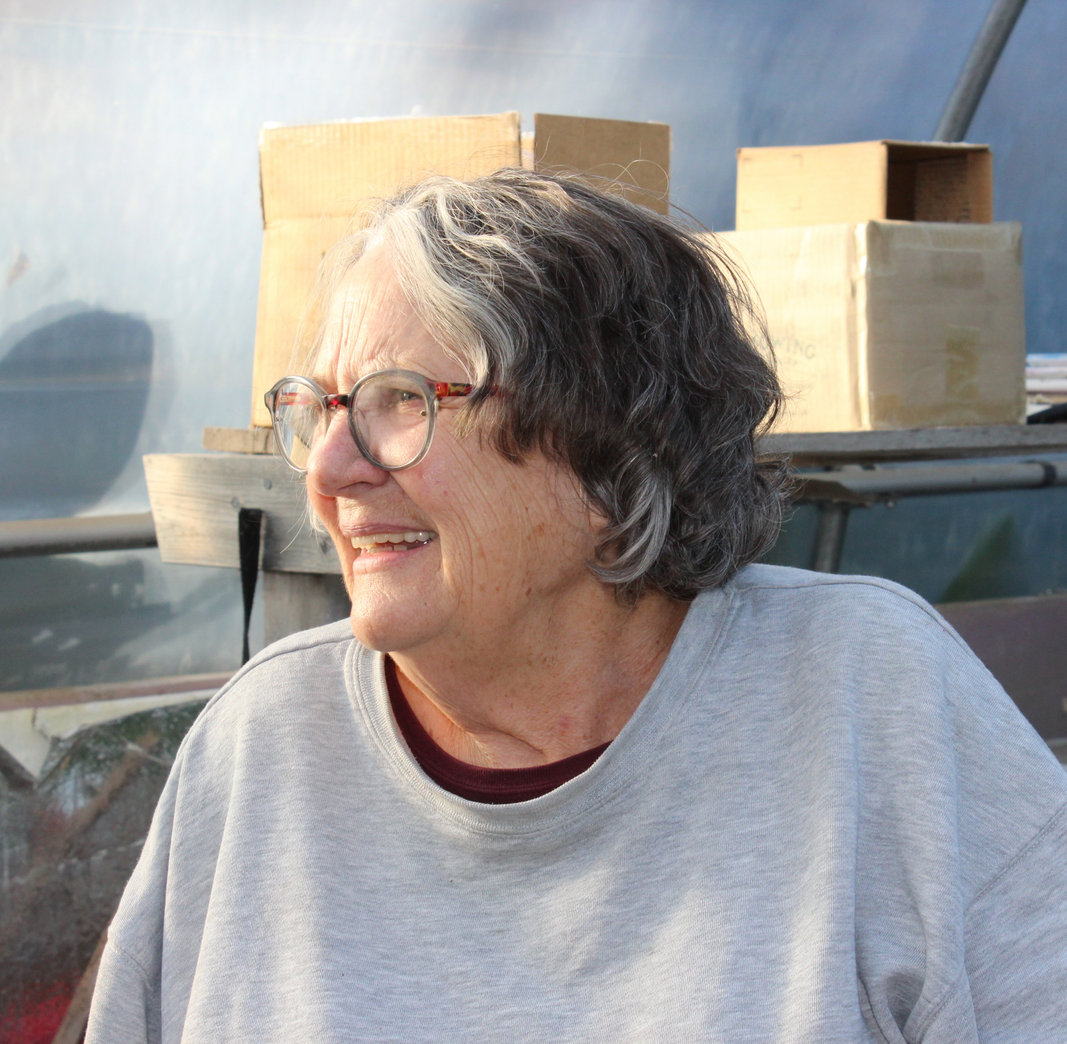
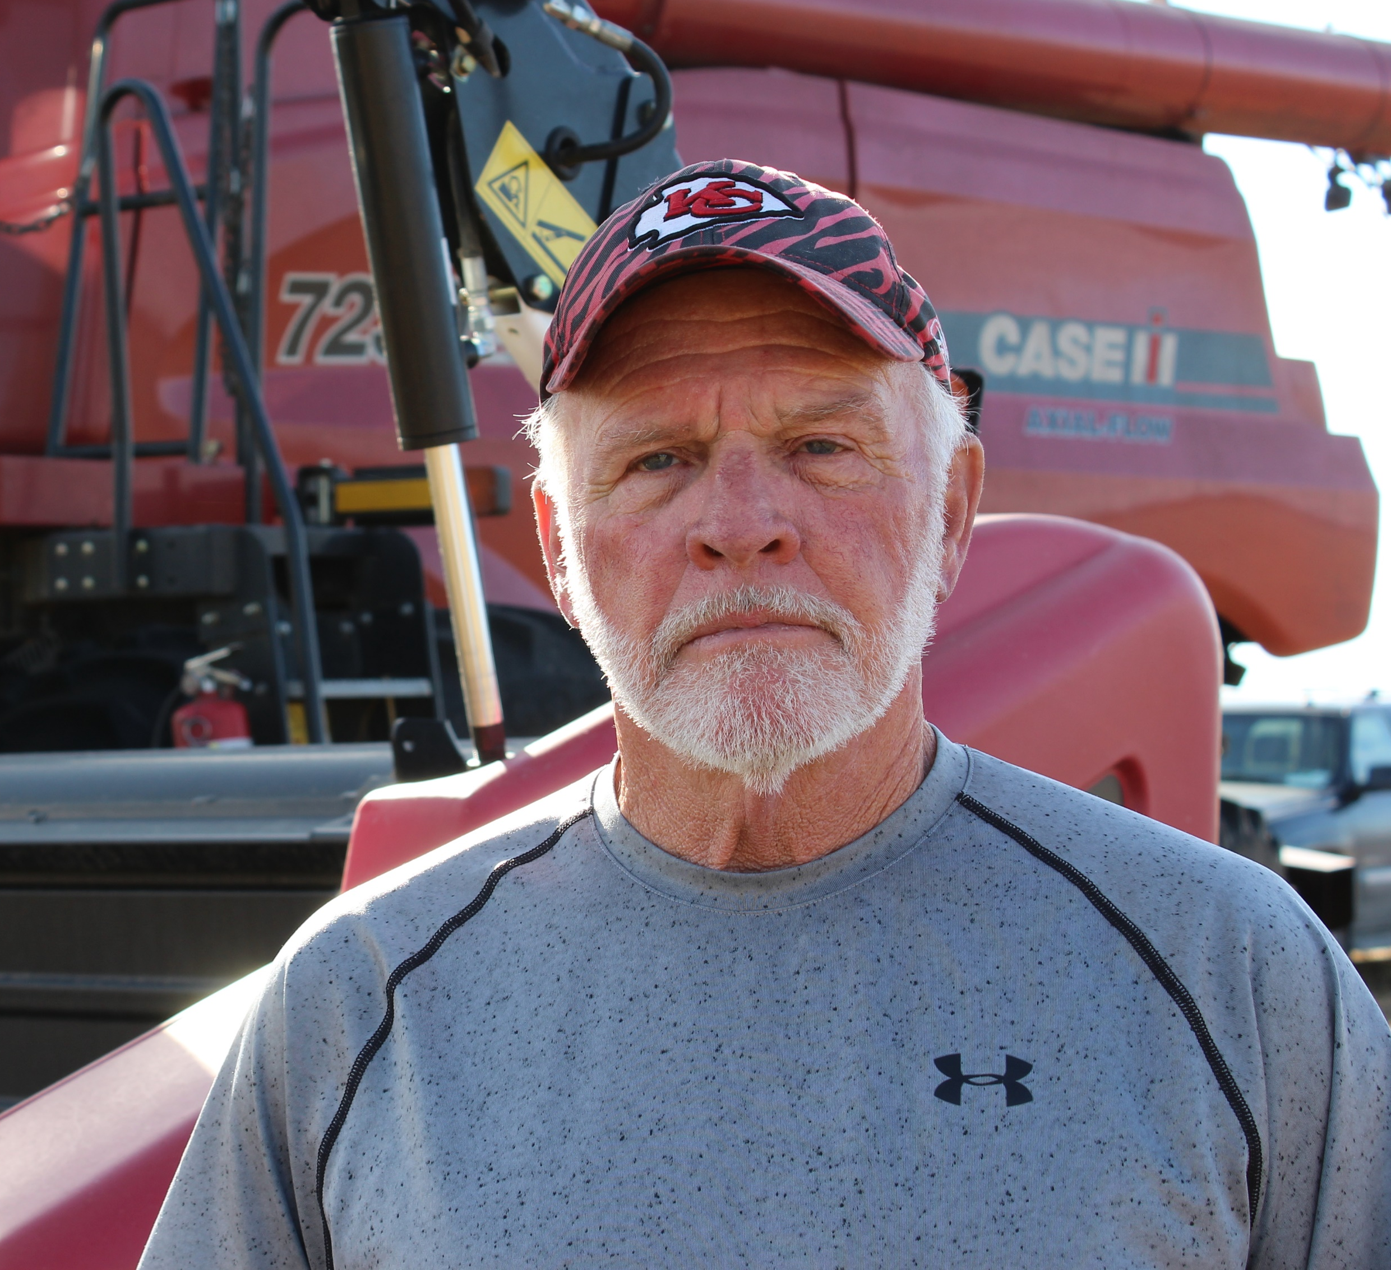
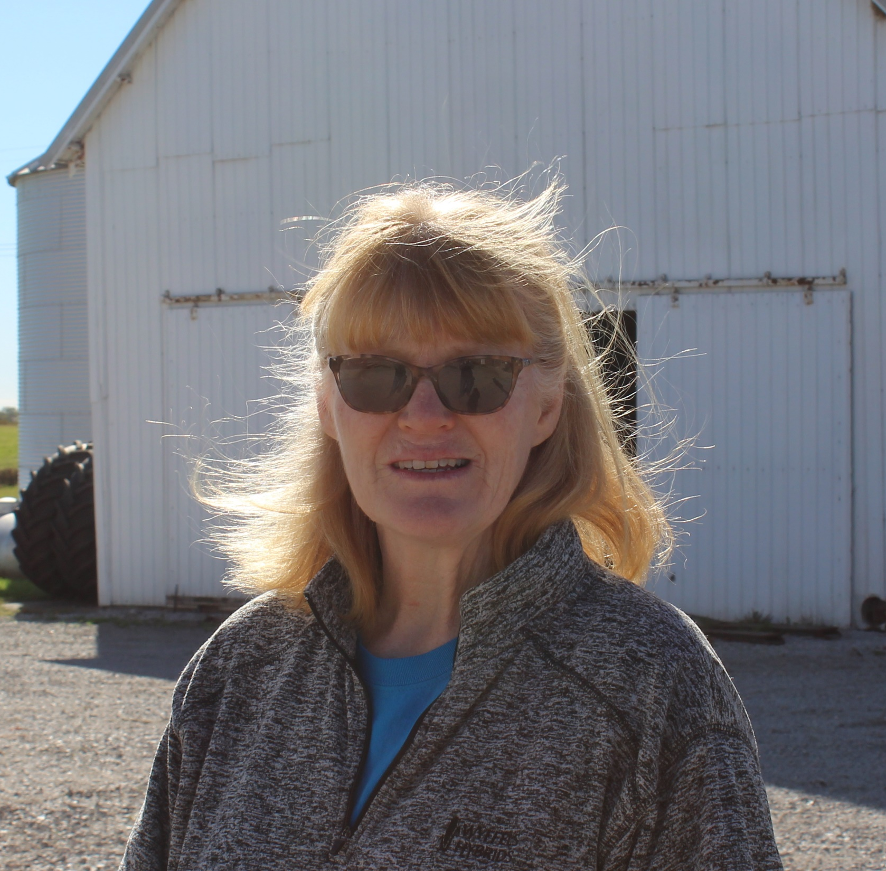
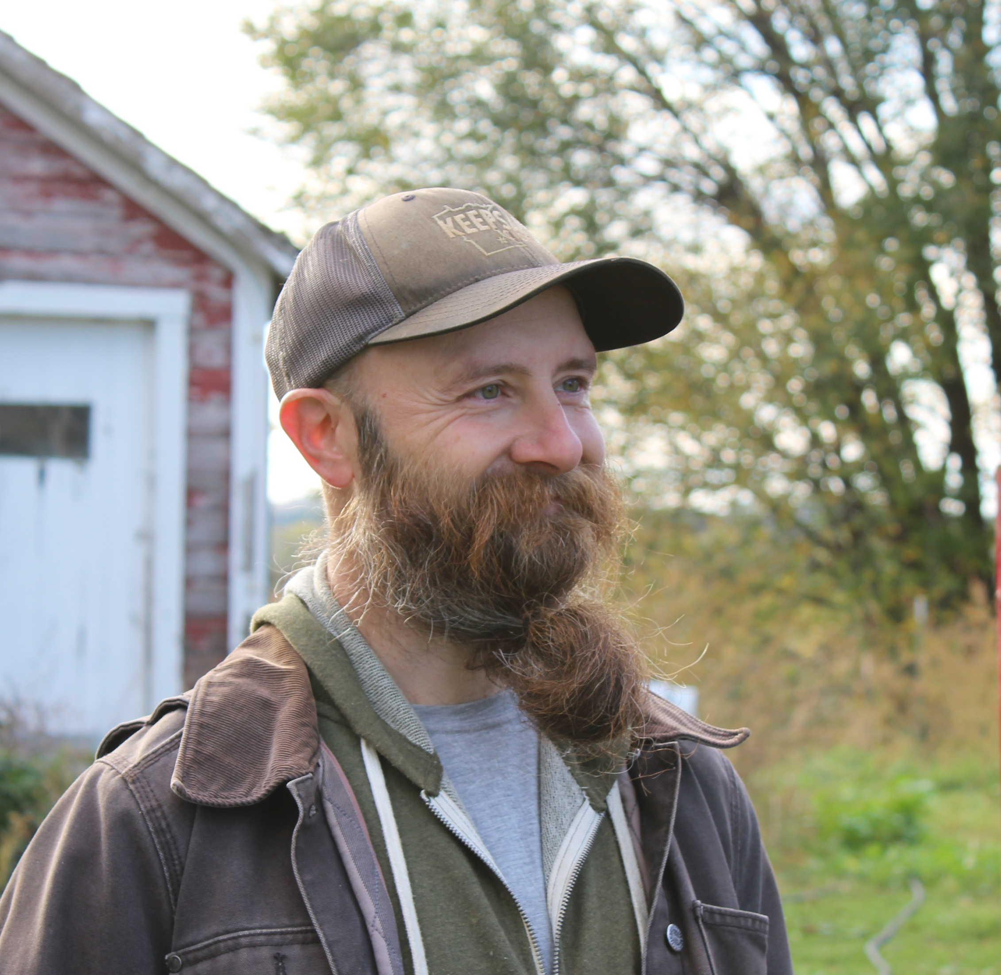
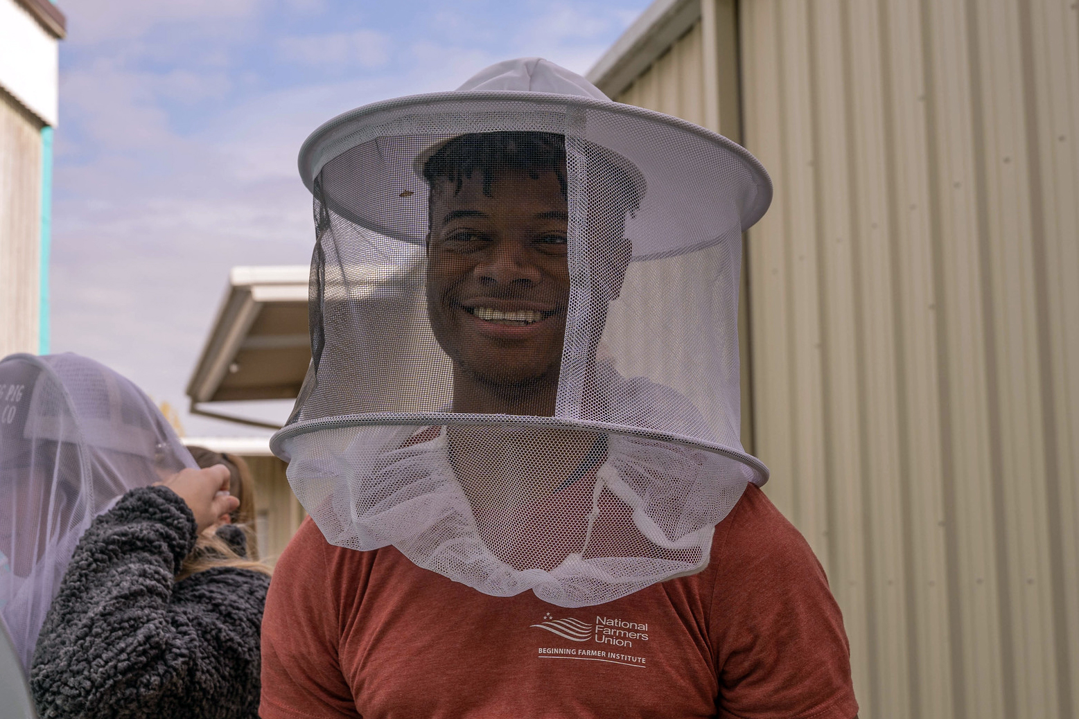
A family farm organization
OUR MISSION IS TO
ADVOCATE FOR FAMILY FARMERS, RANCHERS, FISHERS, AND THEIR COMMUNITIES THROUGH EDUCATION, COOPERATION, AND LEGISLATION.
Notes:
About NFU
Introduce NFU: “NFU is a grassroots organization that fights for family farmers and their communities”
Vision: “We envision a world in which farm families and their communities are respected, valued, and enjoy economic prosperity and social justice”

Slide 3

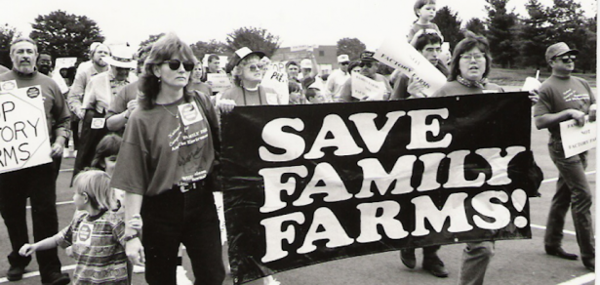
1980s FARM CRISIS

Slide 4

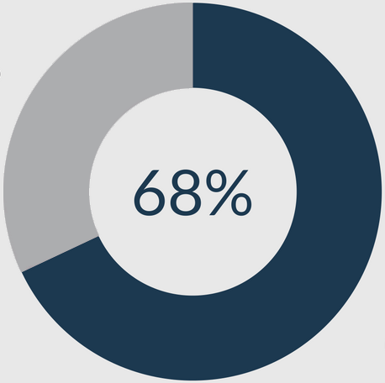
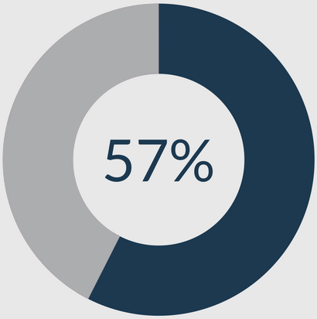
FARM TOWN STRONG
A MAJORITY OF RURAL AMERICANS BELIEVE THESE WILL SOLVE THE OPIOID CRISIS:
EDUCATION
Increasing public education
surrounding resources.
REDUCING STIGMA
Reducing the shame or
stigma of opioid addiction

Slide 5

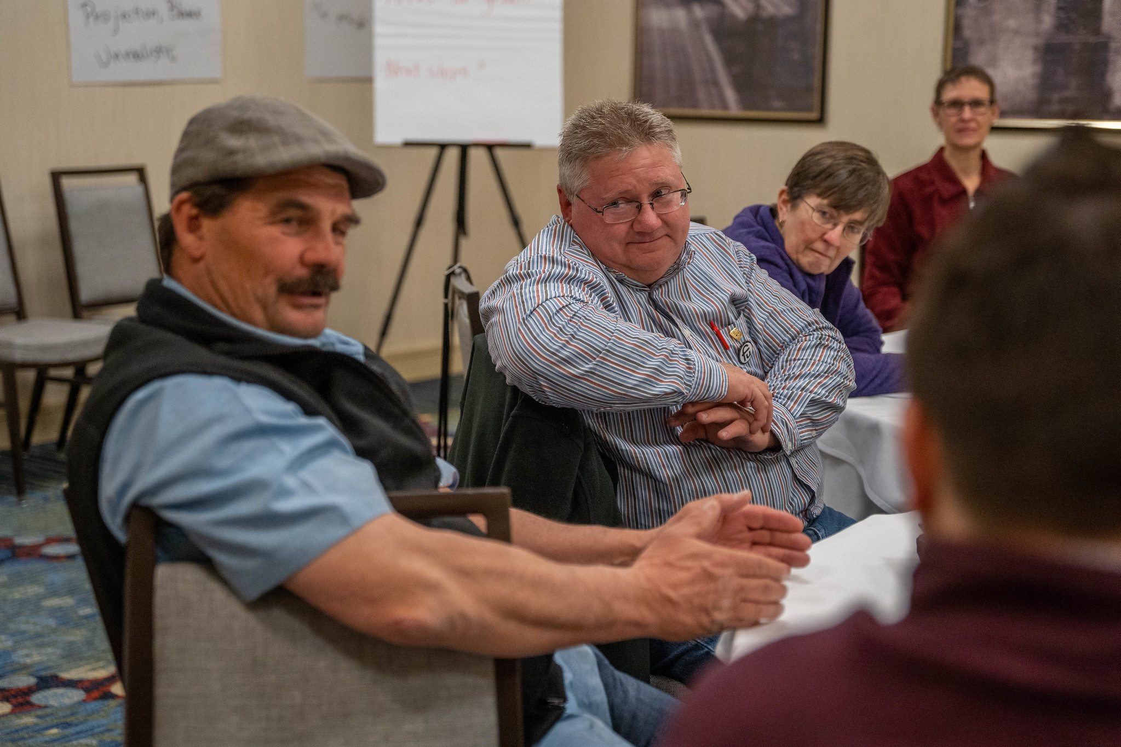
MENTAL HEALTH RESOURCSE

Slide 6
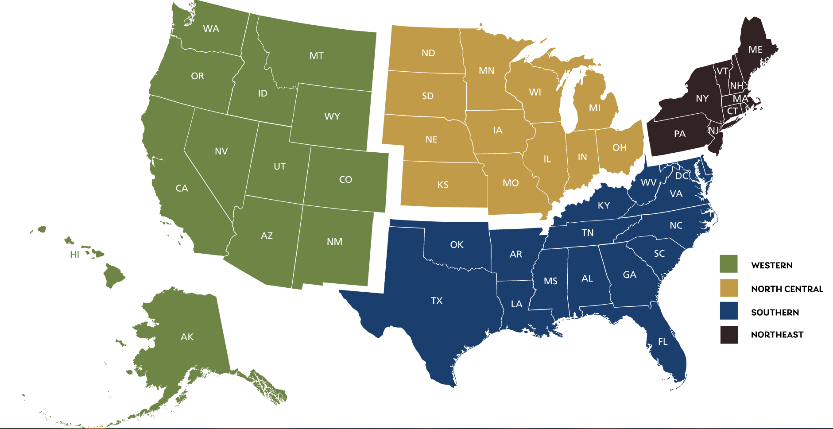
FARM AND RANCH STRESS ASSISTANCE NETWORK (FRSAN)
REAUTHORIZED BY 2018 FARM BILL
FUNDS FARM HELPLINES, WEBSITES, TRAINING PROGRAMS, WORKSHOPS, OUTREACH, AND HOME ASSISTANCE
NFU & NASDA LED LETTTER TO APPROPRIATORS WITH 30+ ORGANIZATIONS
$28 MILLION WAS DISTRIBUTED
FROM CONSOLIDATED APPROPS
ACT OF 2021
FRSAN REGIONS

Slide 7
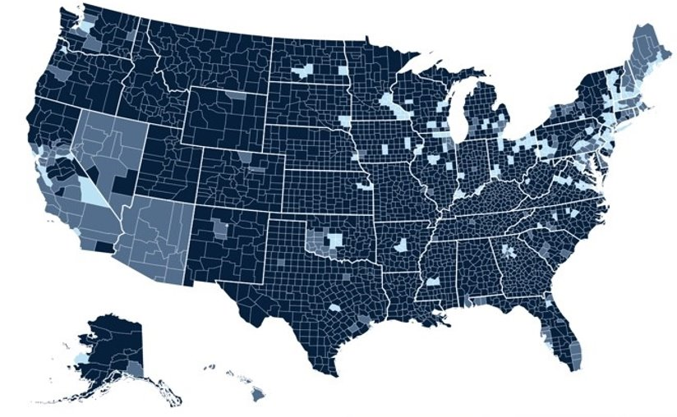
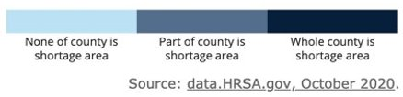
MENTAL HEALTH SERVICES SHORTAGE AREAS

Slide 8
Rural mental health

