Slide 1
New Products, New Uses, New Jobs
The BioPreferred Program Challenge

Slide 2



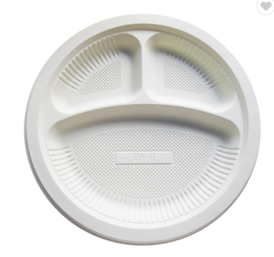
Products from Agriculture, Forestry, and Marine Materials
Fabric from wood pulp and agricultural waste
Paint from soybeans
Detergents from enzymes and biobased surfactants
Single Use Plates from corn
Notes:
The term "biobased product" means a product determined by the Secretary to be a commercial or industrial product (other than food or feed) that is- (A) composed, in whole or in significant part, of biological products, including renewable domestic agricultural materials, renewable chemicals, and forestry materials; or (B) an intermediate ingredient or feedstock.

Slide 3
Biobased Products and Secretary Vilsack 2022 Priorities
Addressing Climate Change via Climate Smart Agriculture & Forestry
Plants sequester carbon, removing carbon from atmosphere, so products from plants are more sustainable.
The use of biobased products instead of petroleum counterparts would displace about 9.4 million barrels of oil per year according to latest economic report.
Potential GHG reductions from the biobased products industry are estimated at 12.7 million metric tons of CO2 equivalents per year according to latest economic report.
Many biobased products are manufactured near farm gate reducing transportation issues.
Advancing Racial Justice, Equity and Opportunity
Products made from agriculture, forestry, and marine materials create jobs and improve outcomes for farmers and new opportunities in manufacturing.
Creating More and Better Market Opportunities
Innovative biobased products create new markets for farm commodities and increase export opportunities.

Slide 4
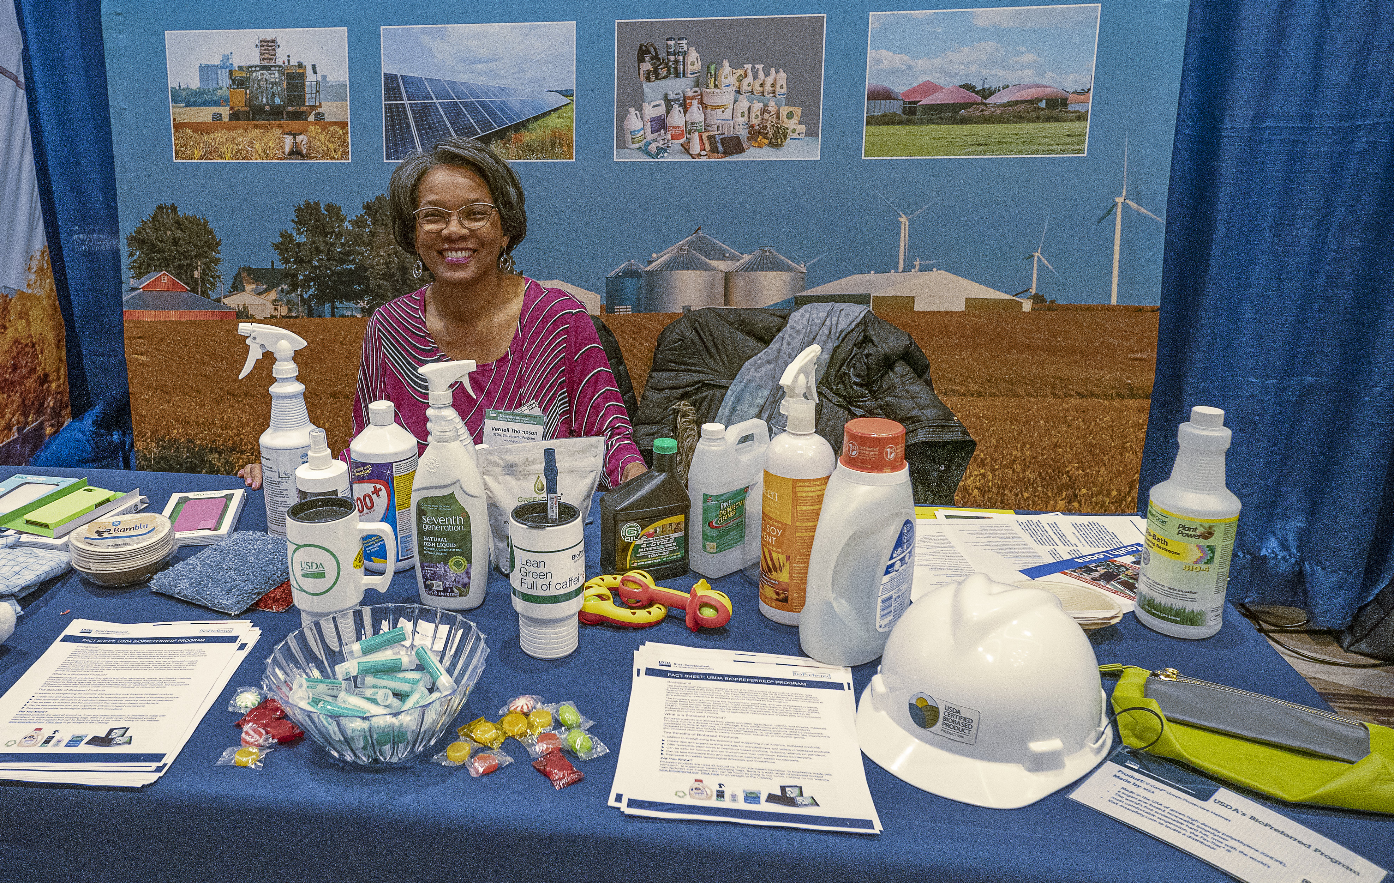
The Mission of the USDA BioPreferred Program
spur U.S. economic development
create new U.S. jobs
provide new markets for farm commodities
reduce our reliance on petroleum,
increase the use of renewable agricultural resources,
reduce adverse environmental and health impacts.

Slide 5

The BioPreferred® Program
Managed by U.S. Department of Agriculture (within Rural Development)
Established by the 2002 Farm Bill
Expanded in the 2008, 2014, and 2018 Farm Bills
Identifies and seeks new markets for
biobased products
Two major program elements
  Mandatory Federal Purchasing
  Voluntary Labeling Program
Market Push, Market Pull
Notes:
In the 2002 Farm Bill Congress once again addressed the cyclical nature of agriculture and created the BioPreferred program to help develop new markets for agricultural commodities by harnessing the purchasing power of the federal government through mandatory purchase requirements and also put in place a voluntary label to identify biobased products thus encouraging ordinary consumers to buy USDA Certified Biobased Products. Consumer demand was also being driven by the desire to buy and use renewable, environmentally friendly products

Slide 6
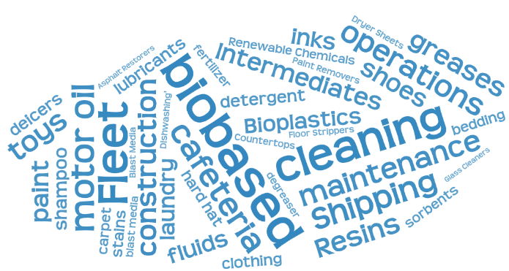
USDA BioPreferred Program:
Mandatory Federal Purchasing
Federal agencies and federal contractors required to buy biobased products in categories designated by USDA
Currently, 139 diverse categories including cleaning products, motor oils, lubricants, and adhesives
About 17,000 products in BioPreferred Program catalog that qualify for mandatory federal purchasing

Slide 7
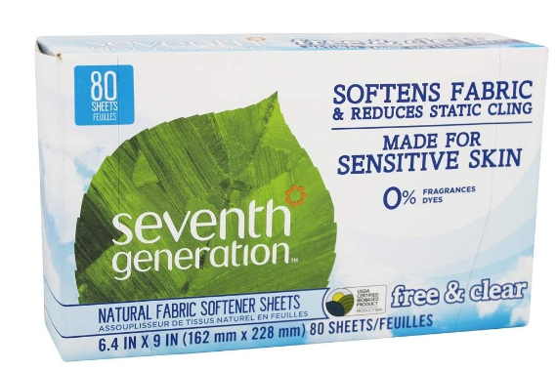

USDA Certified Biobased Product Label
To make it easier to locate biobased products, companies can apply to have their product tested and “certified.”
Indicates that this product is 95% biobased
FP indicates product qualifies for preferred federal purchasing
Notes:
seventh generation has over 50 products in the program, most of them USDA Certified

Slide 8
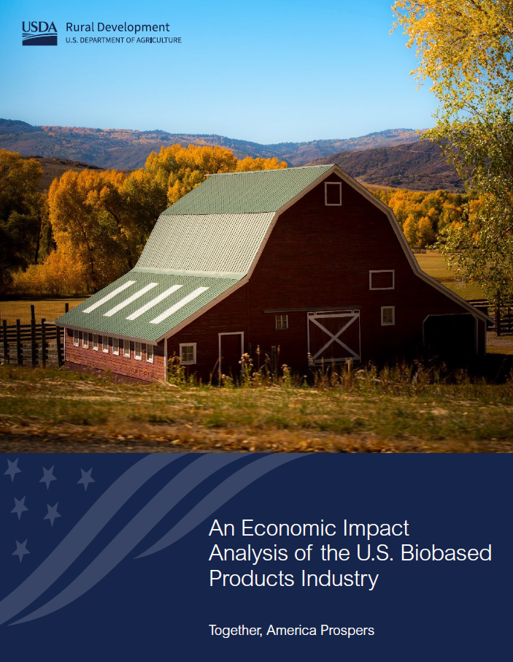
Biobased Products Economic Impact Studies
A Series of Economic Reports Commissioned by USDA
Focus of Each Report
2015: National Level
2016: State Level
2018: National Level & Exports
2019: State Level & Exports
An Economic Impact Analysis of the U.S. Biobased Product Industry (2019)
Notes:
The BioPreferred Program began publishing reports on the economic impact of biobased products in response to the directive in the 2014 Farm Bill. Each report has built on the previous reports. The 2015 and 2018 reports both modeled the biobased products industry at the national level. The 2016 and 2019 reports modeled the biobased products industry at the state level. These reports demonstrate how important the biobased products industry is to the U.S. economy.

Slide 9
Key Findings: Overview of 2019 Report
The Number of People Employed
4.6 Million
in the U.S. Biobased Products Industry in 2017
Value added Contribution to the U.S. Economy
$470 Billion
from the U.S. Biobased Products Industry in 2017
The Jobs Multiplier
2.79
For every 1 Biobased Product industry job, 1.79 more jobs are supported in the United States
An Economic Impact Analysis of the U.S. Biobased Products Industry
Jesse Daystar, Dr.Jay Golden, Robert Hanfield, 2019
Notes:
Employment is the number of full time and part time jobs in the sector. Each job (whether full time or part time) counts as one job in IMPLAN.
Value Added is the difference between an industry's or an establishment's total output and the cost of its intermediate inputs. It equals gross output (sales or receipts and other operating income, plus inventory change) minus intermediate inputs (consumption of goods and services purchased from other industries or imported). The industry’s value added is its contribution to the Gross Domestic Product.
Another way to look at it: Value Added is labor income, other property type income (includes corporate profits, capital consumption allowance, payments for rent, dividends, royalties, and interest income), and taxes on production and imports, less subsidies.
The Jobs Multiplier is the number of jobs the biobased products industry supports for each employee in the industry. If the biobased products industry did not impact the rest of the U.S. economy this would be one (one job in the biobased products industry supports one job total). However, because the biobased products industry is so vital to the rest of the U.S. economy and the jobs in the biobased products industry can be so high value, the spillover effects support almost two additional jobs in addition to the one in the biobased products industry.

Slide 10
Today in the BioPreferred Program
10th Anniversary of the USDA Certified Biobased Product Label
  Over 5800 USDA Certified Biobased Products
Over 17,000 products in the BioPreferred Program Catalog
  Manufacturer’s voluntarily “register” their qualifying products
Over 3400 companies participate in the Program
Federal Service and Construction Contractors Reported 76 Million in Biobased Product Purchases in FY2021
Top 5 Biobased Product Categories Certified This Year
Intermediates - Chemicals
Intermediates – Paints and Coatings
Erosion Control Materials
Intermediates – Fibers and Fabrics
Intermediates – Plastic Resins

Slide 11
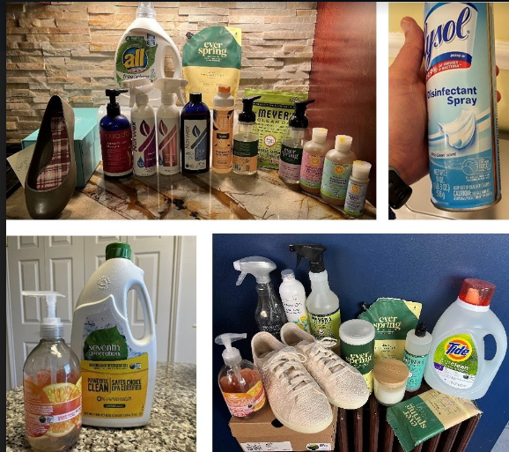
How YOU Can Support Farmers, the Economy, and the Environment
Purchase biobased products for home and office use
Spread the word – make biobased a household word!
These are biobased products currently being used by BioPreferred Program staff in their homes

Slide 12

Thanks!
help@usdabiopreferred.net
Phone: (202) 643-3287
Vernell Thompson, USDA BioPreferred Program
vernell.Thompson@usda.gov

