Slide 1


U.S. Organic Industry Trends and Outlook

Slide 2
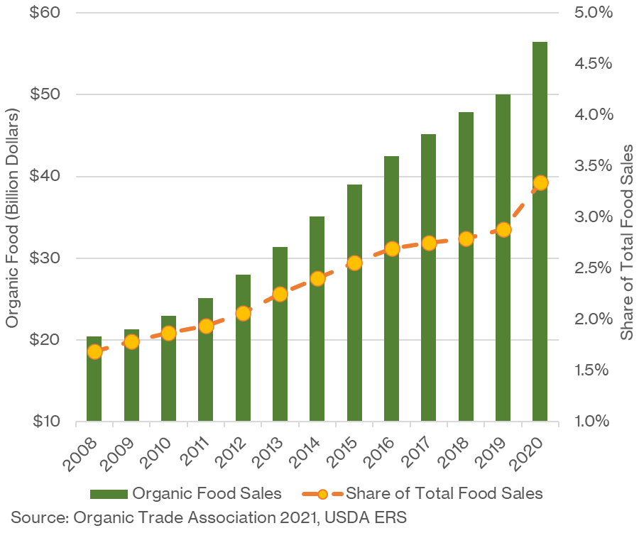
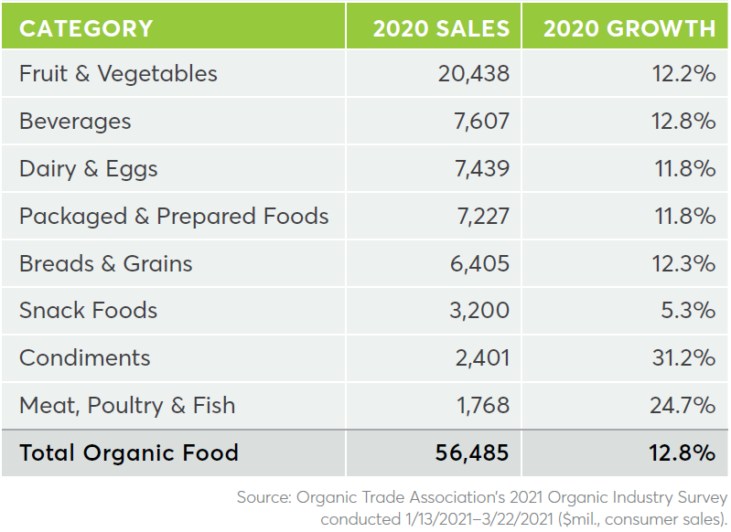
U.S. Organic Consumer Demand Growth Remains Positive
Organic food sales reach $56 billion over 2020
Organic food sales continue to outpace conventional
Organic food sales 9% CAGR (2009-2019)
Conventional food sales 3% CAGR (2009-2019)
Record 2020 sales as consumers adjust to COVID

Slide 3
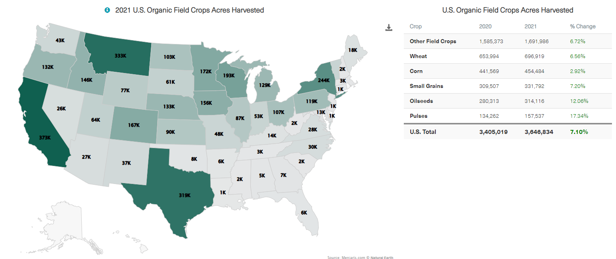
Organic Acreage Growth Remains Strong

Slide 4
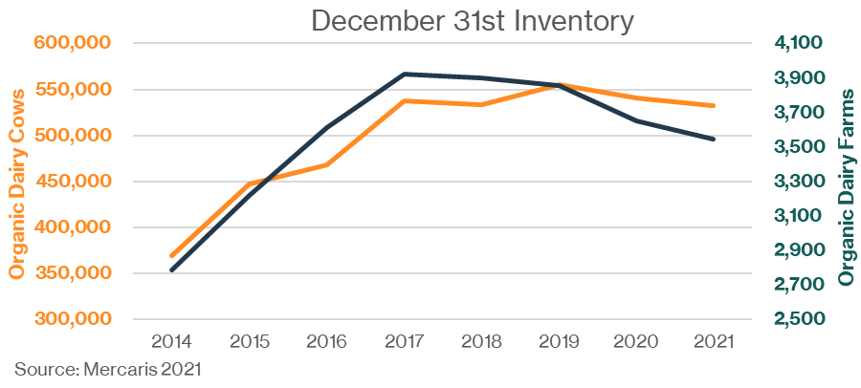
U.S. Organic Dairy In Decline
2020 had 10% sales growth and 3% inventory decline
63% of 2020 growth came from fluid milk sales
Through November 2021, U.S. organic fluid milk sales were down nearly 3% y/y
Without product diversification, organic dairy sales are likely to struggle
If organic dairy expands, it’s likely to be due to lower feed prices

Slide 5
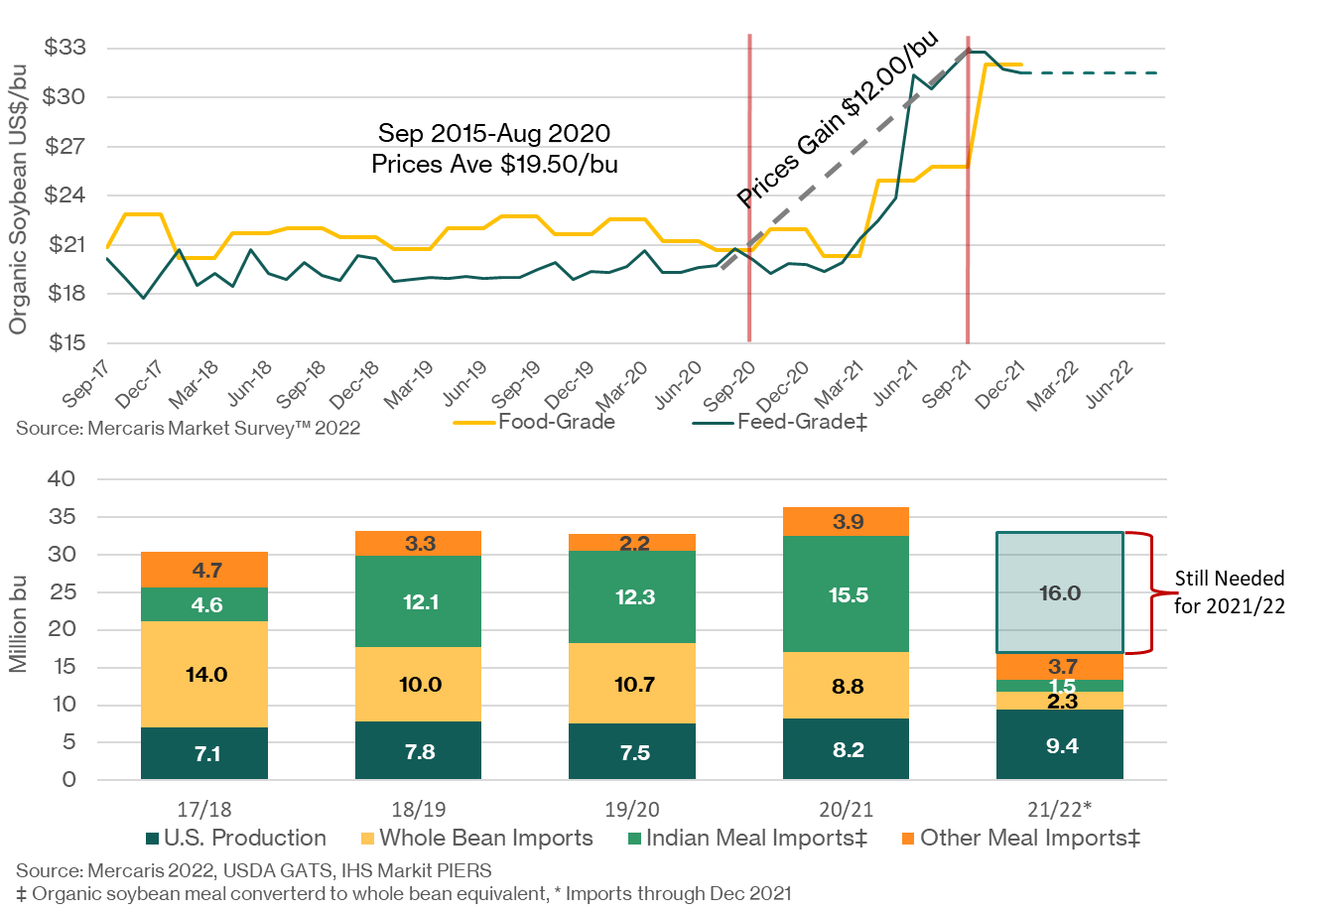
Organic Soybeans Turn Very Bullish
The long quiet comes to an end
Price remarkably stable through 19/20 on steady supply of imports
Indian organic soybean meal becomes 38% of U.S. supplies over 19/20
January 2021: A new reality emerges
Price gain 70% on looming Indian organic import reform, and global supply chain challenges
Indian organic soybean meal import reach record levels ahead of trade restrictions
2021/22 Holds Bullish Market Risk
Assuming organic soybean use reaches 2019/20 levels, the U.S. will need to imports another 16 million bu before Sep 2021
Where can it come from?

Slide 6
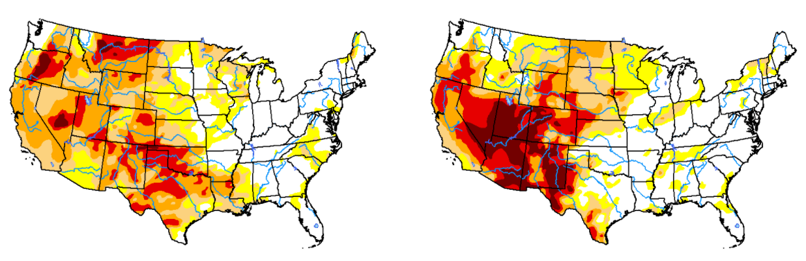
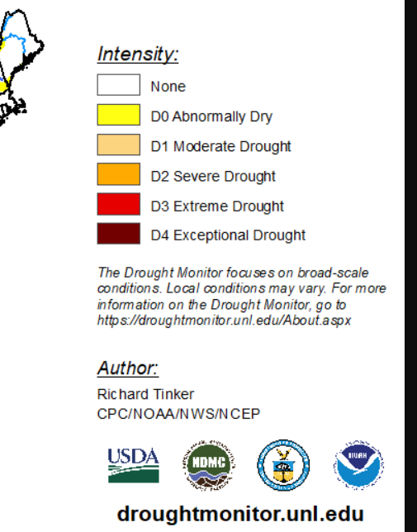
Drought Conditions Persist in Key Western States
January 26th, 2021
January 25th, 2022

Slide 7
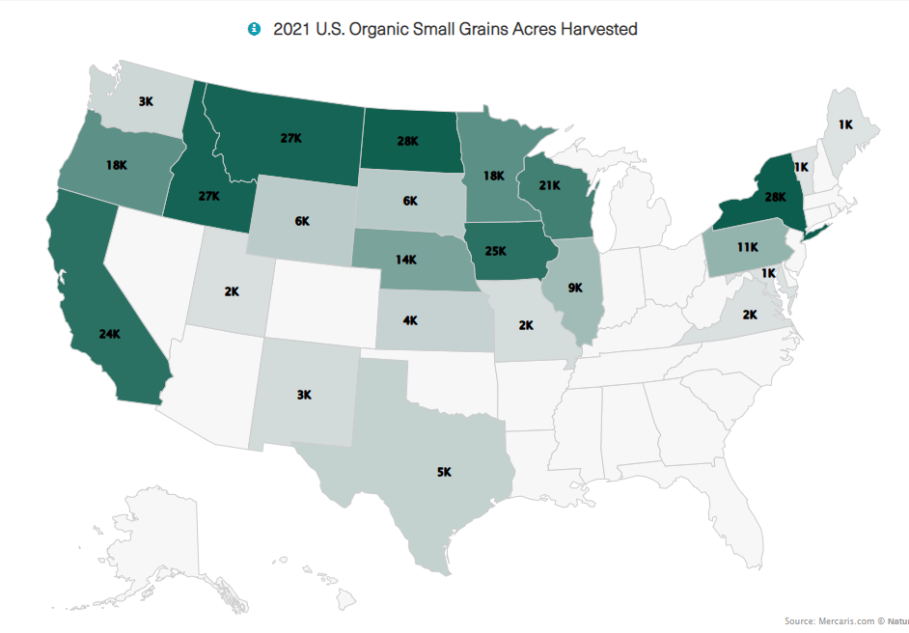
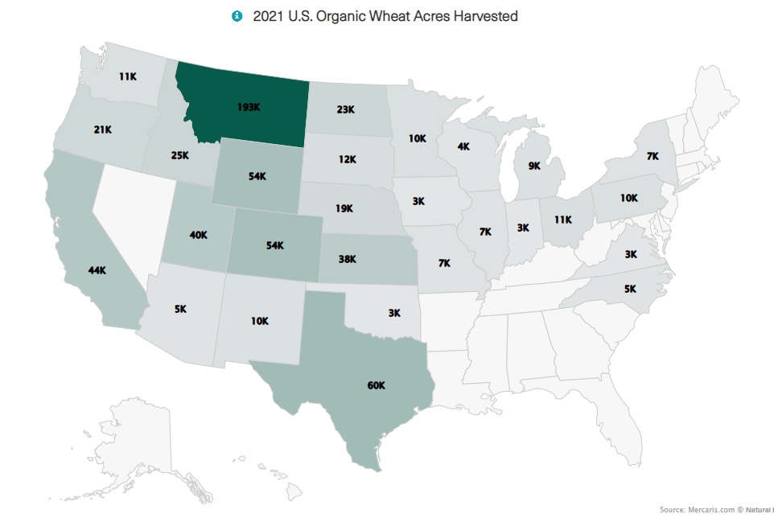
U.S. Organic Wheat and Small Grains Under Drought Threat

Slide 8
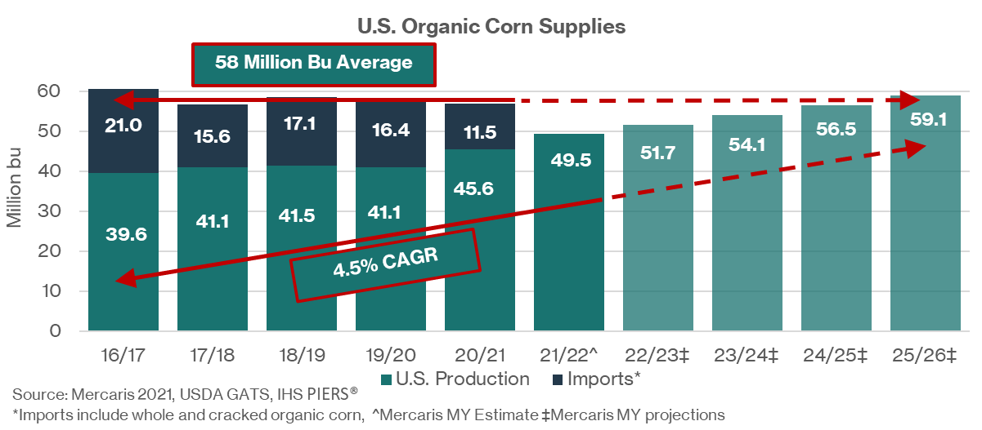
Overall U.S. Organic Corn Supply Remains Steady
Altogether, 2020/21 organic corn supplies flat y/y at 58 million bushels
59 million bushels pushes us over the edge
Total U.S. organic corn supply has remained remarkably stable around 58 million bushels annually
Last time supplies went over 58 million bushels was 2018/19, leading to the bearish 2019/20 MY
What happens the next time we break the 58 million bushel mark?

Slide 9
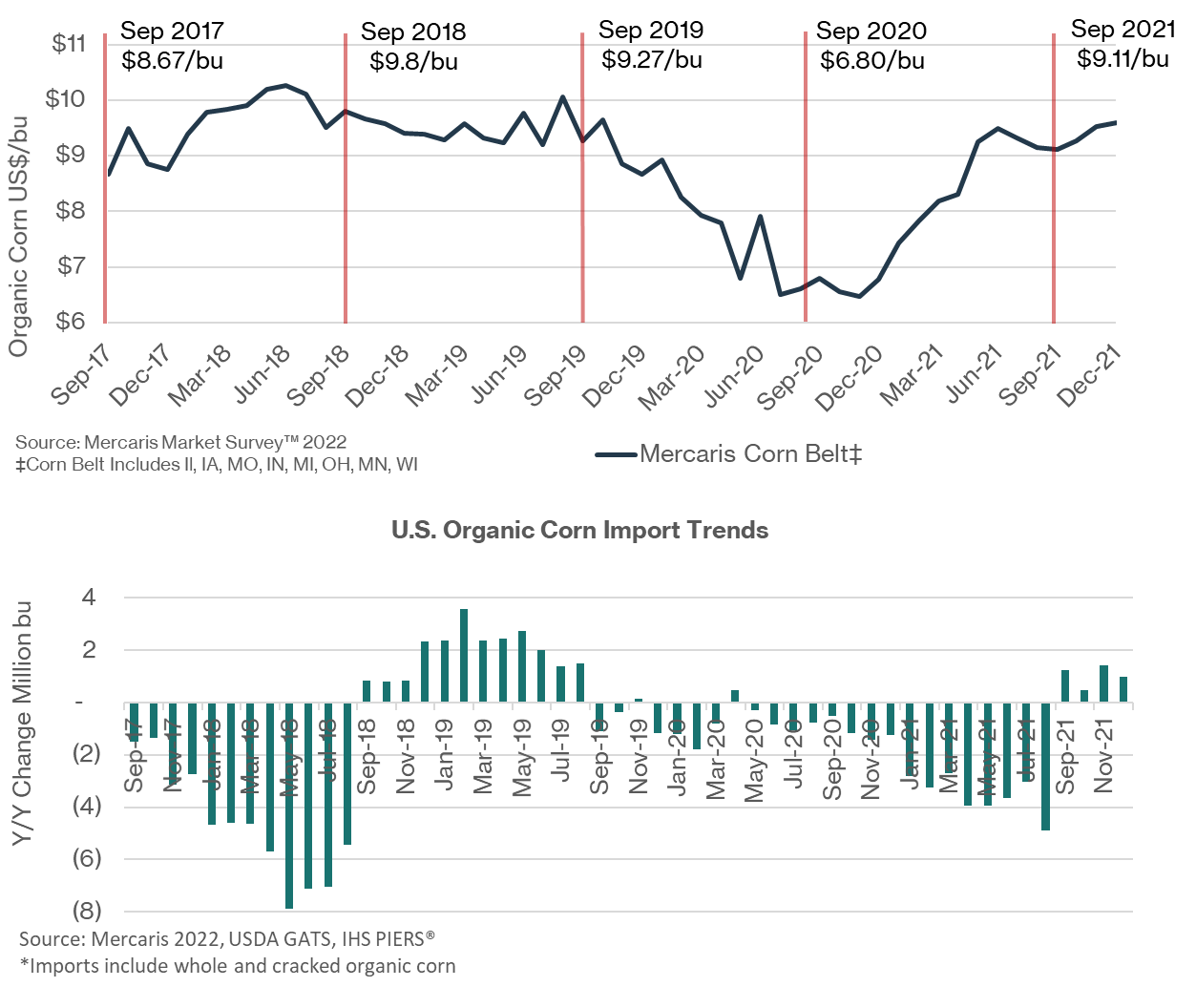
Organic Corn Prices Remain Firm, Despite growing Supplies
Sep 2019-Sep 2020
  Prices fall on $2.47/bu as harvest exceeds expectations
  Imports stall on lower U.S. prices
Sep 2020-Sep 2021
  Imports retract as U.S. market works through old-crop supplies and harvested new-crop, down 30% y/y
  Prices recover, gaining $2.28/bu
Sep 2021 and beyond
  U.S organic corn harvest estimated at a record setting 49.5 million bu for 2021, up 9% y/y
  Imports are holding slightly higher since the start of 2021/22
  Price remain bullish despite growing supplies (up $0.50/bu September through December 2021)
  Growers/purchasers hold supplies on uncertain U.S. production outlook
  Could we be building towards another 2019/20?

Slide 10
Could Feed Cost Hit the Brakes?
2020/21 production costs jump 16% above 5-year average on higher organic soybean meal price
What happens if…
$1,200/ST OSBM = 31% to 36% higher
$1,300/ST OSBM = 38% to 44% higher
$1,400/ST OSBM = 44% to 51% higher
How sustainable is production growth at +30% higher feed costs?

Slide 11
What if Organic Feed Demand Grows Slows
Organic dairy remains the largest grain consumer
But not a source of growth, and actually in retraction
Organic poultry expansion has carried the market
4.9% annual growth
As a group broilers, turkeys, and layers account for 56% of total demand over 2020/21
Flat dairy and growing poultry put feed demand growth at 3.1% annually
Flat dairy and growing poultry put GCAU growth at 3.1%
Organic corn growth a bit faster at 4.2%
Organic corn production growing at 4.5%

Slide 12
For more information, please contact:
Ryan Koory
Ryan.Koory@Mercaris.com
573-644-2004

