Slide 1

Assessing the Impact of the 2020/21 La Niña on
Agriculture in Argentina and Brazil
Mark D. Brusberg
Chief Meteorologist
USDA Office of the Chief Economist / World Agricultural Outlook Board
Presented To
2021 Agricultural Outlook Forum
Grain and Oilseeds Outlook
February 19, 2021
Agricultural Weather Assessments
World Agricultural Outlook Board

Slide 2
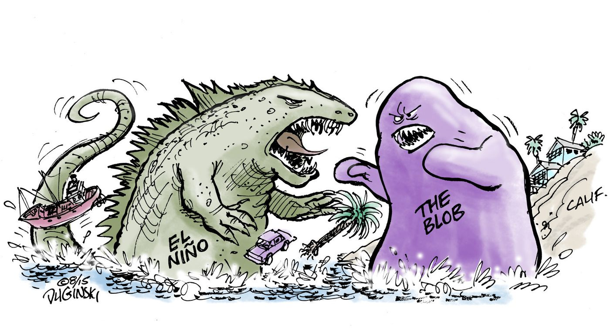
What is La Niña?
Agricultural Weather Assessments
World Agricultural Outlook Board

Slide 3
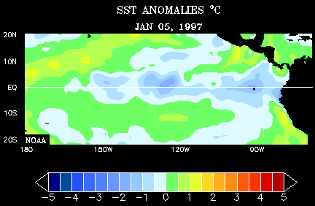
What is La Niña?
Agricultural Weather Assessments
SOURCE: NOAA
World Agricultural Outlook Board

Slide 4
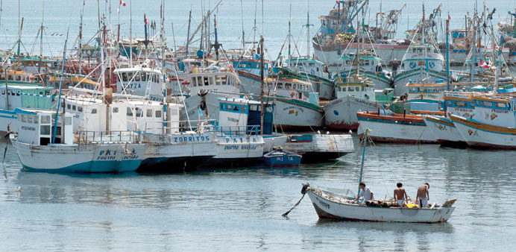
* El Niño means The Little Boy, or Christ Child in Spanish. El Niño was originally recognized by fishermen off the coast of South America in the 1600s, with the appearance of unusually warm water in the Pacific Ocean. The name was chosen based on the time of year (around December) during which these warm waters events tended to occur.
ANCHORED: A file photo of fishing boats anchored in Paita, Peru. The warmer waters last year ensured a huge drop in the volume of cold-water anchovies that were caught by the coast. Peru is the world’s top producer of animal feed made of ground-up anchovy, known as fishmeal, and the lack of anchovies is one of the reasons that economic growth slowed to its weakest pace in five years. (Steff Gaulter – Gulf Times, July 26, 2015)
Photo: US Navy/Wikipedia
* NOAA. What are El Niño and La Niña. National Ocean Service website, https://oceanservice.noaa.gov/facts/ninonina.html, accessed on 2/20/18.
Agricultural Weather Assessments
World Agricultural Outlook Board

Slide 5
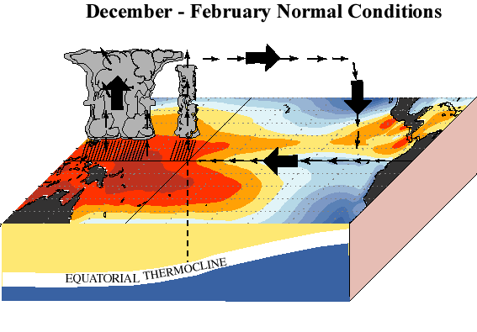
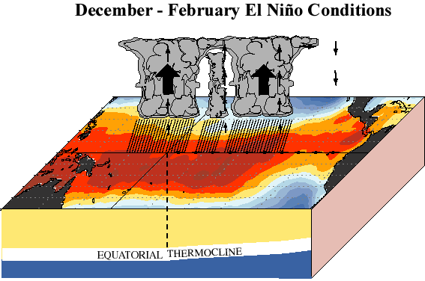
Easterly winds at surface in eastern Pacific (upwelling of nutrient rich water)
Increased convection in western Pacific
Weak easterly or reversal of eastern easterlies (impedes upwelling / deeper thermocline)
Increased convection in central Pacific
Agricultural Weather Assessments
http://www.cpc.ncep.noaa.gov/products/analysis_monitoring/ensocycle/enso_cycle.shtml
World Agricultural Outlook Board

Slide 6
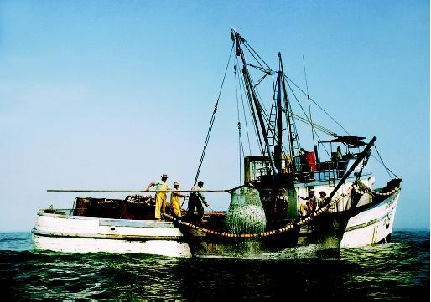
* La Niña means The Little Girl in Spanish. La Niña is also sometimes called El Viejo, anti-El Niño, or simply "a cold event.“
La Niña episodes represent periods of below-average sea surface temperatures across the east-central Equatorial Pacific. Global climate La Niña impacts tend to be opposite those of El Niño impacts. In the tropics, ocean temperature variations in La Niña also tend to be opposite those of El Niño.
El Niño was named by Peruvian fishers who noticed that the warming of ocean surface waters reduced their anchovy catch. Here fishers pull a load of anchovies off the coast of Peru during normal ocean conditions
http://www.waterencyclopedia.com/Da-En/El-Ni-o-and-La-Ni-a.html
* NOAA. What are El Niño and La Niña. National Ocean Service website, https://oceanservice.noaa.gov/facts/ninonina.html, accessed on 2/20/18.
Agricultural Weather Assessments
World Agricultural Outlook Board

Slide 7
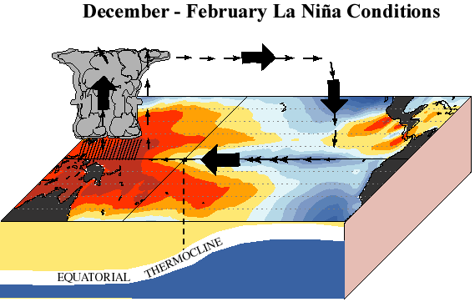
Easterly winds at surface in eastern Pacific (upwelling of nutrient rich water)
Increased convection in western Pacific
Stronger surface easterlies in eastern Pacific (accentuates upwelling / thermocline closer to surface)
Increased convection in western Pacific
Agricultural Weather Assessments
http://www.cpc.ncep.noaa.gov/products/analysis_monitoring/ensocycle/enso_cycle.shtml
World Agricultural Outlook Board

Slide 8
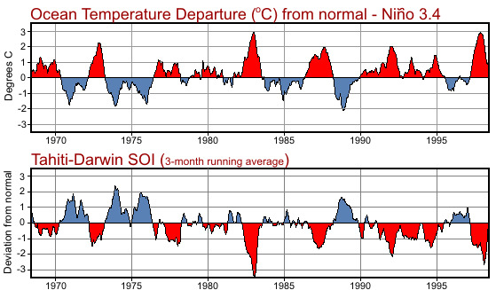
ENSO:
El Niño
(Peruvian Fishers)
+
Southern
Oscillation
(Sir Gilbert Walker)
“During El Niño conditions, the average air pressure is higher in Darwin than in Tahiti. Therefore, the change in air pressures in the South Pacific and water temperature in the East Pacific Ocean, 8,000 miles (13,000 km) away, are related.”
Agricultural Weather Assessments
https://www.weather.gov/jetstream/enso
World Agricultural Outlook Board

Slide 9
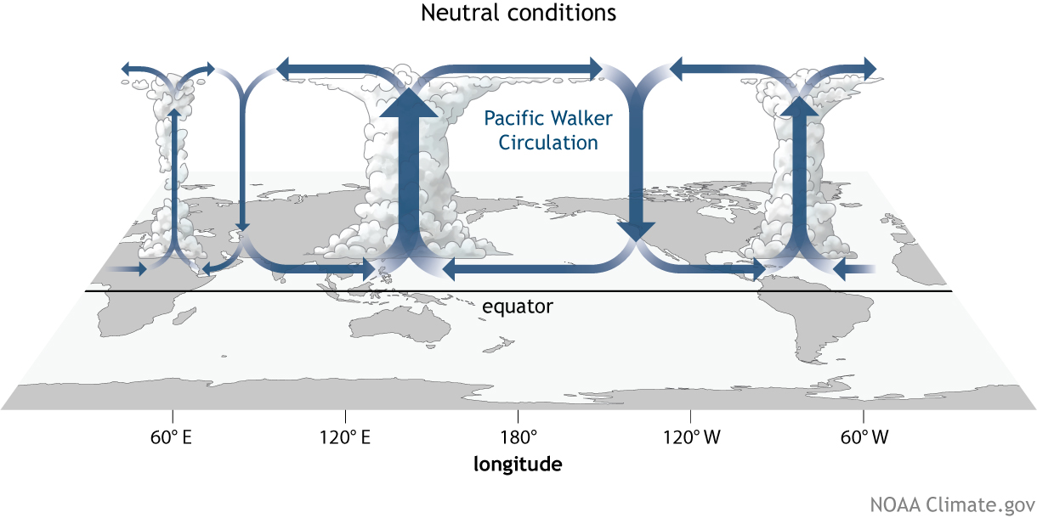
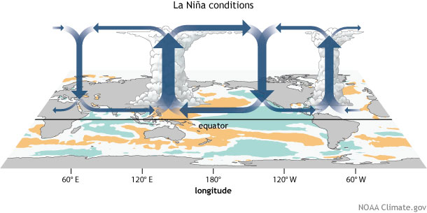
Redirected Circulation
Enhanced Circulation
Agricultural Weather Assessments
From: The Walker Circulation: ENSO's atmospheric buddy (Tom Di Liberto, August 1, 2014)
https://www.climate.gov/news-features/blogs/enso/walker-circulation-ensos-atmospheric-buddy
World Agricultural Outlook Board

Slide 10
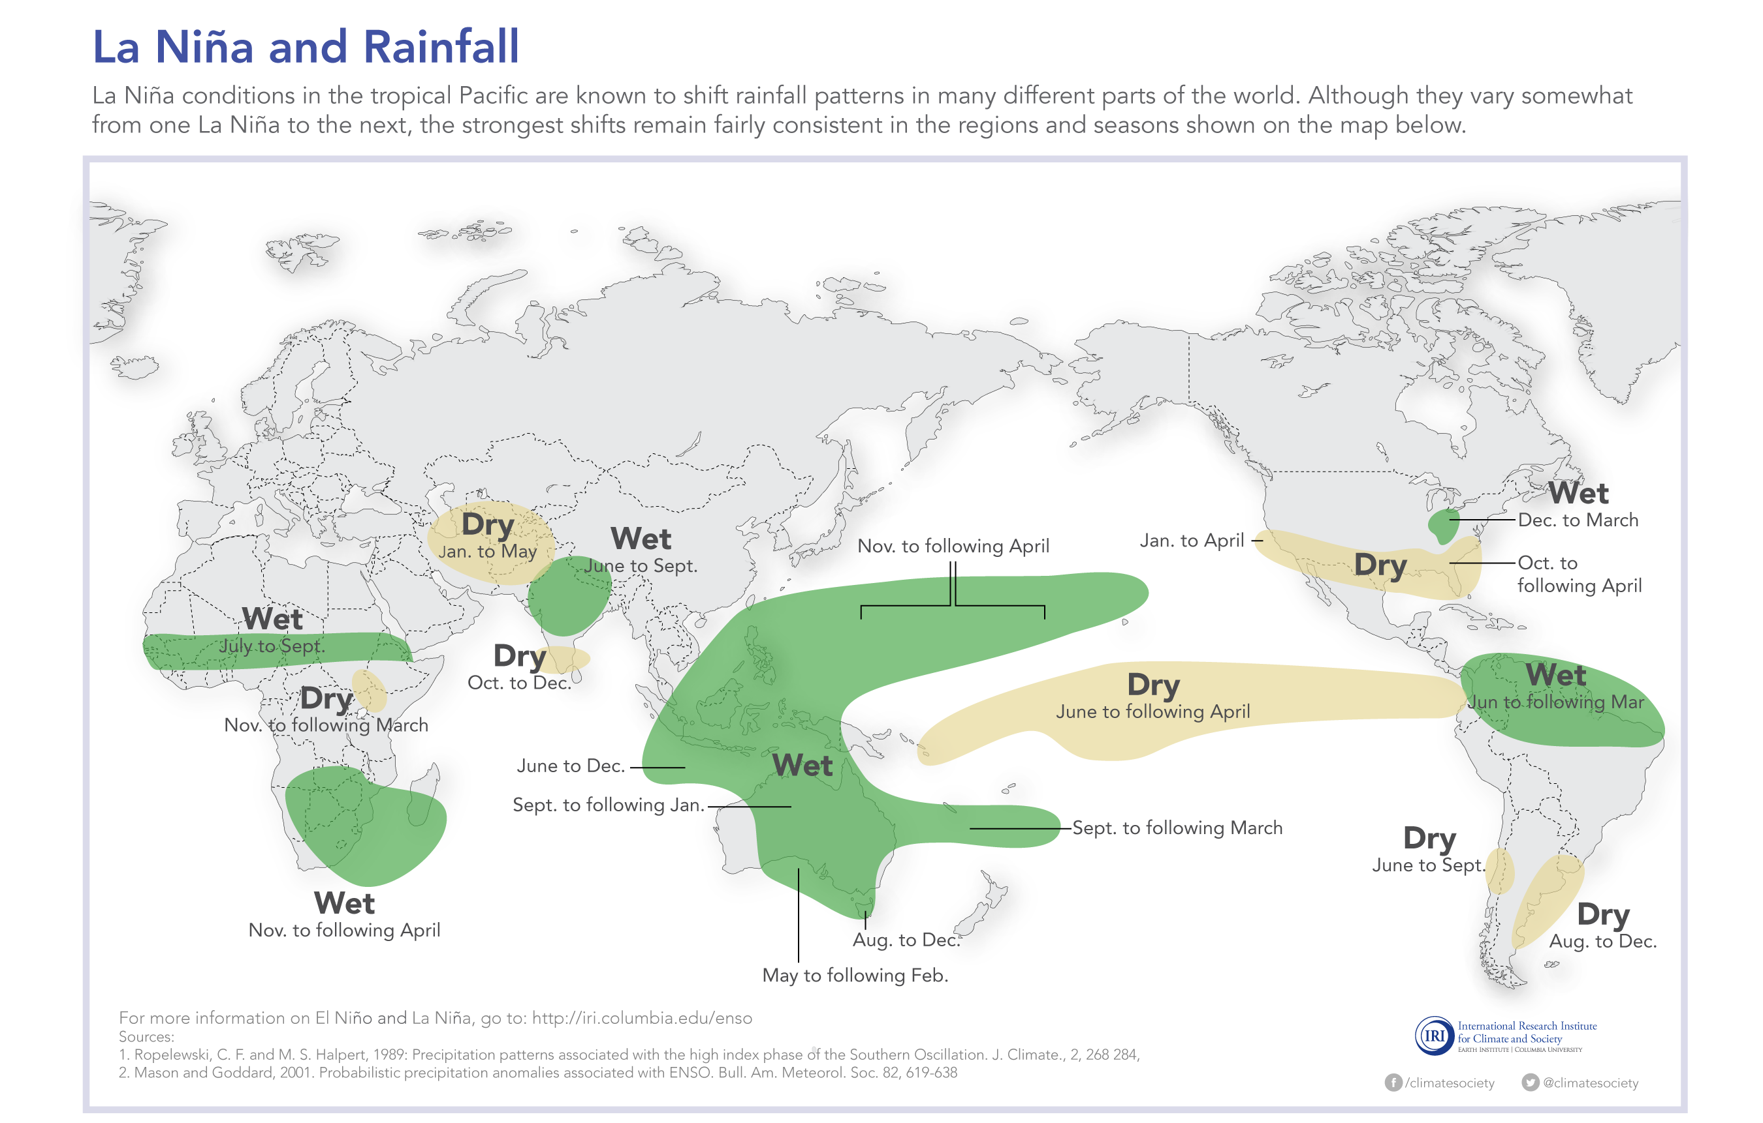
Agricultural Weather Assessments
World Agricultural Outlook Board

Slide 11
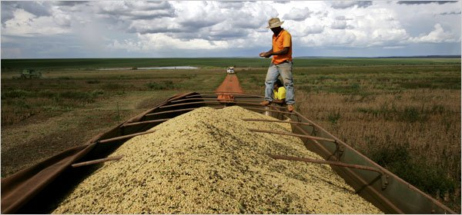
Potential Impacts on South American Agriculture:
La Niña’s Warning Signs and Probabilities
Lalo de Almeida for The New York Times
Agricultural Weather Assessments
World Agricultural Outlook Board

Slide 12
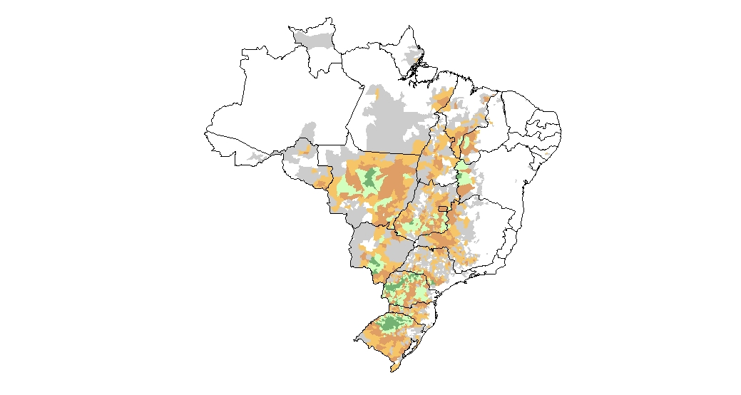
Brazil Soybeans
Para
Maranhao
Piaui
Rondonia
Mato Grosso
Tocantins
Soybean Production
*Average (2017-19)
Bahia
Goias
Minor
Production
Major
Aw: Tropical wet and dry
Intensity
Minas
Gerais
*Source: IBGE
Cr: Subtropical Rain
Mato Grosso
do Sul
Sao
Paulo
Parana
Santa
Catarina
Soybean crop calendar for most of Brazil
Planting
Rio Grande
do Sul
Flower
Fill
Harvesting
JUL
AUG
SEP
OCT
NOV
DEC
JAN
FEB
MAR
APR
MAY
JUN
Agricultural Weather Assessments
World Agricultural Outlook Board

Slide 13
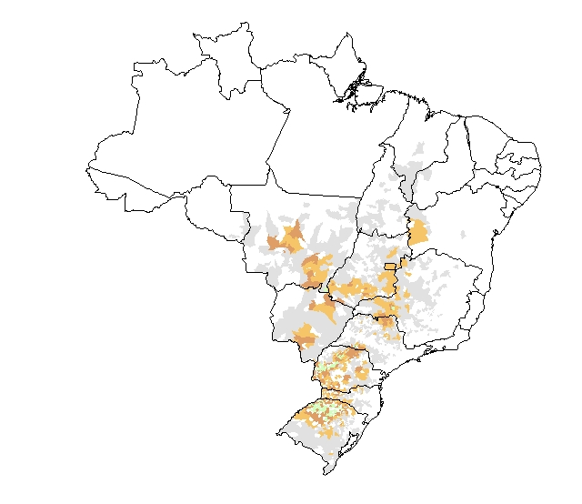
Brazil: Changes in Soybean Production
1990-92 versus 2017-19
Soybean Production
*Average (1990-92)
Soybean Production
*Average (2017-19)
Minor
Production
Major
Tropical
Minor
Production
Major
Tropical
Intensity
Intensity
*Source: IBGE
*Source: IBGE
Subtropical
Subtropical
Notable northward expansion into central and northeastern Brazil.
Agricultural Weather Assessments
World Agricultural Outlook Board

Slide 14
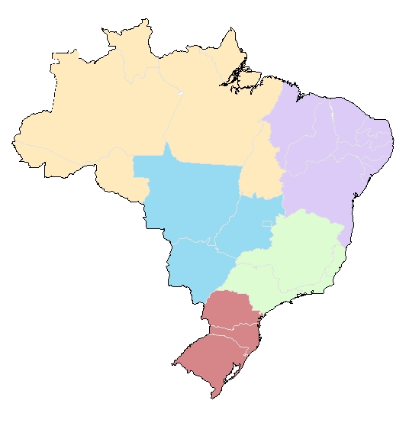
Brazil Soybeans: Regional Changes in Soybean Production
*1990-92 versus 2017-19
North (< 1)
Northeast
North
Northeast
South
1990-92
Center-West
Center-West
Southeast
Southeast
South
North
Northeast
1990-92
47%
39%
11%
3%
<1%
2017-19
31%
47%
8%
9%
5%
Change
-16
+12
-3
+6
+5
South
South
Center-West
Southeast
Northeast
North
2017-19
Center-West
Southeast
Agricultural Weather Assessments
*Source: CONAB
World Agricultural Outlook Board

Slide 15
Mato Grosso experiences a distinct wet and dry season.
Mato Grosso
Parana typically receives rainfall throughout the year.
Parana
Optimal Soy
Planting
Agricultural Weather Assessments
World Agricultural Outlook Board

Slide 16
Late
Early
Normal
La Niña
El Niño
Neutral
7
2
3
2
4
4
3
4
2
Normal:
September 24-30
Average
Sep 27
Agricultural Weather Assessments
* Based on discussions with CONAB / INMET (2007)
World Agricultural Outlook Board

Slide 17
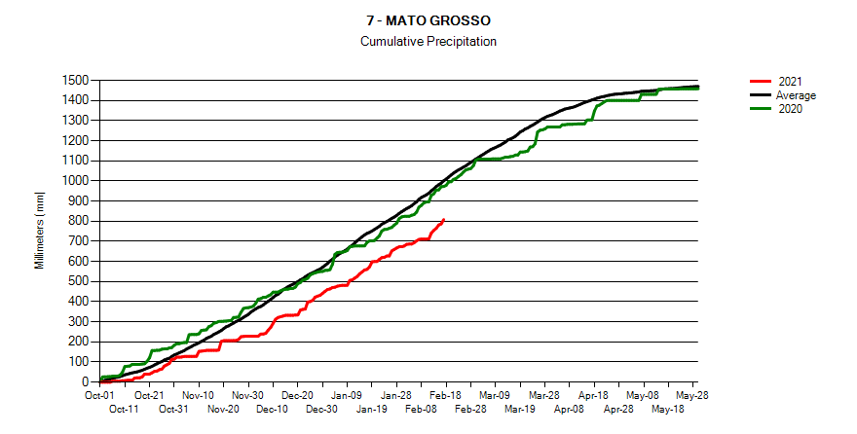
30-year
Average
2019/2020
2020/21
Late-arriving seasonal rainfall delayed the start of soybean planting.
Although rainfall is below the seasonal norm, amounts were adequate for soybeans in most major production areas.
Agricultural Weather Assessments
World Agricultural Outlook Board

Slide 18
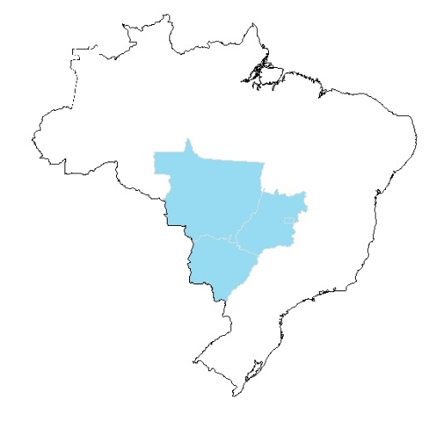
El Niño
La Niña
Source: Climate Prediction Center
Agricultural Weather Assessments
Source: CONAB
World Agricultural Outlook Board

Slide 19
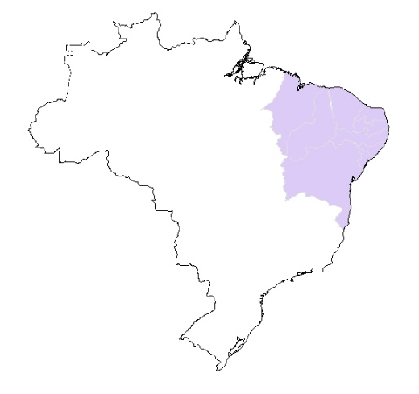
El Niño
La Niña
Source: Climate Prediction Center
Agricultural Weather Assessments
Source: CONAB
World Agricultural Outlook Board

Slide 20
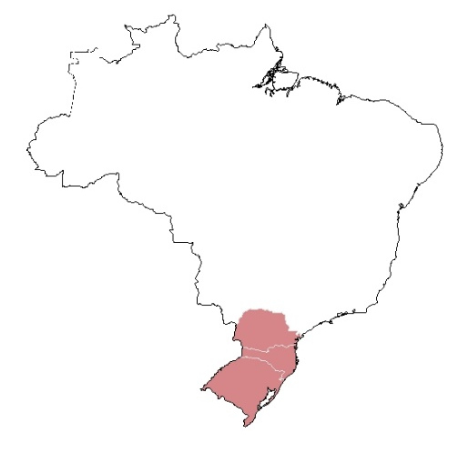
El Niño
La Niña
South
1990-92: 50%
2012-14: 33%
Source: Climate Prediction Center
Agricultural Weather Assessments
Source: CONAB
World Agricultural Outlook Board

Slide 21
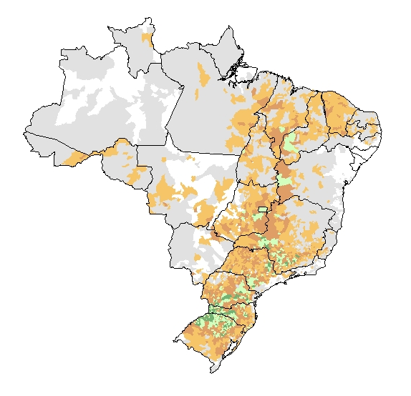
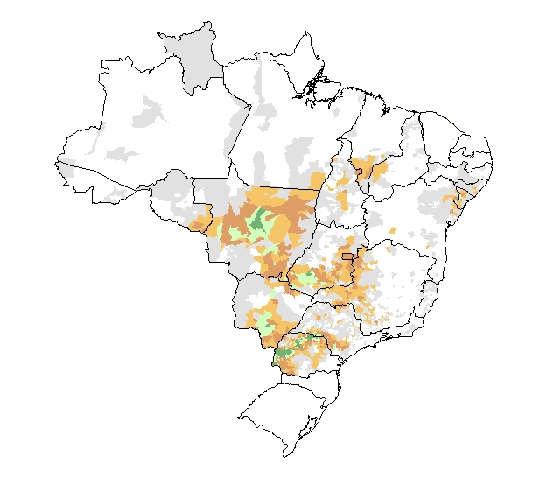
Brazil Corn Production
Corn Production
*Average (2017-19)
Minor
Production
Major
Intensity
*Source: IBGE
1st Corn crop calendar for most of Brazil
2nd Corn crop calendar for most of Brazil
Planting
Planting
Flower
Flower
Fill
Harvesting
Fill
Harvesting
JUL
AUG
SEP
OCT
NOV
DEC
JAN
FEB
MAR
APR
MAY
JUN
JUL
AUG
SEP
OCT
NOV
DEC
JAN
FEB
MAR
APR
MAY
JUN
Agricultural Weather Assessments
World Agricultural Outlook Board

Slide 22
“Safrinha Corn”
“Main Season Corn”
Agricultural Weather Assessments
Source: CONAB
World Agricultural Outlook Board

Slide 23
Soybean Harvest:
February 12, 2021
Corn Planting:
February 12, 2021
Significant soybean harvest delays due to late planting ---> delays in corn planting.
Agricultural Weather Assessments
World Agricultural Outlook Board

Slide 24
Late
Early
Normal
La Niña
El Niño
Neutral
1
5
8
6
4
1
4
1
0
Normal:
April 28 - May 4
Average
May 1
2009 & 2018
Agricultural Weather Assessments
* Estimated by last ~10 mm report before first extended period of dryness (after April 1)
World Agricultural Outlook Board

Slide 25
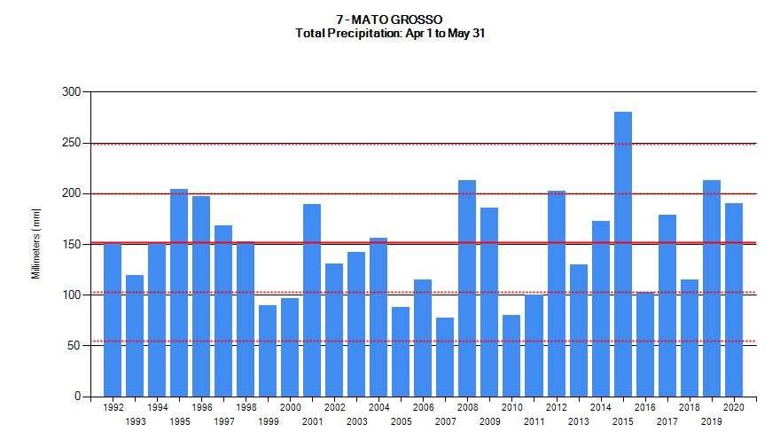
La Niña Years
2007/08 –
2008/09
2010/11 –
2011/12
2016/17 –
2017/18
1995/96
2000/01
1998/99 –
1999/2000
2005/06
Agricultural Weather Assessments
2009 & 2018
World Agricultural Outlook Board

Slide 26
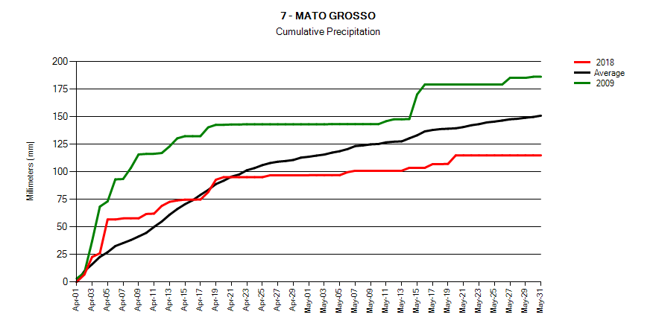
2009
April 19
“Bonus Rain”
30-year
Average
Much Wetter before
Dryness Develops
2018
2nd Corn *Yield vs Trend
2008/09: +15% (record)
2017/18: -3%
*CONAB: 2000-2019
Agricultural Weather Assessments
World Agricultural Outlook Board

Slide 27
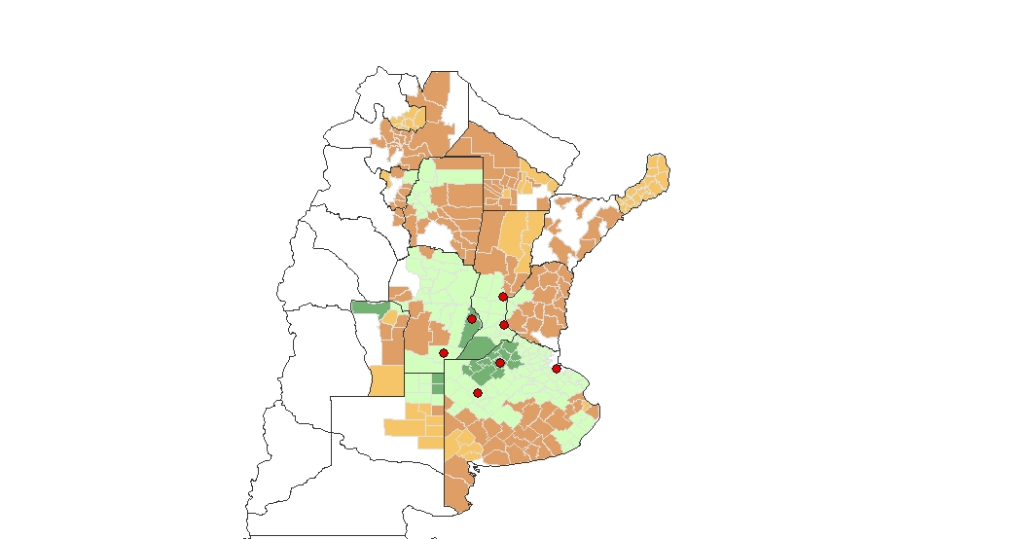
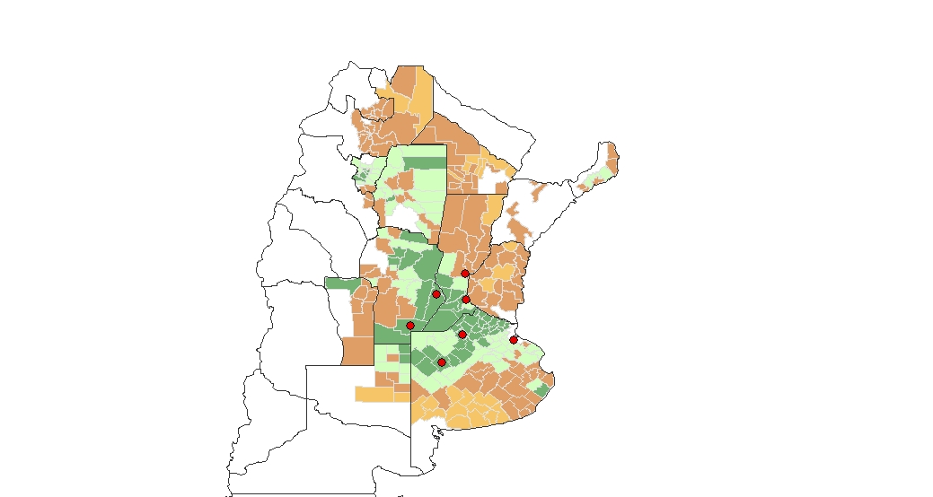
Argentina: Corn and Soybean Yields
(Relative Productivity)
Salta
Salta
Formosa
Formosa
Tu.
Chaco
Tu.
Chaco
Santiago
del
Estero
Santiago
del
Estero
Corrientes
Corrientes
Santa
Fe
Santa
Fe
Cordoba
Cordoba
Entre
Rios
Entre
Rios
Stations in
“Main Crop Area”
Stations in
“Main Crop Area”
San
Luis
San
Luis
Buenos
Aires
Buenos
Aires
La Pampa
La Pampa
Corn Yields
*Average (2015/16 – 2019/20)
Soy Yields
*Average (2015/16 – 2019/20)
Lower
Higher
Lower
Higher
Agricultural Weather Assessments
*Source: SAGPyA
World Agricultural Outlook Board

Slide 28
Percent of Normal Precipitation (%)
October 1 - November 30, 2020
Total Precipitation (mm)
October 1 - November 30, 2020
Corn crop calendar for most of Argentina
Soybean crop calendar for most of Argentina
PLANT
PLANT
SILK
FLOWER
FILL
FILL
HARVEST
HARVEST
SEP
OCT
NOV
DEC
JAN
FEB
MAR
APR
MAY
JUN
JUL
AUG
SEP
OCT
NOV
DEC
JAN
FEB
MAR
APR
MAY
JUN
JUL
AUG
Agricultural Weather Assessments
World Agricultural Outlook Board

Slide 29
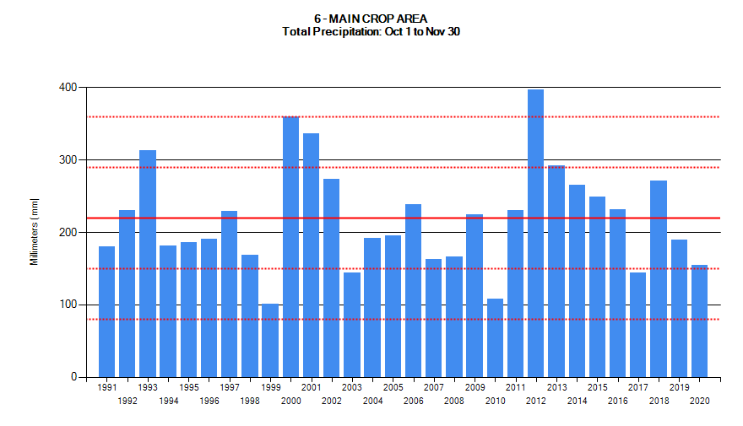
La Niña Years
2017/18
2020/21
2010/11
Agricultural Weather Assessments
World Agricultural Outlook Board

Slide 30
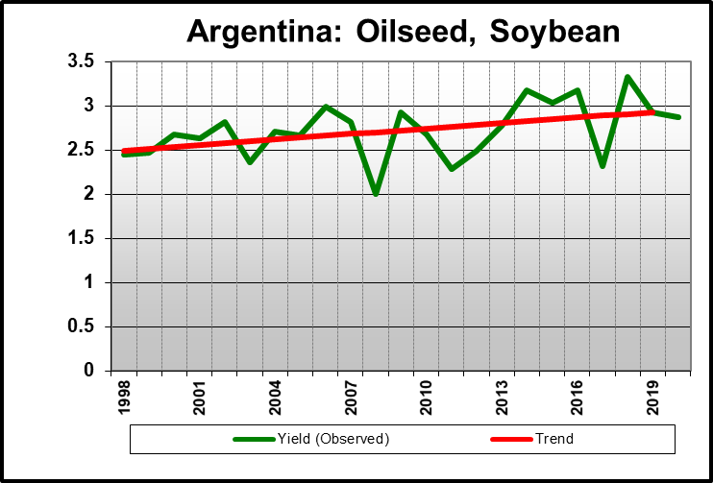
2017
2010
Model Consensus Forecast:
Between -1.0 and -1.5
(CPC: November 2020)
*La Niña Intensity - DJF
Weak (-0.5 to -1.0)
Strong (< -1.0)
Yields Calculated Using PSD Updated February 2021
* Source: Climate Prediction Center December, January, and February Average
Agricultural Weather Assessments
World Agricultural Outlook Board

Slide 31
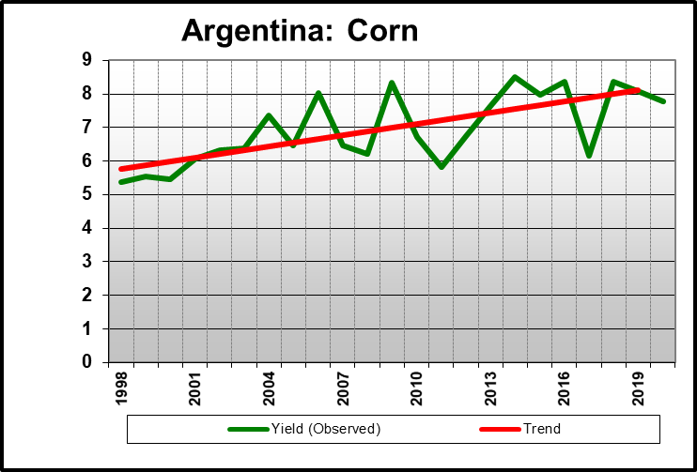
2010
2017
Model Consensus Forecast:
Between -1.0 and -1.5
(CPC: November 2020)
*La Niña Intensity - DJF
Weak (-0.5 to -1.0)
Strong (< -1.0)
Yields Calculated Using PSD Updated February 2021
* Source: Climate Prediction Center December, January, and February Average
Agricultural Weather Assessments
World Agricultural Outlook Board

Slide 32
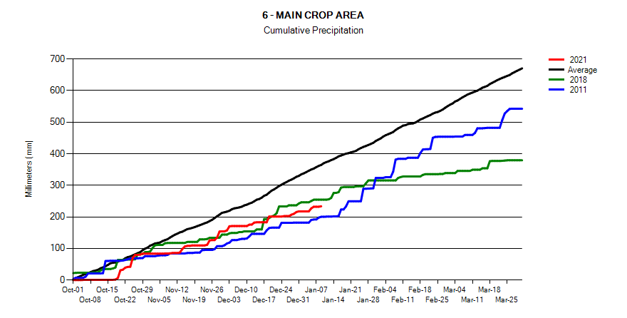
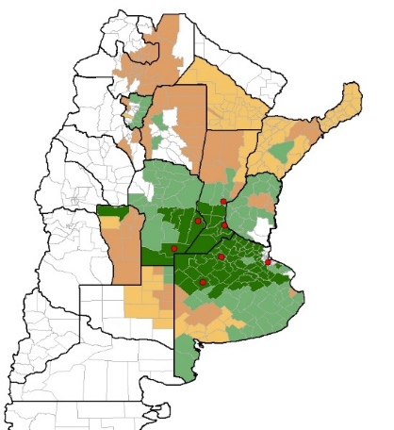
December
WASDE
30-year
Average
Salta
Form.
Tu.
Santiago
del
Estero
Chaco
Santa
Fe
Corrientes
2010/11
Cordoba
Entre
Rios
Corn: -5.1%
Soy: -2.2%
San
Luis
La Pampa
Buenos
Aires
* Corn Yields
2017/18
2020/21
Corn: -22.4%
Soy: -20.7%
Sources
Corn: Bolsa
Soy: PSD
Agricultural Weather Assessments
World Agricultural Outlook Board

Slide 33
Percent of Normal Precipitation (%)
December 1, 2020 – January 31, 2021
Total Precipitation (mm)
December 1, 2020 – January 31, 2021
Corn crop calendar for most of Argentina
Soybean crop calendar for most of Argentina
PLANT
PLANT
SILK
FLOWER
FILL
FILL
HARVEST
HARVEST
SEP
OCT
NOV
DEC
JAN
FEB
MAR
APR
MAY
JUN
JUL
AUG
SEP
OCT
NOV
DEC
JAN
FEB
MAR
APR
MAY
JUN
JUL
AUG
Agricultural Weather Assessments
World Agricultural Outlook Board

Slide 34
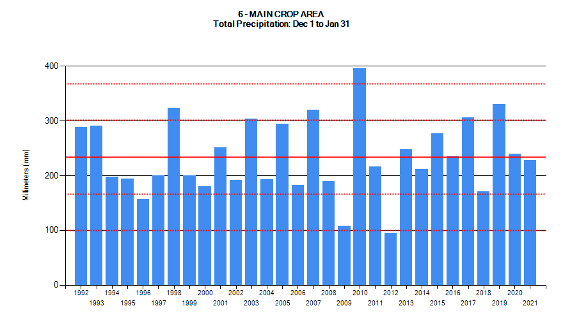
La Niña Years
2010/11
2020/21
2017/18
Agricultural Weather Assessments
World Agricultural Outlook Board

Slide 35
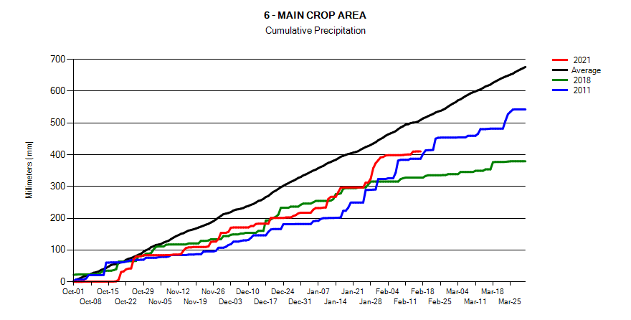
December
WASDE
January
WASDE
February
WASDE
30-year
Average
Salta
Form.
Tu.
Santiago
del
Estero
Chaco
Santa
Fe
Corrientes
2010/11
Cordoba
Entre
Rios
Corn: -5.1%
Soy: -2.2%
San
Luis
La Pampa
Buenos
Aires
* Corn Yields
2017/18
2020/21
Corn: -22.4%
Soy: -20.7%
Sources
Corn: Bolsa
Soy: PSD
2010/11 Analog Still Looks Reasonable
(February Will be Key)
Agricultural Weather Assessments
World Agricultural Outlook Board

Slide 36
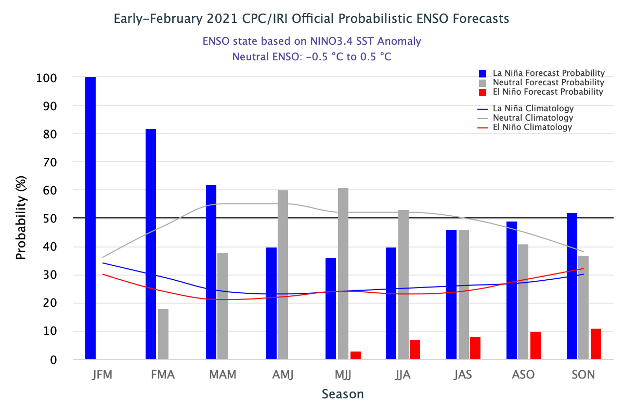
CPC/IRI Probabilistic ENSO Outlook
Updated: 11 February 2021
There is a ~60% chance of a transition from La Niña to ENSO-Neutral during the Northern Hemisphere spring 2021 (April-June).
The probability for La Niña to be in place for the remainder of the South American summer growing season is greater than 80 percent.
Agricultural Weather Assessments
http://www.cpc.ncep.noaa.gov/products/precip/CWlink/MJO/enso.shtml
World Agricultural Outlook Board

Slide 37
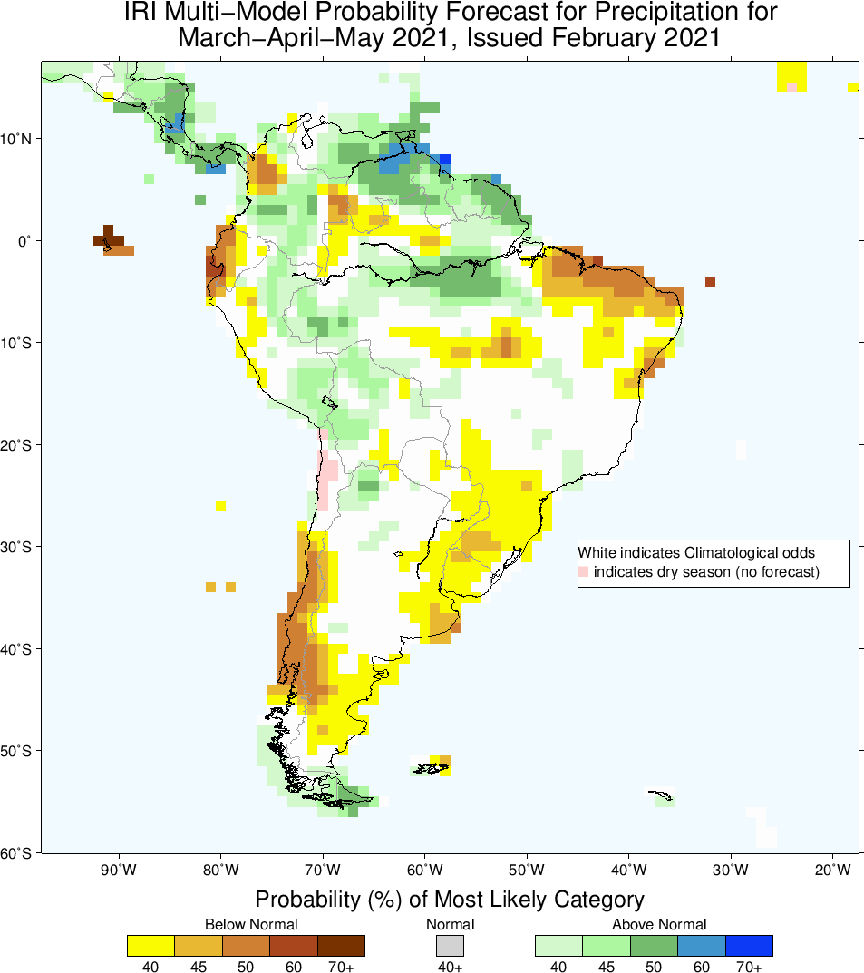
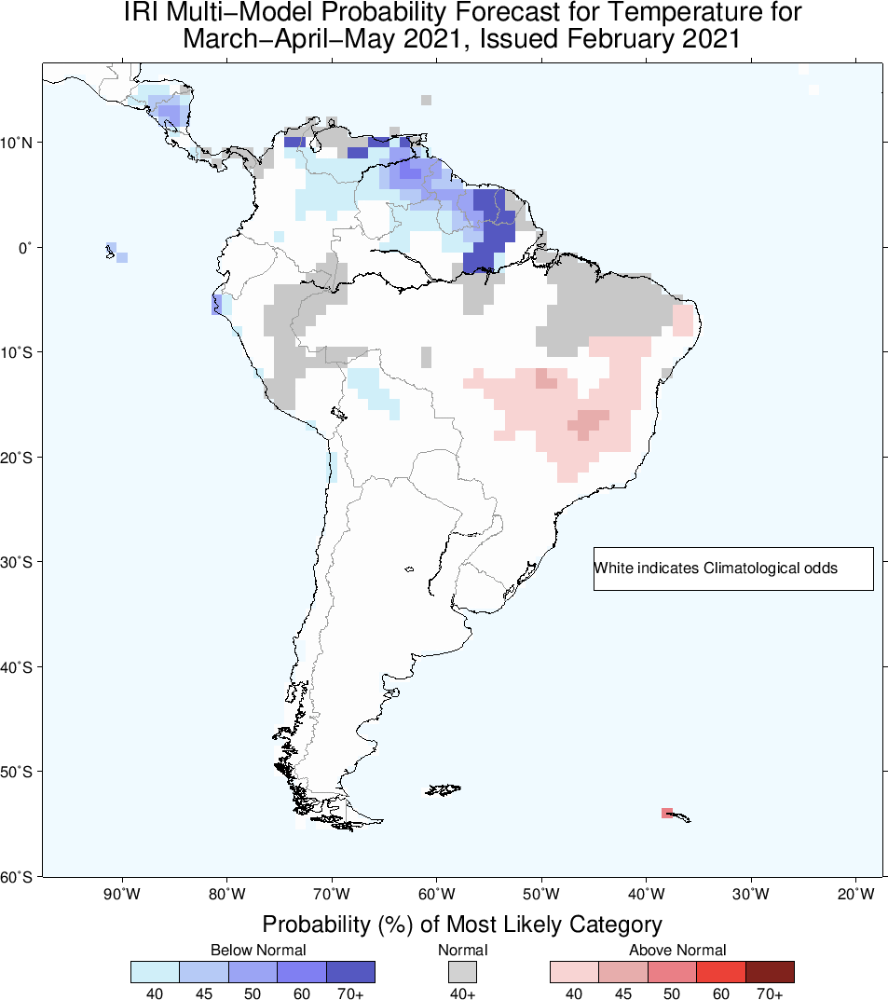
The outlook (MAM) depicts trend towards dryness in parts of Brazil and Argentina.
(driven by La Niña outlook).
Agricultural Weather Assessments
World Agricultural Outlook Board

Slide 38
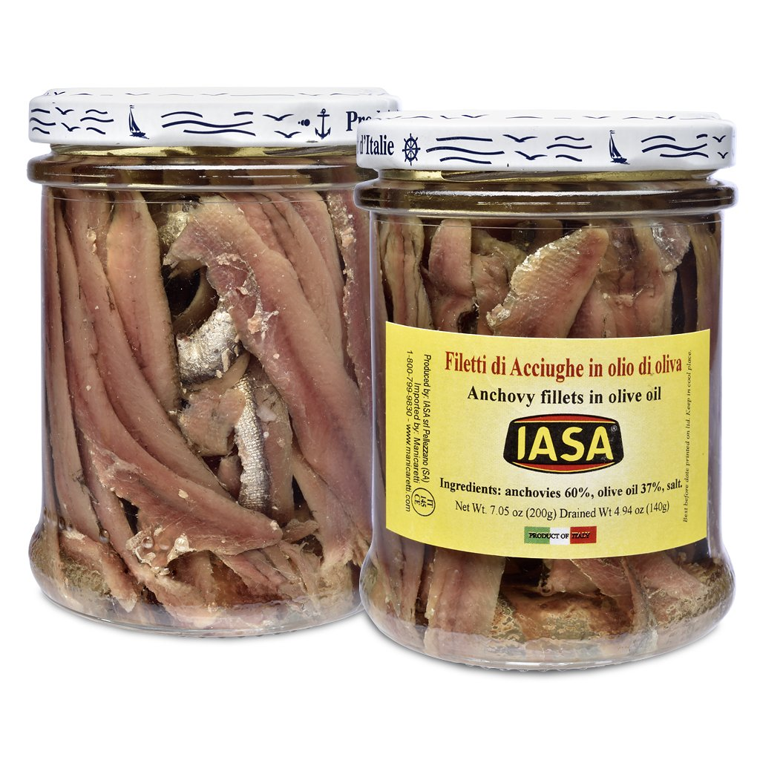
Thanks!
mark.brusberg@usda.gov
Agricultural Weather Assessments
https://www.markethallfoods.com/products/anchovy-fillets-iasa
World Agricultural Outlook Board

