Slide 1
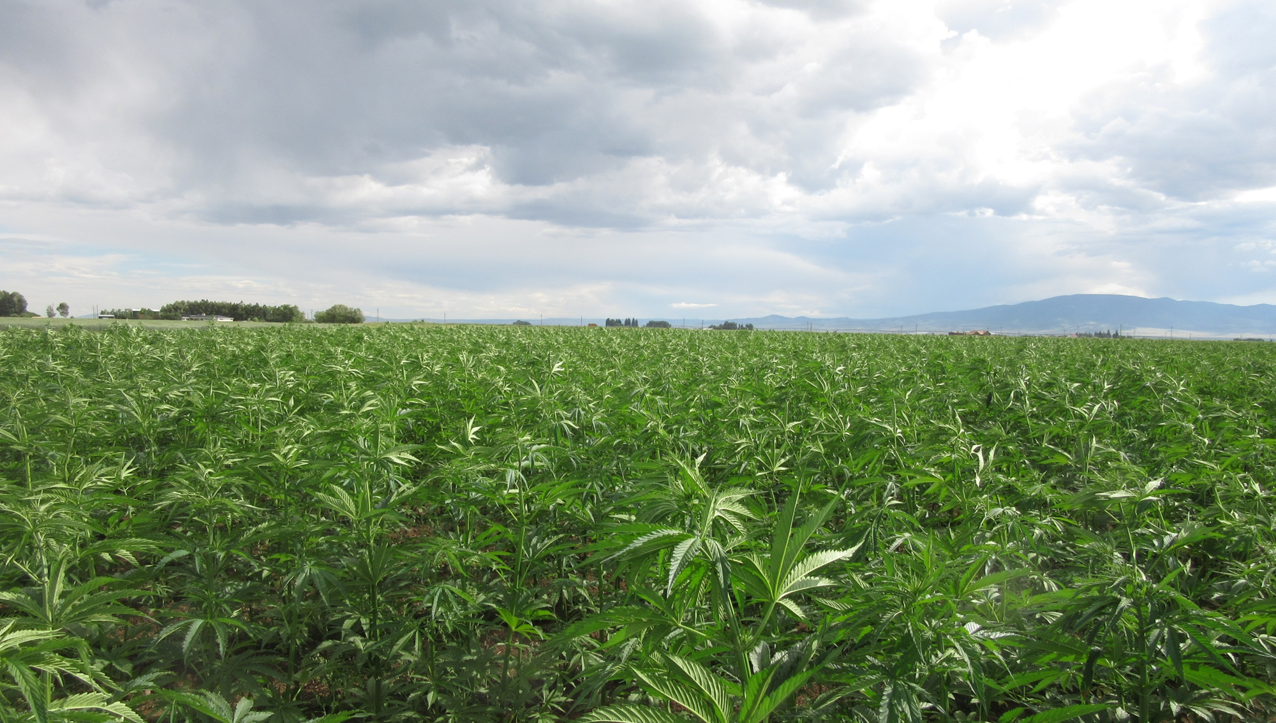

Colorado’s Industrial Hemp Program
USDA Agricultural Outlook Forum
February 20, 2020
Presented by Steve Silverman
Deputy Commissioner
Colorado Department of Agriculture

Slide 2
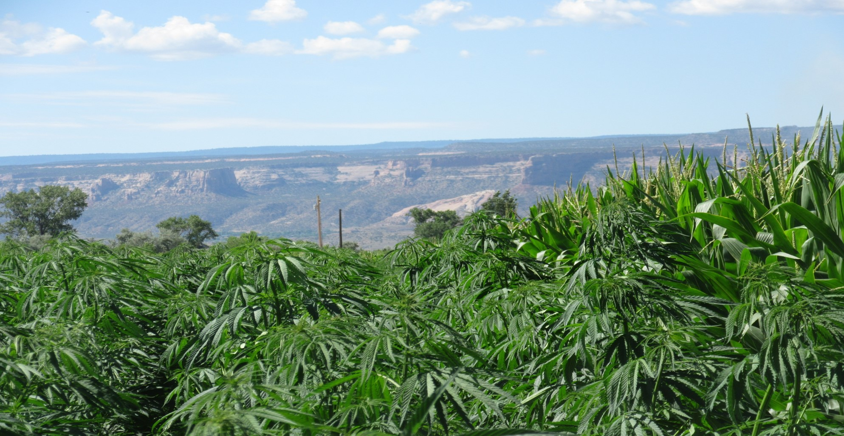
Colorado Department of Agriculture, Industrial Hemp Program Staff
Brian Koontz Program Manager
Jessica Quinn Registration and Compliance Coordinator
Margaret Foderaro Inspection and Outreach Coordinator
Mindy Archuleta Administrative Assistant
Jeremy Aguirre Administrative Assistant
Rob Donald Certified Seed Trials
Laura Pottorff Plant Health and Certification Section Chief
Wondirad Gebru Plant Industry Assistant Division Director
Field Services 20 Inspectors
Laboratory Services

Slide 3

GROWTH OF PROGRAM
REGISTRATIONS ISSUED AND NUMBER OF REGISTRANTS
CURRENT REGISTRATION NUMBERS
Active Registrations | 2635
Registrants | 1950
Registered Acres | 88743
Registered Square Feet | 15.4 Million

Slide 4
Acres Planted Continues to Grow
**Rounded to nearest hundred

Slide 6
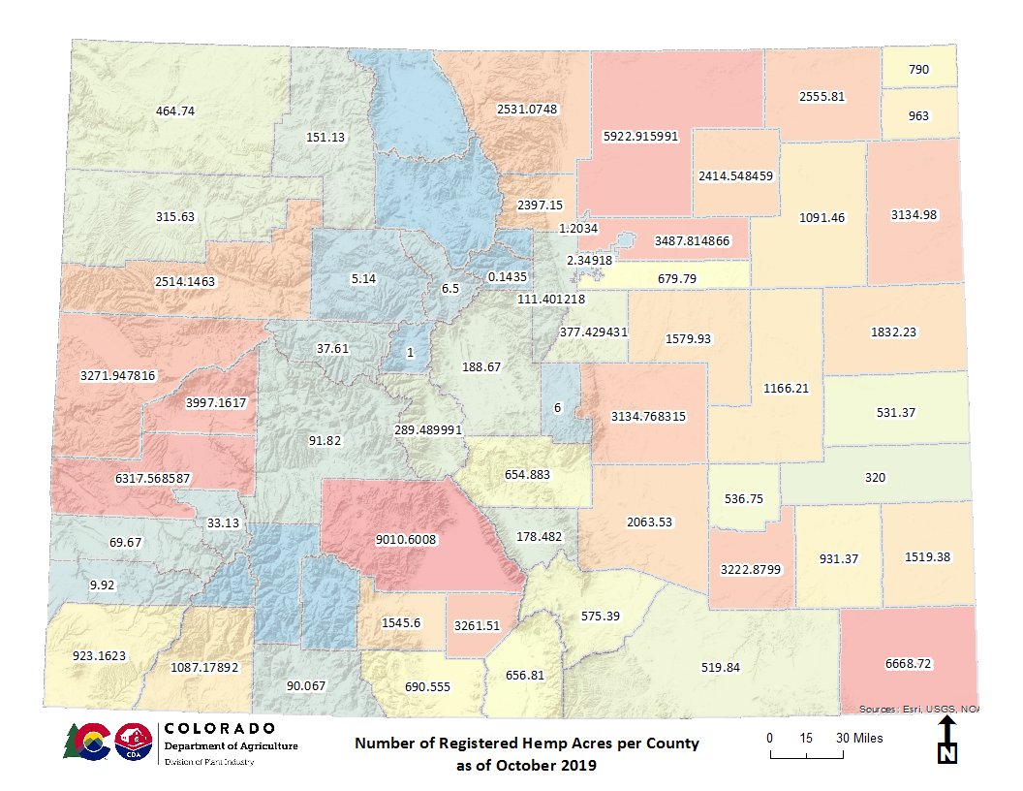

Slide 7

Current State Initiatives
Colorado Hemp Advancement & Management Plan (CHAMP)
USDA Interim Final Rule Comments
Submission of State Plan to USDA

Slide 8
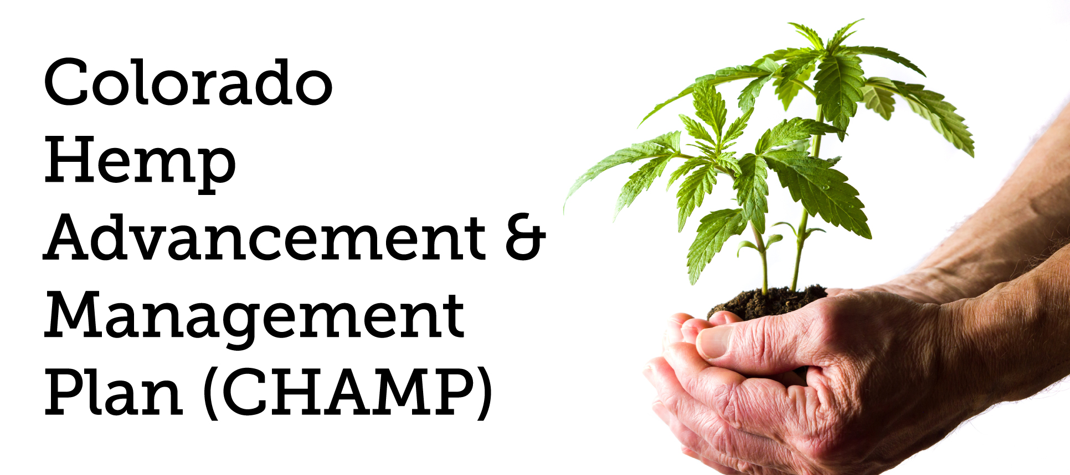
CHAMP Updates
Colorado Hemp Advancement & Management Plan

Slide 9
The CHAMP Initiative
The Colorado Department of Agriculture is partnering with leading state, local, and tribal agencies, as well as industry experts in cultivation, testing, research, processing, finance and economics to establish a statewide initiative known as the Colorado Hemp Advancement and Management Plan (CHAMP).
The CHAMP initiative is a broad stakeholder effort. A key objective is to define a well structured supply chain for hemp in order to establish a strong market for the state’s farming communities.
The CHAMP initiative is a year-long project that will conclude with the publishing of the CHAMP Report in spring 2020.
The collaborative effort includes CDA, the Governor's Office, Department of Public Health and Environment, Department of Revenue, Department of Regulatory Agencies, Office of Economic Development and International Trade, Department of Public Safety, Colorado Commission of Indian Affairs, Department of Higher Education, local governments and industry experts.

Slide 10
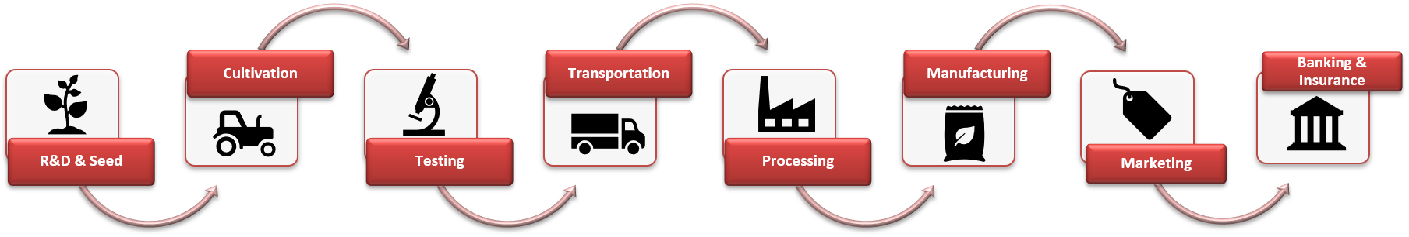
CHAMP - Hemp Supply Chain

Slide 11
Challenges Facing Colorado’s Hemp Industry
Market Uncertainty
Supply Chain uncertainty
Regulatory/Legal Uncertainty (e.g., FDA’s recent issuance of warning letters)
Unstable genetics - rigid THC requirements
Unnecessary value destruction
Inefficient/costly disposal

Slide 12
Key Colorado Concerns about USDA’s Interim Final Rule (IFR)
15-day Sampling period is too tight
DEA lab certification requirement is onerous and unnecessary
0.5 percent negligence threshold is too low
0.3 percent destruction threshold is too low
More guidance and flexibility needed for disposal protocol
Cumulative effects - systemic bias towards disadvantaged producers
Need to extend deadline for the sunset of the 2014 Pilot Program authority

Slide 13
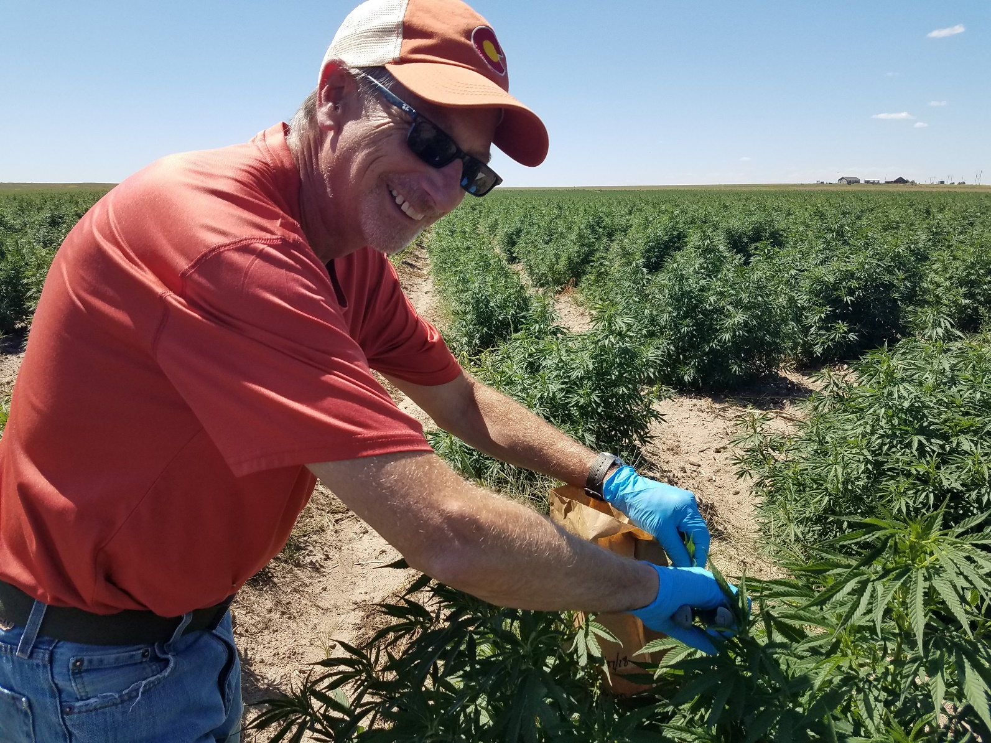
Questions? steve.silverman@state.co.us

