Slide 1

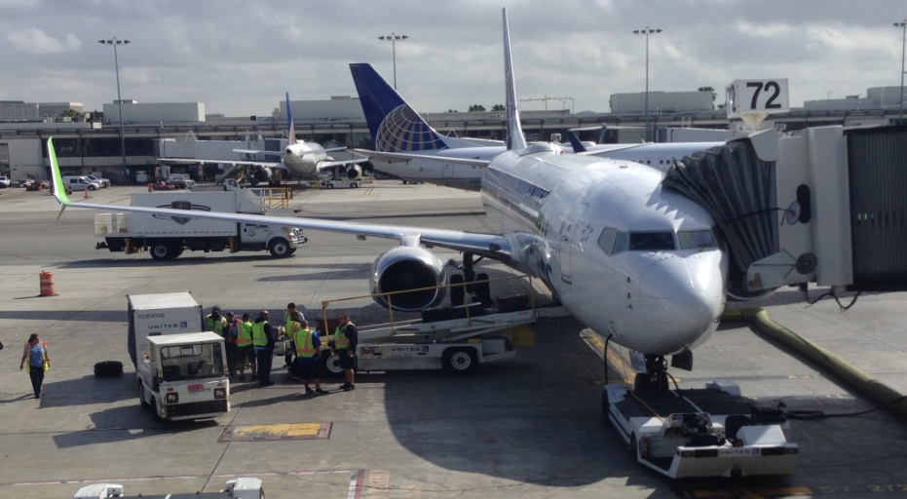
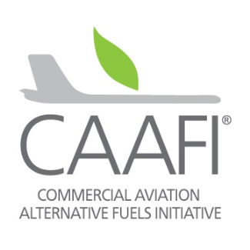
Sustainable Aviation Fuel (SAF) Update
New Opportunities in the Biobased Economy
Steve Csonka
Executive Director, CAAFI
First flight from continuous commercial production of SAF:
UAL 0708, 10 March 2016, LAX-SFO
Fuel from World Energy - Paramount (HEFA-SPK 30/70 Blend)
24Feb’22

Slide 2
What is SAF (Sustainable Aviation Fuel)? a.k.a. aviation biofuel, biojet, alternative aviation fuel
Aviation Fuel: Maintains the certification basis of today’s aircraft and jet (gas turbine) engines by delivering the properties of ASTM D1655 – Aviation Turbine Fuel – enables drop-in approach – no changes to infrastructure or equipment, obviating incremental billions of dollars of investment
Sustainable: Doing so while taking Social, Economic, and Environmental progress into account, especially addressing GHG reduction
How: Creating synthetic jet fuel with biochemical and thermochemical processes by starting with a different set of carbon molecules than petroleum … a synthetic comprised of molecules essentially identical to petroleum-based jet (in whole or in part)
…Unabashedly - Lowest societal-impact way to decarbonize civil aviation!!

Slide 3
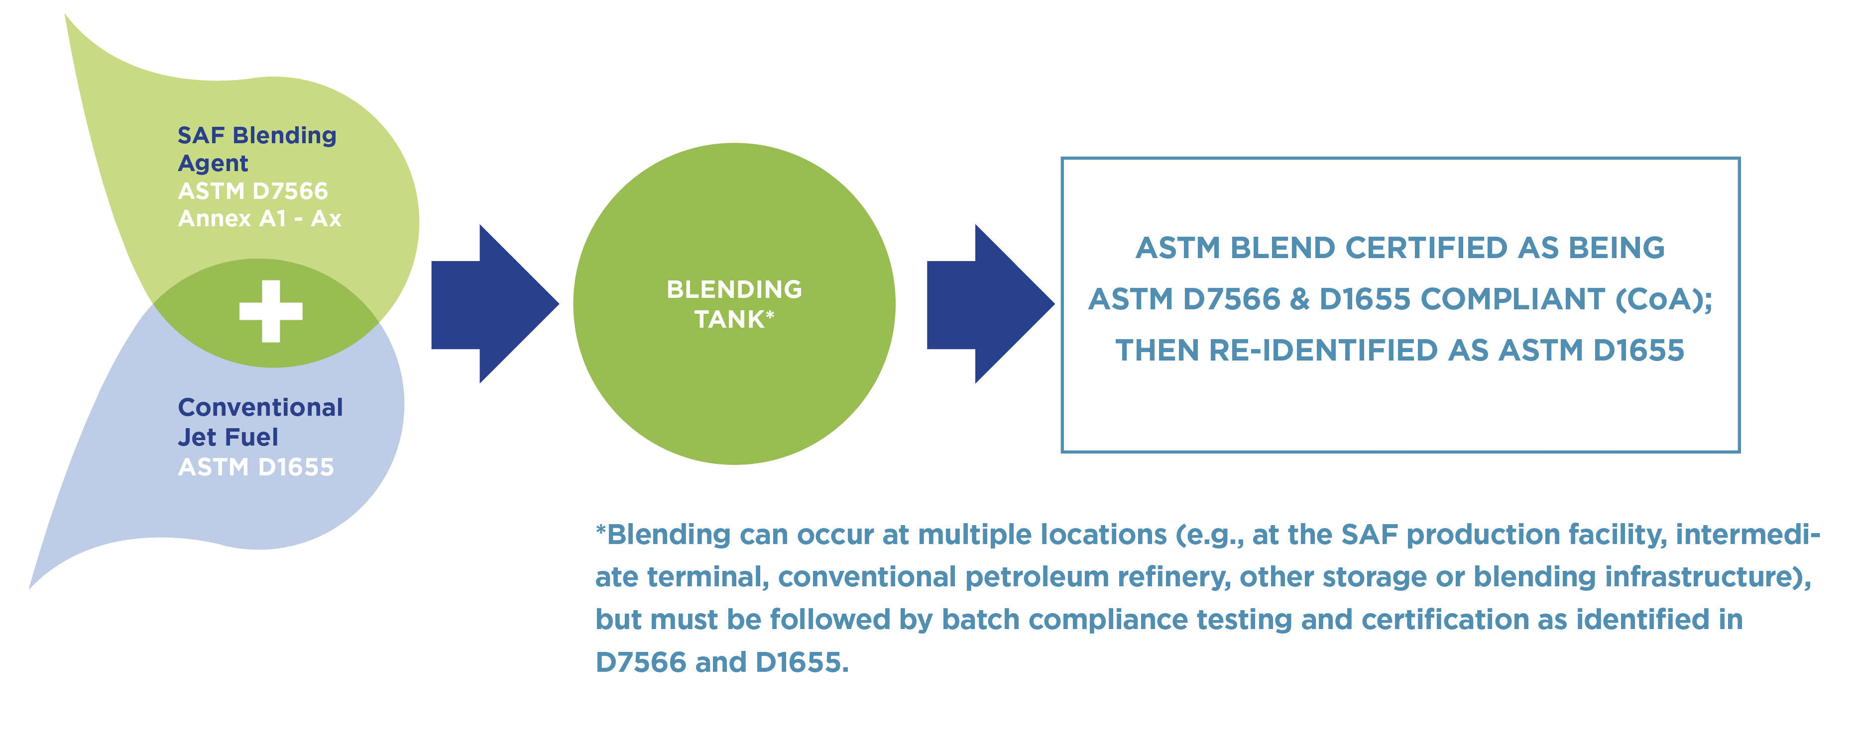
How SAF is made - Biorefinery example
1
2
3
4
Feedstocks (sourcing H & C)
Lipids
Lignocellulose
Starches / Sugars
Waste streams
Circular economy byproducts
Conversion Processes
Biochemical (microbes, e.g. fermentation)
Thermochemical (heat, pressure, catalysts)
Refinery Processes
Hydrotreament
Hydrocracking
Hydroisomerization
Distillation
SAF Blending Agents:
ASTM D7566 Annex A1 - Ax
Biocrude
C7-C17 pure HC suitable for jet
5
6
Fully fungible with all jet fuel infrastructure

Slide 4
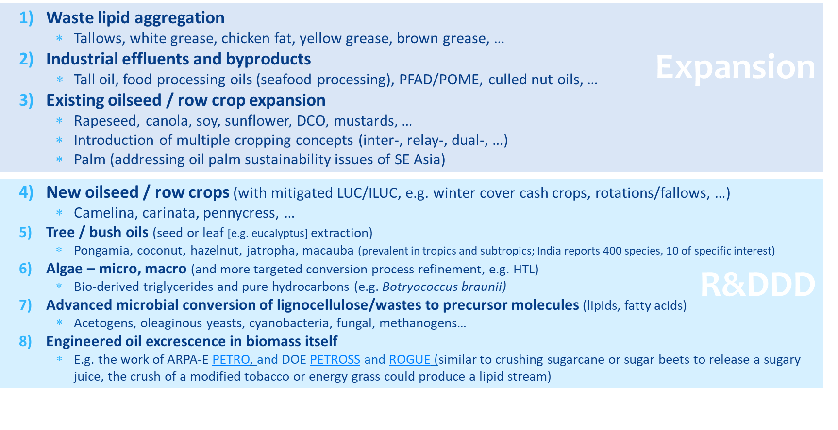
Feedstock development - a lipids example
1
Feedstocks (sourcing H & C)
Lipids
Lignocellulose
Starches / Sugars
Waste streams
Circular economy byproducts

Slide 5
SAF Progress - technical
SAF are becoming increasingly technically viable
  Aviation now knows we can utilize numerous production pathways
  (7 approved, 6 in-process, >15 in pipeline)
  Exploring expanded use of all major sustainable feedstocks
    Focus on 24x7, low-cost types to enable affordability and capitalization
  Some future pathways will produce blending components that will need less, or zero, blending
  Expanding exploration of renewable crude co-processing with refineries
Continuing streamlining of qualification – time, $, methods
Challenge remaining is achieving reasonable cost and expanding production

Slide 6
Aviation is committed to the use of SAF
“with commensurate assistance from governments”
Airline commitment at 28Sep IATA/ATAG Forum: NZC by 2050, with a focus on SAF
Further commitments to 10% SAF usage by 2030
  A4A & US Government Grand Challenge Announcement, 09Sep’21
  60 companies in Clean Skies for Tomorrow program (IAG, oneworld, …), 22Sep’21
Business Aviation similar commitments at 12Oct’21 NBACE
Offtake committed for SAF production slates from first 7+ refineries, 5–15 years
CORSIA incorporates SAF, developing new Long-Term Goal in current CAEP Cycle
Countries now adopting additional targets and policy approaches for domestic SAF usage (RFS, LCFS, tax policy), including SAF blending mandates in the EU
Aviation also interested in carbon abatement via adjacent tech: PtL, BECCS, DACCS
OEMs and DOD continuing R&D, evaluating acquisition options
      3 B gpy by 2030
      35 B gpy by 2050

Slide 7
Where we stand on U.S. SAF consumption
Initiation underway, still early
Five years of sustained commercial production and use
Commercial & General Aviation engaged
Two facilities in operation, one in commissioning, several others in physical construction
Cost delta still a challenge, with policies favoring renewable diesel
Worldwide: 6 entities produced SAF in 2021 – Finland’s Neste the market leader – some being imported to CA airports
4.71 M
Thru Nov
SPK production expansion
Other pathway qualification
Neat million gallons/year
Flt demos &
plant construction
SPK research & qualification
Credit: FAA
*Reflects voluntarily reported data on use by U.S. airlines, U.S. government, manufacturers, other fuel users, and foreign carriers uplifting at U.S. airports.
^2017-2021 calculation includes reported EPA RFS2 RINs for jet fuel.
2021 data as of Feb 2021
7
19 January 2022
Notes:
So, the U.S. market utilization of jet fuel was about 26.7 B gpy in 2019.
These aggregated numbers are based on voluntarily reported data from Airlines for America (A4A), Department of Defense (Defense Logistics Agency, DLA-Energy), manufacturers (e.g. Gulfstream Inc.), Fuel producers (e.g. Gevo Inc.), fuel providers SkyNRG and other users.
Reflects U.S. airlines and govt. users (e.g. DoD, CLEEN etc.), foreign carriers uplifting at U.S. airports, and other U.S. users.
Government purchases drove initial production, testing and approvals
Commercial purchases driving industry scale up
World Fuel Services (WFS) and SkyNRG have facilitated fuel deliveries between producers and users.
Under the FAA CLEEN program GE and RR procured a total of 4,040 neat gallons of AJF for qualification testing.
We have aggregated numbers at request of some of the commercial partners who would like to keep their specific totals private.
We are on the cusp of much more fuel production:
Altair Fuels in Paramount, CA is the first and only U.S. based full scale facility with a capacity of 30-40M gallons/year – most of this is diesel production currently – expansion plans…
Gevo, Inc. is operating a small facility in Silsby, Texas that has a jet fuel capacity of 30,000 gallons/year and they may double capacity to 60,000 gallons in 2018. If they can get financing and airline commitment they would also like to pursue jet production at full scale (5M gallon/year AJF) at their existing facility in Luverne, MN. This would require a couple of years to build once financing is obtained.
Two commercial facilities closed on financing late last year and are beginning construction this year (Fulcrum and Red Rock) each with about 10M gallon/year capacity.
Multiple additional facilities are working on financing, engineering and planning in the hopes of construction over the next several years (Velocys, SG Preston etc.). Some of these could be considerably larger in capacity (e.g. 100M gallons/year).

Slide 8















U.S. SAF production capacity forecast
Announced intentions, neat*
Net Zero SD 22.5
Carbon Zero
Riverbank+ 22
Carbon Zero #1
Riverbank 22
Bayou
Natchez, MS 33
Paramount
Sierra 7
Rodeo 290
N. Am. #2 30
Silsbee
Lakeview
6
NW #1 10
Gary, IN 21
Iowa 18
Freedom Pines 10
Bakersfield 37
Utah 20
40+ Entities
Collaborating
With CAAFI
Wyoming 8
Indaba Renewable Fuels
Imperial 49+
Paramount+ 150
NE #1 20+
Grays
Harbor
60+
Beaumont 15
~25+ M
~200 M
~250+ M
Exact Timing &
Production tbd
~900+ M
Not comprehensive; CAAFI estimates (based on technology used & public reports) where production slates are not specified. Does not include various small batches produced for testing technology and markets.
Does not include fractions of substantial Renewable Diesel capacity (existing and 10B gpy in-development) that can be pivoted to SAF based on policy support

Slide 9
How we achieve SAF commitments / goals
Needing to double production capacity every year through 2030
Affordability (via R&D and D&D)
  Conversion technologies, system integration
  Lower cost feedstocks, higher carbon utilization, lower CI
  Learning curve advancements and supply chain optimization
Worldwide production expansion
  All areas, local feedstock types
  Additional grass roots efforts (PPP efforts, e.g. CAAFI, AIREG, …)
Policy assistance to help bridge gaps of affordability and production
  Valorization of additional environmental / societal services

Slide 10
SAF Grand Challenge (SGC)
CAAFI observations from the periphery
SGC Execution Team (FAA, DOE, USDA) working with SAF IAWG on the Roadmap
  Targeting 6-month completion commitment made at launch
  Building off update of previous FAJFR&DS
  Goals for 2030, 2040, 2050 – Workstreams starting immediately
Vetting sessions held with academia and National Labs, will next turn to select industry sessions, and then more broadly
  First session in planning for Feb., other listening sessions likely, possibly by topic
Upon Agency agreement (March) – will announce and solicit further input via RFI
Execution via multiple mechanisms, likely matrixed workstreams, via 3-4 key foci
  Expanding Supply & Technologies for production
  Expanding Regional Resources
  Tools and Analysis
  Barrier identification and mitigation opportunities
Initiation will be focus of CAAFI Biennial General Meeting on 01-03Jun in D.C.

Slide 11
Overall industry summary on SAF:
SAF are key for meeting industry’s commitments on carbon reductions
  Aviation enterprise aligned, representing a 26B gpy US & 97B gpy worldwide opt’y
  Jet fuel demand expected to increase for foreseeable future ... 3 - 5% per year (following COVID rebound)
  SAF delivers net GHG reductions of 65-100+%, other enviro services
  Segment knows how to make it; Activities from FRL 1 to 9, with many in “pipeline”
  Industry and Governments are working to foster, catalyze, enable, facilitate, …
    Removing barriers: Pathways identified for fully synthetic SAF (50% max blend today), enhancing SAF value proposition by enabling deeper net-carbon reductions
  First 6 facilities on-line worldwide (5 from lipids), increasing run-rates, multiple offtakers
  Commercial agreements being pursued, fostered by policy and other unique approaches
  Additional work needed on “appropriate conversion process for targeted feedstocks” enabling affordability with sustainability
  SAF will be an enabler for expanded agricultural, silviculture, aquaculture, …

Slide 12

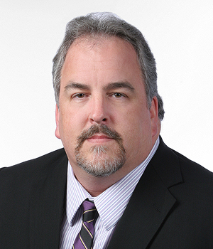
Steve Csonka
Executive Director, CAAFI
+1-513-800-7980
Csonka.CAAFI.ED@gmail.com
Steve.Csonka@caafi.org
www.caafi.org
info@caafi.org
Next CAAFI Biennial General Meeting
01-03Jun’22, Washington, D.C.

