Slide 1



Argentine
Agricultural Sector
Impact of new policies
Agustín Tejeda Rodriguez
Chief Economist
Buenos Aires Grains Exchange, Argentina

Slide 2




Argentine Agricultural Policies
Impact on crop season 2019/20
Economic incentives for 2020/21
What to expect for the long term?

Slide 3
Argentine Agricultural Policies
Impact on crop season 2019/20
Economic incentives for 2020/21
What to expect for the long-term?

Slide 4


The importance of Agriculture in Argentine Economy
GDP
(13.7%)
Employment
2.4 million people
(12%)
Tax Revenue
(14%)
Exports
USD 39.6 billions
(65%)
Source: Buenos Aires Grain Exchange

Slide 5
This role has increased during the last year
THE ONLY SECTOR SHOWING ECONOMIC GROWTH
GDP - Yearly Growth 2019 (%)
Source: INDEC

Slide 6
Export taxes: Macroeconomic Impact
- Production
- Exports
- Added Value
+ Tax Revenue
In marginal terms, a new increase in export duties will reduce exported value (cost) more than it increases tax revenue (benefit).
Source: Buenos Aires Grain Exchange

Slide 7
Export taxes: Effects on Incentives
Soybean: Direct Effects
Source: Buenos Aires Grain Exchange

Slide 8
Export Duties Per Product
INDIRECT EFFECTS: DIFFERENT DUTIES AFFECT COMPARATIVE MARGINS BETWEEN CROPS
Current Situation

Slide 9
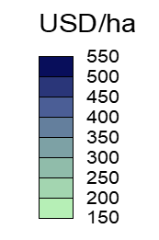
Comparative Direct and Marketing Costs
LOWER COSTS FOR SOYBEAN IN A CONTEXT OF MACROECONOMIC UNCERTAINTY AND FINANCING CONSTRAINTS
SOYBEAN
CORN
Source: Buenos Aires Grain Exchange

Slide 10
Export Duties Over Time
RECENT CHANGE: BACK TO SEP 2018
Res. 793/Sep. 2018
Res. 37/Dec. 2019
Emergency Law
N. Kirchner – C. Fernández
2003-2015
Macri
2016-2018 / 2019
A. Fernández
(2020 – 2024)

Slide 11
Export Taxes: Impact on Planted Area
EFFECTS: CEREALS VS SOYBEAN
Soybean
Cereals
Source: Buenos Aires Grain Exchange

Slide 12
Export Taxes: Impact on Exports
Soybean Complex
Corn
Wheat
Source: INDEC

Slide 13
Argentine Agricultural Policies
Impact on crop season 2019/20
Economic incentives for 2020/21
What to expect for the long-term?

Slide 14




2019/20 Crop Season: Planted Area
2019/20 Planted Area Intention (Million Ha)
Expectations of an increase in export duties had risen after the primary elections, when farmers were still able to switch from late corn to soybeans.
17.7
6.3
6.6
1.65
(+1.7%)
(+6.5%)
(-13%)
Early:
+15.5%
Late:
-18.5%
Source: Buenos Aires Grain Exchange

Slide 15
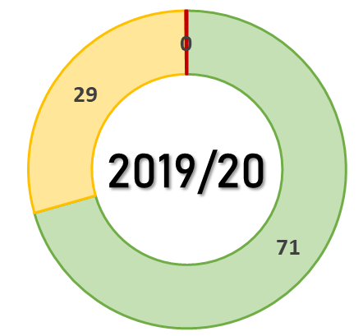
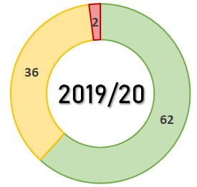
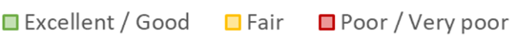
2019/20 Crop Season: Production
CROP CONDITION
2019/20 Production Estimates
(Million Tons)
Soybean
Corn
53
49
18.8
3.2
Source: Buenos Aires Grain Exchange

Slide 16
Argentine Agricultural Policies
Impact on crop season 2019/20
Economic incentives for 2020/21
What to expect for the long-term?

Slide 17
2020/21 Crop Season: Full Impact on Planted Area
-1.5%
Planted Area 2020/21 (Million Ha)
Planted area could decrease between 0.5 and 0.8 million ha. in comparison to the baseline. Cereals will fall at a higher rate than soybeans.
-2.4%
2020/21
Source: Buenos Aires Grain Exchange

Slide 18
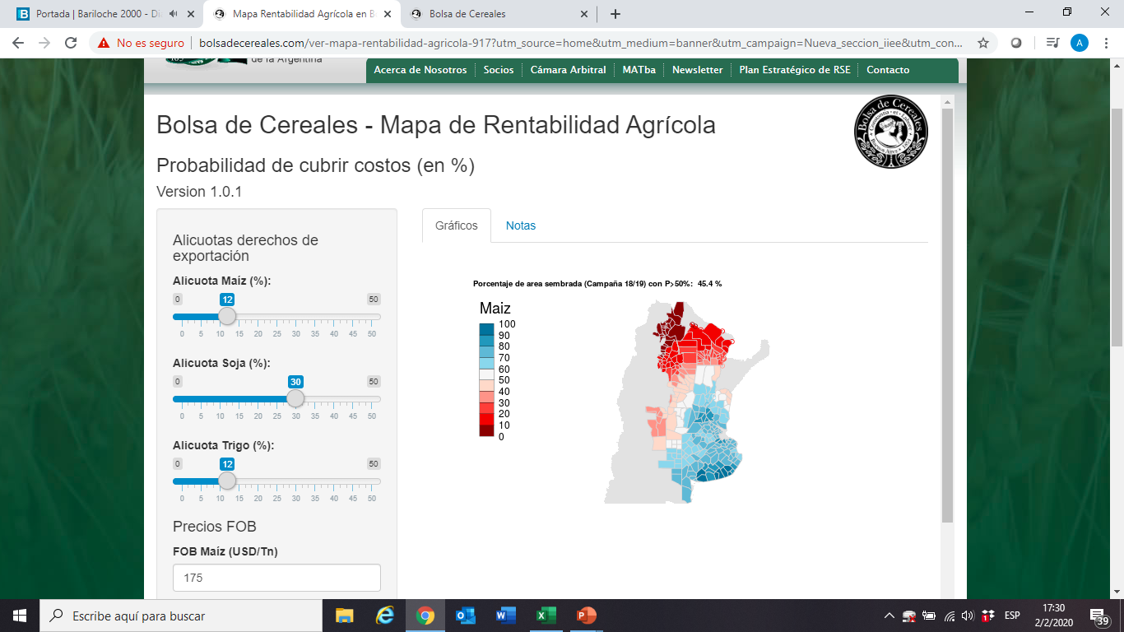
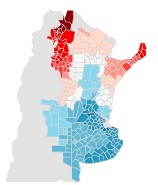
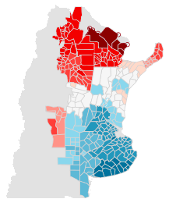
The State of Farm Economy: Regional Effects
PROBABILITY OF COVERING PRODUCTION COSTS
CORN
SOYBEAN
WHEAT
%
Source: Buenos Aires Grain Exchange

Slide 19
Soybean Complex Situation: Simulated Scenarios
FACTORS OF UNCERTAINTY
Export Duties
African Swine Fever
Trade War
¿Coronavirus?

Slide 20
Soybean Complex in Argentina: Results for 2019/20
Soybean (Million tons)
Source: Buenos Aires Grain Exchange

Slide 21
Argentine Agricultural Policies
Impact on crop season 2019/20
Economic incentives for 2020/21
What to expect for the long-term?

Slide 22
Long-term Projections: What to Expect?
SIMULATED SCENARIOS
Baseline
Closing yield Gaps
Improvements in logistics and infrastructure
New Duties established in 2019
Duties 2015
Maximum export duties in force in 2015
Exp. Restrictions
Export Duties and Export Restrictions applied between 2008-2015
Potential

Slide 23
Long-term Projections: Planted Area
Planted Area to 2028/29 (000 ha)
Cereals-to-Oilseed Ratio
+11%
-1.4%
Source: Buenos Aires Grain Exchange

Slide 24
Long-term Projections: Production
CEREALS VS OILSEEDS
Grain Production to 2028/29 (Million Tons)
186
149
139
136
Source: Buenos Aires Grain Exchange

Slide 25


Closing Remarks
Soybean is the most competitive crop, in a context of macroeconomic uncertainty, financing constraints and high export taxes.
Export taxes are the main ag policy tool used by Argentina.
Measures have effects on total planted area and the cereals-to-oilseed ratio.
The recent increase in export duties will affect the next 20/21 crop season. The last four seasons trends might be reversed.

Slide 26


The future will depend on the policy framework adopted. With a set of policies that promote investment and exports, we would reach more than 185 million tons. Otherwise, grain production would even fall.

Slide 27
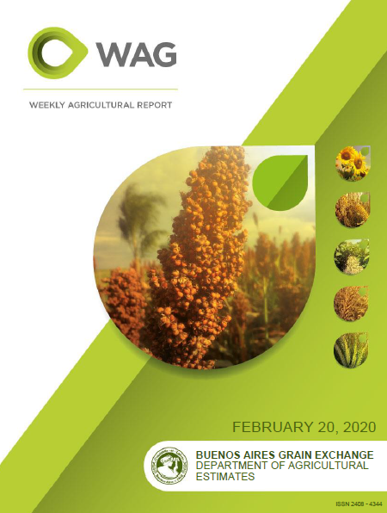
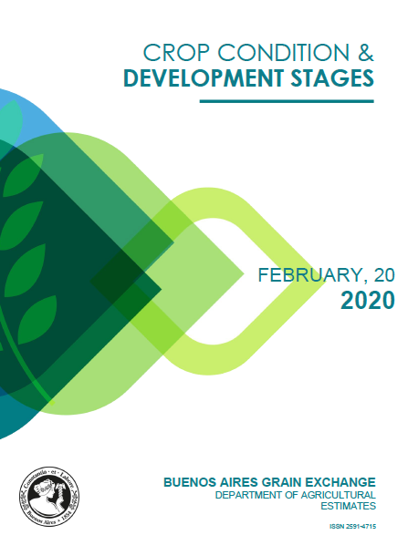
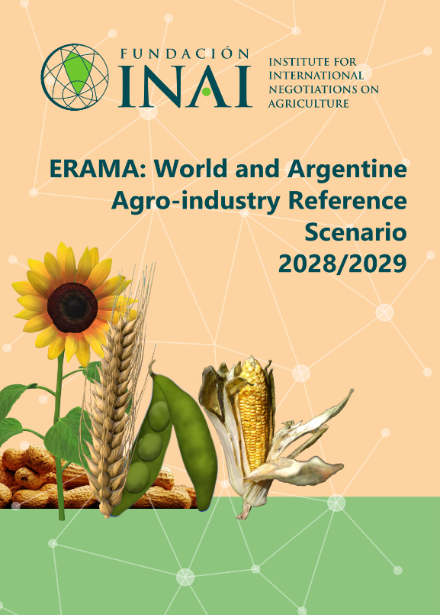
Our Work

Slide 28

Thank you
Agustín Tejeda Rodriguez
atejeda@bc.org.ar
http://www.bolsadecereales.com/
Buenos Aires Grains Exchange, Argentina

