Slide 1
Trends in Grocery Retail
Andrew Harig
Vice President – Tax, Trade, Sustainability & Policy Development
FMI
aharig@fmi.org
202-220-0628

Slide 2
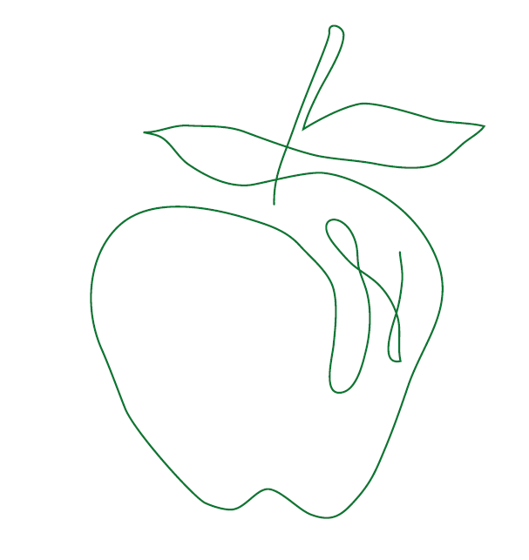
As the food industry association, FMI works with and on behalf of the entire industry to advance a safer, healthier and more efficient consumer food supply.
FMI brings together a wide range of members across the value chain — from retailers who sell to consumers, to producers who supply the food, as well as the wide-variety of companies providing critical services — to amplify the collective work of the industry.

Slide 3
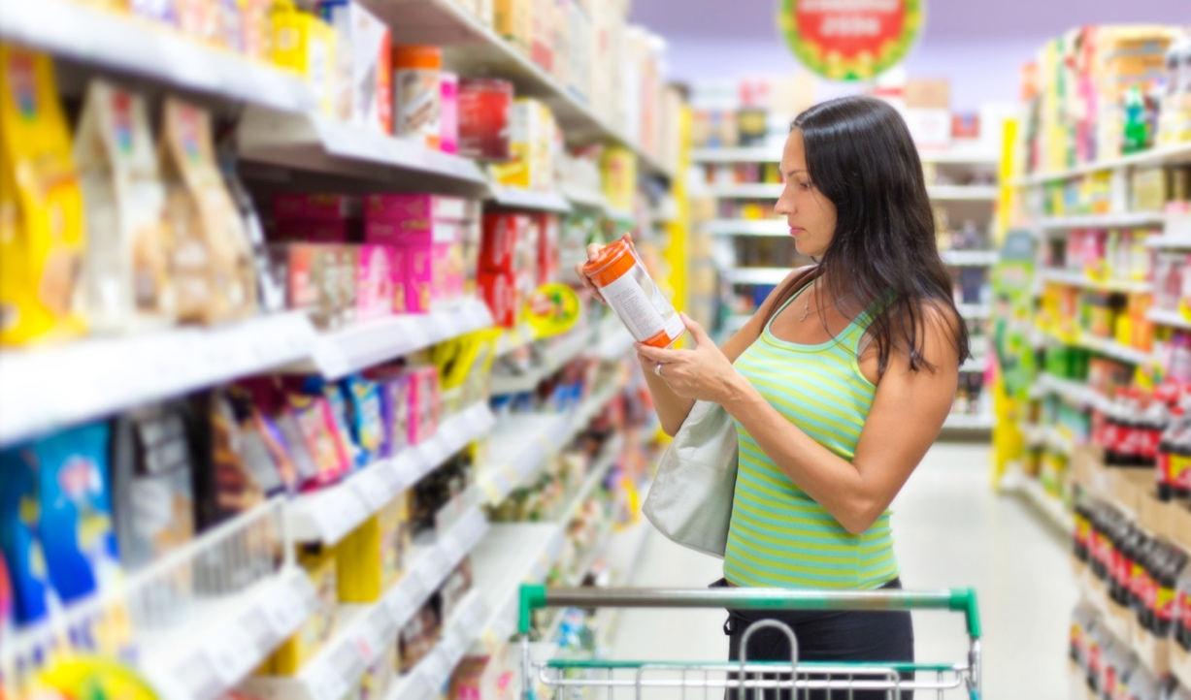
FMI in the Marketplace
$800 billion industry with nearly 6 million employees.
FMI propels the retail food industry by advocating for and supporting a safer, healthier, and more efficient consumer food supply.
Nearly
33,000
retail food
stores
$800
billion
food retail industry annual sales volume
More than
400
associate members
that include retail
supplier
partners
Representing nearly
6 million employees
80%
of all FMI members are independent operators*
Nearly
12,000
pharmacies
        *Independent operators:
        50 stores or less

Slide 4
As the last two presentations make clear, food retail is in uncharted territory….
Very low food price inflation
Consolidation
Technology changes
Channel splitting
Today, I’m going to focus on two trends that are re-shaping retail and helping to improve the customer experience while keeping prices low:
Rise of the online shopper
The push for ever-greater personalization

Slide 5
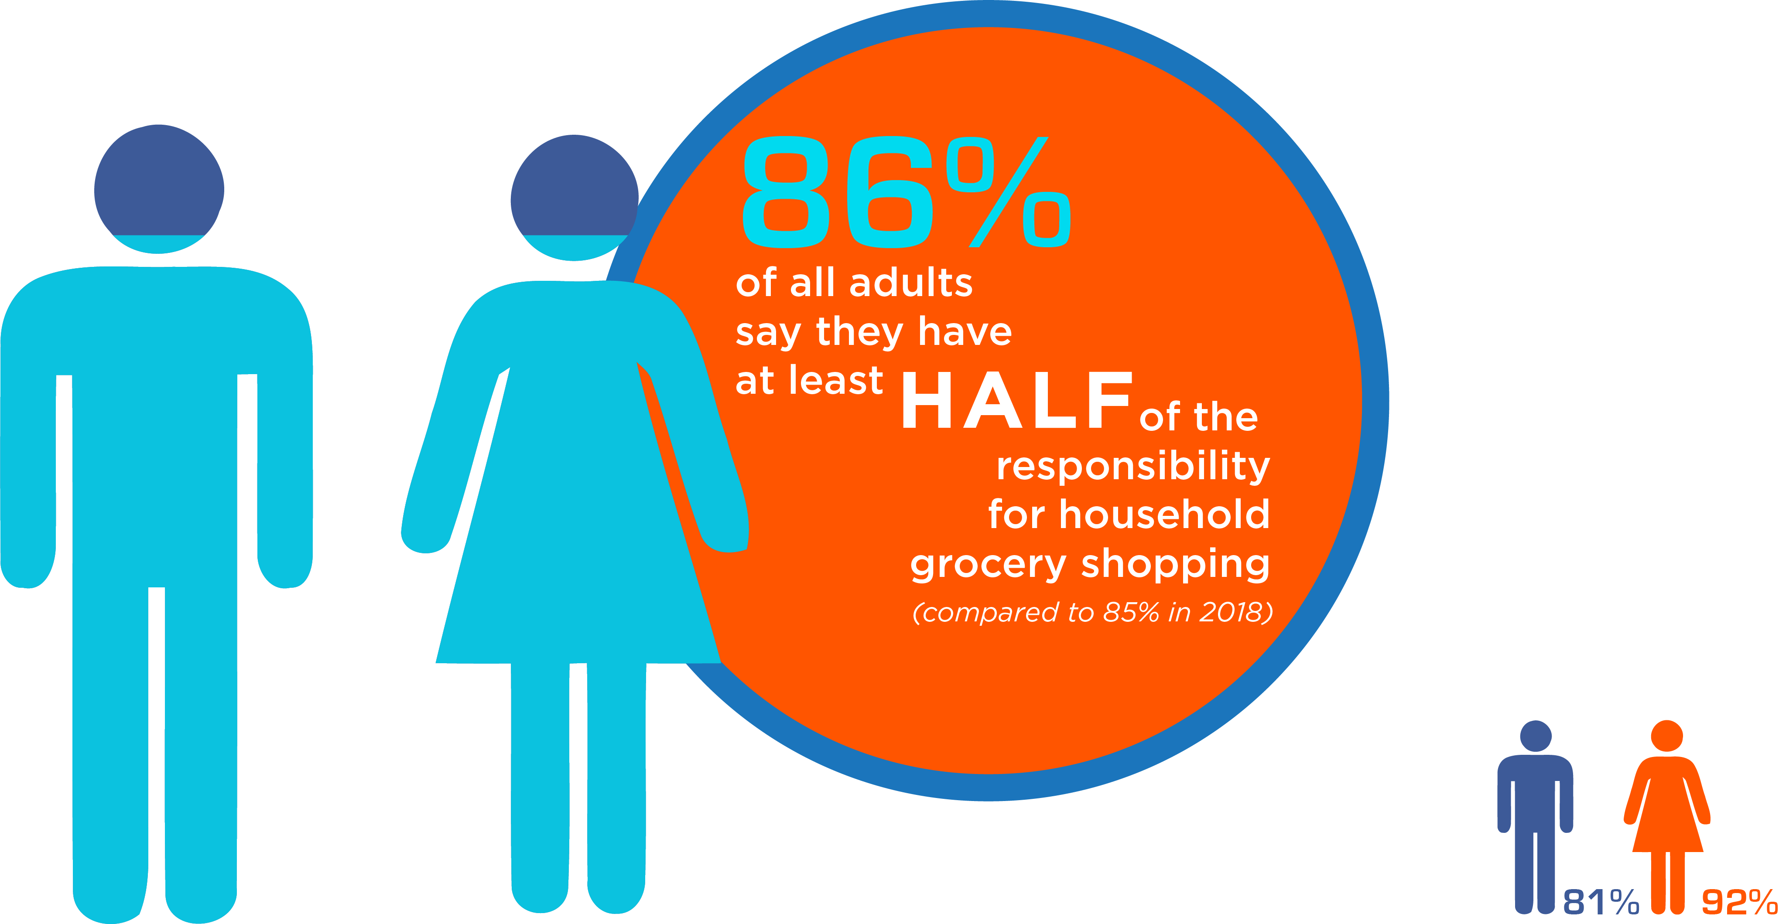
GROCERY SHOPPING REMAINS
A NATIONAL PASTIME
CURRENTLY IN THE U.S.
5

Slide 6


SHOPPERS
SHOP
MULTIPLE
CHANNELS/
BANNERS
The whole ‘one-size-fits-all’ thing – or lack thereof – is the whole reason why I have to go to all these places. If there was a store with reasonable prices, great selection of healthy,
ethically-sourced food, with
friendly, low-key, down-
to-earth service, I’d
like that. But until then,
the combination of all
them together does a
good job of meeting
my family’s needs.
— Josh, 58
Shoppers visit
an average of
4.4
(up from 4.1 in 2018)
retail banners
for groceries
each month
Shoppers visit
an average of
3.1
different channels
for groceries each month
U.S. GROCERY SHOPPER TRENDs 2019 | #GROCERYTRENDS
6
U.S. GROCERY SHOPPER TRENDS 2019 | #GROCERYTRENDS
6
Notes:
Not only do most Americans grocery shop, they like shopping a multiple places.
Shoppers visit an average of 4.4 retail banners and 3.1 different channels each month. (This means the month of July they may visit 4-5 different grocery stores, pick up food at a supercenter or club store and order some grocery items on line.)
The other piece to note on this is that the number of different channels shopped each month is even higher among Gen Z (3.9) and Millennials (3.8). It is also higher in households with kids (3.8)
You might also be interested to know that younger grocery shoppers tend to shop even more banners, with Gen Z’ers hitting some 6.2 a month, and Millennials (5.0).
Retail banner average is also higher for Households with children (5.4) and households with $100K+ income. (5.5)
Given that we view Millennials and Gen Zer’s as the portents to the future, it certainly looks like channel fragmentation will be with us for a while.

Slide 7
Channel surfing continues; Supermarkets stabilize as the primary destination for ½ of grocery shoppers
Primary Store for Groceries, Historical Trend

Slide 8
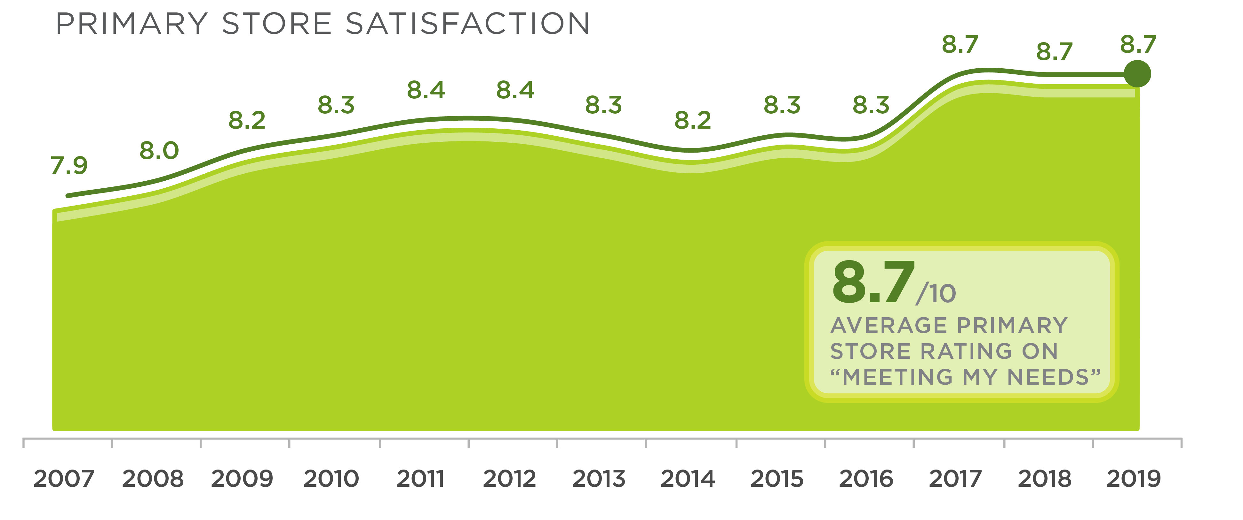
SATISFACTION WITH PRIMARY STORE IS AT A 10-YEAR HIGH
Notes:
They turn to their retailer for some help in sorting through and addressing these various values
And as this graph shows, for the most part consumers are satisfied with their primary store – indicated by a stable 8.7 satisfaction rating.
That said I grew up in the Nadia Commenici era of olypmic performances, so I believe perfection is achievable and a score of 10 is possible…
So as we proceed, let’s bear that in mind –
looking at what it takes to maintain that 8.7 AND taking note of what it would take to gain those additional 1.3 points to rate a 10.

Slide 9
Weekly trips and spend remain stable
1.7
Online Shoppers
1.6
trips per week
1.5
Not Online Shoppers
T R I P S
1.6 average trips +0.9 by others alone 2.5 trips per household (2.2 in 2018)
spent on groceries per week per household
SPEND
Notes:
The two lines of data covered on this slide include weekly trips to the grocery store and average spent on groceries per week.
Trips are holding steady at the 1.6 trips per week level, however there are 2 observations I would add.
1. That number only registers the Primary shopper’s trips, when you add in the other shared shopping partner, the average household is visiting food retail outlet(s) some 2.5 times a week.
2. My second observation is that consumers who have online in their shopping repertoire still visit their brick and mortar outlet some 1.7 times a week. Online may be cutting into in-store basket size, but currently is not cutting into the number of trips to the store. We’ll have more on that later when we get into online grocery shopping in detail.
The spend line on the bottom of the slide reveals that we had a slight uptick of $4.50 in the 2019 average household grocery spend, bringing the weekly average to $113.50.
By the way, the dark red line on the Spend graph is data we get from the Bureau of Labor statistics, offering their take on the weekly grocery spend. The fact that their line and consumer’s guessimate line are parallel or on top of each other is a confirmation othat the consumers have a pretty reliable grasp on what they spend for groceries.

Slide 10
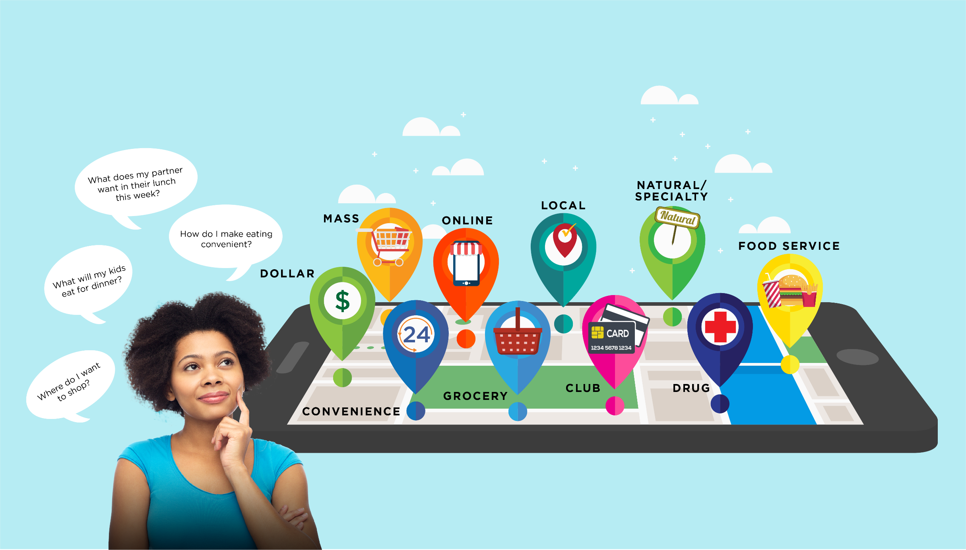
TODAY’S SHOPPERS NEED A COMPASS
TO HELP THEM EAT AND SHOP

Slide 11
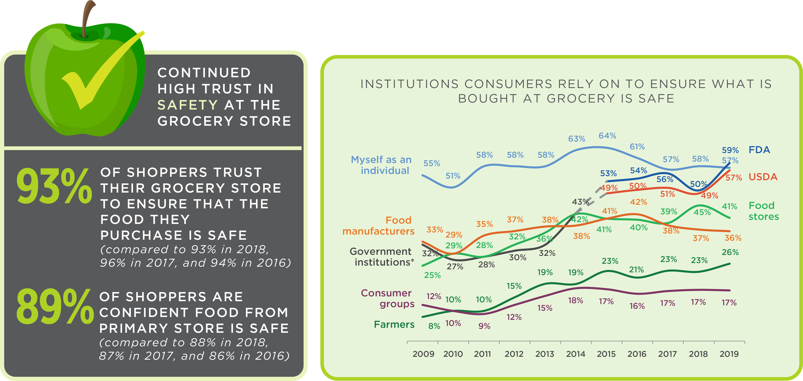
SHOPPERS HAVE COME TO COUNT ON A GROWING NUMBER
OF ENTITIES TO ENSURE FOOD BOUGHT AT STORE IS SAFE
11
Notes:
Another indication that shoppers want to control their own grocery cart can be seen in who they count on to ensure their standards of food safety are being met.
They count on a number of helpers: govt agencies (FDA, USDA), their food stores, consumer groups and families. – BUT they see themselves up near the top
Food stores get high marks for trust and confidence in food safety (as seen in the box on the left) – but this is seen by consumers as a collaborative dance – a complex choreography involving a number of partners, with the individual still holding the cards about the dance moves they prefer and the partner they trust to help them pull off this routine.

Slide 12
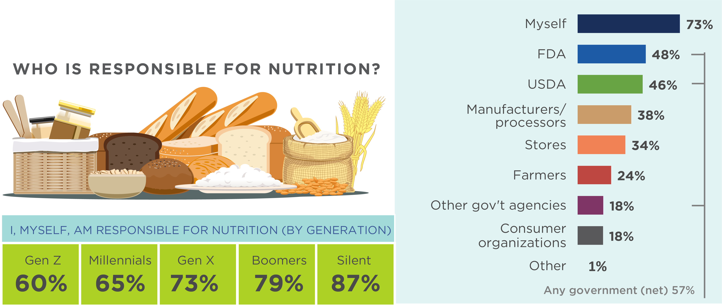
SHOPPERS MAKE NUTRITION THEIR
RESPONSIBILITY BUT RECOGNIZE
A NUMBER OF PARTNERS
Notes:
Another indicator that shoppers want to stay in charge of executing their shopping plan is seen in their answer to who do you hold responsible for the nutritional; content of the food you buy.
Again we see a host of partners they call on to help with the nutritional determinations but ultimately they see themselves as the driver of this bus. The resources they draw upon include govt agencies, manufactures and food stores, farmers and others. But consumers take the lead.
For an interesting generational note , take a look at the box in the lower left.
Gen Zers still hold themselves primarily resposnbile for nuturtion decisions but rely more heavily on the help/guidance of others on this scroe.
Millennials are somewhat in the same camp.
Gen er’s are poster children of normal , with a score that reflects the national average and puts them squarely in the spot right between the generations coming before them and coming after them.
Boomers and the Silent generation (matures) demonstrate their characteristic resilient reliance upon themselves - even when it comes to determining nutrition.

Slide 13

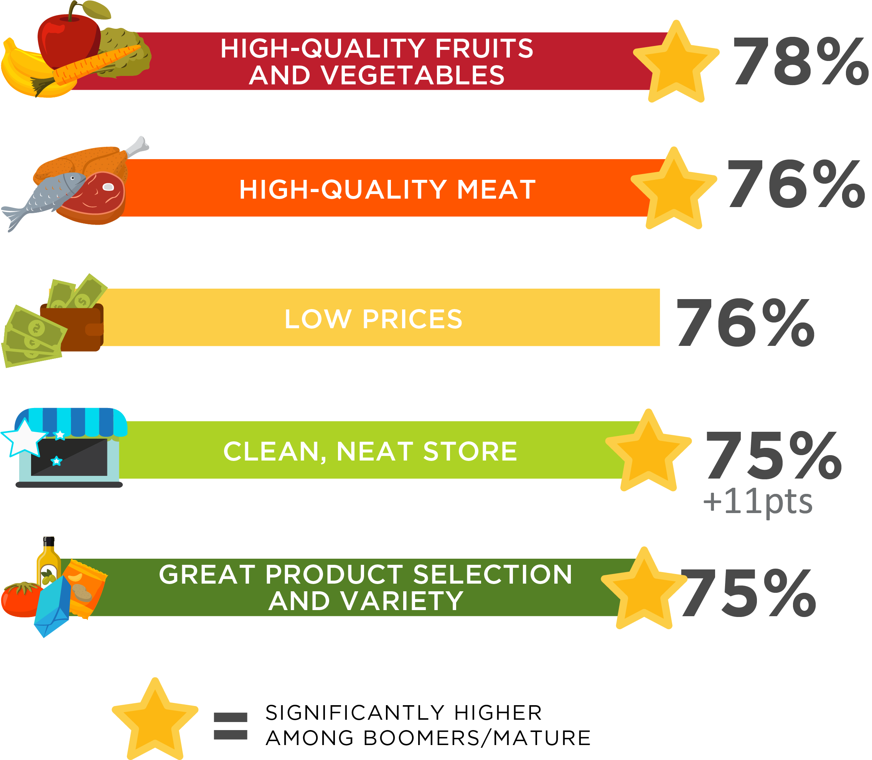
FRESH CATEGORIES
MOST IMPORTANT FEATURES
OF PRIMARY STORE
Notes:
When asked to rate the most important attributes in a store, we find the fresh categories among the most appreciated:
High quality fruits and vegetable s – edging out high quality meat for top honors this year.
Low prices tied for second
and the features of clean, neat store product selection and variety tied for fourth place.
The gold star high lights the areas that are significantly important to Baby Boomers and matures, with that age group rating them higher than the average indicated
But this is just the top of the list

Slide 14
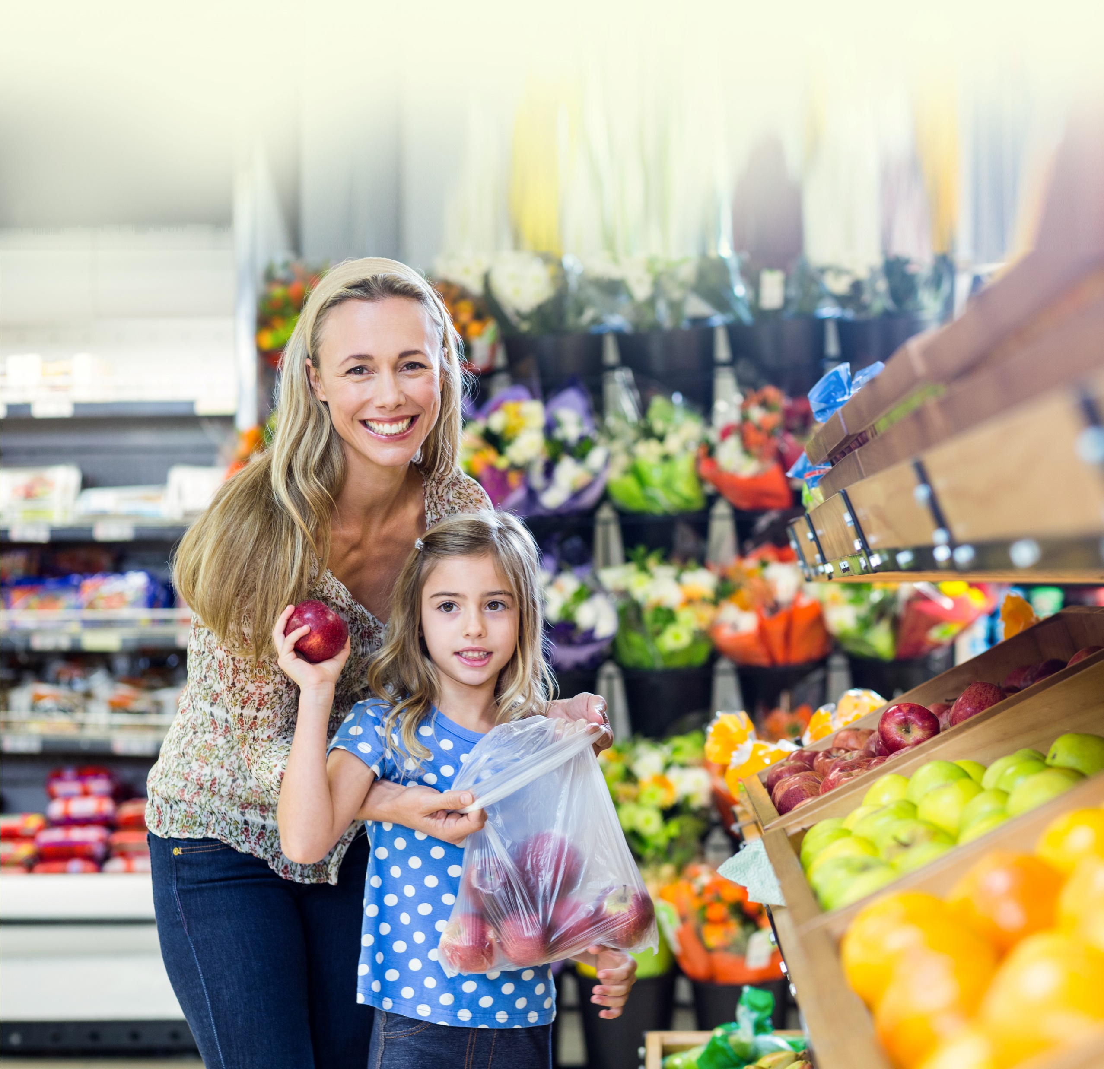
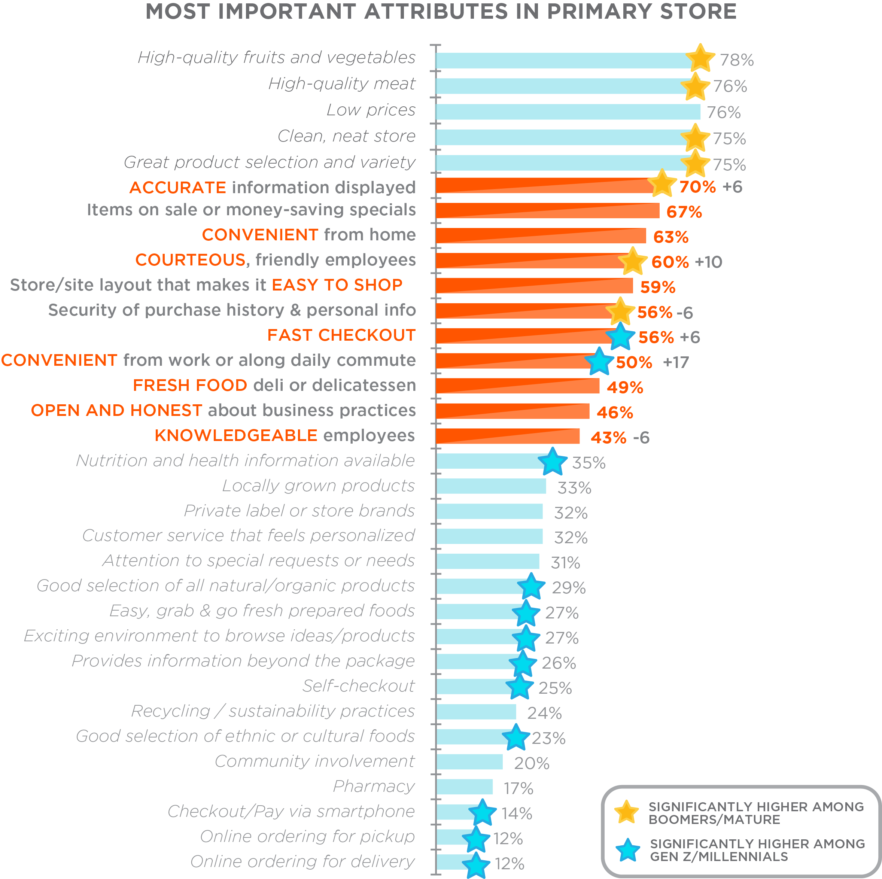
IN-STORE EXPERIENCE
AND CONVENIENCE ALSO
IMPORTANT FEATURES
Notes:
This is what the more complete list looks like.
I know that it is our tendency to pay attention to the top ten and indeed those are crucial to keeping a stable satisfaction score, However , there are some other considerations I would highlight that we find interesting and important.
Beside the percentage scores, We’ve highlighted several areas where there has been significant movement when compared to the 2018 scores.
Those particularly receiving higher scores than last year: (therefore growing areas of concern include:
Accurate information displayed
Friendly courteous staff
Fast checkout
convenient from work
However, what I really think warrants our attention are those areas marked with a blue star – many of these are mid-range concerns and some are bottom dwellers, but these are the areas where the millennials and genZrs over-index (rate higher than normal)
My premise is if you want to maintain in the present tense pay attention to the top ten, if you want to thrive in the future, excel at the top and start concentrating on the blue star areas.

Slide 15
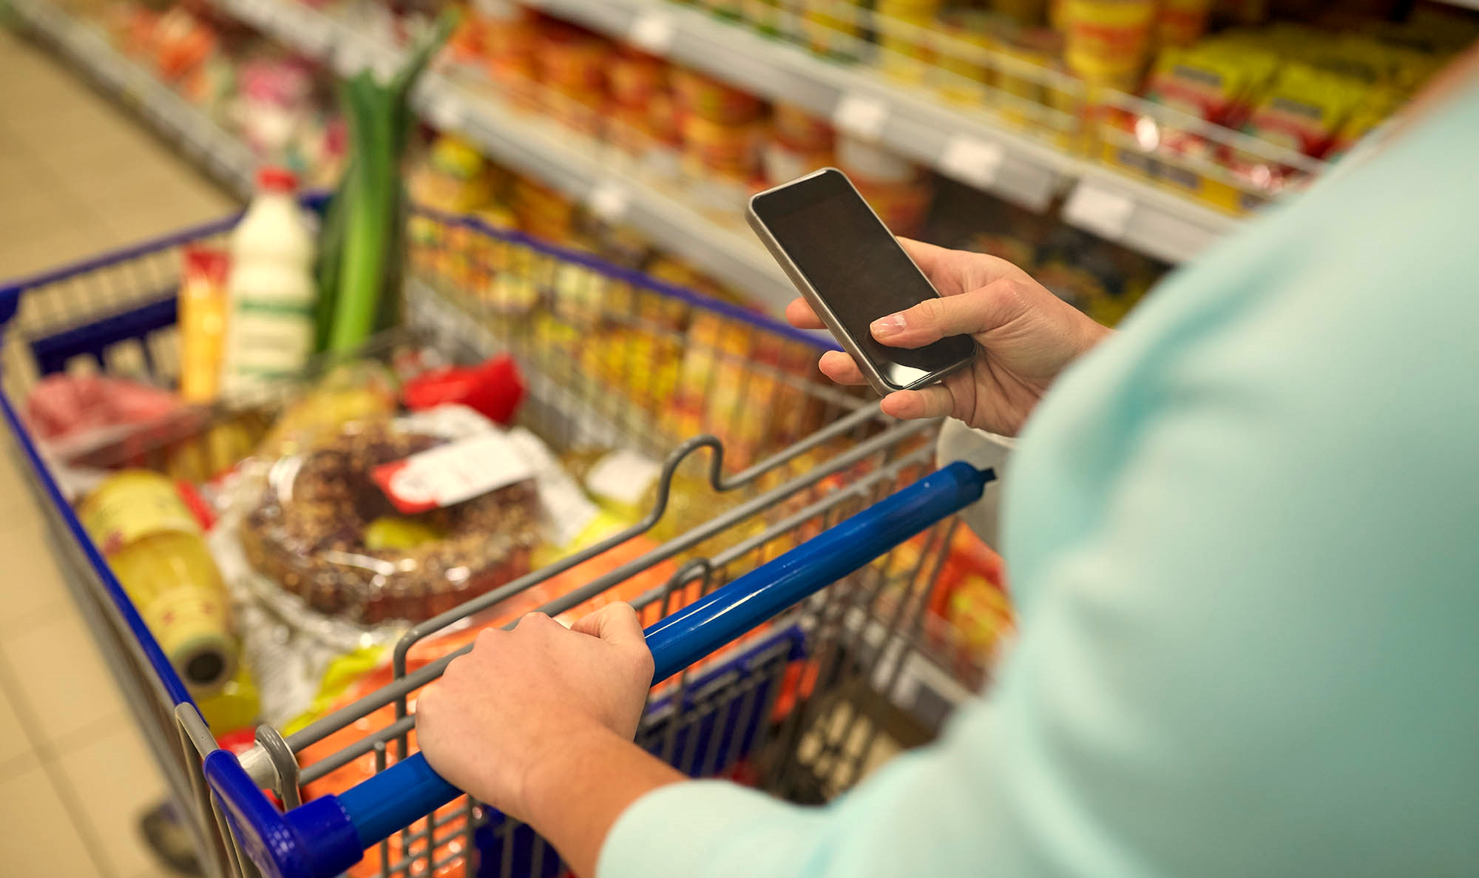



The Online Marketplace
Notes:
Having noted all the channels that shoppers are using, let’s look a bit more explicitiy at online to see how it is developing.

Slide 16
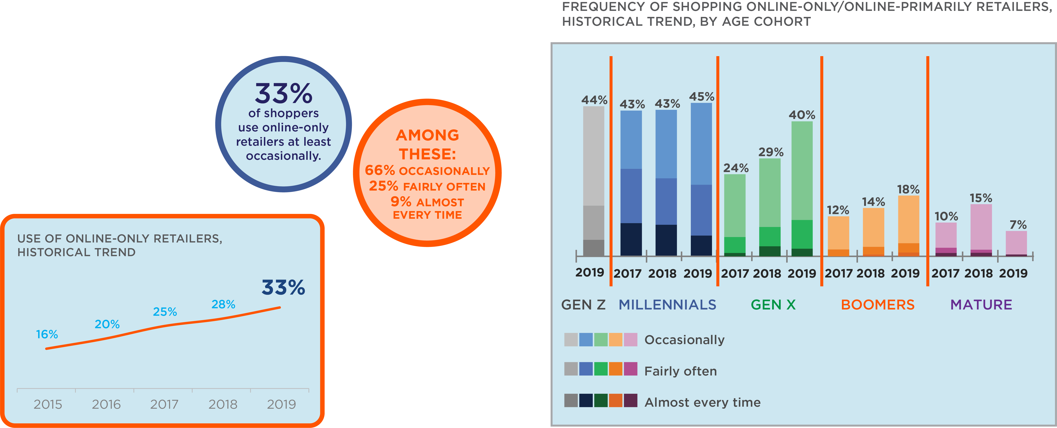
THE ONLINE GROCERY CHANNEL; GEN X CATCHING THEIR
MILLENNIAL FRIENDS
Notes:
Back in 2015 when we first started tracking grocery shopper engagement with online, we found that about 16% of consumers were utilizing this channel. Online engagement continues its steady climb reaching the 33% level this year (officially doubling its audience in five years. ) While not a rocket trajectory, online adoption in the grocery world is showing steady growth.
Online use has always been an important area to examine by age group due to millennials leading the charge in embracing online grocery shopping. That appears to have cooled a bit with Millennial adoption of online (shown in blue) leveling out a bit at around the 45% range.
Also note that the level of online engagement (registered in varying shades of blue representing occasionally, fairly often and almost every time) even the depth of millennial engagement is slipping just a bit, indicating that millennials continue using online as one of the channels they shop, but perhaps not as frequently as before.
However, there are three important observations about this slide that we need to note:
Look at Gen X ( in the green) adoption in 2019 ; it is beginning to rival millennial levels – even the depth of GenX adoption picked up a bit.
Boomers continue to pick it up a bit, but mature engagement with online shopping took a hit this year, falling back to near 2015 levels.
The other thing to note is this is the first year we started having Generation Z participants in our survey and look at where they enter the online-grocery-shopping picture (far left in gray) – at a level right up there with their older millennial friends.
In short, all age categories that point to the future (Gen Z, millennials and GenX) indicate a continued embracing of online shopping with adoption continuing its steady climb.

Slide 17


Some additional learnings about frequent online shoppers
Frequent online shoppers:
Who are the frequent online shoppers?
Male -55%
Millennials and GenX
Parents
College-educated
Higher HHI (36% $100k+)
Urban
South
Shop more in general;
  more banners,
  more channels
  AND more weekly trips to the brick & mortar grocer.
Spend more in general;
  Not only more online but in the store.
Notes:
Here are some additional Trends-supported observations about the shopper who frequently use online channels:
First off, in general, they shop more than the average consumer.
they shop more banners, (7-8 and average is 4.4)
more channels (3)
AND they make more weekly trips to the grocer. (1.7 VS average of 1.6)
Second, they Spend more in general; ($160 vs. the average of $113)
Not only more online but in the store.
So what does this mean?
1. As I’ve already pointed out, it means online has cut into basket size a bit, but not much given the higher spend, amount and not n in regard to umber of trips. Frequent online shoppers are actually in stores more than those do not shop online at all, but they are also spreading their higher grocery spend across almost 8 grocery venues.
When you crunch all the demographic information as we did and shown in the blue box, the profile of the online grocery shopper could be personified as a 30-year old new Atlanta Dad who is college educated and pulls down six figures.
So frequent online grocery shoppers actually still spend more time and money in-store than those who do not shop online at all, but remember they spread those minutes and coins over several banners.

Slide 18
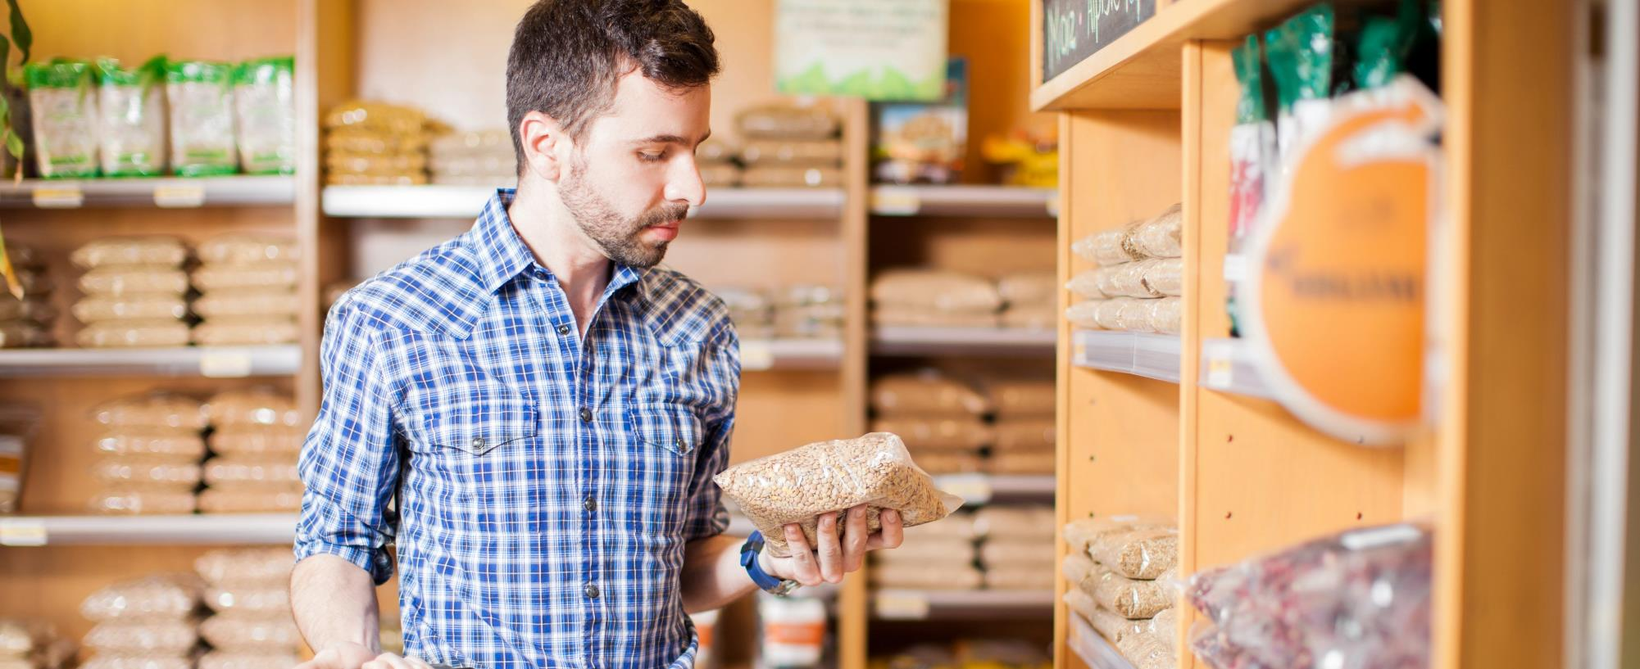
Personalization; what the customers wants from a retailer
Notes:
So, let’s turn our attention to the area where we focused our attention this year. And that is on the topic of personalization.

Slide 19
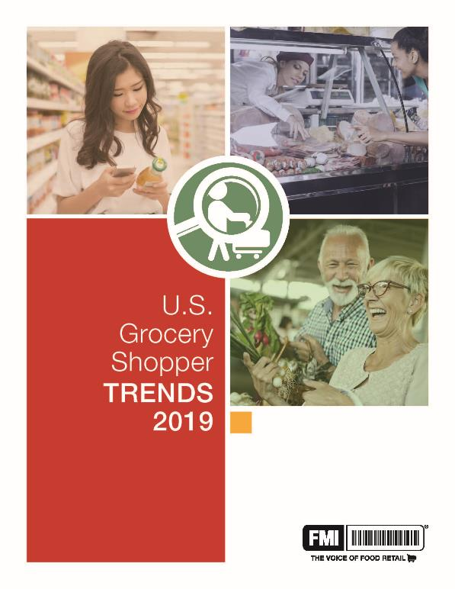
U.S Grocery Shopper Trends
4 Myths about Personalization
Myth 1
Myth 2
Myth 3
Myth 4
Notes:
What we uncovered were some common misconception out there - four myths in particular about personalization that we feel need to be de-bunked.
We will present our findings in the form of 4 myths we encountered about personalization.
Myth – commonly accepted story that is not necessarily objectively true, but may contain elements of truth ( a’la Stephen Colbert, it has a truthiness to it) but is dangerously overdrawn or misperceived.
We will look at these four myths of personalization and seek to set the record straight about what is fact and what is fiction.
Are you up for a bit of quick mythbusting?

Slide 20
Myth 1
Shoppers aren’t asking for differentiated treatment, it may be a plus.
Myth
Fact
Shoppers want Everything Personalized
They expect to control and do some of the work of personalization
themselves, that’s what they think shopping is.
They just want shopping to be easier, with flexibility to meet their
families’ changing needs.
Notes:
The first myth is that shoppers want everything personalized for them. This statement underappreciates the amount of work consumers are willing to do to personalize their shopping trip for themselves and overstates how much control they are wiling to relinguish to the retailer in the name of personal service.
FACT: Differentiated treatment may definitely be a plus, and YES, most assuredly shoppers want help in making their shopping experience more pleasant and efficient, BUT shoppers aren’t asking for everything to be done just for them on a silver platter. Shoppers have a strong degree of self-determination that must be respected in every attempt to personalize service. They want to control the experience and they expect do some of the work of personalization; in fact, that is what they ultimately think shopping is.
They just want grocery shopping to be easier, with flexibility to meet their families’ changing needs. They don’t want you making the choice for them, they want you helping them make their own choice and there is a fine line we must walk in this regard.

Slide 21
Myth 2
Families still want to eat together, and family meals require balancing among personal and shared needs and tastes.
Myth
Fact
Personal eating requirements means shoppers buy for individuals
rather than a family.
Desires for social cohesion and parental goals for cultivating healthy food habits put hard limits on extreme eating personalization.
Notes:
Myth number two is “personal eating requirements mean that shoppers buy for individuals rather than a family.
FACT: Families still want to eat together,
However, family meals and purchasing for snacks means paying attention to the individuals who constitute the family. It is a delicate balance of paying attention to both the needs of the one and the needs of the many. Especially when there is a collision of values at stake..

Slide 22
Myth 3
The stores shopper’s rate most highly excel at the benefits
of personalization:
Myth
Fact
Specialized eating habits are the domain of
specialty retail, mass market cannot compete
Convenience
Specialty stores find it easy to understand and make recommendations, but they do not own these benefits.
Caring
Enabling the shopper to meet their needs.
Notes:
Back to mythbusting.
MYTH #3: Specialized eating habits are the domain of specialty retail. Mass-market food retail cannot compete on meeting personal eating aspirations.
FACT: Retailers positioned around a specialty certainly find it easier to understand, make recommendations and provide guidance to shoppers coming into their stores –. After all, by their mere presence in a specialty store, consumers tip their hand about a particular interest.
But we must remember, the stores that shoppers’ rate most highly get those marks through excelling at the benefits of personalization -- convenience, caring and enabling the shopper to meet their needs.
Specialty stores do not own these benefits.
So rather than specializing, we urge our members to personalize; educate yourself about what’s driving consumers to the specialty store and enable them to meet that need in the convenience of your store

Slide 23
Myth 4
Digital should amplify rather than replace non-digital efforts.
Myth
Digital platforms are more easily customizable, so they should be the
focus of personalization initiatives
Sharing personal data and supporting personal eating requires permission and a foundation of existing trust.
Fact
Notes:
MYTH #4; Digital experiences are more easily customized, and therefore digital platforms are the best place for a retailer to start personalization initiatives.
FACT: FMI has been saying for years that online and bricks and mortar are not an either-or proposition, but one that is both/and.
Nowhere does that truth hold firmer than in the area of personalization.
We know technology is embedded in the consumer shopping experience across all channels. We also know the consumer expectation is that tech-engagement must embrace more than sales and delivery. Shoppers crave interaction before a transaction and a great mobile experience provides an opportunity to stand out. In the case of providing support to shopping and if little- or low-stakes data is to be shared, a digital-first approach may be appropriate. However, anything beyond that kind of introductory information-sharing requires a foundation of existing trust.
On-line and Off-line must work together hand-in-hand and when it comes to food – that most highly personal of products - digital should amplify rather than seek to replace non-digital efforts.

Slide 24
24

