Slide 1

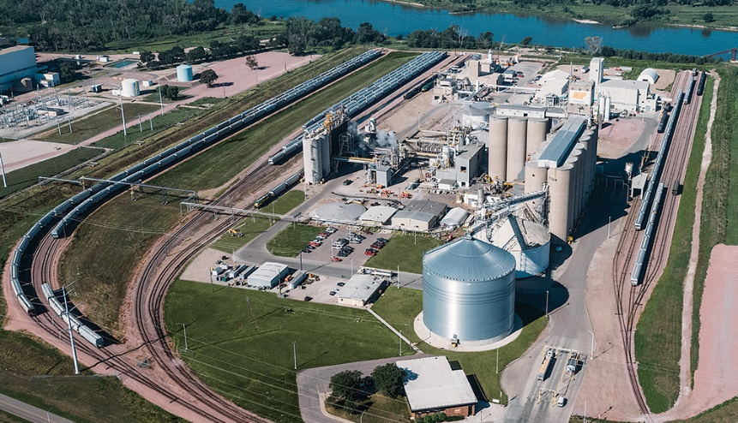
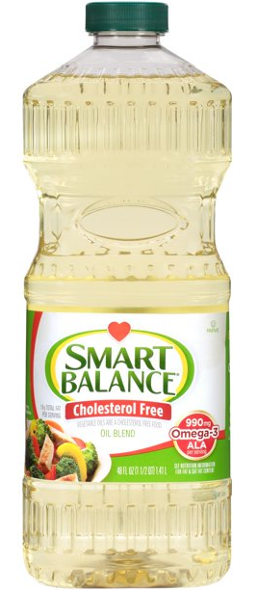
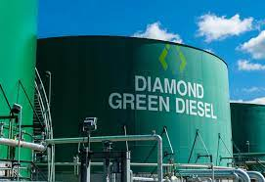
The Outlook for Renewable Diesel
Presented to the USDA Ag Outlook Forum
Bill Lapp, President of
Advanced Economic Solutions
February 2022
Notes:
Open AND Display: Livestock Update Data Master, PDM, Eggs Set & Chicks Placed
1

Slide 2
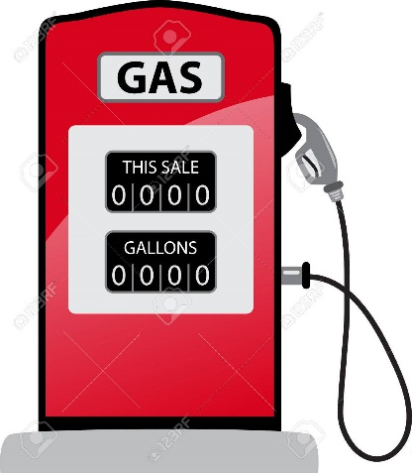

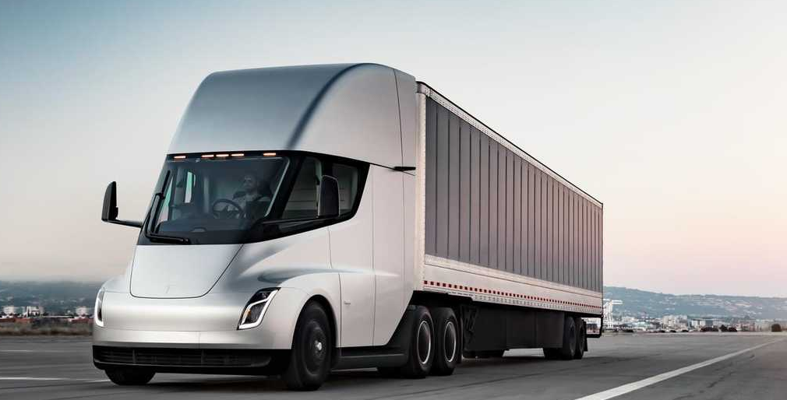
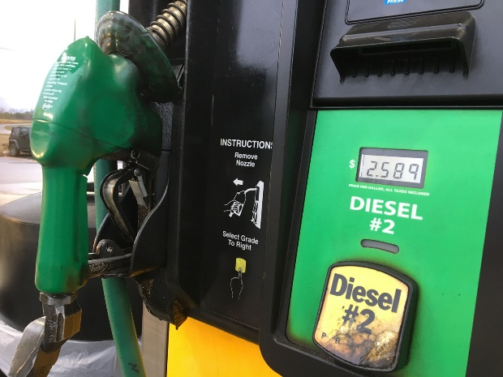
Gasoline vs. Diesel Fuel
Gasoline
140 B gallon US market, declining
Almost all US gasoline contains 10% ethanol
“Blend wall” – most gasoline sold is no more than 10% ethanol, per EPA statute
2020 Biofuel Usage:
  Ethanol 12.9 B gallons
  Cellulosic ethanol 0.3 B gallons
Diesel Fuel
60 B gallon US market, growing
Most US diesel fuel contains either biodiesel or renewable diesel
No limit to inclusion of biodiesel or renewable diesel
2020 Biofuel Usage:
  Biodiesel 2.0 B gallons
  Renewable 900 mm gallons

Slide 3
Renewable Diesel is not Biodiesel
Renewable diesel is produced through heat and pressure
  Biodiesel (methyl ester) is produced through a chemical process
Renewable diesel can be directly mixed with diesel fuel
  There is chemically no difference between the renewable diesel and diesel fuel
  Biodiesel is a blendstock, requiring the use of a blending station to be mixed at specific percentages with diesel fuel
Both renewable diesel and biodiesel qualify as fuels that can be used to meet the federal Renewable Fuel Standard (RFS)
  Renewable diesel earns 1.7 ethanol-equivalent RINs per gallon
  Biodiesel earns 1.5 ethanol-equivalent RINs per gallon

Slide 4

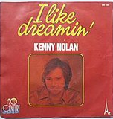
Renewable Diesel (RD) Growth Path:
- From 1 B Gallons to 4 B Gallons in 3 Years
2021
2024
1 B Gallons
4 B Gallons
Theme for This Adventure:
OR

Slide 5
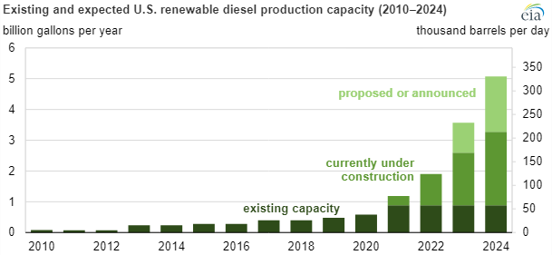
Surging US RD Production Capacity
Source: Energy Information Agency
2024:
3-5 B gallons
2021:
1 B gallons
Notes:
https://www.iea.org/reports/renewables-2021/biofuels?mode=transport&region=United+States&publication=2021&flow=Production&product=Renewable+Diesel

Slide 6
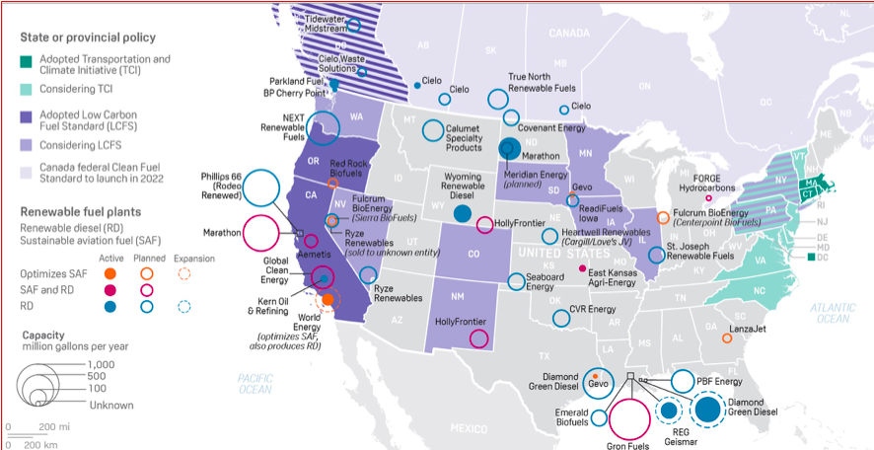
Gold Rush: Current/Proposed RD Plants
Source: S&P Global, Platts Analytics, EIA

Slide 7

Renewable Diesel (RD) Growth Path:
- Why Are “We” Doing This?
2021
2024
1 B Gallons
4 B Gallons
Drivers of Large-Scale Investment:
Californication (LCFS)
Oil Companies ESG Efforts
Federal incentives (RFS)
“Better” Mouse Trap for Biofuels
  Aided by large tax credits
WE FREAKIN’ .

Slide 8
Renewable Diesel Producer Economics
- Using RBD soyoil as feedstock
Example:
  RBD Soyoil @ $0.79 $6.33
  Operating Costs $0.50
    TOTAL $6.83
Tax Credits:
  Blender credit $1.00
  LCFS credit $0.79
  RINS generated $2.43
    Total $4.22
Net Production Cost: $2.61
RD Price $2.80
Net Margin +$0.19
Source: The Jacobsen, AES estimates

Slide 9
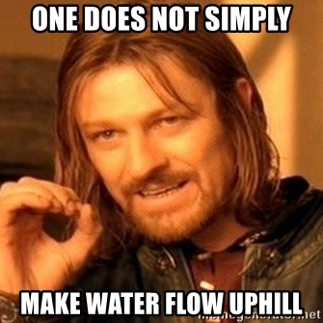
RD Growth Path:
- What are the challenges?
2021
2024
1 B Gallons
4 B Gallons
Laundry List of Challenges
Who will buy this much RD
Is there enough feedstock to produce 4 B gallons?
Enough soybeans to crush?
What role for canola?
What role for “non-food” oilseeds?
Where does the soymeal go?
How much inflation of food prices will be acceptable?

Slide 10
Renewable Diesel (RD) Growth Path:
- Feedstock Issues
2021
2024
1 B Gallons
4 B Gallons
8 B Lbs Feedstock
+24 B Lbs
32 B Lbs Feedstock
Estimated Fats & Oils Usage
(Source: AES, USDA)
Food 28.5 B lbs
Export 3.1 B lbs
Biofuel 23.0 B lbs
Feed use 4.5 B lbs
Required by 2024: +24 B lbs
- How do we get there?

Slide 11
Renewable Diesel (RD) Growth Path:
- How To Find 24 B Lbs of Lipids in 36 Months
2021
2024
1 B Gallons
4 B Gallons
8 B Lbs Feedstock
+24 B Lbs
32 B Lbs Feedstock
Possible Solutions
Dramatic increase in US soybean crush (400 mm bus?)
  Equal to 4.5 B pounds of soyoil
  Investment plans already underway
  Creates huge soymeal challenge
  Either need more soybean acres or a reduction in soybean exports
Dramatic increase in Canadian canola crush (5 MMT?)
  Equal to 4.6 B pounds of canola oil
  Internally used?
  Mostly for food use?
  Either need more canola acres or a reduction in canola exports

Slide 12
Renewable Diesel (RD) Growth Path:
- How To Find 24 B Lbs of Lipids in 36 Months
2021
2024
1 B Gallons
4 B Gallons
8 B Lbs Feedstock
+24 B Lbs
32 B Lbs Feedstock
Possible Solutions (cont.)
Production of non-food oilseeds
  Examples: crambe, camelina, jojoba and jatropha
  Higher oil content than soybeans (similar to canola)
  Very few producers currently
Reduced feed use of fats and distiller corn oil
Increased used cooking oil supply
Imported feedstock (need Census data!)
Reduced vegoil exports
Reduced biodiesel production
Reduced food use of vegoils? - Unlikely
- Or Simply Fall Short of 4 B Gallons?

Slide 13
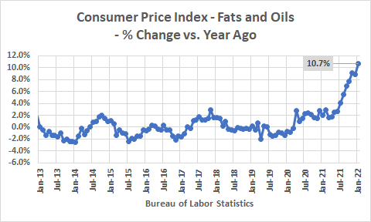
RD Creating Food Inflation
- Consumer vegoil prices rising by over 10%
2021 CPI for Fats and Oils: +10.7% vs. YA
  Wholesale prices (PPI): +36.4%
Soyoil futures over $.70/lb.
  Versus $.25-.35/lb. two years ago
  Approaching all-time high ($.72)
Refined soyoil premiums are record wide
  Over $.10/lb
Availability is a concern among food industry participants
State and federal policies promoting biofuel production have been the primary driver of higher vegoil prices
EPA’s decision on renewable volume obligations for 2022 will be key to how much higher prices could go

Slide 14

RD Growth Path:
- Unintended Consequences Abound
Adverse impact upon other biofuels
  Biodiesel gets squeezed out by RD
Protein meal swamp the markets
  Oil share forced higher, but where does the meal go?
  DDG values reduced
Soybeans play a more limited role in supplying RD producers with feedstock
  LCFS rules (tax credits) favor feedstock other than soyoil

Slide 15
Soyoil Usage Adjusting to RD Growth
- RD Crowding Out Biodiesel & Exports

Slide 16
The Outlook for Renewable Diesel
Presented to the USDA Ag Outlook Forum
Bill Lapp, President of
Advanced Economic Solutions
February 2022
Notes:
Open AND Display: Livestock Update Data Master, PDM, Eggs Set & Chicks Placed
16

