Slide 1
Supply Chain Disruptions:
Impact & Outlook for U.S. Dairy Exports
USDA Agricultural Outlook Forum

Slide 2
Setting the Stage: Ocean Freight is Crucial to U.S. Dairy Exports
Source: USDEC, USDA

Slide 3
Exports Crucial to U.S. Dairy & Milk Checks
Source: USDEC, USDA

Slide 4
Carriers Preferring Empties over Goods
Source: USDEC, Ports of Los Angeles, Long Beach, Oakland

Slide 5
Productivity at Port Falling
Source: USDEC, Ports of Los Angeles, Long Beach, Oakland

Slide 6
Ultimately Meaning Fewer Loaded Export Containers
Source: USDEC, Ports of Los Angeles, Long Beach, Oakland

Slide 7
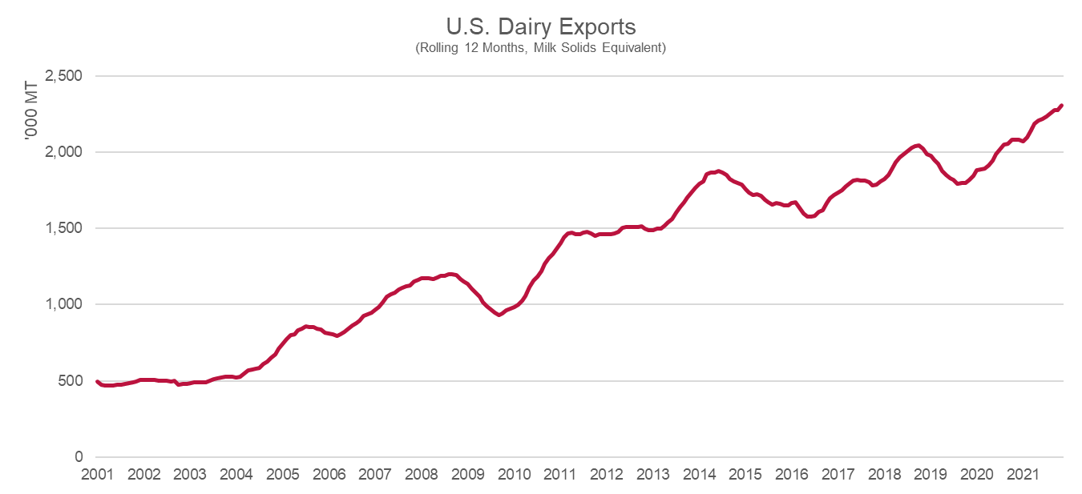
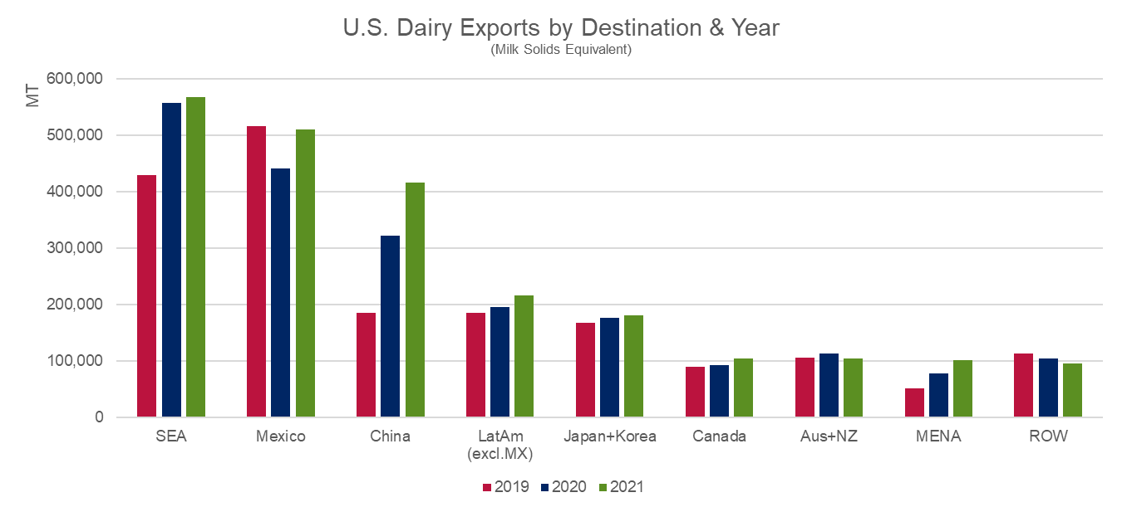
Despite Port Delays, Record Year for U.S. Exports
Category | 2021 (MT) | 20-'21 % Change | 20-'21 Vol Change (MT)
Total Export Value | $7.75 Billion | ▲18% | ▲$1.2 Billion
Total Milk Solids | 2,299,481 | ▲10% | ▲214,698
SMP/NFDM | 892,528 | ▲10% | ▲82,355
Dry Whey Products | 613,943 | ▲10% | ▲57,509
Whey (0404.10) | 549,849 | ▲10% | ▲51,363
WPC80+ | 64,094 | ▲11% | ▲6,146
Cheese | 404,675 | ▲14% | ▲49,267
Lactose | 393,035 | ▲4% | ▲15,988
Butterfat | 57,487 | ▲121% | ▲15,988
WMP | 39,645 | ▲3% | ▲1,110
Source: USDEC, Trade Data Monitor

Slide 8
So, What Was the Cost to U.S. Dairy Exports? Over $1.5 Billion!
Higher Costs
Lost Opportunity
Reduced Value
Source: USDEC

Slide 9
Asia Markets Are Essential to U.S. Dairy
Source: USDEC, Trade Data Monitor

Slide 10
And Highly Competitive
Source: USDEC, Trade Data Monitor

Slide 11
What Can We Do About Disruption?
USDEC has advocated to…
Pass the Ocean Shipping Reform Act
Leverage administrative authority for creative solutions (e.g. USDA-Port of Oakland Partnership)
Incentivize loaded containers over empties
Increase truck weight limits
Invest in infrastructure & equipment at port
Find and train more truck drivers
And more…

Slide 12
2022 Export Outlook

Slide 13
Is There Enough Milk to Meet Demand?
Source: USDEC, Understanding Data & Markets

Slide 14
China vs. Rest of the World
Source: USDEC, Trade Data Monitor

Slide 15
Can Int’l Consumers Afford Record High Prices?
Source: USDEC, Trade Data Monitor

Slide 16
Key Factors to Watch in 2022
Supply: Milk Production (U.S. & Abroad)
Demand: China, Price Sensitivity
Wildcards: Supply Chain Congestion

Slide 17
Thank You
William Loux
Sr. Director, Global Trade Analysis
wloux@usdec.org

