Slide 1
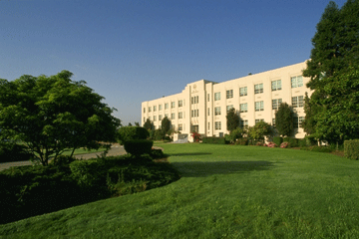
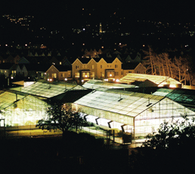
New Opportunities in the Bioeconomy that Target Zero Waste Agriculture
William Orts
USDA-Agricultural Research Service
Western Regional Research Center
Albany, CA

Slide 2

Our USDA Research Mission:
Add value to agricultural products to help the rural economy
Agricultural Research Service
USDA’s chief scientific research agency
1,800 PhD-level scientists
100+ research locations

Slide 3

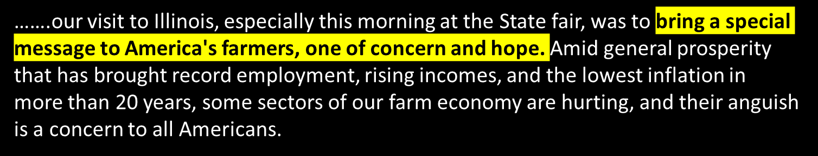
"The nine most terrifying words in the English language are: I'm from the Government, and I'm here to help. “ -- Ronald Reagan, 1986

Slide 4
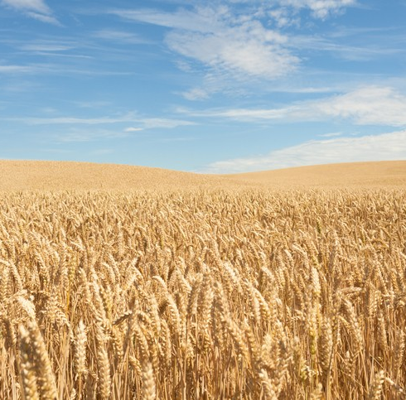
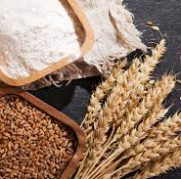
Wheat:
We only use the seed for flour…..
Which represents less than 25% of the crop.
What do we do with the rest?

Slide 5
Zero Waste Agriculture - Drivers
Adding value to agricultural products.
  Improve the rural economy.
Biodegradability. Compostability.
  Reduce litter. Reduce ocean plastics/microplastics.
Regulatory.
  Prevent negative health & environmental impacts.
  The USDA’s BioPreferred Program.
Recycling and Landfill Diversion.
  Closing the circular economy. Capturing methane releases.
Greenhouse gas reduction.
  To create the best product!
Notes:
Summary:
Corn-to-ethanol is a great start, but supply pressures are in the foreseeable future.
Corn is used in
Food – high fructose corn syrup in our food/ beverage/ candy industry ⬄ whole kernal corn in our diets (relatively small % of total corn)
Feed – of major importance in cattle industry, and
Commercial feedstock – used in the paper industry; fermented sugars used in chemical processing; i.e.citric, acetic, lactic acid via fermentation

Slide 6
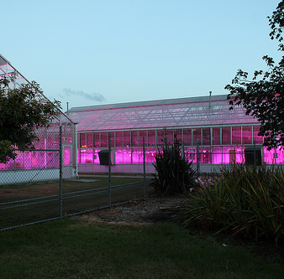
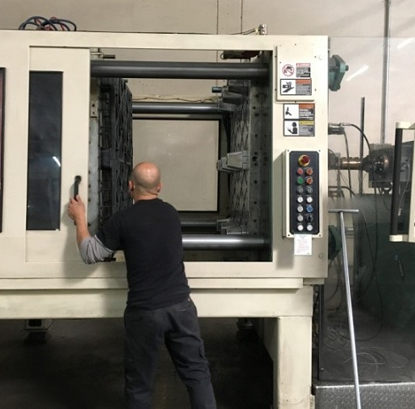


Summary
Biobased & bioinspired materials are profitable options
Zero Waste Agriculture is achievable.

Slide 7
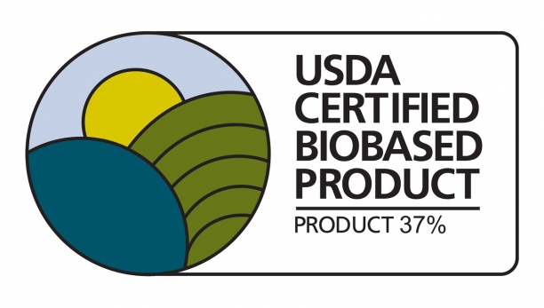
The BioPreferred Program
http://www.biopreferred.gov/
The BioPreferred program gives venders a significant advantage in filling federal contractors. This can be HUGE when filling military contracts, etc.
Biobased content is readily measured (ASTM D6866; ratio of C-14 to C-12)

Slide 8

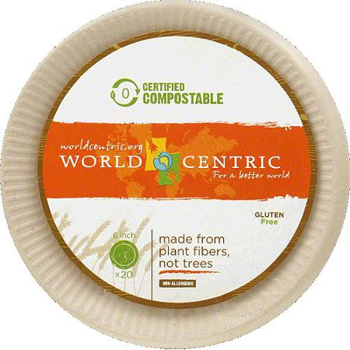
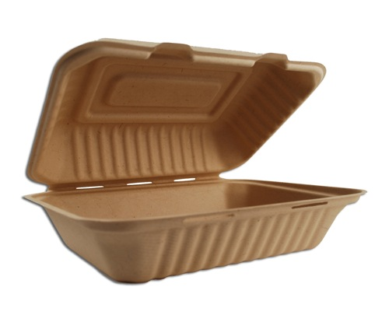
Partnerships: Single use items from straw

Slide 9
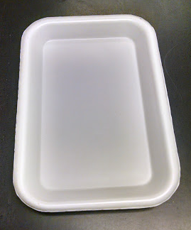
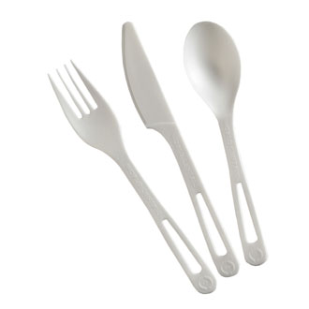

Single use items from corn
Notes:
Partners situated in our pilot plant – we are a big part of their “research arm”

Slide 10
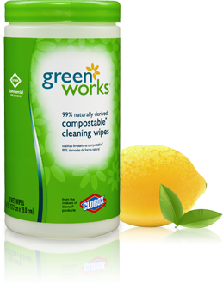

Slide 11


Slide 12




Slide 13

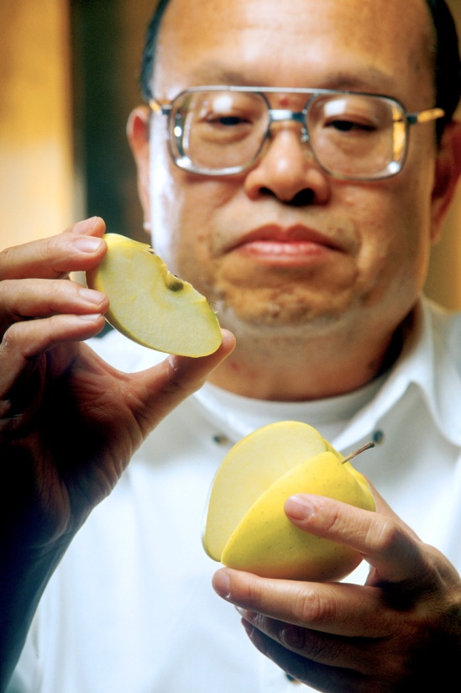
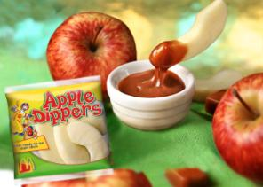
McDonald’s sells 65 million lbs/yr of apples in the U.S.
USDA continues to collect royalties

Slide 14
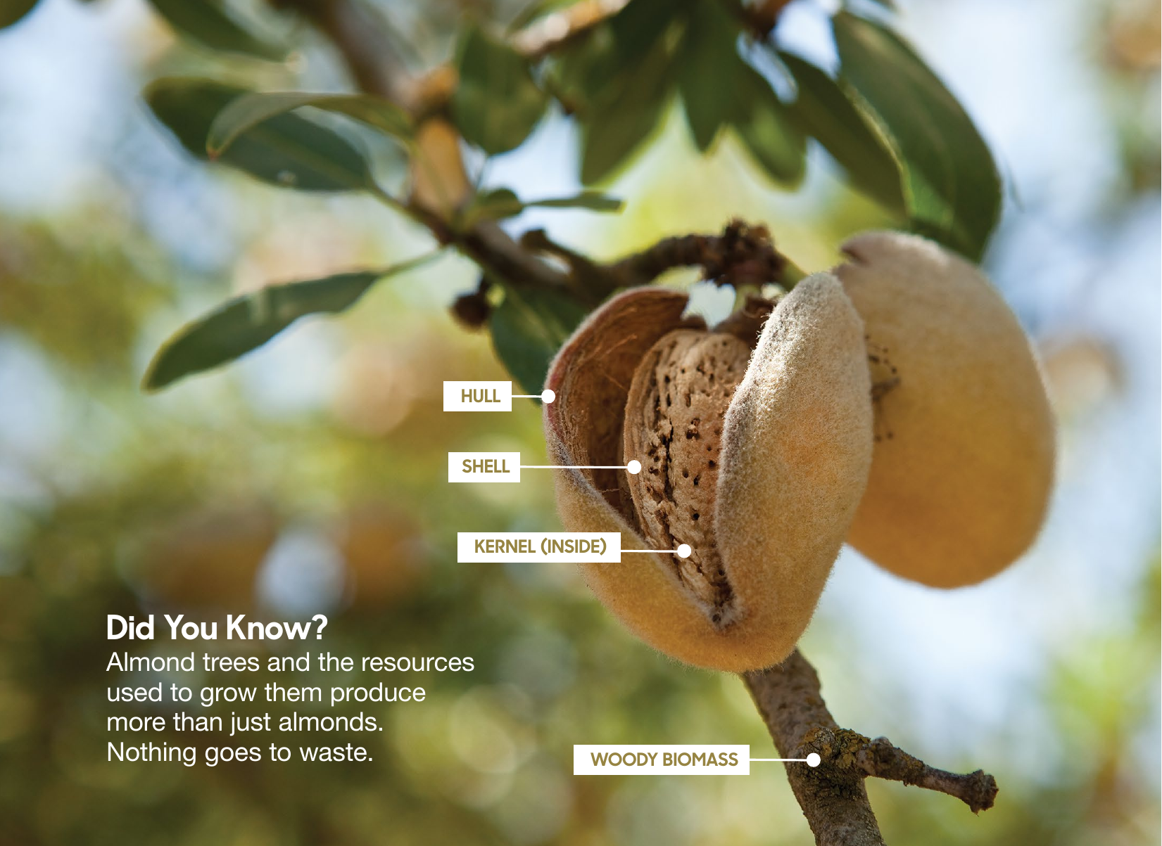
Almond Trees Produce
Three Co-products
Notes:
Discuss current uses

Slide 15
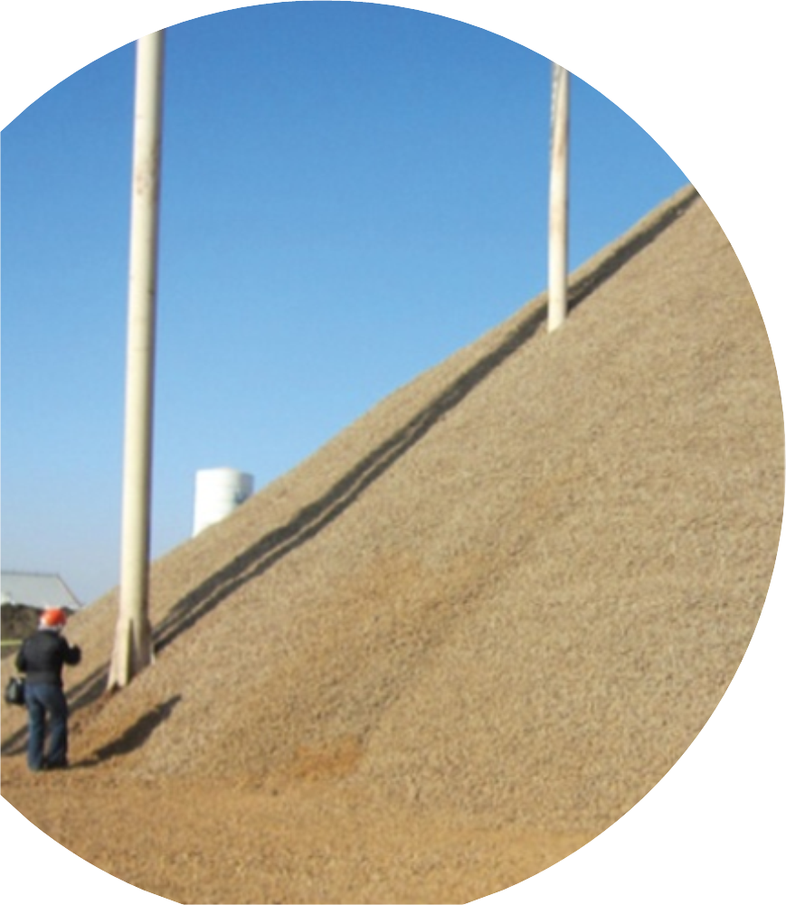
Strategic Driver: Agricultural Coproducts & Residues
California produces 82% of the world’s almonds, resulting in nearly 0.95 million tonnes of shells annually and 1.1 million tonnes of hulls.
    New markets for almond shells and other agricultural byproducts are needed.
US Tree Nut Biomass Production
Pecan Shells
Hazelnut Shells
Walnut Shells
Almond Shells & Hulls
Pistachio Shells & Hulls
Million Pounds

Slide 16
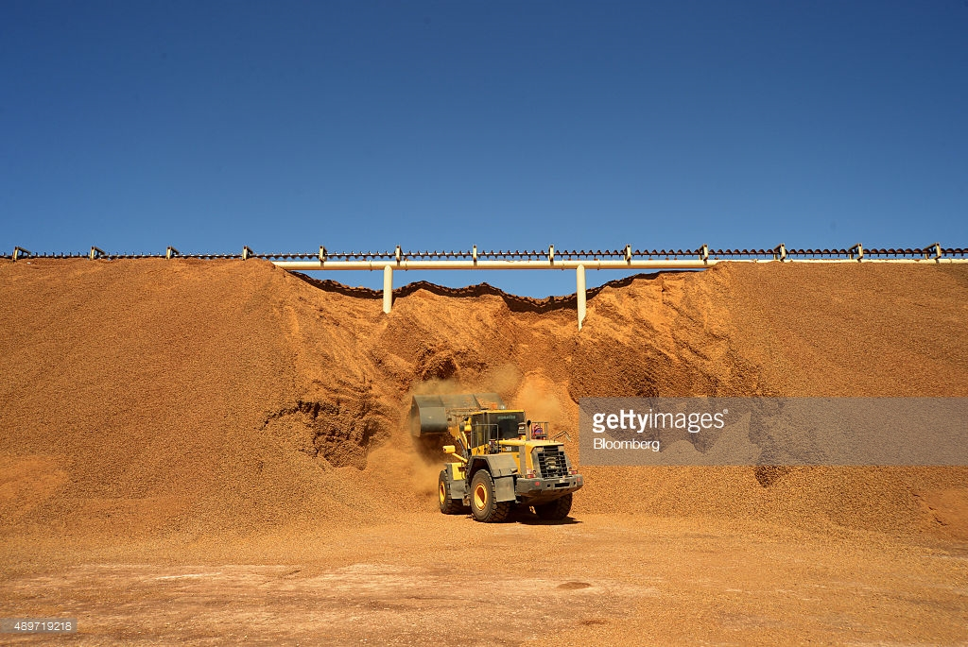

California’s cows happily eat almond co-products
But lately, due to drought, change in markets, land costs, etc.
There are fewer cows and lots more almonds.…

Slide 17

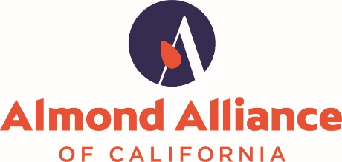
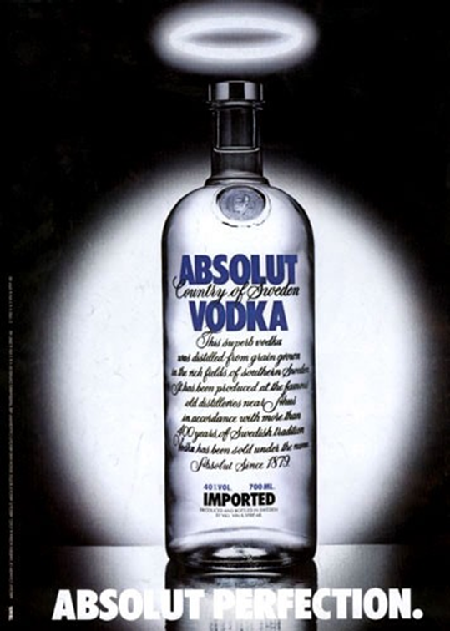
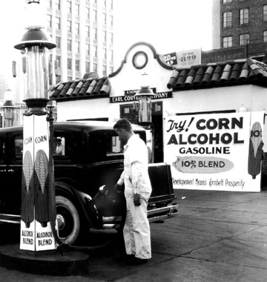
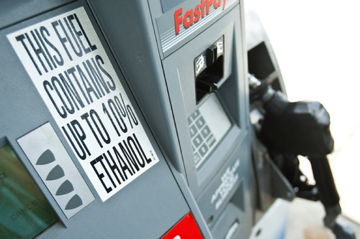
Can we make fuel ethanol from almond hull sugars?

Slide 18
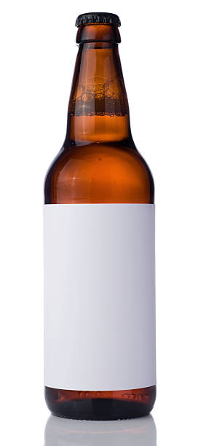


Slide 19
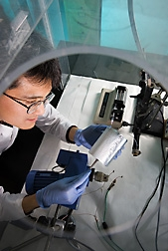
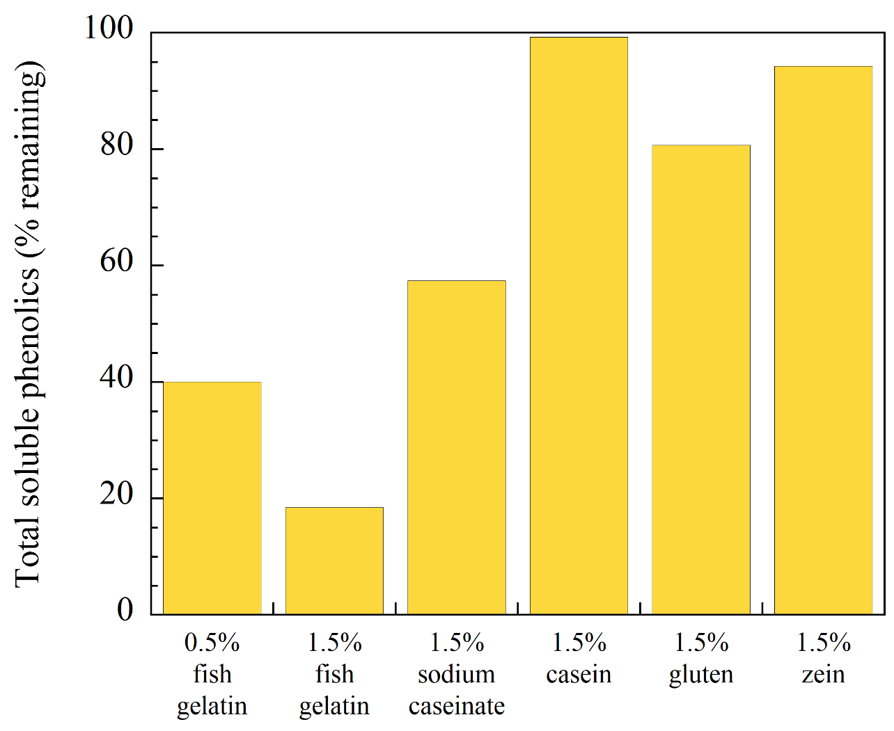
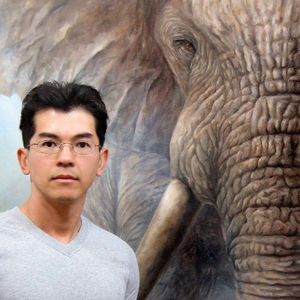
Hull Sugars: Removal of bitter phenolics using proteins
Bor-Sen Chiou
Trung Cao
− Mix in shaker for 1 hour and then filter

Slide 20
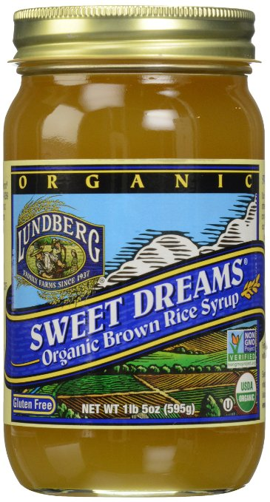
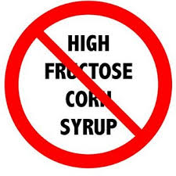
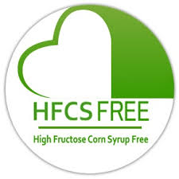
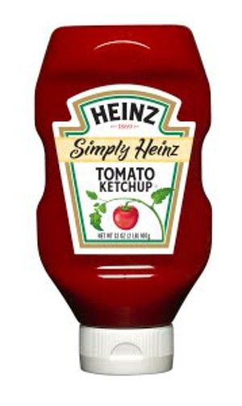
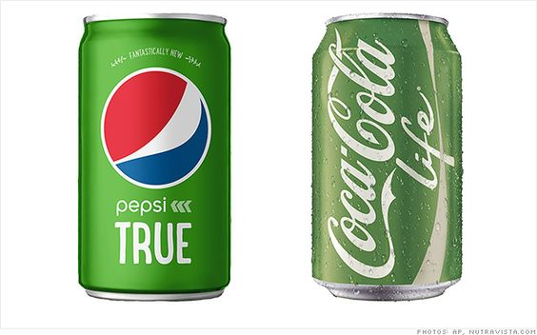
The market is calling for natural sugars

Slide 21
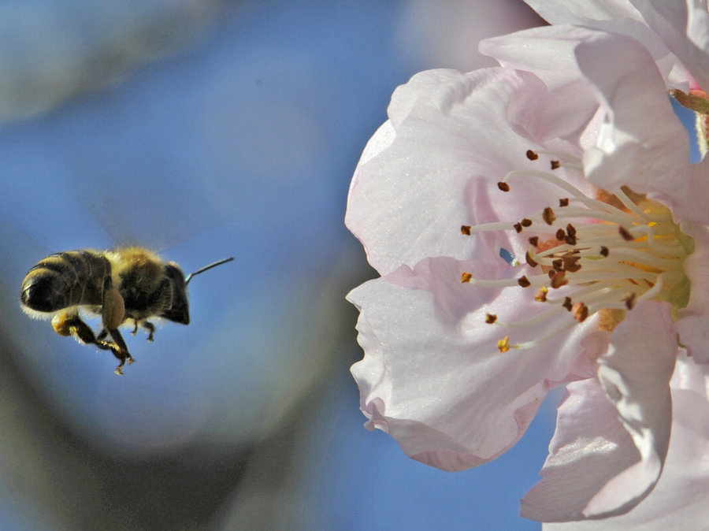
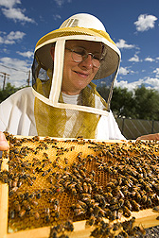
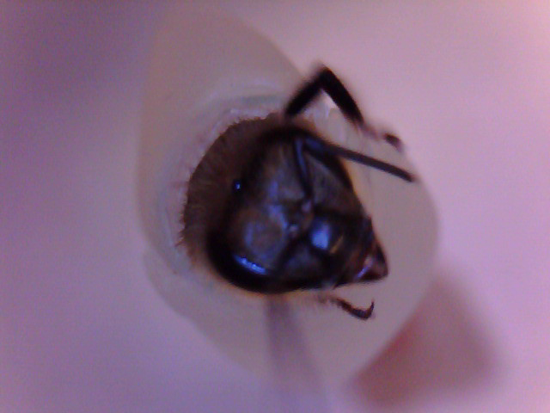
Hull sugars in bee diets
Gloria DeGrandi-
Hoffman

Slide 22
What to do with almond shells?

Slide 23
Torrefaction: Making charcoal
Biomass
200°C
300°C
400°C
900°C
1000°C
Gasification
Pyrolysis
Torrefaction
Densifies the biomass
Removes moisture and volatiles

Slide 24
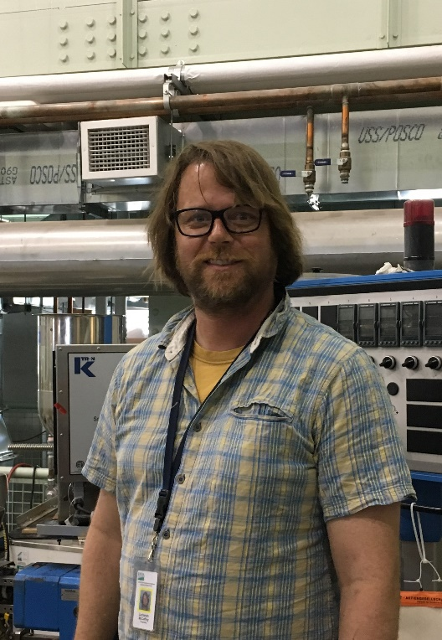
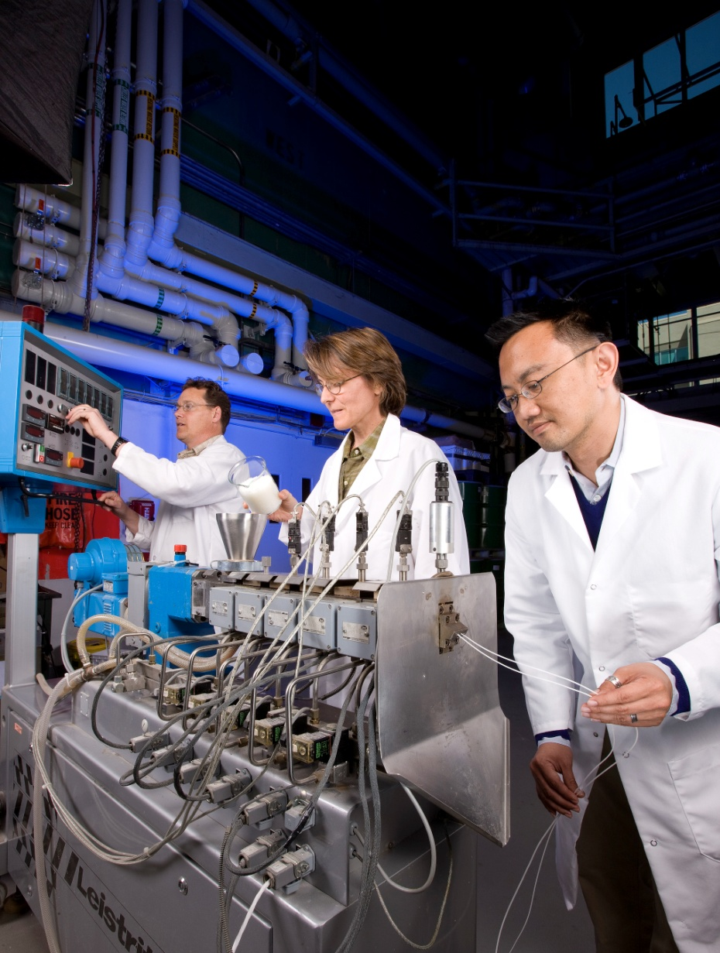
TORREFIED SHELLS: ADDING VALUE
THE EFFECTS OF TORREFIED FILLERS ON THERMAL AND MECHANICAL PROPERTIES OF PLASTICS
Bor-Sen Chiou
Zach McCaffrey
Allison Flynn
Lennard Torres

Slide 25
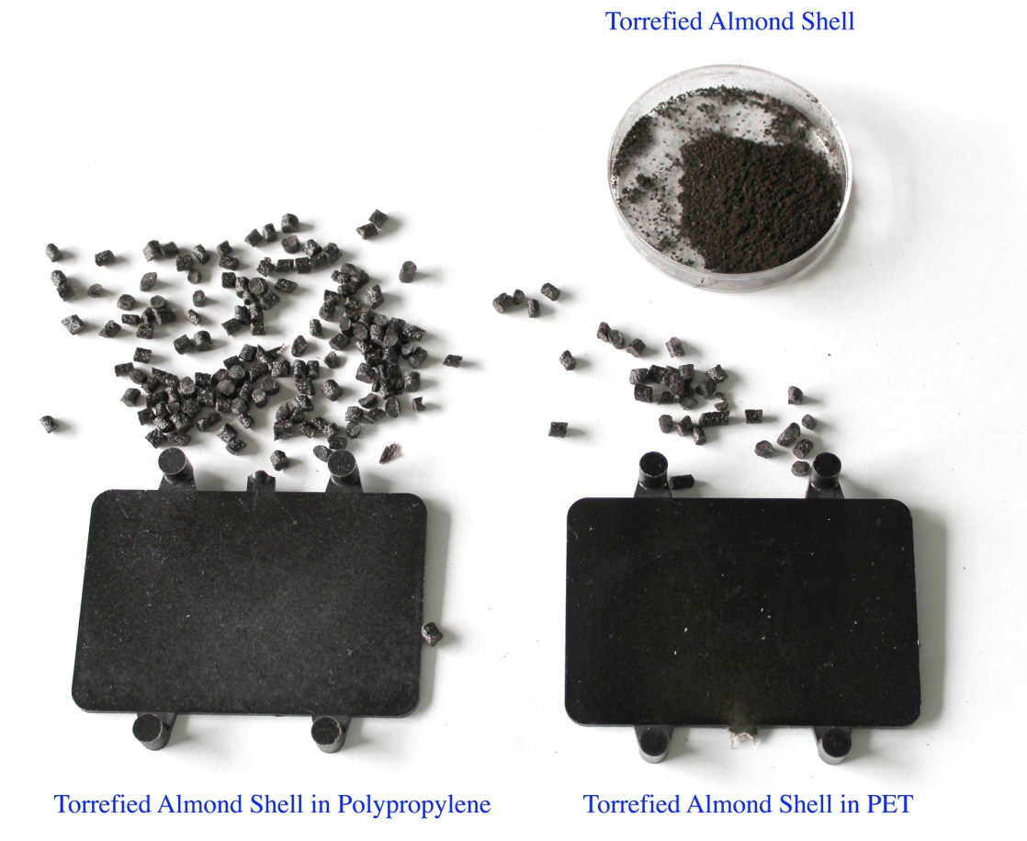
Torrefied Almond Shell Composites
− Alternative to wood-polymer composites

Slide 26
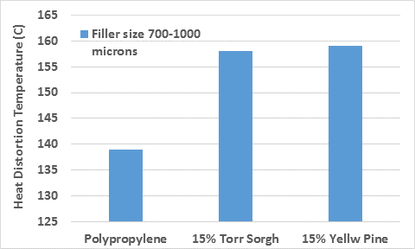
Heat Deflection Temperature
Temperature at which material deforms under specific load
The softening point of plastics is improved by adding shells
Polypropylene 15% Almond Shells 15% Pine

Slide 27
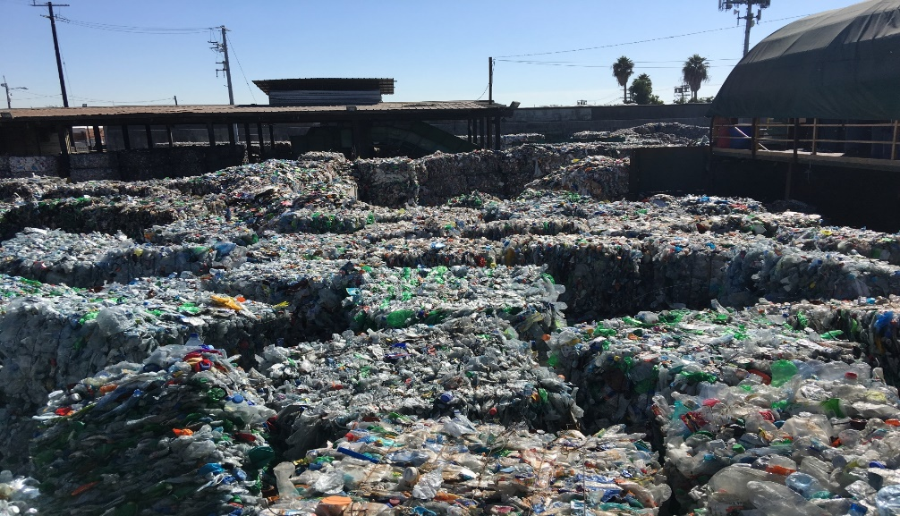
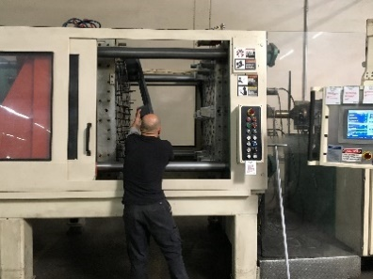


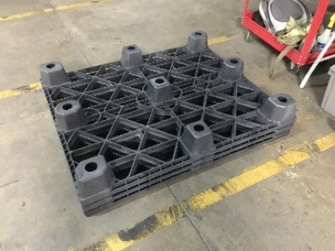



Torrefied Biomass in Plastics

Slide 28
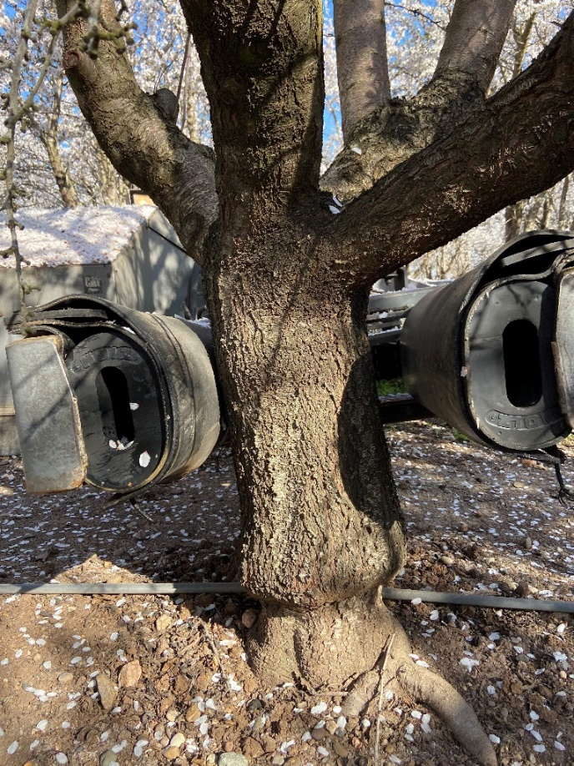
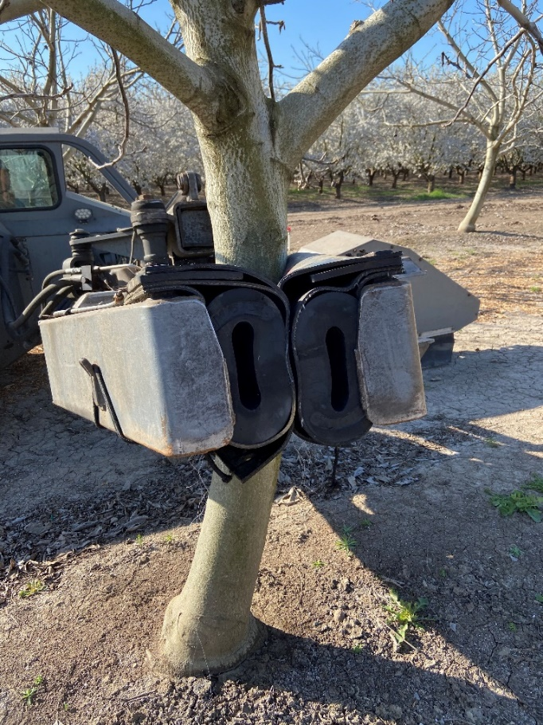
Torrefied Biomass in Rubber Compounds
Prototype shaker heads produced in 2020-2021
Connor Wagner (Almond Board) with Delilah Wood, Zach McCaffery, Lennard Torres and Colleen McMahan
Torres, L. F., McCaffery, Z. Washington, W., Williams, T. G., Wood D. F., Orts, W. J. McMahan, C. M. Torrefied agro‐industrial residue as filler in natural rubber compounds. (2021) Journal of Applied Polymer Science 138 (28), 50684

Slide 29
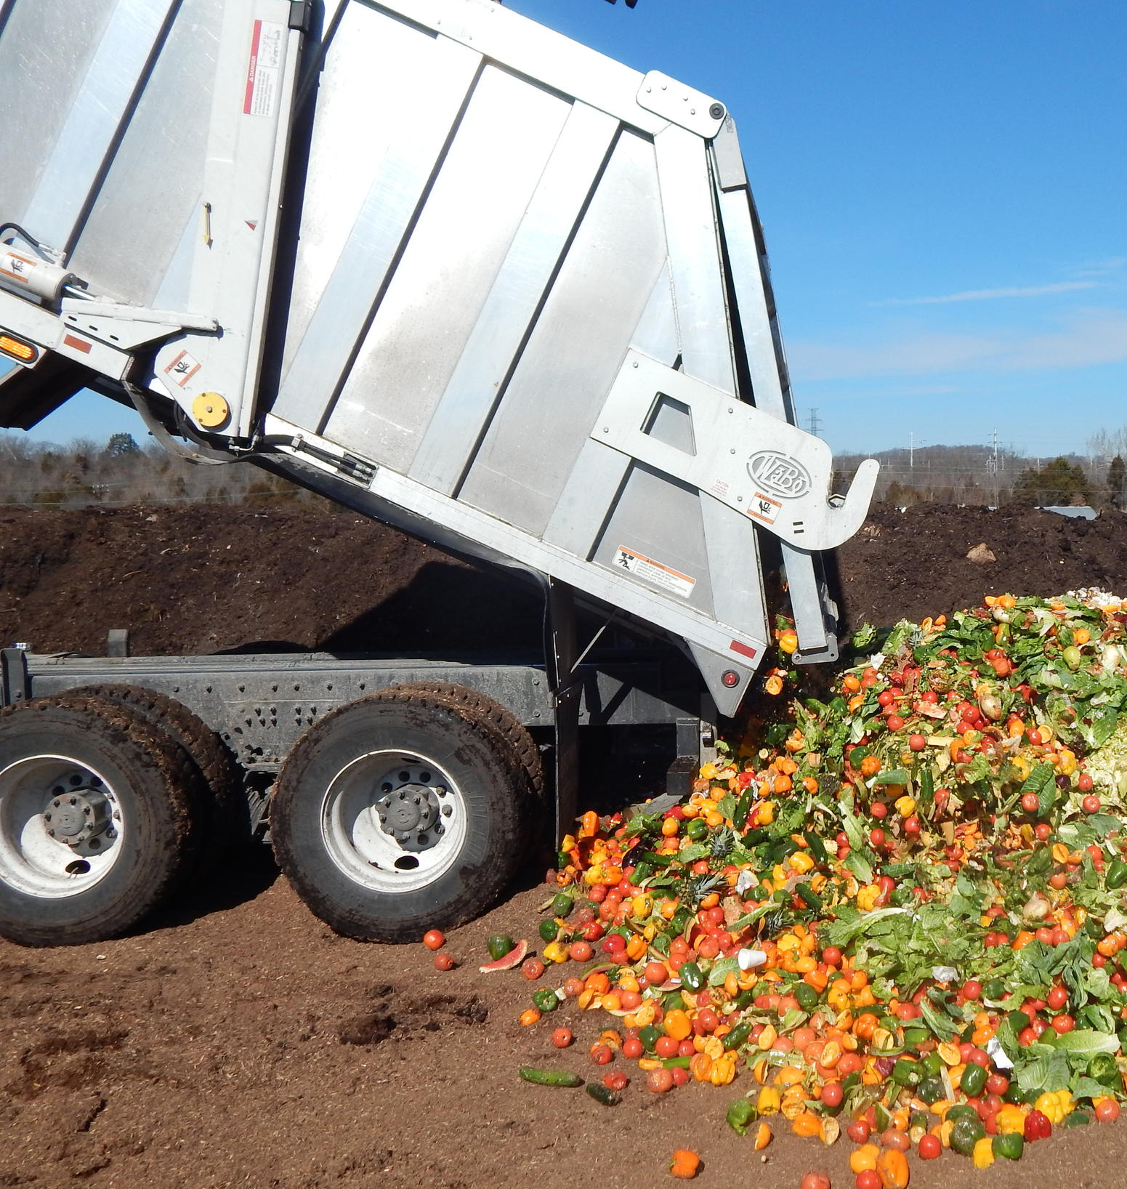
New infrastructure for food waste
& ag-residues

Slide 30
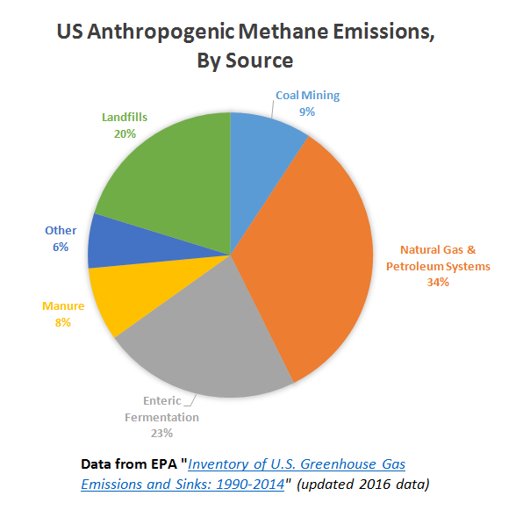
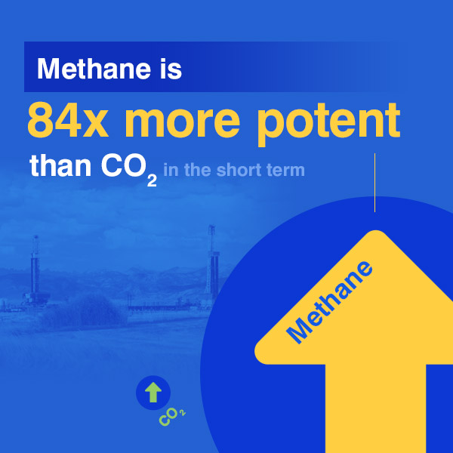

Methane: Potent greenhouse gas!!
https://www.edf.org/climate/methanemaps/leaks-problem

Slide 31
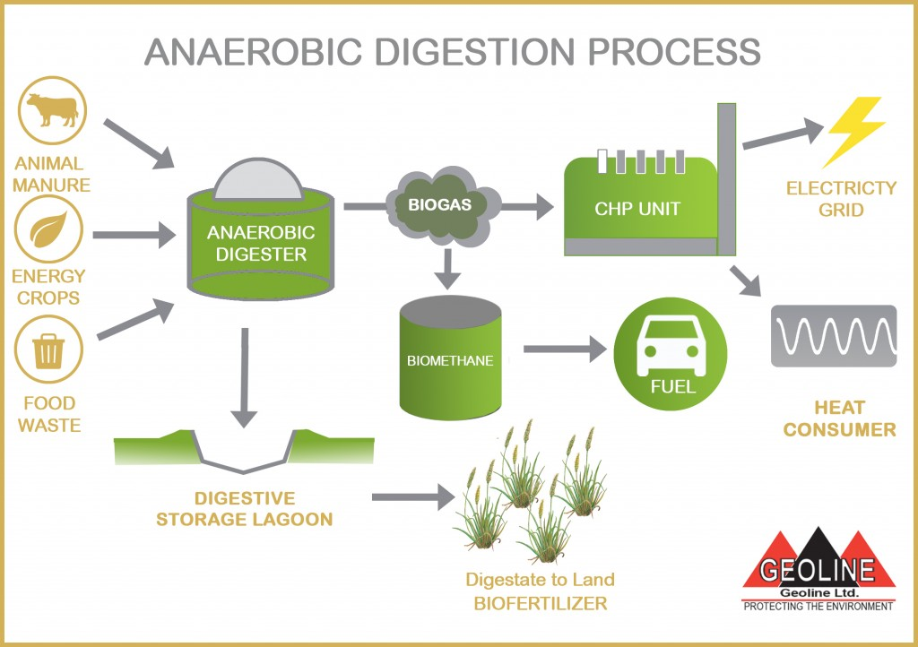
Digestion:

Slide 32
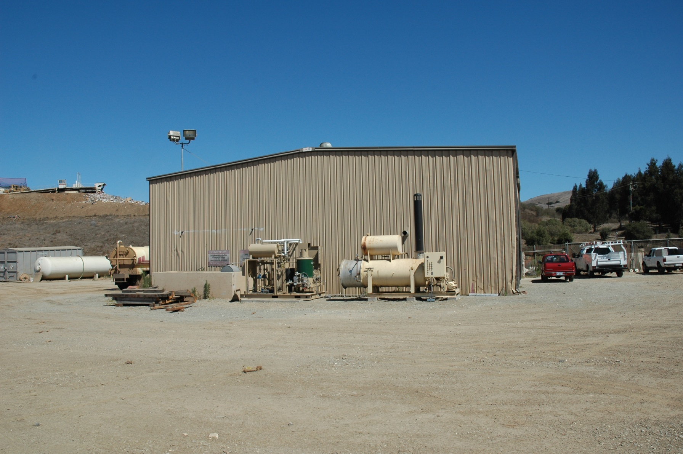

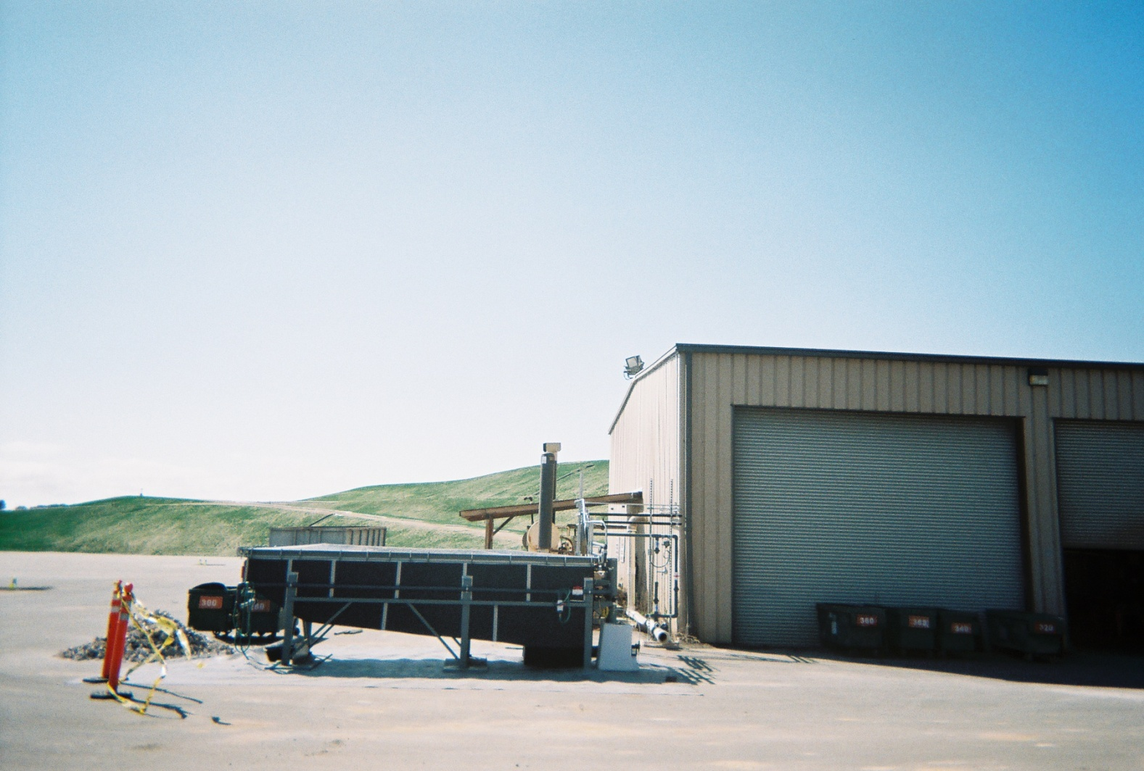
Salinas Crazy Horse Landfill – Bioenergy Park
Notes:
Pilot scale MSW steam treatment facility formerly in Reno for testing over the past 6 years; now installed in Salinas California
LEFT – building RIGHT
Trommel screens
Work done in collaboration with CR³, an innovative company in the field of MSW treatment

Slide 33
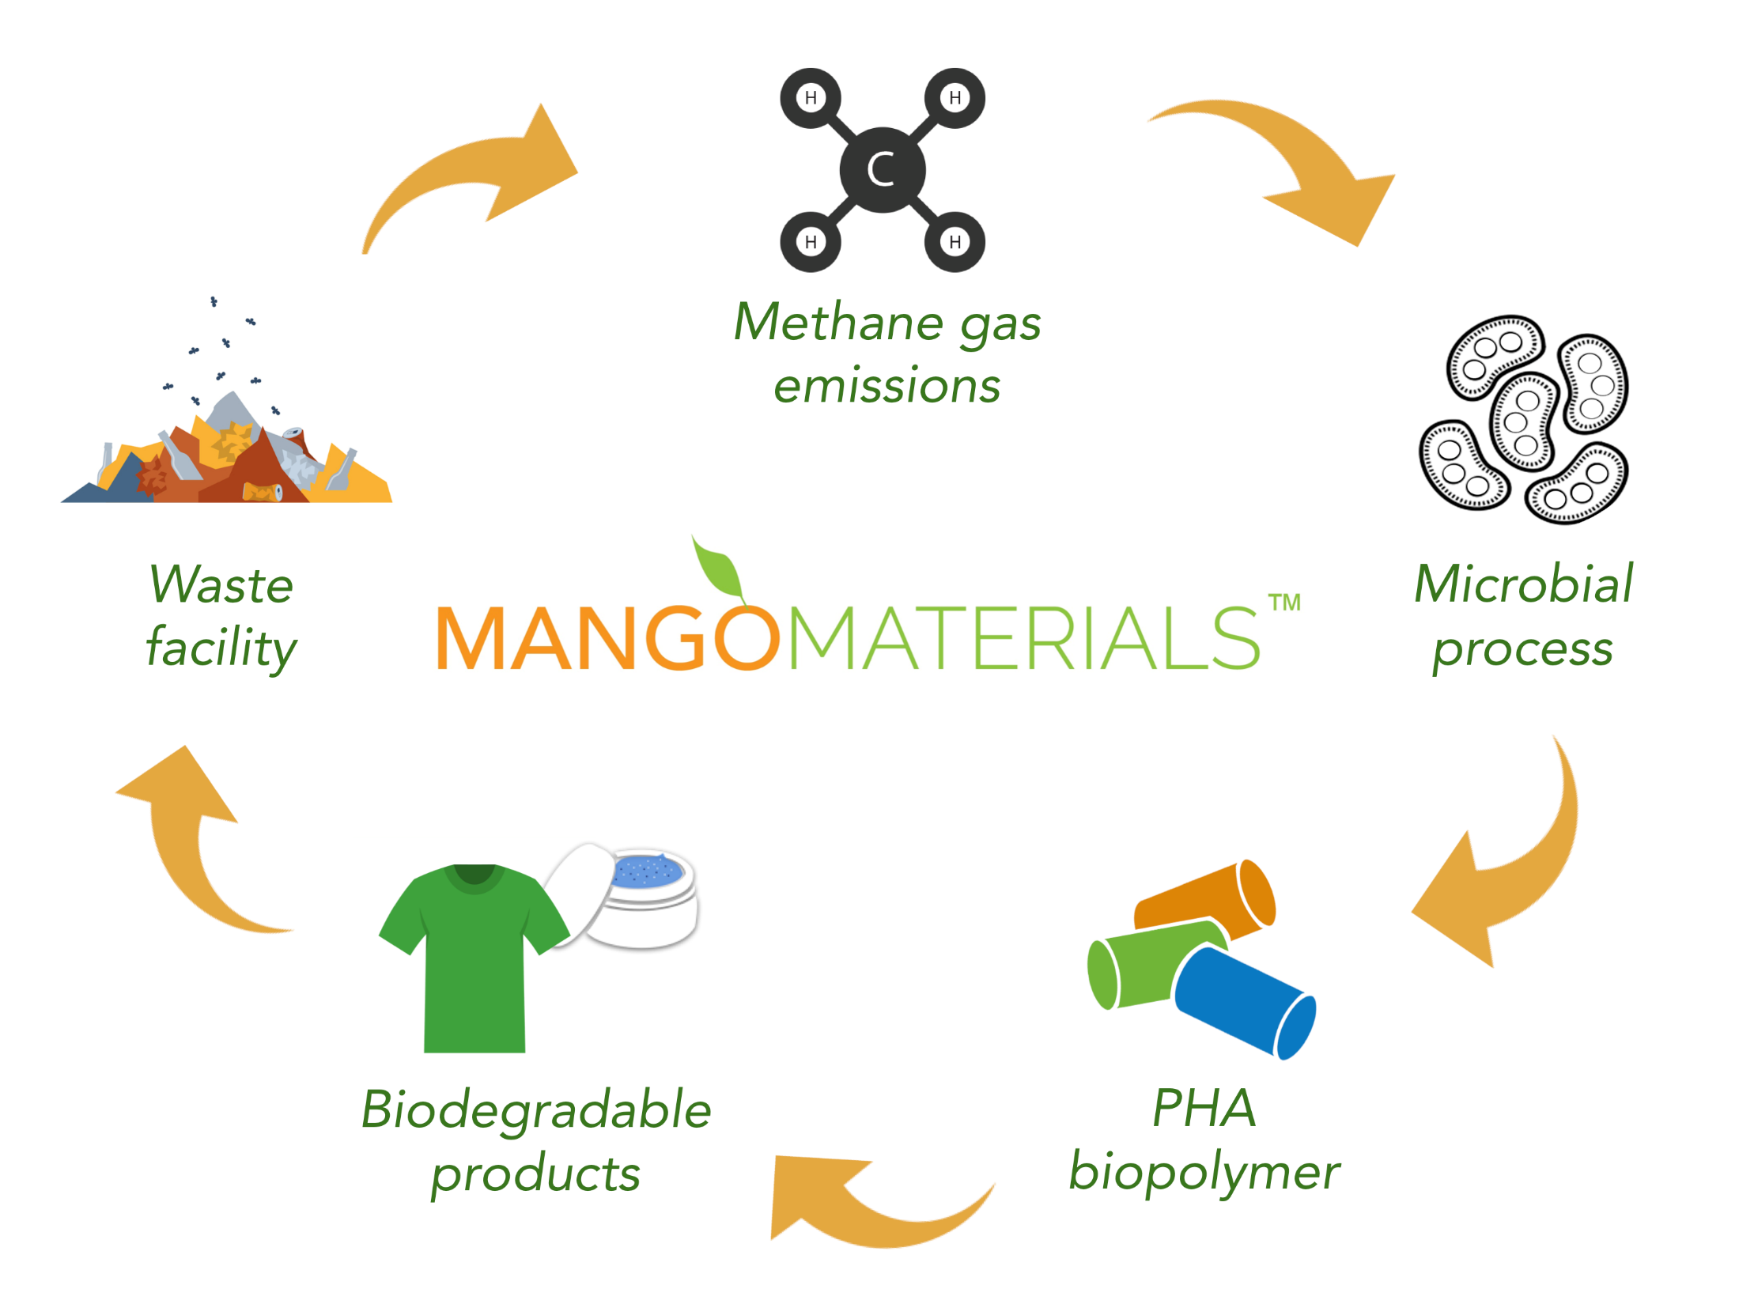

Slide 34



  PHA Biorefineries:
  PolyHydroxyAlkanoates
  properties similar to polypropylene

Slide 35



Slide 36




PHA fibers from Ag-Wastes

Slide 37

Methane-derived bioplastics act as excellent natural barriers and degradable food films.
Danimer Scientific and PSI to develop home-compostable films for foodservice.

Slide 38




Bioproducts:
Imagine a world where nature provides our material needs…..
Wood, paper, cotton, silk, wool, leather, linen…..
Notes:
Tenerife, Canary Islands, Spain
Stock Photo:
Image ID: 52981264
Release Information: N/A
Copyright: Pakmor

Slide 39
Summary
Zero Waste Agriculture is achievable.
Biobased & bioinspired materials are profitable options

Slide 40










Partnerships: Industrial Collaborators

Slide 41

Researchers: Zero Waste Agriculture
USDA Team
De Wood
Bor-Sen Chiou
Zach McCaffrey
Mark Wechsler
Lennard Torres
Charles Lee
Andrew Cal
Allison Flynn
Trung Cao
Artur Klamczynski
William Hart-Cooper
Gregory Glenn
Colleen McMahan
Grace Chen
William Orts
Bill.Orts@USDA.gov

