Slide 1

AMS
Creating Opportunities for American Farms & Businesses

Slide 2
New and Better Markets –
Local and Regional Food Systems
More resilient food supply chain – with focus on local and regional food systems
More and better market options for consumers and producers
Fairer food system – nutritious food more accessible
Creating wealth that stays in small town and underserved communities
Current unprecedented funding for supply chain resilience and local and regional food systems = opportunities + challenges

Slide 3
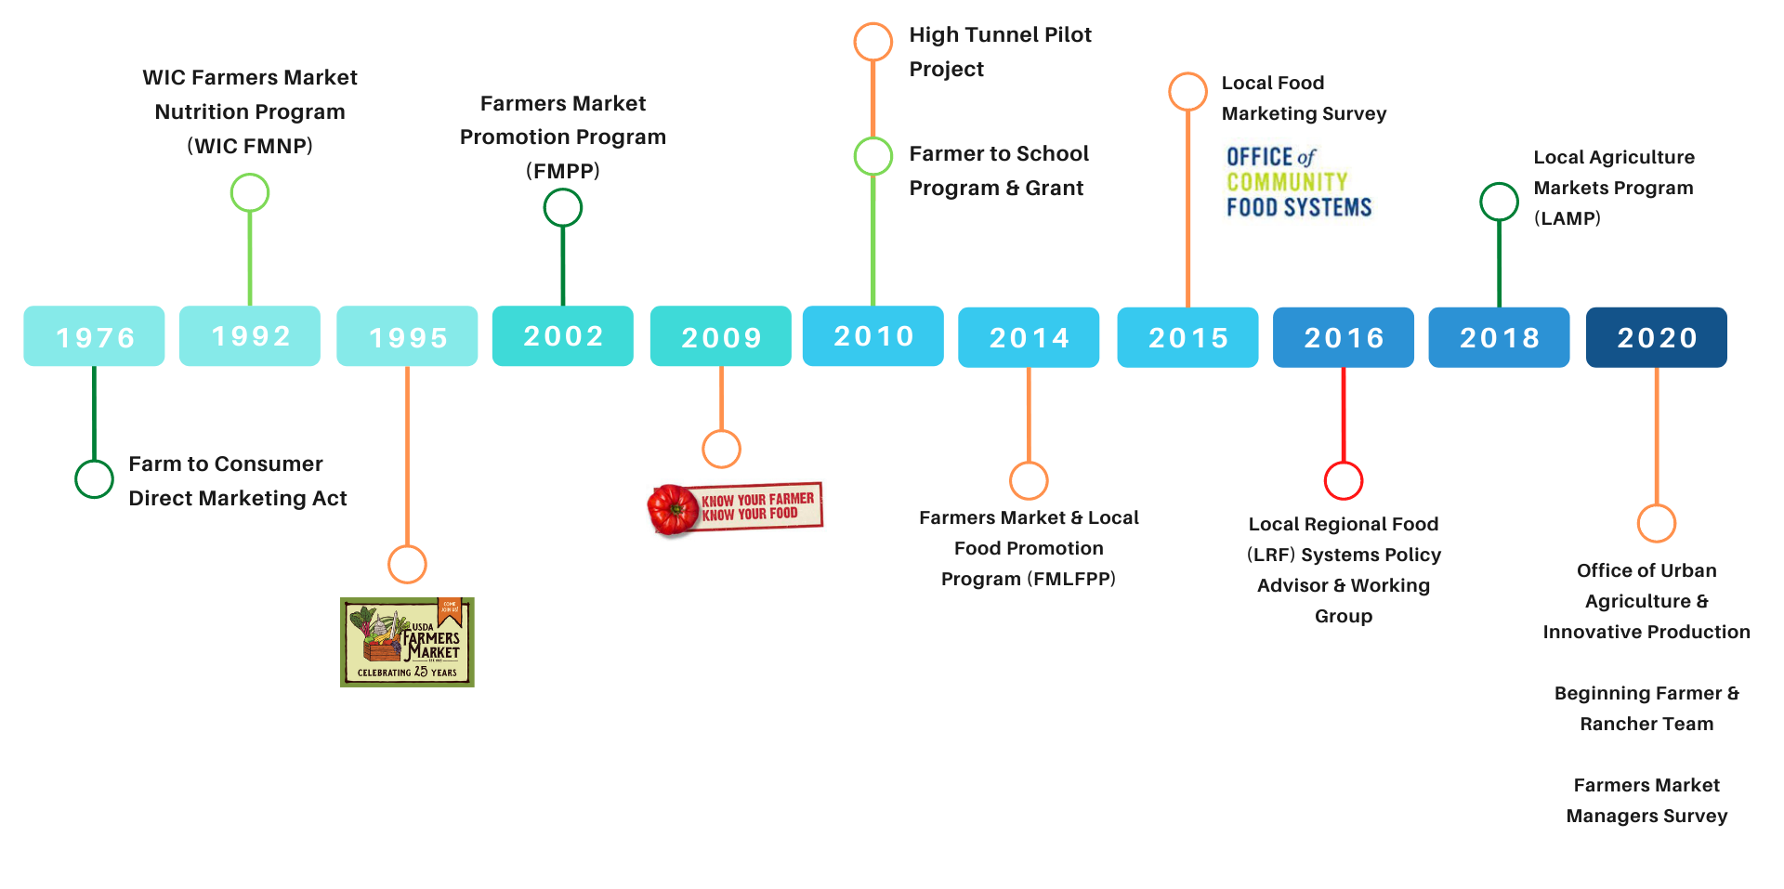
Local & Regional Foods at the USDA
Farm Bill
Child Nutrition Reauthorization
Structural Change or Implementation Activity
Local and Regional Food Working Group
Notes:
[

Slide 4
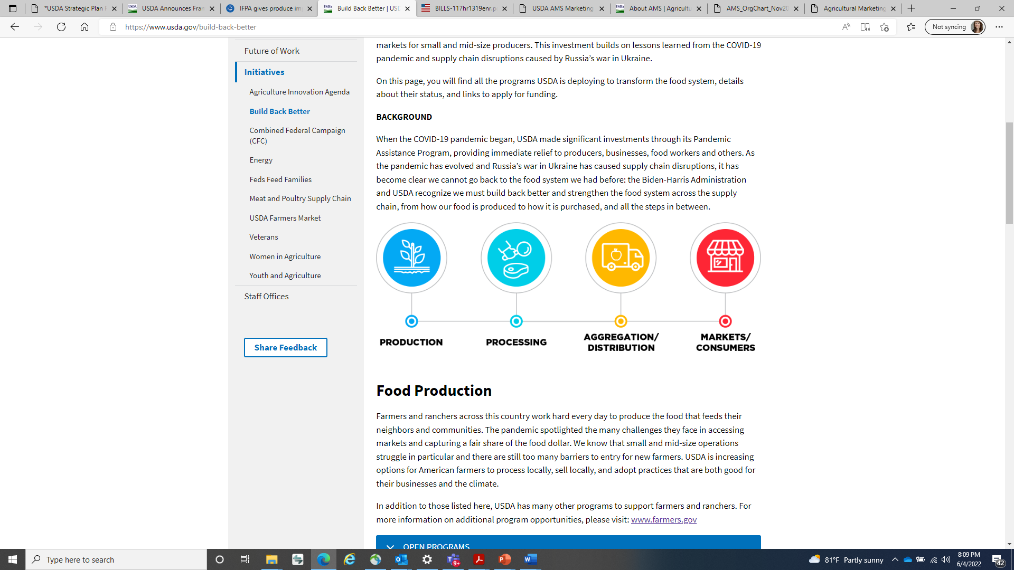
USDA FOOD SYSTEM TRANSFORMATION FRAMEWORK
Organic Certification and Transition Cost Share program
Food Safety Certification for Specialty Crop Program
Organic Transition Initiative
Urban Agriculture
Food Supply Chain Loan Guarantee Program
Meat and Poultry Processing TA
Food Supply Chain Infrastructure
Dairy Business Innovation Centers
Local Food Purchase Assistance
Local Food for Schools
Regional Food Business Centers
Farm to School
Food Loss and Waste
TEFAP Reach and Resiliency Grants
Local Food Promotion Program & Regional Food System Partnerships Program
Healthy Food Financing Initiative
Senior Farmers Market Nutrition Program
GusNIP Produce Prescription Programs
SNAP Technology Improvements
Healthy Food Incentive Fund

Slide 5
More and Better Markets
AMS’s Role in Local & Regional Food Systems
Research and Data Provider
Technical Assistance Provider
Funder
Food Buyer
Convenor

Slide 6
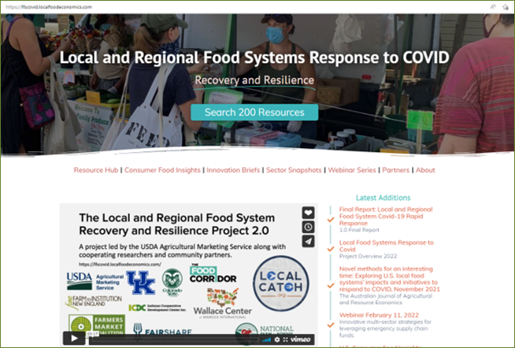
Convenor
Serves as an interagency convener
Provides access to the most relevant and up-to-date information available on local and regional food systems (LRFS)
Acts as a central node for networks to collaborate across the LRFS sector

Slide 7

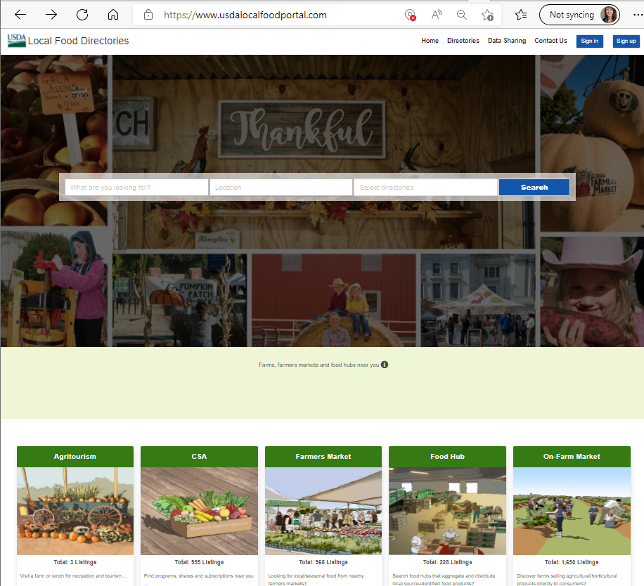
Researcher & Data Provider
Works with internal and external agencies to explore common local and regional food systems issues
Provides research and data that supports market access and transparency
Cooperative agreements, ranging from developing training materials to support commercially viable urban agriculture to a national survey of food incubators and community kitchens

Slide 8

Researcher & Data Provider/
Technical Assistance Provider
Florida Agricultural and Mechanical University & University of Maryland Eastern Shore
Evaluate barriers to AMS grant opportunities for underserved communities
Invest in building trust and confidence between these communities and the USDA
Take action to rectify inequalities in program access through targeted outreach, training, and technical assistance
Grant Program Successes and Challenges with Focus on Underserved Communities
Notes:
.

Slide 9
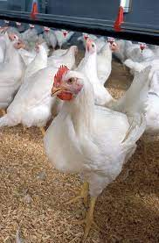
Technical Assistance Provider
Meat and Poultry Processing Technical Assistance (MPPTA)
AMS is investing up to $25 million to establish a nationwide MPPTA network focusing on four key areas:
Federal Grant Application Management
Business Development and Financial Planning
Meat and Poultry Processing Technical and Operation Support
Supply Chain Development
TA Providers: Flower Hill Institute, Oregon State University – Niche Meat Processors Assistance Network , Intertribal Agriculture Council, American Association of Meat Processors, American Meat Science Association, Agricultural Utilization Research Institute

Slide 10
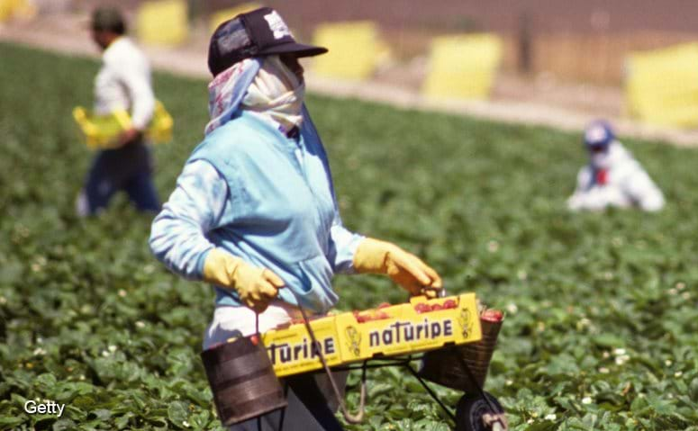
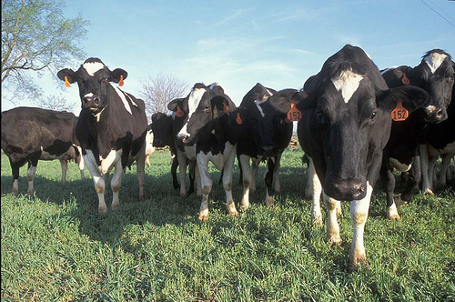
Funder
Farm and Food Worker Relief Program
The Farm and Food Worker Relief Program provides competitive grants to State agencies, Tribal entities, and non-profit organizations
Grant recipients will distribute $600 in relief funds to farm workers, meatpacking workers and grocery store workers (i.e., beneficiaries), to defray costs associated with the COVID-19 pandemic.
Dairy Business Innovation Initiatives
DBI Initiatives provide direct technical assistance and grants to dairy businesses, including niche dairy products, such as specialty cheese, or dairy products derived from the milk of a dairy animal, including cow, sheep and goat milk.
Four DBI Initiatives: California State University, Fresno, University of Tennessee, Vermont Agency of Agriculture, Food & Markets, University of Wisconsin

Slide 11

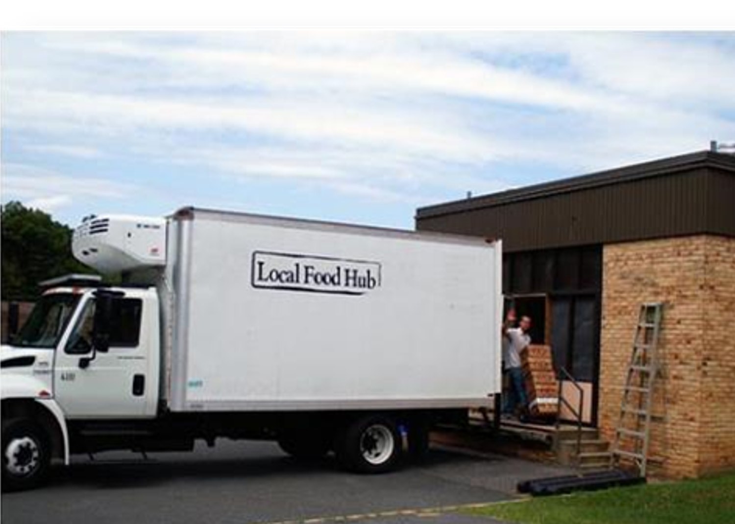
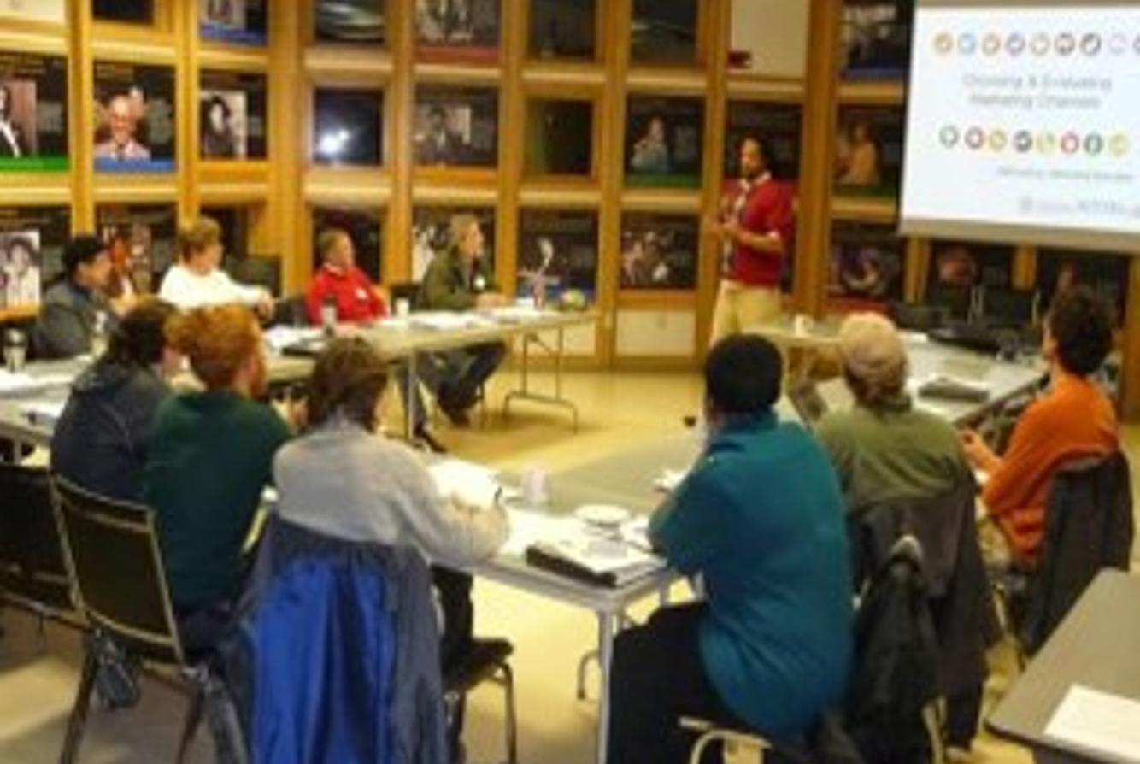
Funder
Farmers Market Promotion Program (FMPP)
Local Food Promotion Program
(LFPP)
Regional Food System Partnerships Program (RFSP)
In FY22 & F23, LFPP and RFSP offer a Farm to Institution Program Type.

Slide 12



Regional Food Business Centers
Coordination
Technical Assistance
Capacity Building

Slide 13
Food Buyer
Local Food Purchase Assistance Cooperative Agreement
Award up to $400 million to states for 50 states, U.S. territories, and federally recognized tribal governments
Provide an opportunity for States and Tribal governments to strengthen their local and regional food system
Help to support local and socially disadvantaged farmers/producers through build and expanding economic opportunities
Establish, strengthen, and broaden partnerships with producers and the distribution community, local food networks, and non-profits distributing fresh and nutritious foods in rural, remote, or underserved communities

Slide 14
Food Buyer
Local Food for Schools Cooperative Agreement
Award up to $200 million to states for food assistance purchases of domestic local foods for distribution to schools
Support local, small, and socially disadvantaged farmers/producers through building and expanding economic opportunities
Establish and broaden partnerships with farmers/producers and schools to ensure distribution of fresh and nutritious foods

Slide 15
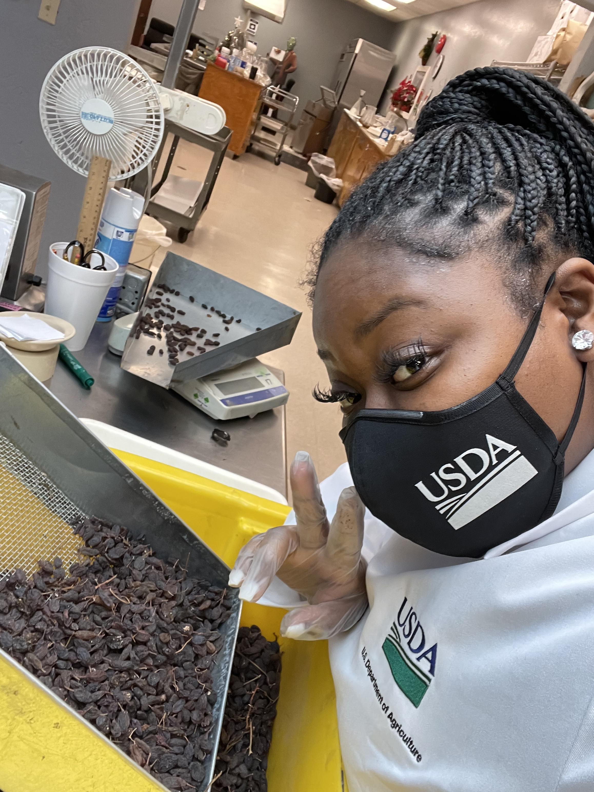
Career Pathways
AMS Student Enrichment Program
Pilot partnership between AMS and Tuskegee University to provide hands-on paid internship experience in mission-critical occupations while increasing participants’ knowledge of the AMS programs
Launched in Summer 2021, the program provided a year-long virtual engagement combined with 4-6 weeks of on-the-job technical training at AMS inspection and grading facilities (Federal Grain Inspection Service, Livestock and Poultry, and Specialty Crops Programs)
Once successfully established, AMS plans to expand this mechanism to additional minority-serving institutions as a pipeline to fill mission-critical occupations.

Slide 16
Discussion
Where might there be alignment between AMS’s involvement in the creation of ‘More and Better Markets’, USDA’s Food Systems Transformation work, and the efforts of the Advisory Committee on Minority Farmers?
What strategies and opportunities exist to address diversity and equity within AMS Research and Promotion (R&P), Federal Marketing Orders, and Federal Advisory Committees?

Slide 17
Thank You
Torey Ian Powell, MSW
Deputy Chief Diversity & Inclusion Officer
Agricultural Marketing Service
Torey.Powell@usda.gov
Learn more at: www.ams.usda.gov

