Slide 1
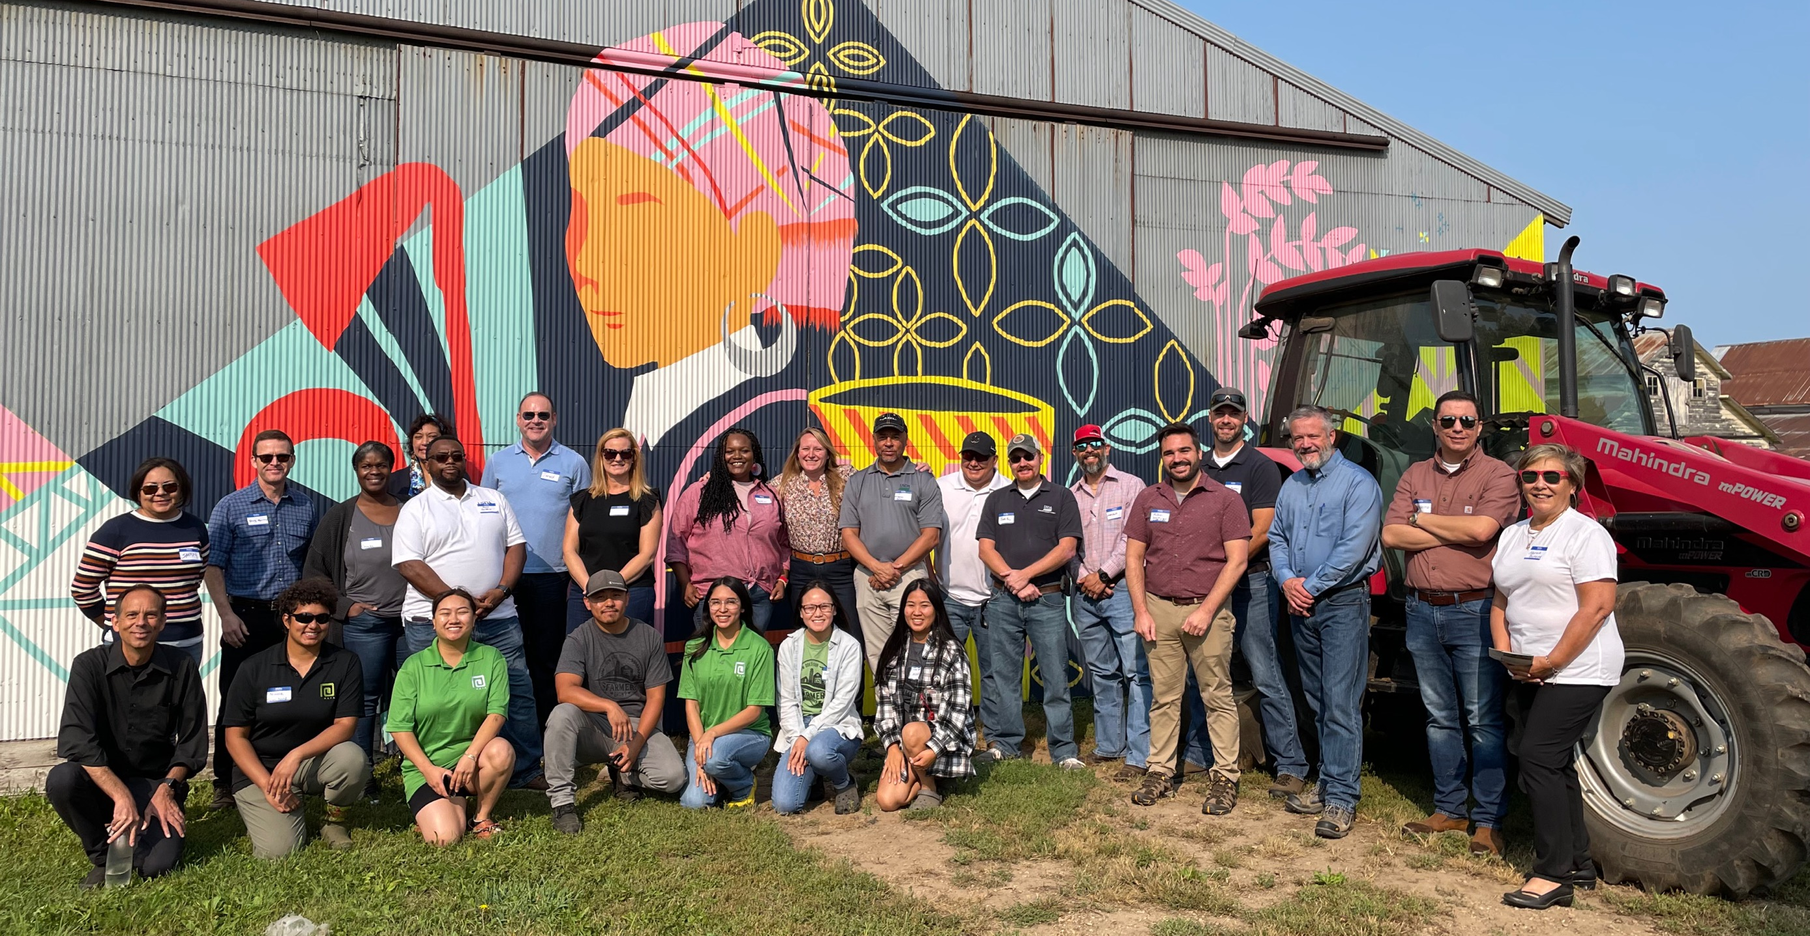
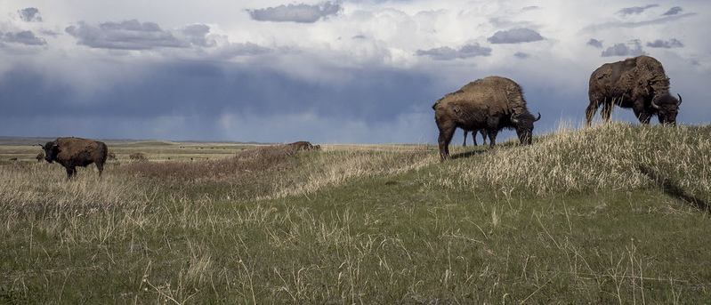
Building Resiliency:
The Vision of the Risk Management Agency
Notes:
GO TO VIEW > MASTER > SLIDE MASTER TO EDIT THE IMAGES ON THE TITLE AND DIVIDER SLIDES

Slide 2
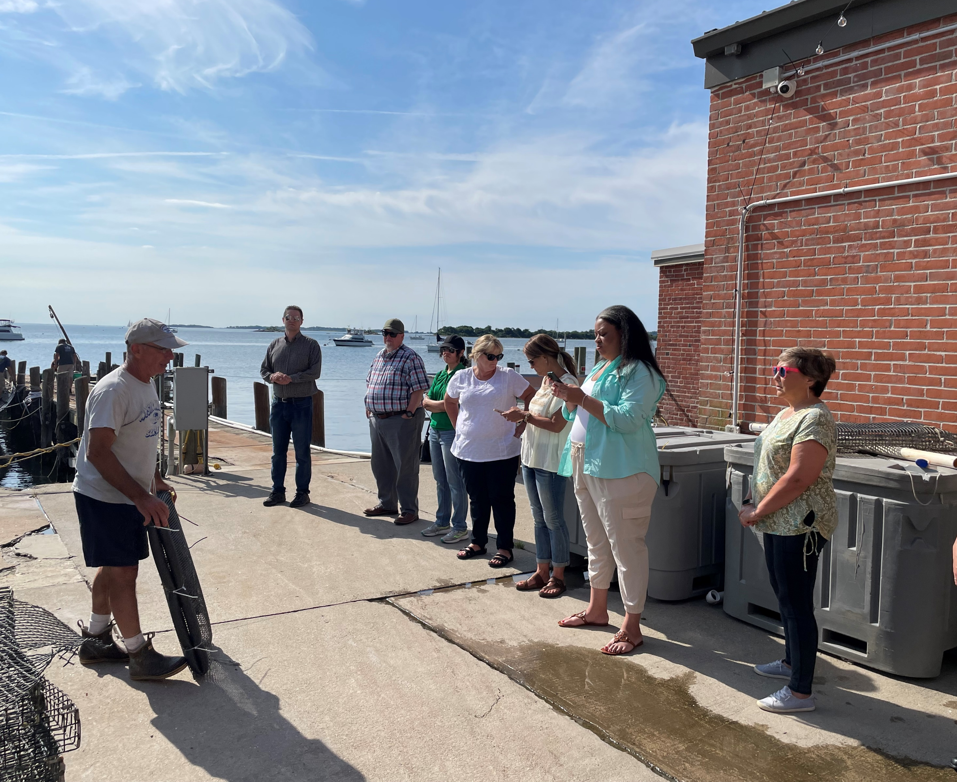
Today’s Agenda
Today, we hope to:
Introduce the mission and vision of the Risk Management Agency
Talk about policies that have been created to support underserved producers
Highlight our Risk Management Education Division
Invite you to stay in touch and learn more

Slide 3
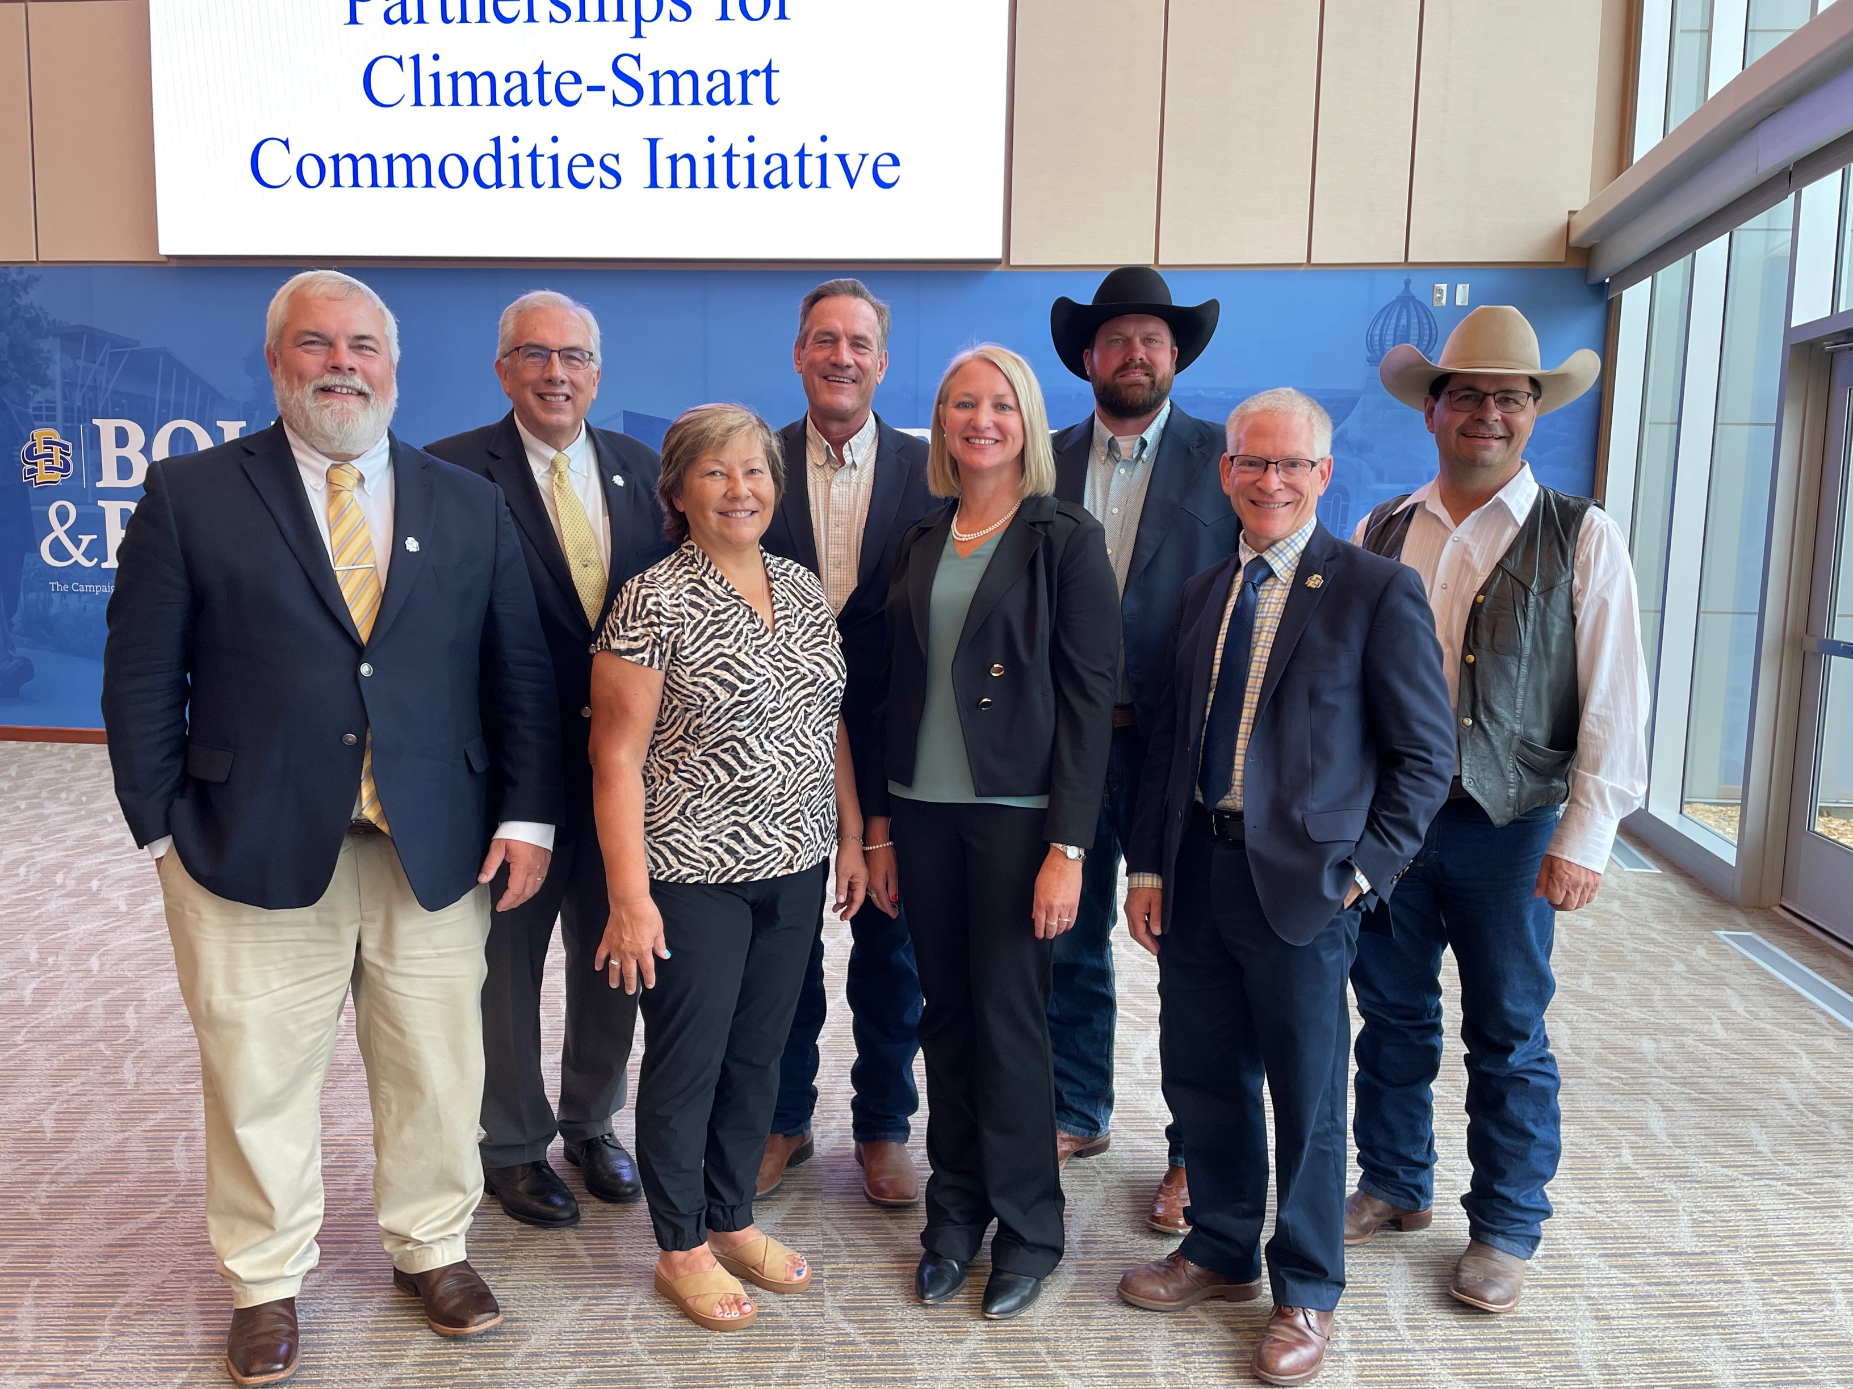
Introduction to Our Team
Representing RMA Today
Marcia Bunger, Administrator
Chola Richmond, Risk Management Education Division
Sean Patrick, Risk Management Education Division

Slide 4
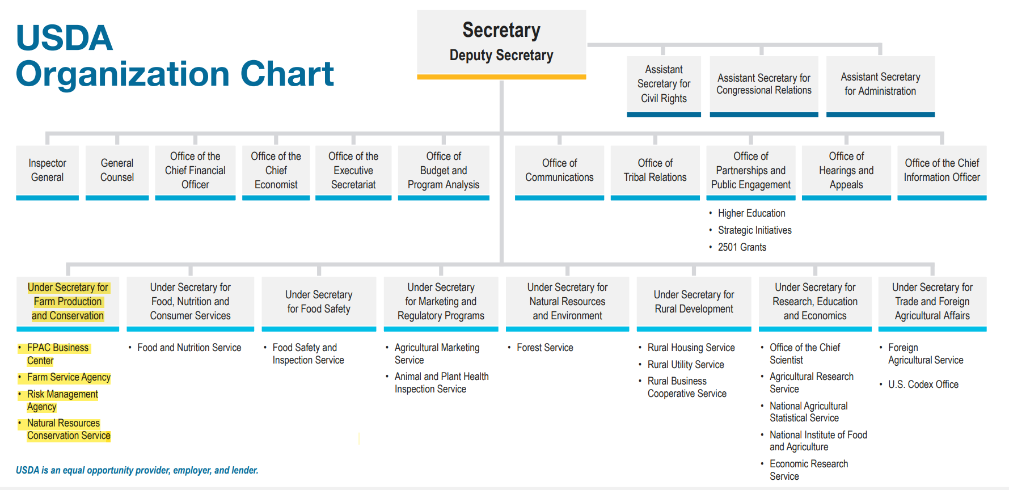
Introduction to RMA

Slide 5
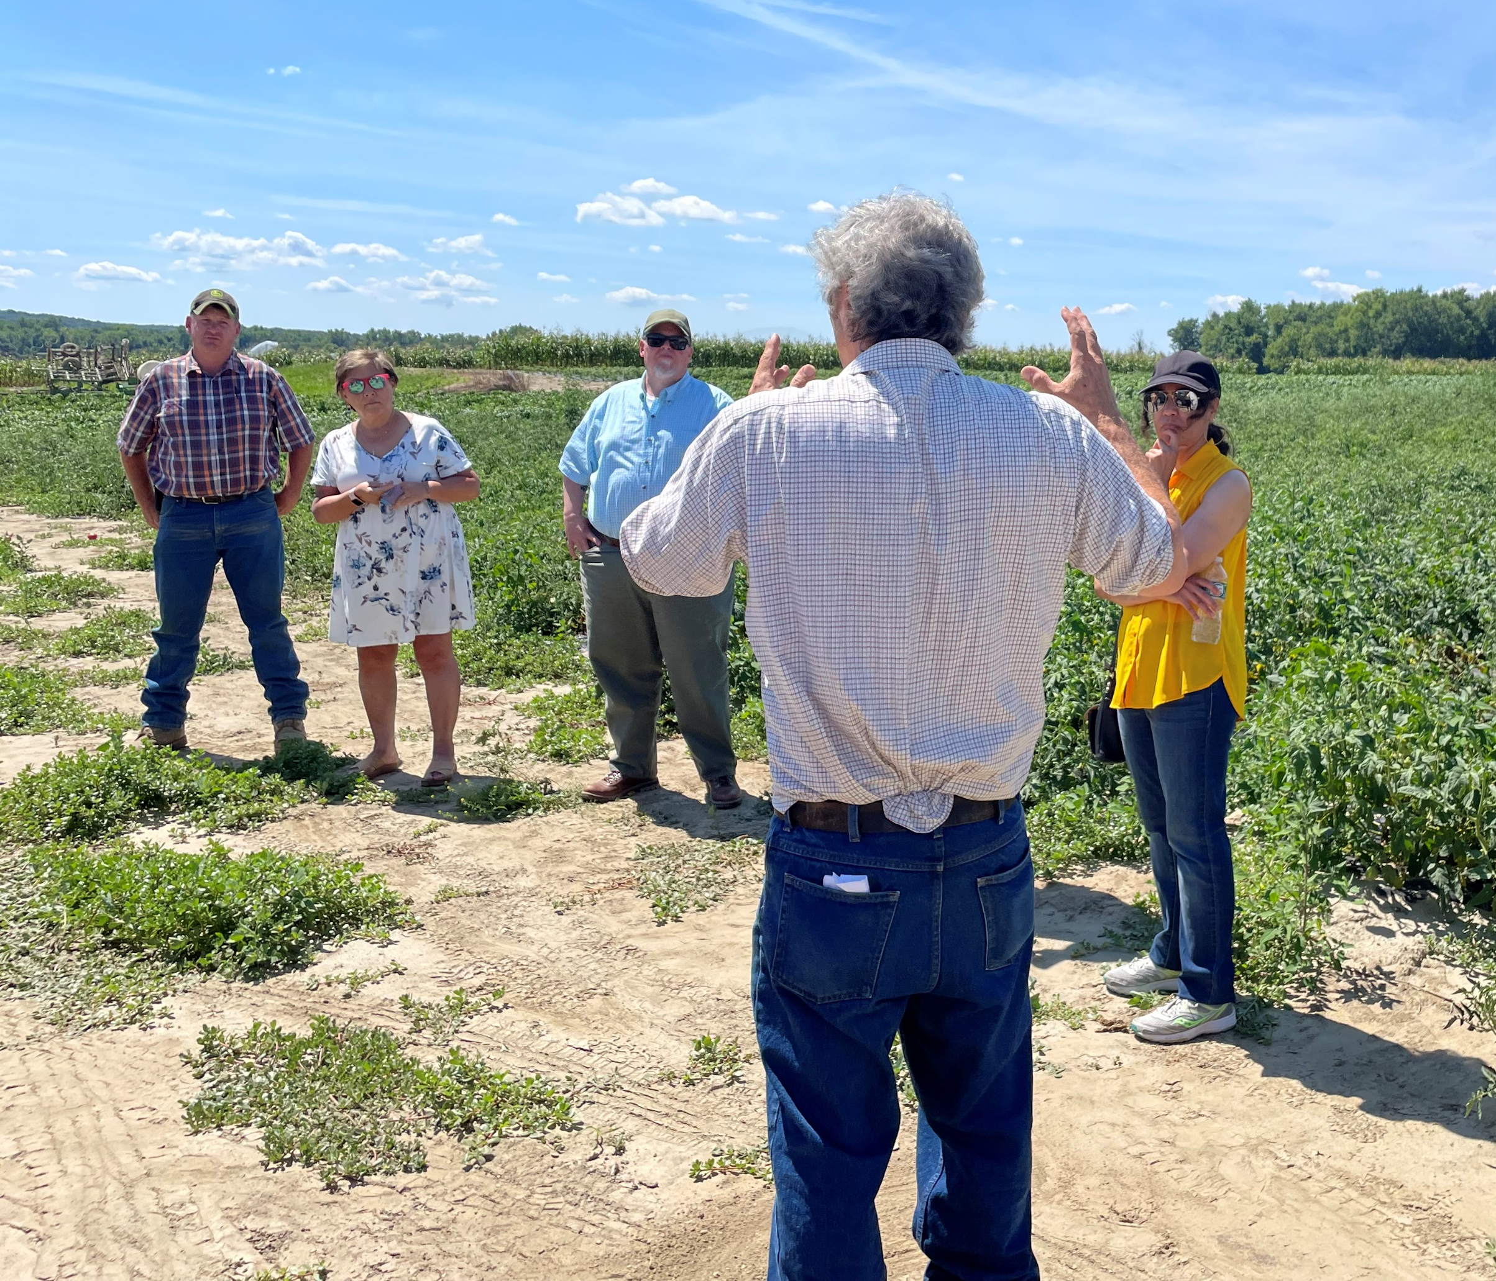
Introduction to RMA
RMA’s mission is to serve America’s agricultural producers through effective, market-based risk management tools to strengthen the economic stability of agricultural producers and rural communities.
Our Core Values:
Customer Focus
Results Orientation
Transparency
Participation
Collaboration
Accountability
Professionalism
Stewardship

Slide 6
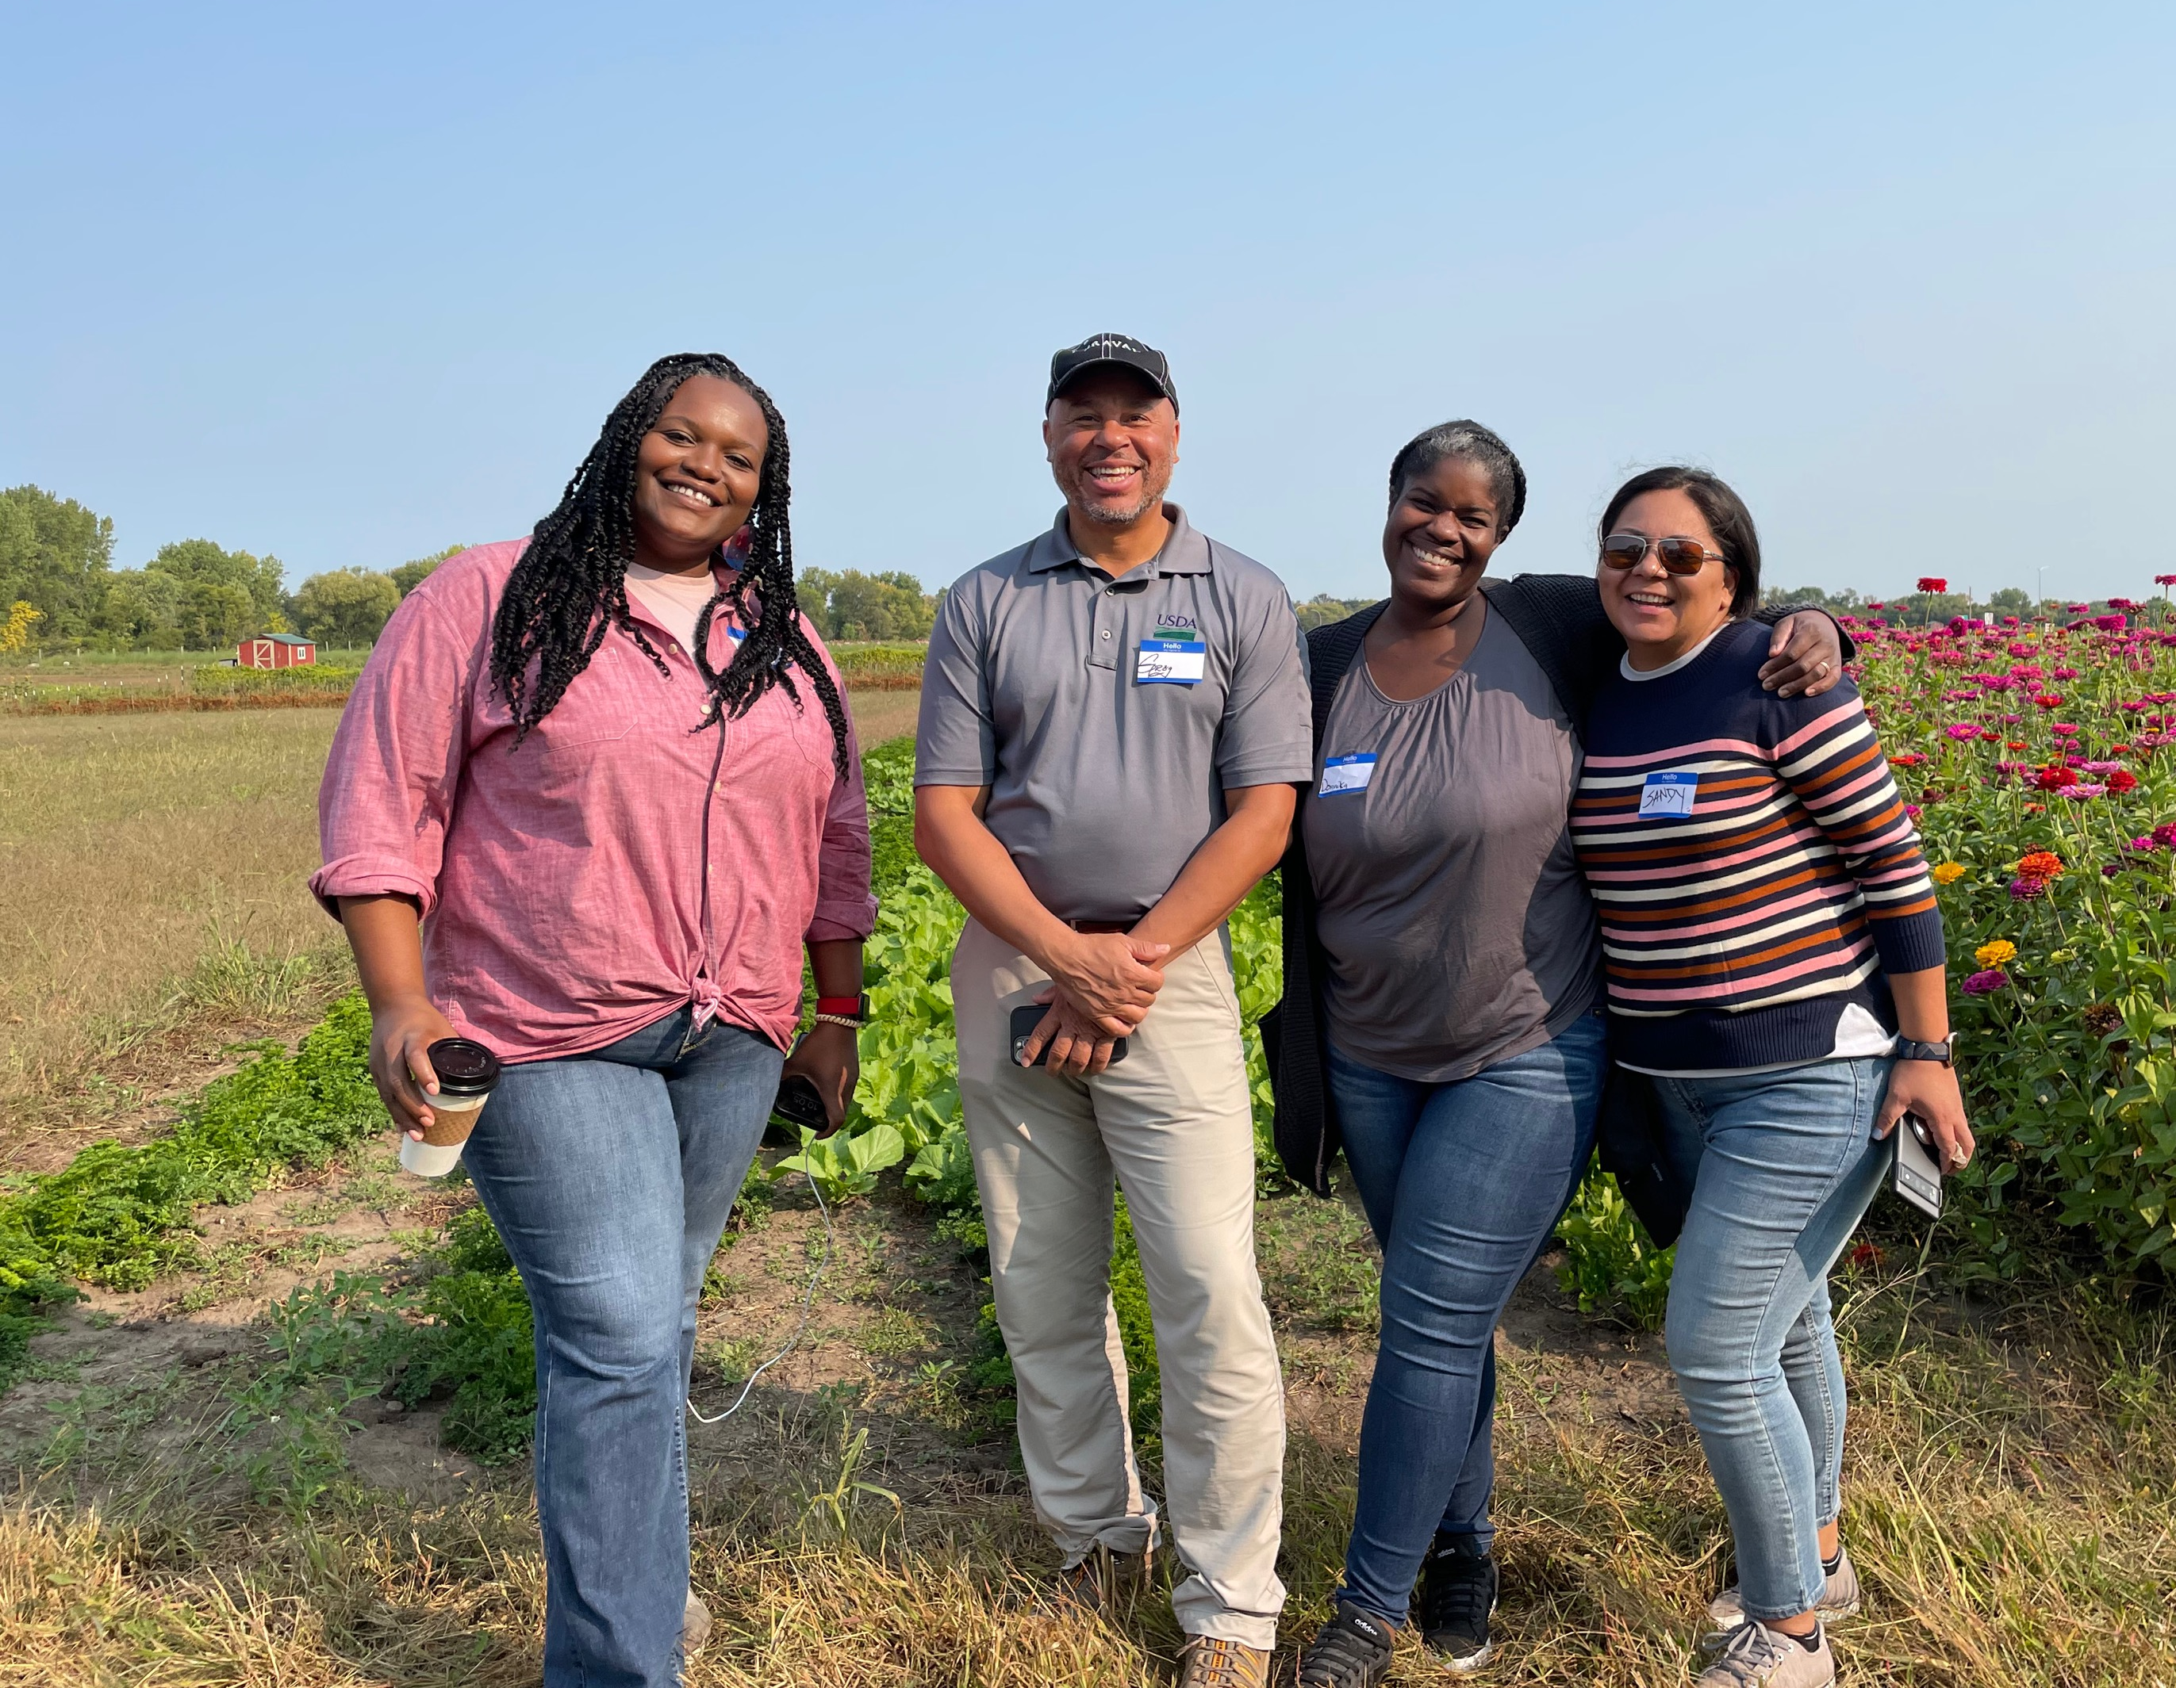
Introduction to RMA
A Few of our Key Priorities:
Reaching Historically Underserved Producers
Micro Farm and Whole Farm Policy Training
Climate Smart Agriculture
Education for Livestock Producers, Organic Operations, Specialty Crops

Slide 7
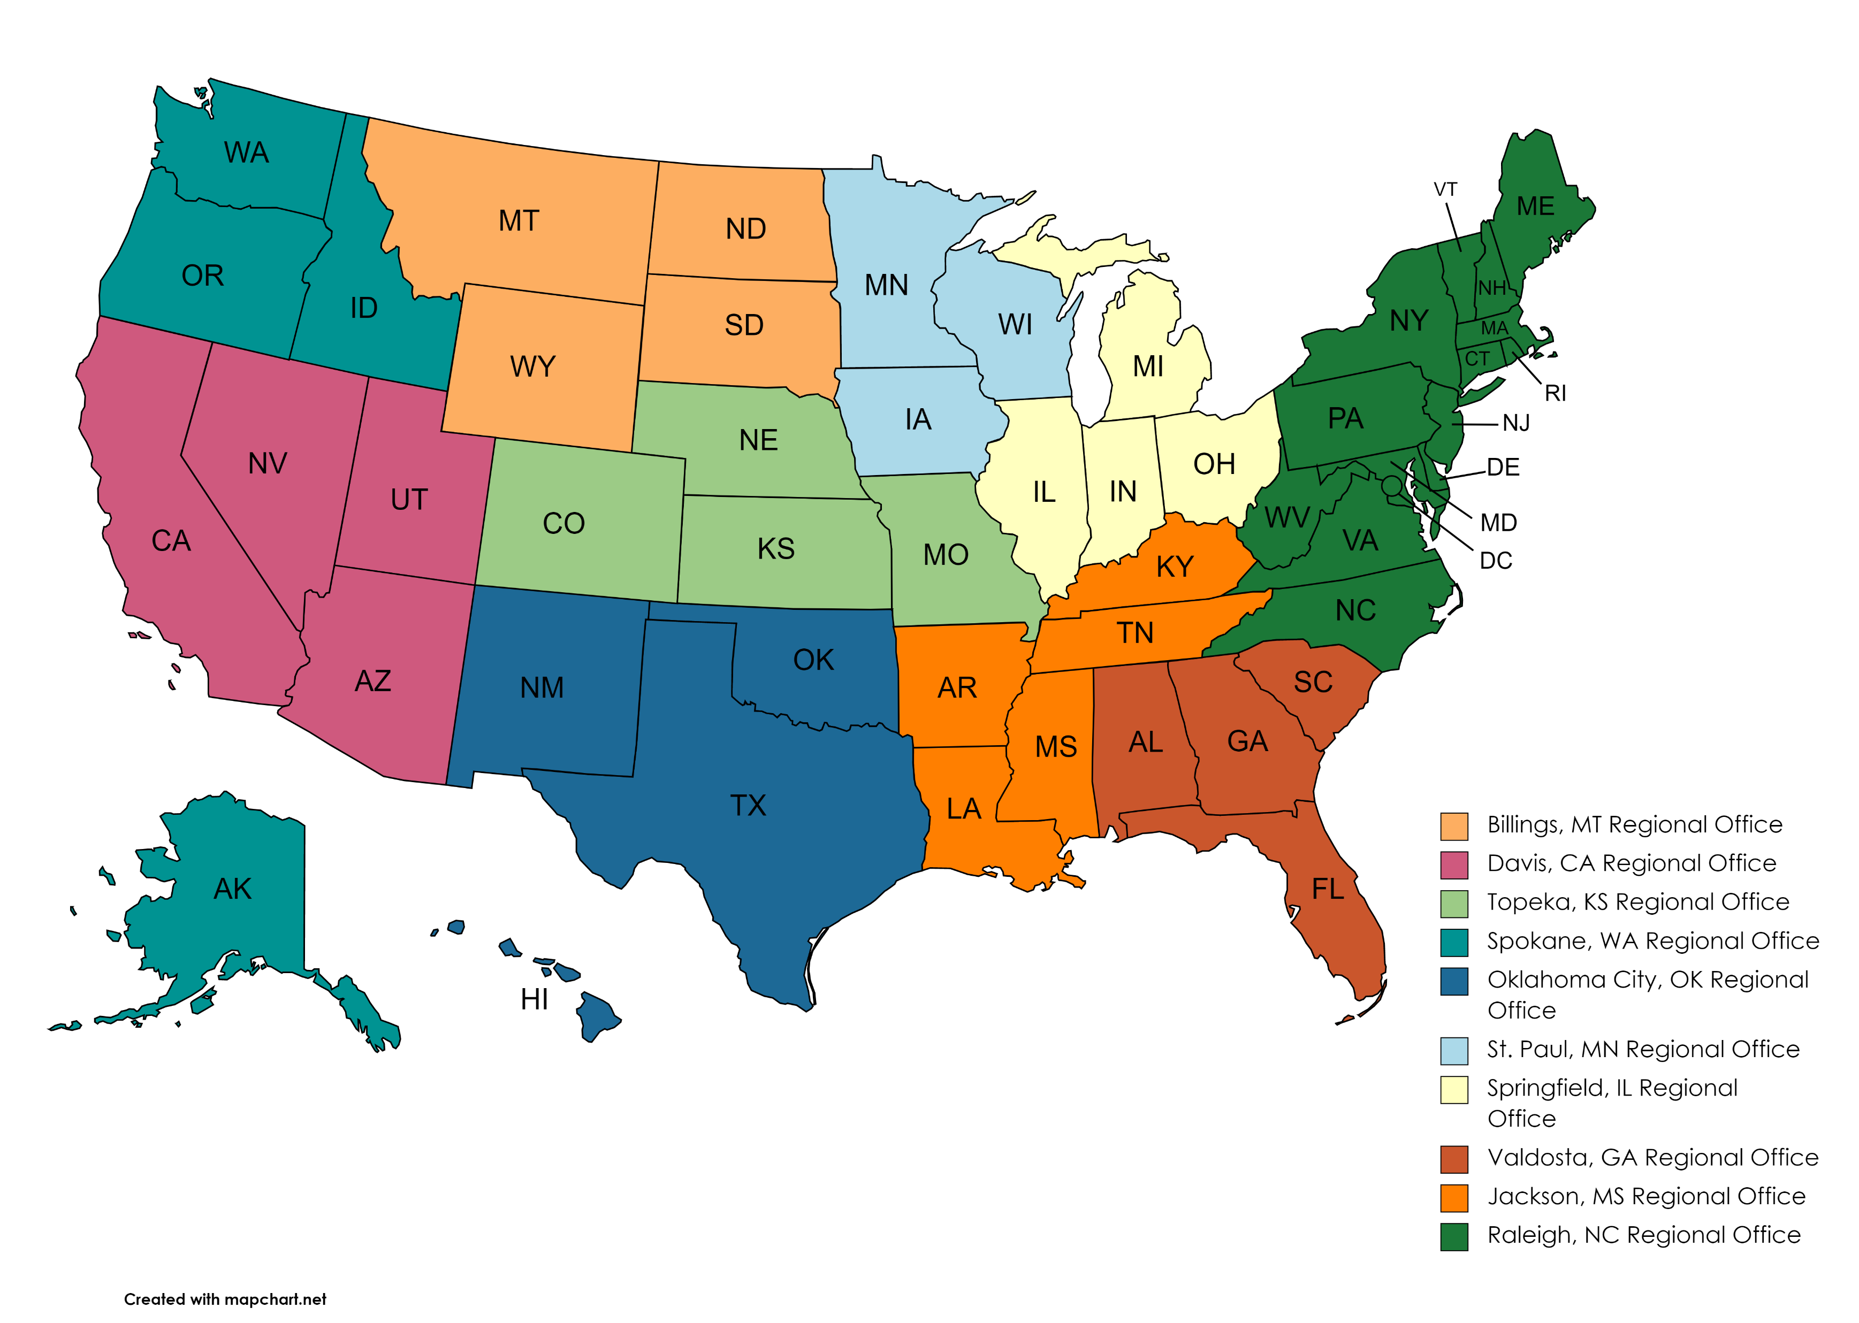
Meeting Producers Where They Are

Slide 8
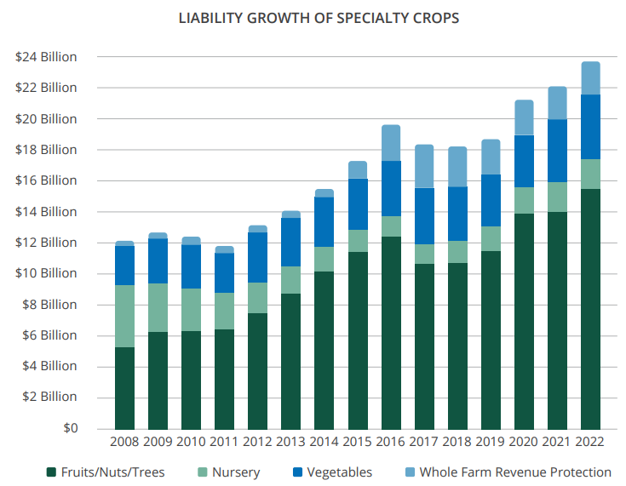
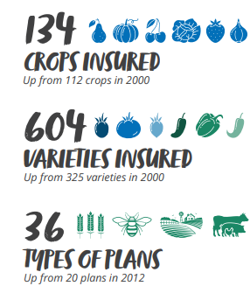
RMA By The Numbers

Slide 9
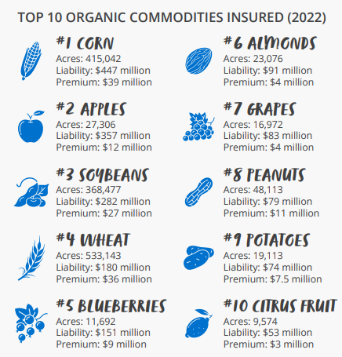
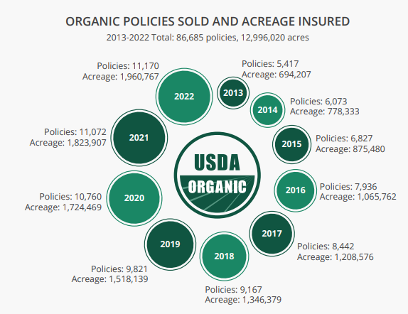
RMA By The Numbers

Slide 10
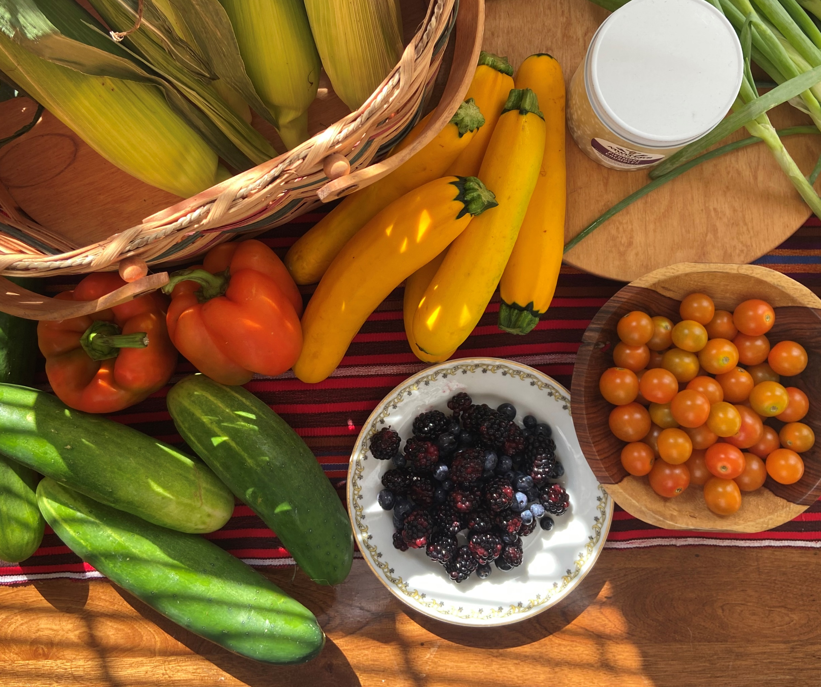
Key Policies - Products for Diversified Farms
Whole Farm Revenue Protection
  Inclusive coverage for diversified farms
  Serves farms with up to $17M annual revenue
Micro Farm Product
  New in 2022
  Serves farms with up to $350K annual revenue
Whole Farm / Micro Farm Road Show
  Has reached over 1,000 producers

Slide 11
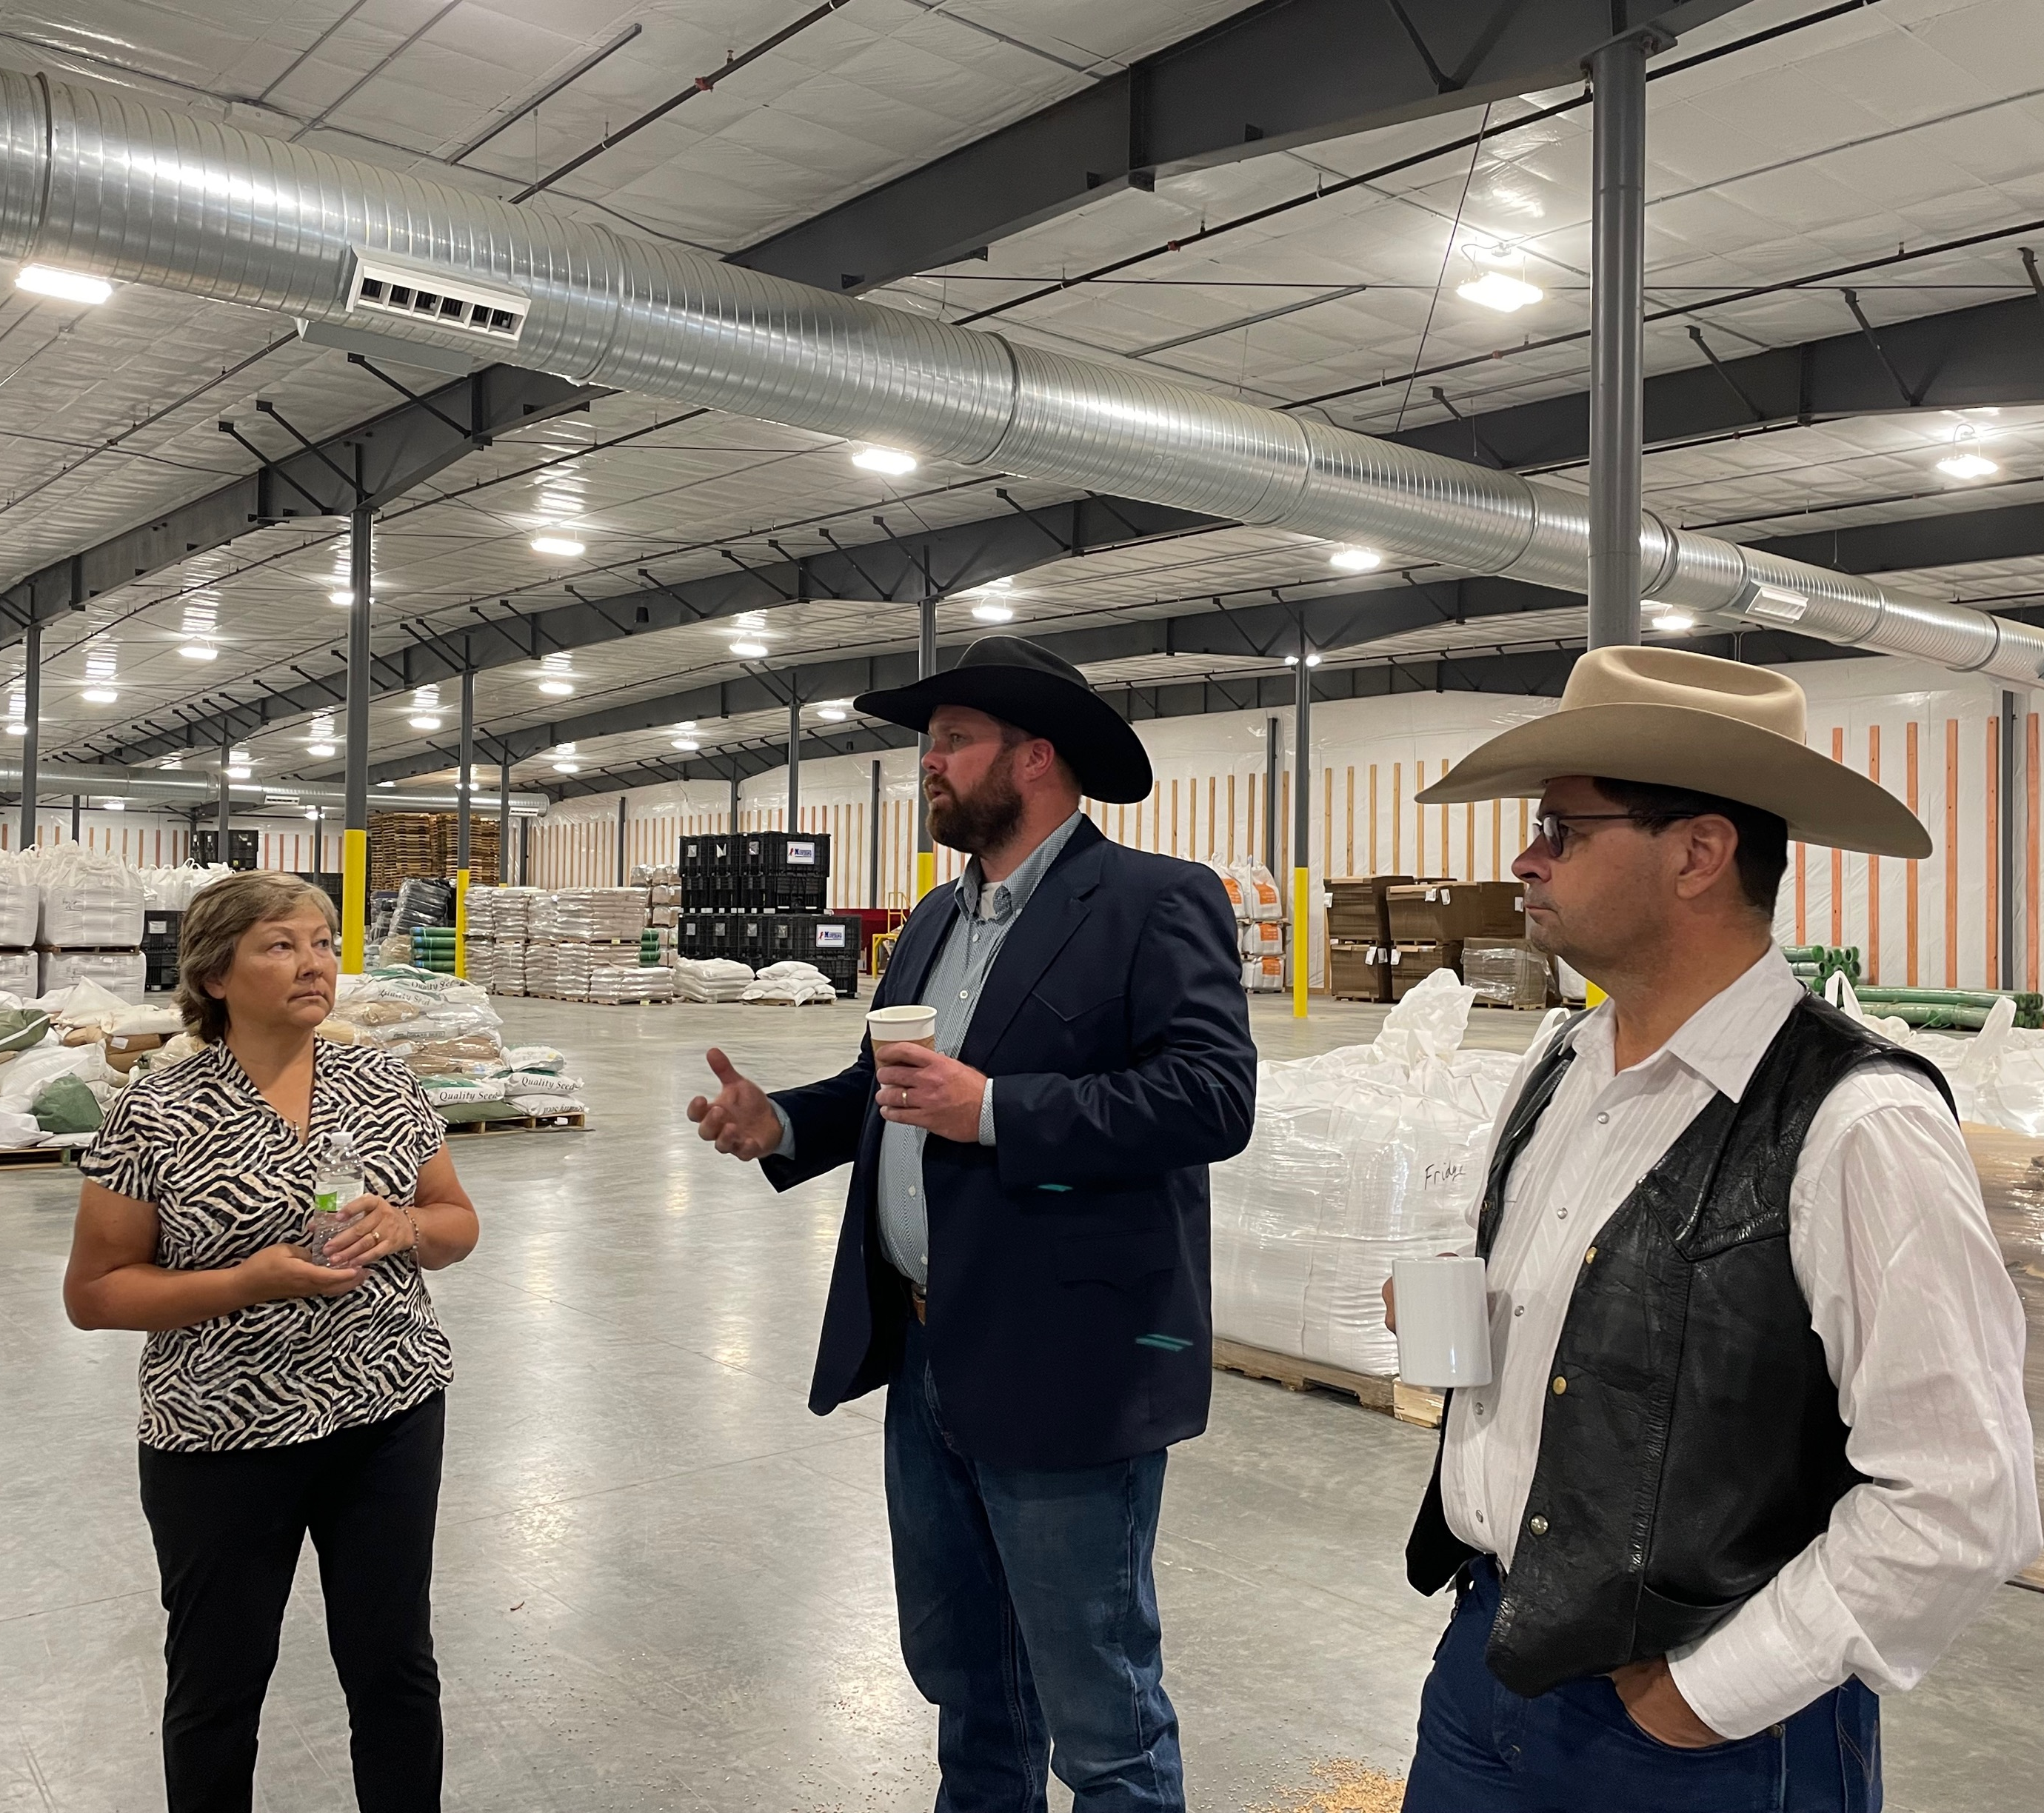
Risk Management Education Division
Our Risk Management Education Division seeks to aid program growth and expansion, and further strengthen the farm safety net for underserved agricultural producers and ranchers by providing risk management tools through effective partnerships and outreach.
RMED’s overarching goal is to ensure risk management involves education with one or more of the five primary sources of agricultural risk.
Production Risk
Marketing Risk
Financial Risk
Legal Risk
Human Risk

Slide 12
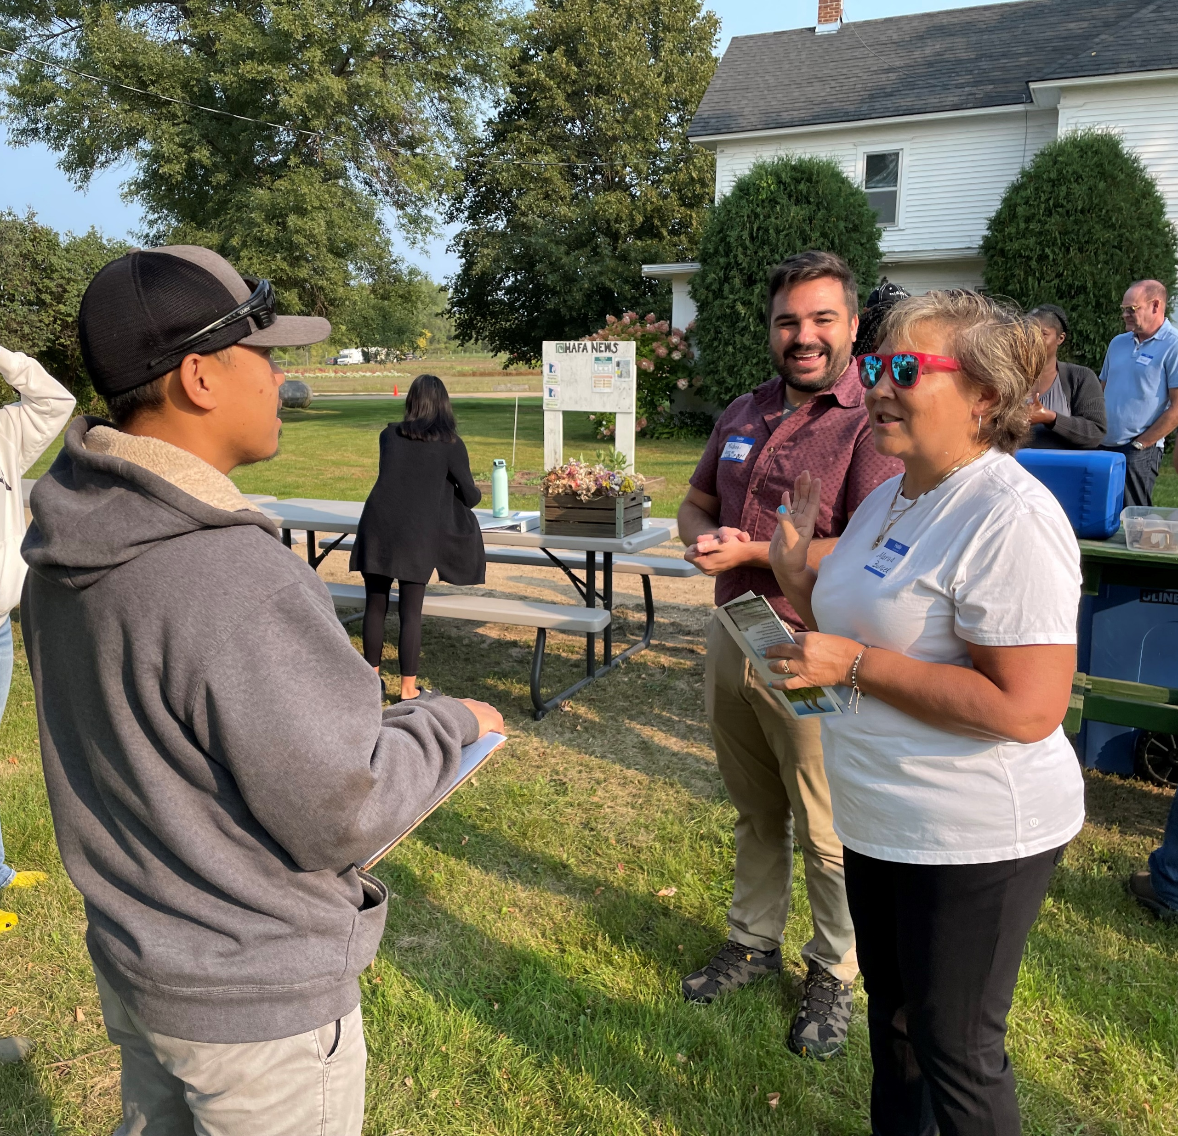
Mission
RMA’s Outreach and Education efforts focus on the following priorities:
Reaching Historically Underserved Producers
  African American, Asian American, Hispanic/Latino, Native American, Pacific Islander
  Beginning Farmers
  Military Veterans
  Women
Micro Farm and Whole Farm Policy Training
Climate Smart Agriculture
Risk Management Education for Livestock Producers, Organic Operations, Specialty Crops

Slide 13
What We Do
RMED works with recipients who are selected through a highly competitive process or direct award for our cooperative agreements and conduct outreach at national-level events.
Recipients assist underserved producers and ranchers in effectively managing and mitigating long-term risks and challenges.
Producers receive assistance understanding and using crop insurance and other farm safety net tools so they can make the best risk management decisions for their agricultural operations.
Past award recipients have included universities, state department of agricultures, county cooperative extension offices, non-profit organizations and other qualified entities.

Slide 14
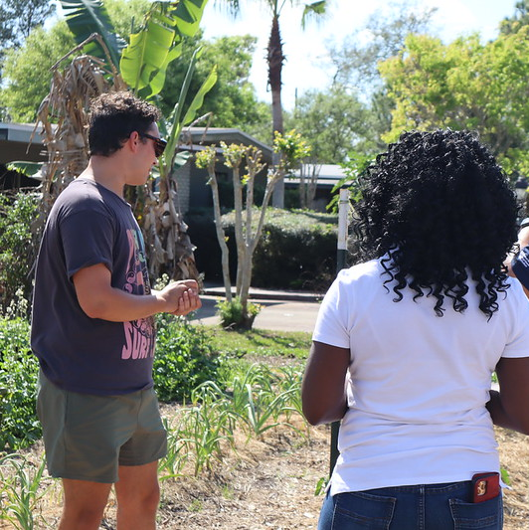
2022 Risk Management Education Partnerships
16 Proposals totaling $2M
Project duration is 12 months, start date August 1, 2022
Audiences served include Native farmers, African American producers, Hispanic growers in the northwest, California grape growers, Alaskan Farmers, organic producers in 20 states, and livestock operations
Partners include nonprofits, HBCUs, and previously funded organizations
Topics range from financial planning to climate smart ag

Slide 15
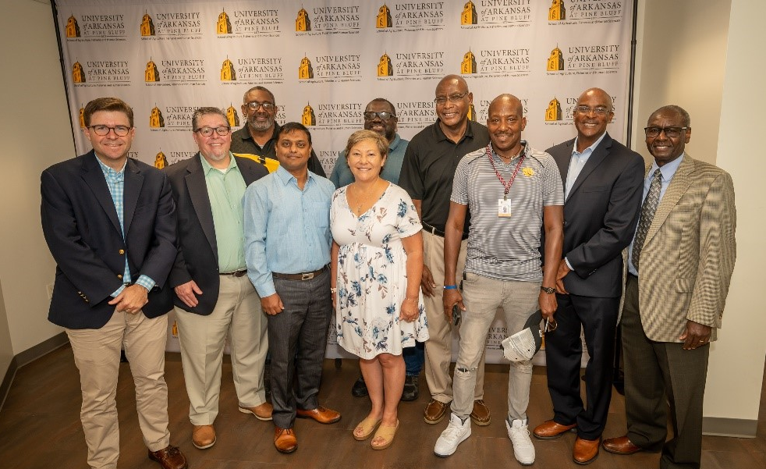
Administrator Marcia Bunger with faculty at the University of Arkansas at Pine Bluff
August 2022

Slide 16
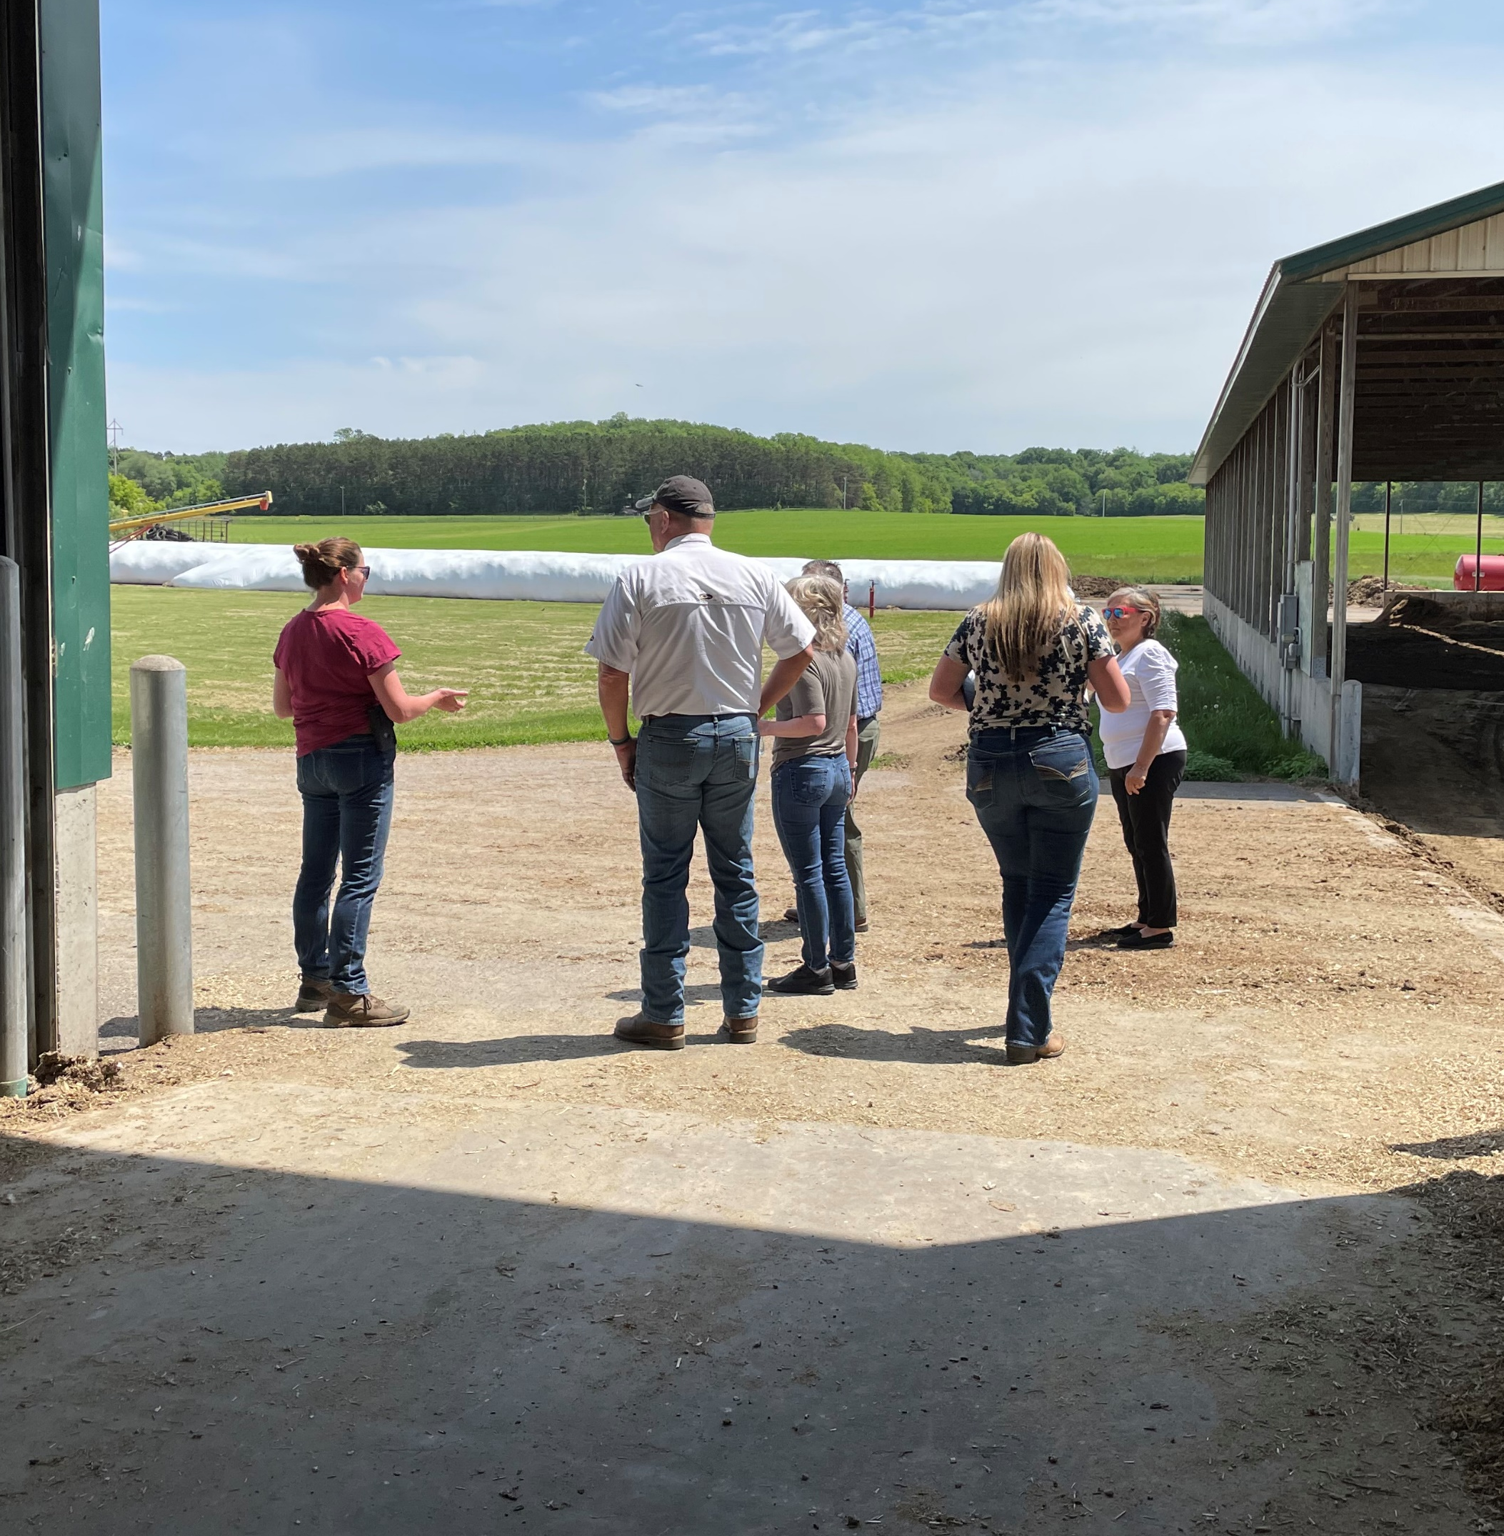
2022 Direct Award Pilot Program
Building Resiliency with a More Diverse Delivery Strategy, an Underserved Agent and Loss Adjuster Training Pilot
This is a collaborative pilot program with Intertribal Agriculture Council, Annie’s Project, Rural Coalition, and Alcorn State University.
This two-year, $1.8M program will establish a pipeline of crop insurance agents and adjusters within underserved communities.

Slide 17
2022 Direct Award Pilot Program
Goals:
To educate and inform traditionally underserved communities about the possibilities of becoming crop insurance agents and adjusters.
To provide the mechanism, preparation, and provision to gain employment in the crop insurance sector.
To make available the educational framework and career development conduit to be licensed by a State.
To strengthen connections between underserved producers and the Federal safety nets for the agriculture industry.
To provide the opportunity of future career ambitions in the insurance industry and placement with crop insurance agencies under contract with RMA Approved Insurance Providers.

Slide 18
Intertribal Agriculture Council
Over the past 30+ years Intertribal Agriculture Council (IAC) has become a prominent leader in Indian Country vis-à-vis federal government agencies and the agricultural field on behalf of individual Indian producers and Tribal enterprises
IAC is the most respected voice within the Indian community and government circles on agricultural policies and programs in Indian country
The policy work of the IAC has a dedicated presence in Washington, DC and permanently houses the Native Farm Bill Coalition
The IAC is committed to connect on-the-ground impacts to solutions at the federal level and further public issue education and policy advocacy for Indian Country’s food producers

Slide 19
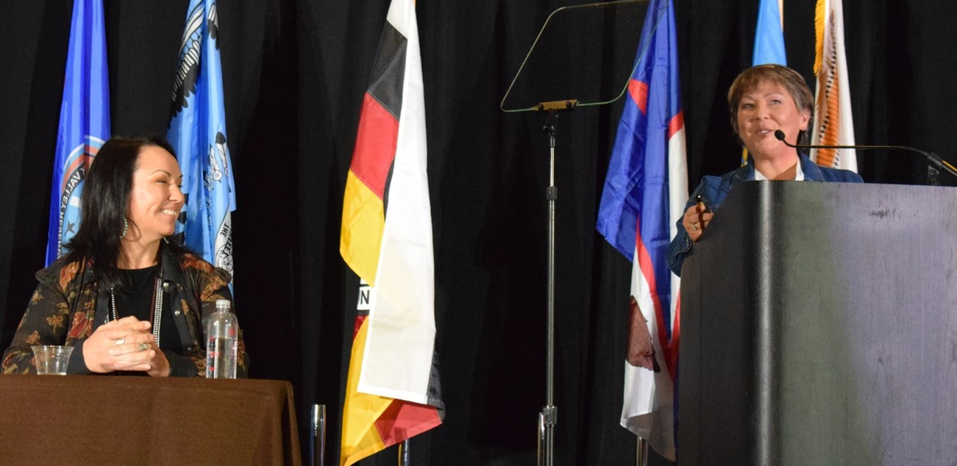
Intertribal Agriculture Council
Administrator Marcia Bunger speaks at the IAC Annual Conference
December 2022

Slide 20
Annie’s Project
Annie’s Project is a national non-profit that has been empowering women in agriculture for nearly 20 years
Annie’s Project reaches over 18,000 underserved producers and have a large community of facilitators and educators
They work in risk management, overall farm/ranch/growing management, networking and leadership development
Although they are women-centered, they welcome and served anyone with an interest in their programming, education, and activities

Slide 21
Rural Coalition
Rural Coalition is a rural organization with over 70 grassroots member organizations, they serve as a critical advocacy voice of African-American, American-Indian, Asian-American, Euro-American, Latino, and women farmers, ranchers, farmworkers, and rural communities.
Rural Coalition works actively to help all historically underserved access online platforms and do business, access to federal benefits, and to build community gardens and help farmers access new markets for the healthy fresh food they produce.
They are committed to racial justice and in assuring the health of the front-line communities in the food system is protected.

Slide 22
Alcorn State University
Alcorn State University, a Historically Black College and University (HBCU) is a comprehensive land-grant institution that celebrates a rich heritage with a diverse student and faculty population.
Alcorn’s Socially Disadvantaged Farmers and Ranchers Policy Research Center specializes in policy research impacting socially disadvantaged farmers and ranchers with a network and collaboration with universities and organizations inside and outside the land grant community.
The Socially Disadvantaged Farmers and Ranchers Policy Research Center improves the success of socially disadvantaged farmers and ranchers.

Slide 23
Timeline
IAC, Annie’s Project, Rural Coalition, and Alcorn State University had the Kick-Off Meeting in October
RMA held the Entrance Call with all Partners present 11/2022
All Partners will sign the MOU by 12/31/2022
Conduct Feasibility study to access the area and/or market and address the demand for Agents/Loss Adjusters by 2/28/2023
Conduct an assessment on each state’s requirements (Department of Insurance) to obtain license by 4/28/2023
Collaborate and develop comprehensive training curriculum by 5/31/2023
Solicit and Enroll program participants from traditionally underserved community by 5/31/2023
Phase I: Conduct Training Curriculum by 12/29/2023
Phase II: Prepare Participants for Insurance Exam by 1/31/2024
Participants take the exam by 5/31/2024
Phase III: Resume/Interview Skills seminar by 12/31/2024
Conduct and Host an AIP Job Fair by 12/31/2024

Slide 24
2023 Risk Management Education Partnership
Approximately $2M in funding available now
Deadline for applications is April 24
Topics range from financial planning to climate smart ag
New service assists entities applying for funding this year-
  Formulating statements of work
  Completing cooperative agreement award and grant applications.
  Project management to meet reporting obligations, successful execution, monitoring and controlling, and project closeout.
  Available to underserved communities, ag-related non-profits, Tribal colleges and universities, Tribal higher education programs, 1890 Land Grant Universities, Historically Black Colleges and Universities, and Hispanic-Serving Agricultural Colleges and Universities.
  Reach out to RMA via email: RMA.risk-ed@usda.gov

Slide 25
Always Learning from Producers
Prospective Customer Survey
On November 9, 2022, USDA released a nationwide survey to help the Department improve and increase access to its programs and services for America’s farmers, ranchers, and forest managers.
The survey gathers feedback on programs and services available through the Farm Service Agency (FSA), Natural Resources Conservation Service (NRCS) and Risk Management Agency (RMA).
All agricultural producers are encouraged to take the survey, especially those who have not worked with USDA previously.
The survey is available online at farmers.gov/survey, and producers should complete by March 31, 2023.

Slide 26
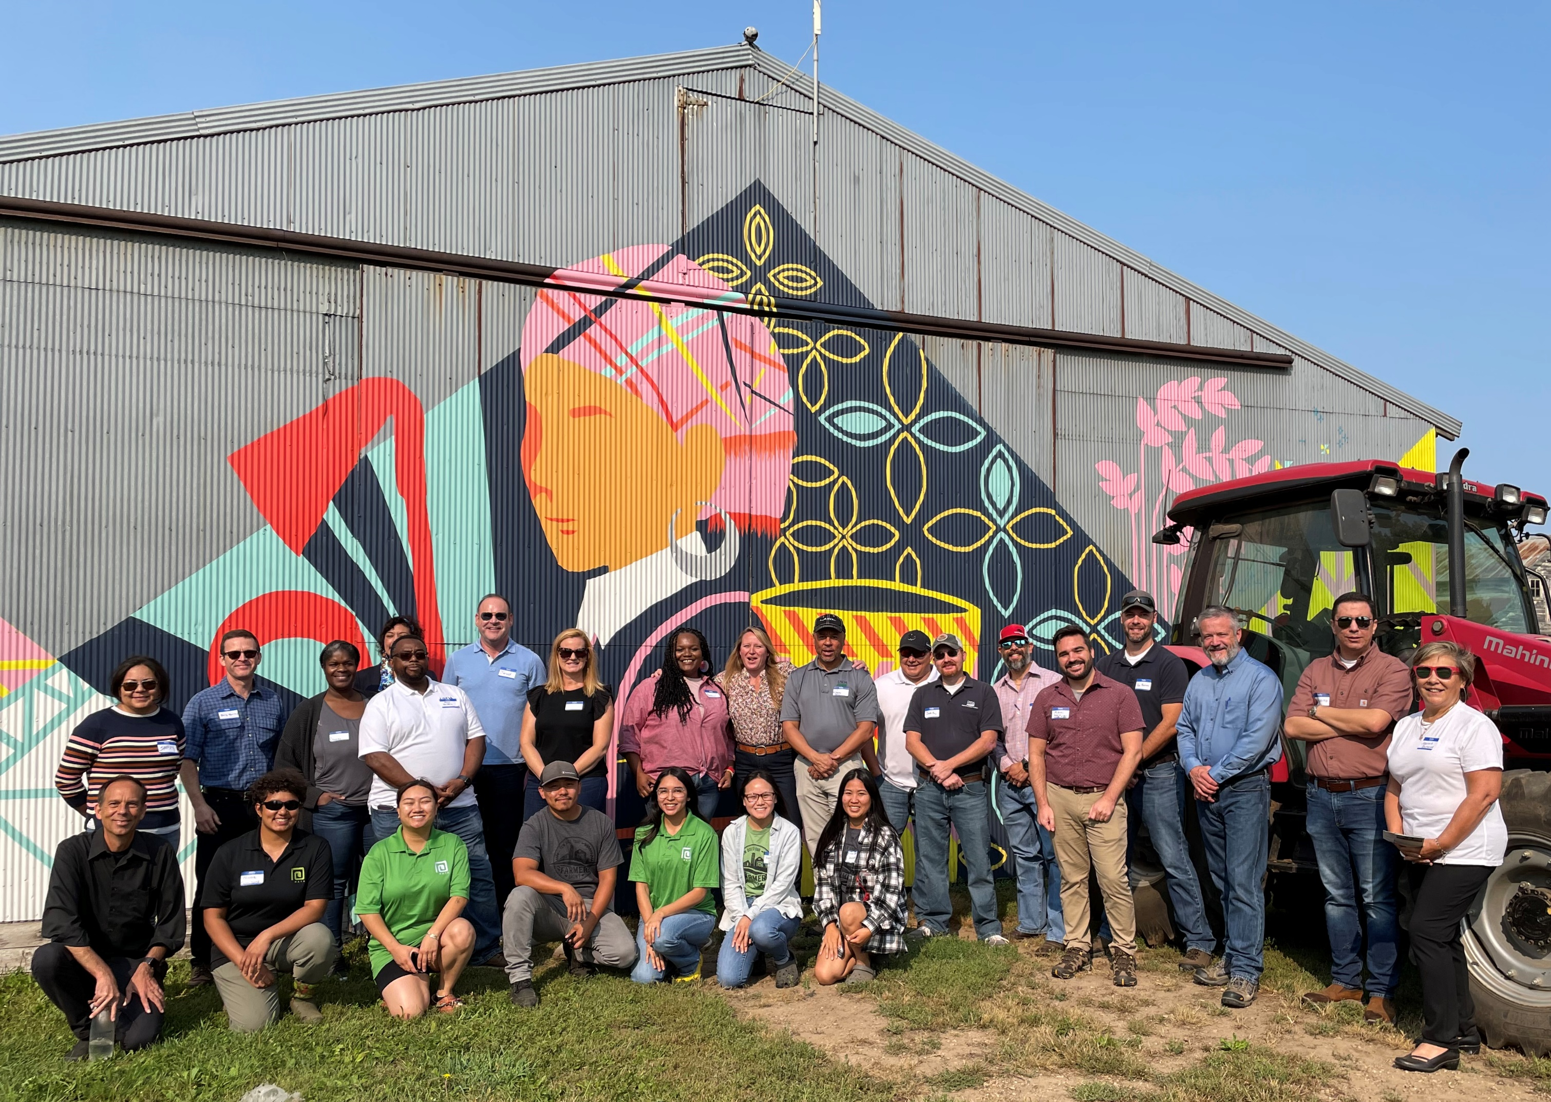
Thank you!
Remember, I am your Administrator! Please reach out to our team.
marcia.bunger@usda.gov
202-209-8801
Notes:
RMED is an active participant in the USDA AAPI Working Group– current outreach efforts include working with the Office of the Secretary to share information with recipients and ROs, support USDA’s efforts by analyzing RMA recipient data for the White House’s new Underserved Youth Task Force –(formerly My Brother’s Keeper Interagency Task Force), at OSEC’s request represent RMA at AAPI events, use the workgroup to share RMA RFA information, and provide OSEC a list of RMA Asian American/Pacific Islander events or potential events/meetings throughout the nation (with a focus on Hawaii) over the rest of FY2017 that the Secretary (or another representative from OSEC) could potentially attend.
RMED is an active participant in the Local and Regional Food Workgroup –This workgroup is multi-agency and we meet bi-weekly to connect with the many programs, research, and educational materials which help farmers, ranchers and food businesses find new opportunities in the local and regional food sector. RMED was part of the planning committee for the USDA Local Foods Impact Metrics Conference, shares information with the group regarding RMED resources and RMA insurance tools, such as WFRP, which can be a resource for those involved in local and regional production.

