Slide 1
Small Business Workshop 201
Day 2
Finding USDA Procurement Opportunities & Fiscal Year 2021 Historical Procurement Data
Presented By: Don Baker
Date: April 14, 2022
Notes:
Good afternoon everyone,
The two topics that I will cover this afternoon are Finding Procurement Opportunities at USDA, and will share the agencies FY21 Historical Procurement Data. This data will be very useful towards seeing the types of supplies and services that USDA has procured in the past. This is important there is a high probability that we will procure the same goods and services in the future.

Slide 2
SAM
USDA posts Contract Opportunities in the System for Award Management (SAM) for contract actions valued at more than $25,000.
  SAM, link.
Vendors can save searches, join interested vendor lists and run reports.
Exceptions to posting are found in the Federal Acquisition Regulation (FAR) 5.202.
Notes:
USDA posts Contract Opportunities in the System for Award Management (SAM) for contract actions valued at more than $25,000. All other agencies in the Federal Government also posts their procurements on this website. If the SAM acronym is unfamiliar to you, the website used to be known as Beta Sam.
For your future use, I have provided a link to the System for Award Management (SAM) website.
The SAM website has a lot of useful tools to include saving searchs, join interested vendor lists and run reports.
There are a few exceptions to posting on the SAM website which can be found in the Federal Acquisition Regulation (FAR) 5.202.

Slide 3
Resources
Office of Contracting and Procurement website, link.
The Small Business Administration (SBA), Federal Contracting Assistance, link.
The Office of Small & Disadvantaged Business Utilization (OSDBU), link.
The FAR, link
Notes:
The content on this slide was shared yesterday, but in case attendees were not able to participate yesterday, I wanted to cover again.
The first link is for the Office of Contracting and Procurement website at USDA.
The second link will connect you to the SBA website. It has many resources for small business wanting to do business with the Federal Government.
The third link is for access to the website for the small business office at USDA.
The last link is for direct access to the FAR if you are unfamiliar federal acquisition terminology or with a clause that see in a future solicitation.

Slide 4
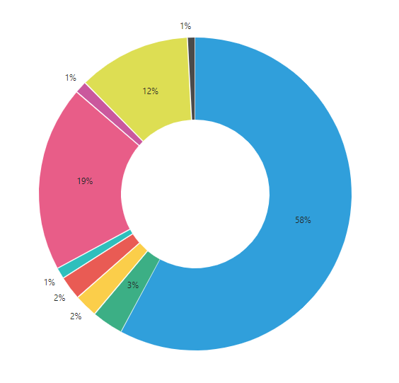
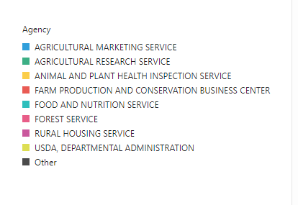
Overview of USDA Spending by Agency
Fiscal Year (FY) 2021 Obligations ($) by Agency:
FS – 19%
AMS-58%
Notes:
On the next 9 slides, I will share historical procurement data from fiscal year 2021. The information is from the Federal Procurement Data System (FPDS), which feeds to USA Spending, and is publicly available.
This slide shows a breakout of Fiscal Year 2021 obligated dollars by agency, on a percentage basis, within USDA. The Agricultural Marketing Service awarded the most dollars in FY21 at $5.58 Billion which represents 58% of obligated dollars. The Forest Service was second at $1.85 Billion which represents 19% of obligated dollars. You can see the other agency’s dollar value on this slide and their associated percentage.
For this slide, and the 8 slides that follow, I’m going to pause for 5 seconds so that you can digest the data before moving to the next slide.

Slide 5
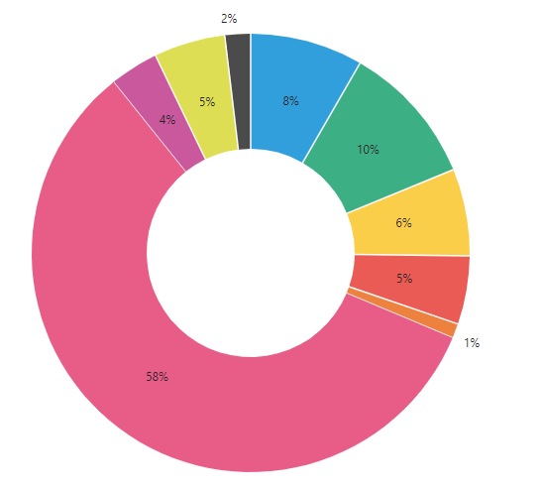
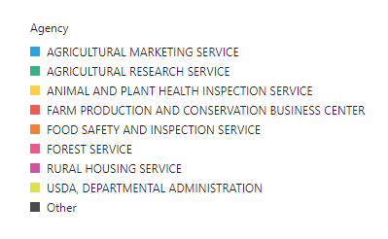
Overview of USDA Spending by Agency
FY 2021 Actions (#s) by Agency:
FS – 58%
Notes:
This slide shows a breakout of Fiscal Year 2021 awarded Actions by agency. The Forest Service awarded the most actions in FY21 at more than 30,000 actions which represents 58% of all actions. A distant second was the Agricultural Research Service at 5,000 actions which represents 10%.
Pause 5 seconds

Slide 6
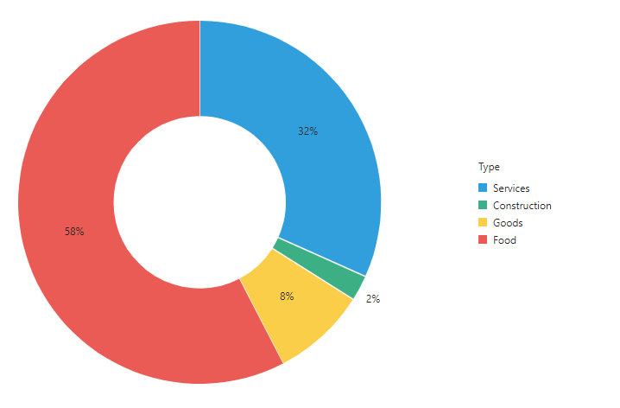
Overview of USDA Spending by Type
Fiscal Year (FY) 2021 Obligations ($) by Type:
Services 32%
Food – 58%
Notes:
This slide shows the FY21 Obligation dollars at USDA by the Type of goods and services. Food purchases total more than $5 Billion which represents 58% of obligations in FY21. Services represented 32% of FY21 dollars which was $3.1 Billion.
Pause 5 seconds

Slide 7
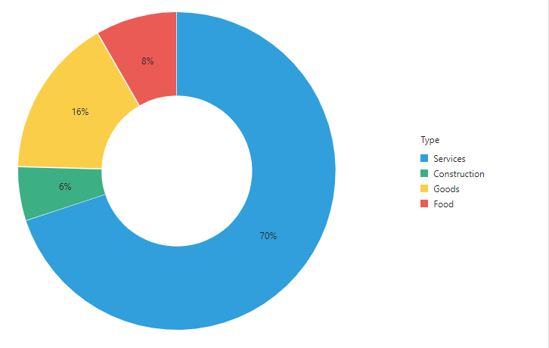
Overview of USDA Spending by Type
Fiscal Year (FY) 2021 Actions (#) by Type:
Services – 70%
Notes:
This slide shows the FY21 awarded Actions at USDA by the Type of goods and services. Almost 37,000 awards were for Services which represented 70% of all awarded actions at USDA. A distant second was Goods which represented 16% of all awarded actions.
Pause 5 seconds

Slide 8
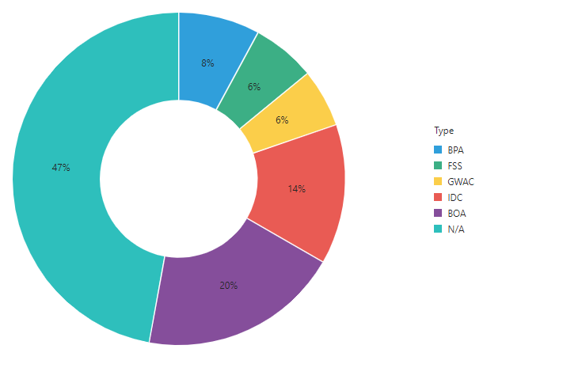
Overview of Procurement Vehicles by IDV
FY 2021 Indefinitely Delivery Vehicles (IDVs) by Obligations ($):
FSS – 47%
Notes:
This slide shows the percentage of dollars USDA awarded using Indefinite Delivery Vehicles or IDVs as well as other procurement methods.
In case you are familiar with USG acronym’s, BPA stands for Blanket Purchase Agreement. FSS stands for Federal Supply Schedules. GWAC stands for Government-Wide Acquisition Contracts. IDC stands for Indefinite Delivery Contract. BOA stands for Basic Ordering Agreement.
BOA’s represent 20% of obligations, IDC obligations represented 14% of obligations., FSS & GWAC both represented 6%, and BPA’s represented 8%. The majority of obligations at USDA were on stand alone contracts or purchase orders which accounts for 47% of obligations.
Pause 5 seconds

Slide 9
Overview of USDA Spending by PSC
FY 2021 Top 10 Product and Service Codes:
Notes:
This slide shows USDA spending by Product and Service Code (PSC). The top 10 Product and Service Codes or PSCs for FY2021 are provided here.
F003 is Natural Resources/Conservation, specifically Forest-Range Fire Suppression/Pre-suppression supplies and services. This represents 18% of all PSCs for FY21.
F018 is Natural Resources/Conservation, specifically Other Forest/Range Improvements (Non-Construction), and it represents 3.57% of all PSCs.
The rest of the PSCs range from 3% to 1.5% of all PSCs for USDA.
If you are interested in learning more about PSC codes, the 2021 Product and Service Code Manual with descriptions can be found on the www.acquisition.gov website.
Pause 5 seconds

Slide 10
Top Supply PSC
FY 2021 Top Supply Product and Service Codes:
Notes:
This slide focuses only on Supply PSC’s which shows PSC 6640 is the most used Supply PSC at 3%, and its for Laboratory equipment and supplies. Close behind is PSC 8915 which is fruits and vegetables at 2.45%.
Pause 5 seconds

Slide 11
Top Services PSC
FY 2021 Top Services Product and Service Codes:
Notes:
This slide focuses on Services PSC’s which shows F003 as the most used PSC for USDA. The F003 PSC is used for Forest-Range Fire Suppression/Pre-suppression and represented 18% of all Service PSCs. F018 (Natural Resources/Conservation) is a distant second at 3.57%.
Pause 5 seconds

Slide 12
Top Construction PSC
FY 2021 Top Construction Product and Service Codes:
Notes:
This is the last slide that provides historical procurement data from fiscal year 2021, and this slide shows that PSC Z1LB is the top PSC for FY21. Z1LB is for Maintenance of Highways, Roads, Streets, Bridges and Railways and is a little over 1% of all PSCs. Y1LB is for the Construction of Highways, Roads, Streets, Bridges and Railways and is a little over 1% of all PSCs.
Pause 5 seconds

Slide 13
Procurement Forecast
The Office of Small and Disadvantaged Business Utilization (OSDBU), manages the procurement forecast for USDA.
The Procurement Forecast is managed according to USDA Departmental Regulation (DR) 5090-003, “Annual Procurement Forecast Requirements”, https://www.usda.gov/directives/dr-5090-003.
The Fiscal Year (FY) 2022 Forecast of Procurement Opportunities can be found at https://www.dm.usda.gov/smallbus/forecast.htm.
Notes:
For your situational awareness, the Office of Small and Disadvantaged Business Utilization at USDA manages the procurement forecast. The Procurement Forecast is an annual requirement at USDA, is updated in April of each year, and is managed according to USDA Department Regulation. A link is provided in this slide if you would like to review those requirements.
I’ve also provided a link for the FY22 forecast of procurement opportunities.
That concludes my presentation. If you have any questions, please put them in the chat, or ask it when Jacqueine recognizes you.

