Slide 1



United States Department of Agriculture
National Partnership Office
USDA Forest Service
National Forest System
Forest Service
Notes:
Photo: Nantahala National Forest, North Carolina

Slide 2
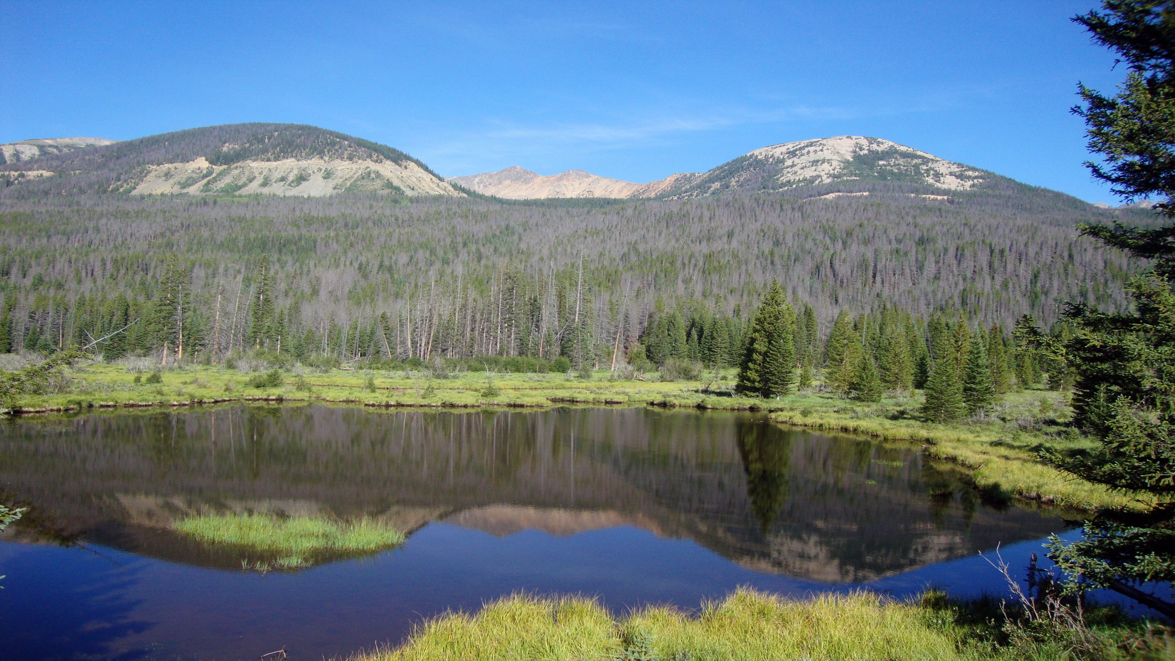

National Partnership Office
Build partnership capacity & community of practice
across the agency
Cultivate national level partnerships
to serve the whole agency
Empower and enable a culture of innovation
so the Forest Service can achieve its mission
Notes:
Photo: This is a view of the Never Summer Mountains from the Beaver Ponds Picnic Area in western Rocky Mountain National Park. These dead trees are the handiwork of mountain pine beetles.

Slide 3
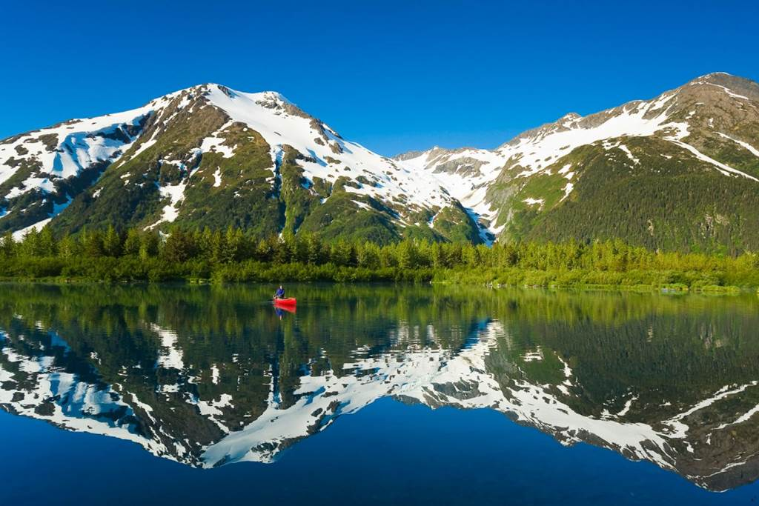
Partnership Capacity & Community
Putting partnerships at the center of agency culture
Community of practice – core group, partnership network, intra- and interagency collaborators
  Messaging
  Staffing
  Leadership
Capacity building and training
Notes:
Photo: Chugach National Forest, Alaska

Slide 4

National Partnerships and Programs
Can be tiered off of efficiently
Create external advocates
Opportunity for large-scale work
Examples include Coca-Cola, Travels with Darley, the National Forest Foundation, National Fish and Wildlife Foundation, National Environmental Education Foundation, and many others
Every Kid Outdoors, Secure Rural Schools, etc.
Notes:
Siuslaw NF

Slide 5
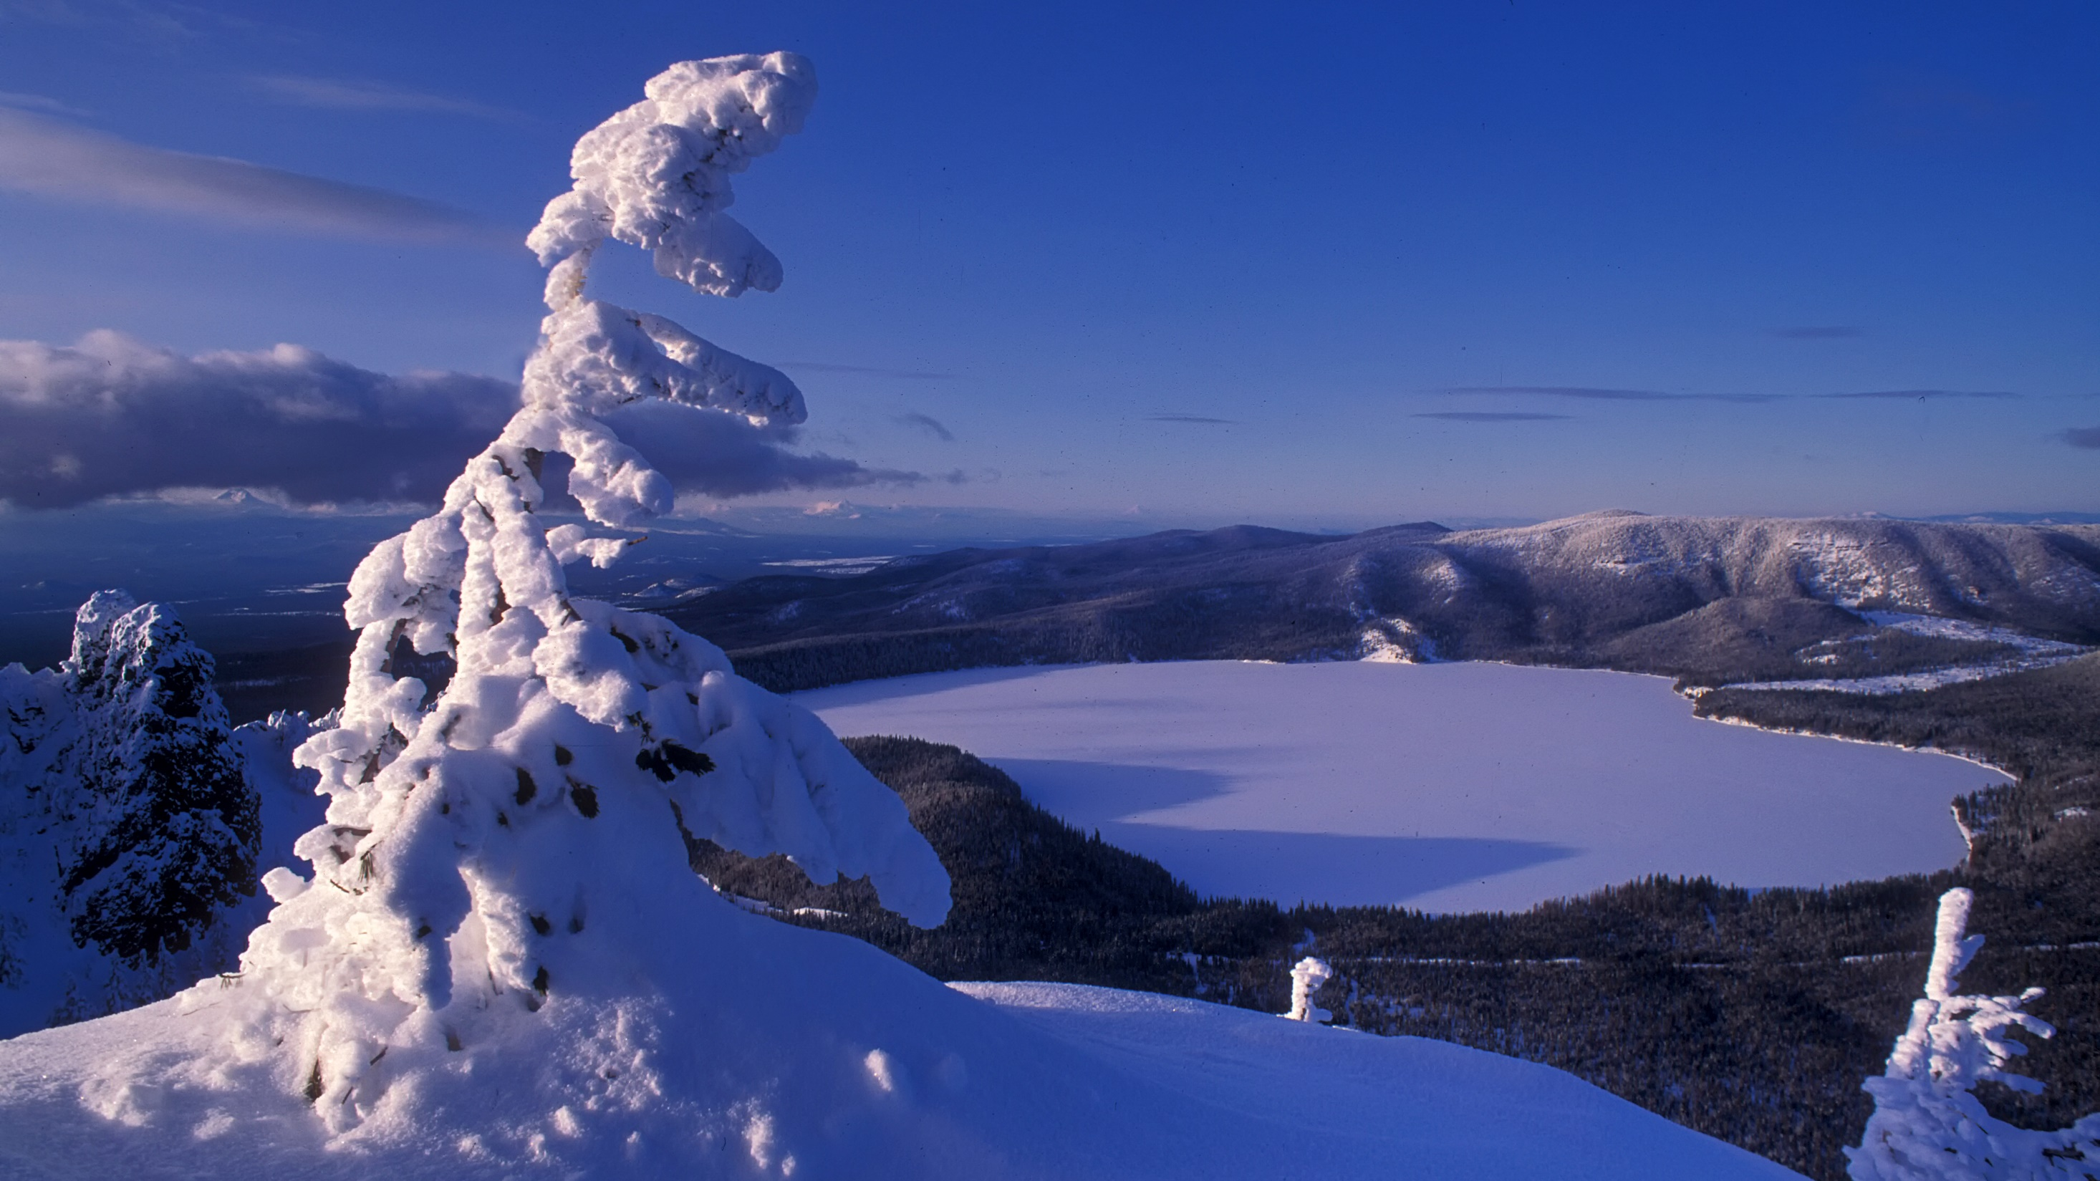
United States Department of Agriculture
Partnership Support Team (PST)
USDA Forest Service
National Partnership Office
Forest Service
Notes:
Deschutes NF

Slide 6

PST Overview
This program pulls the agency’s national, field-focused partnership work together under one umbrella, providing it renewed vision, funding, and staff support.
This work provides the field with partnership and Grants & Agreements tools, expertise, and agency-wide support.
Ultimate goal is to aggressively grow partnerships, capitalize on opportunities to innovate, and support the partnership community across the country.
Notes:
Helena NF

Slide 7

PST Resources
Partnership Essentials Training
National Partnership Resources SharePoint and Teams page
Partnership Peer Learning Series
Partnership Community Calls
Managing by Network
On-site Consultation
Notes:
Ottawa NF

Slide 8
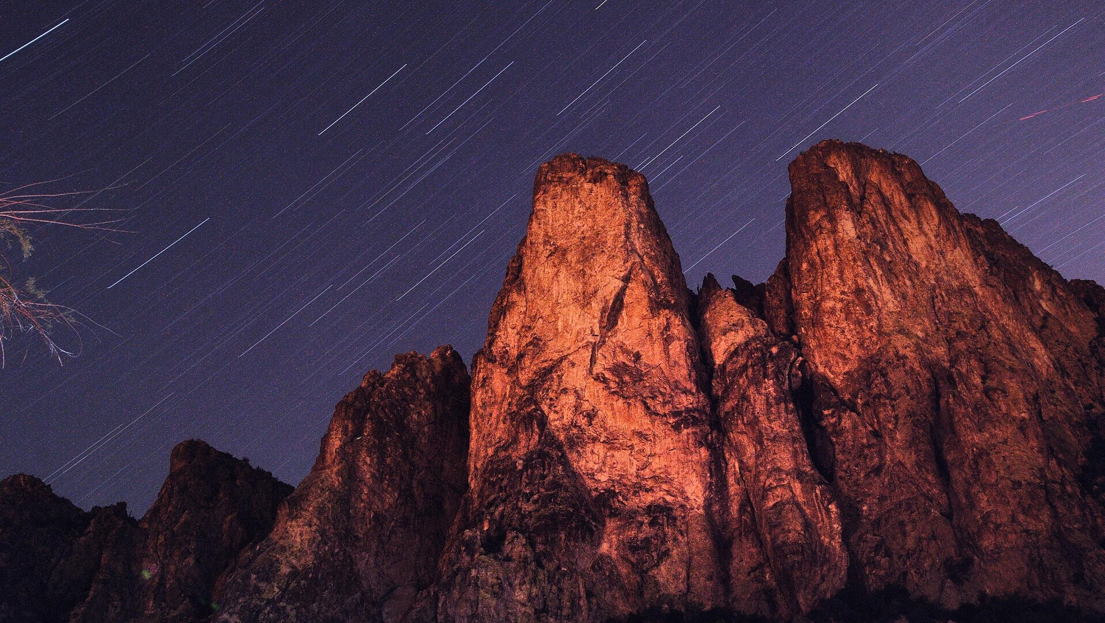
United States Department of Agriculture
Secure Rural Schools (SRS)
USDA Forest Service
National Partnership Office
Forest Service
Notes:
Tonto NF

Slide 9
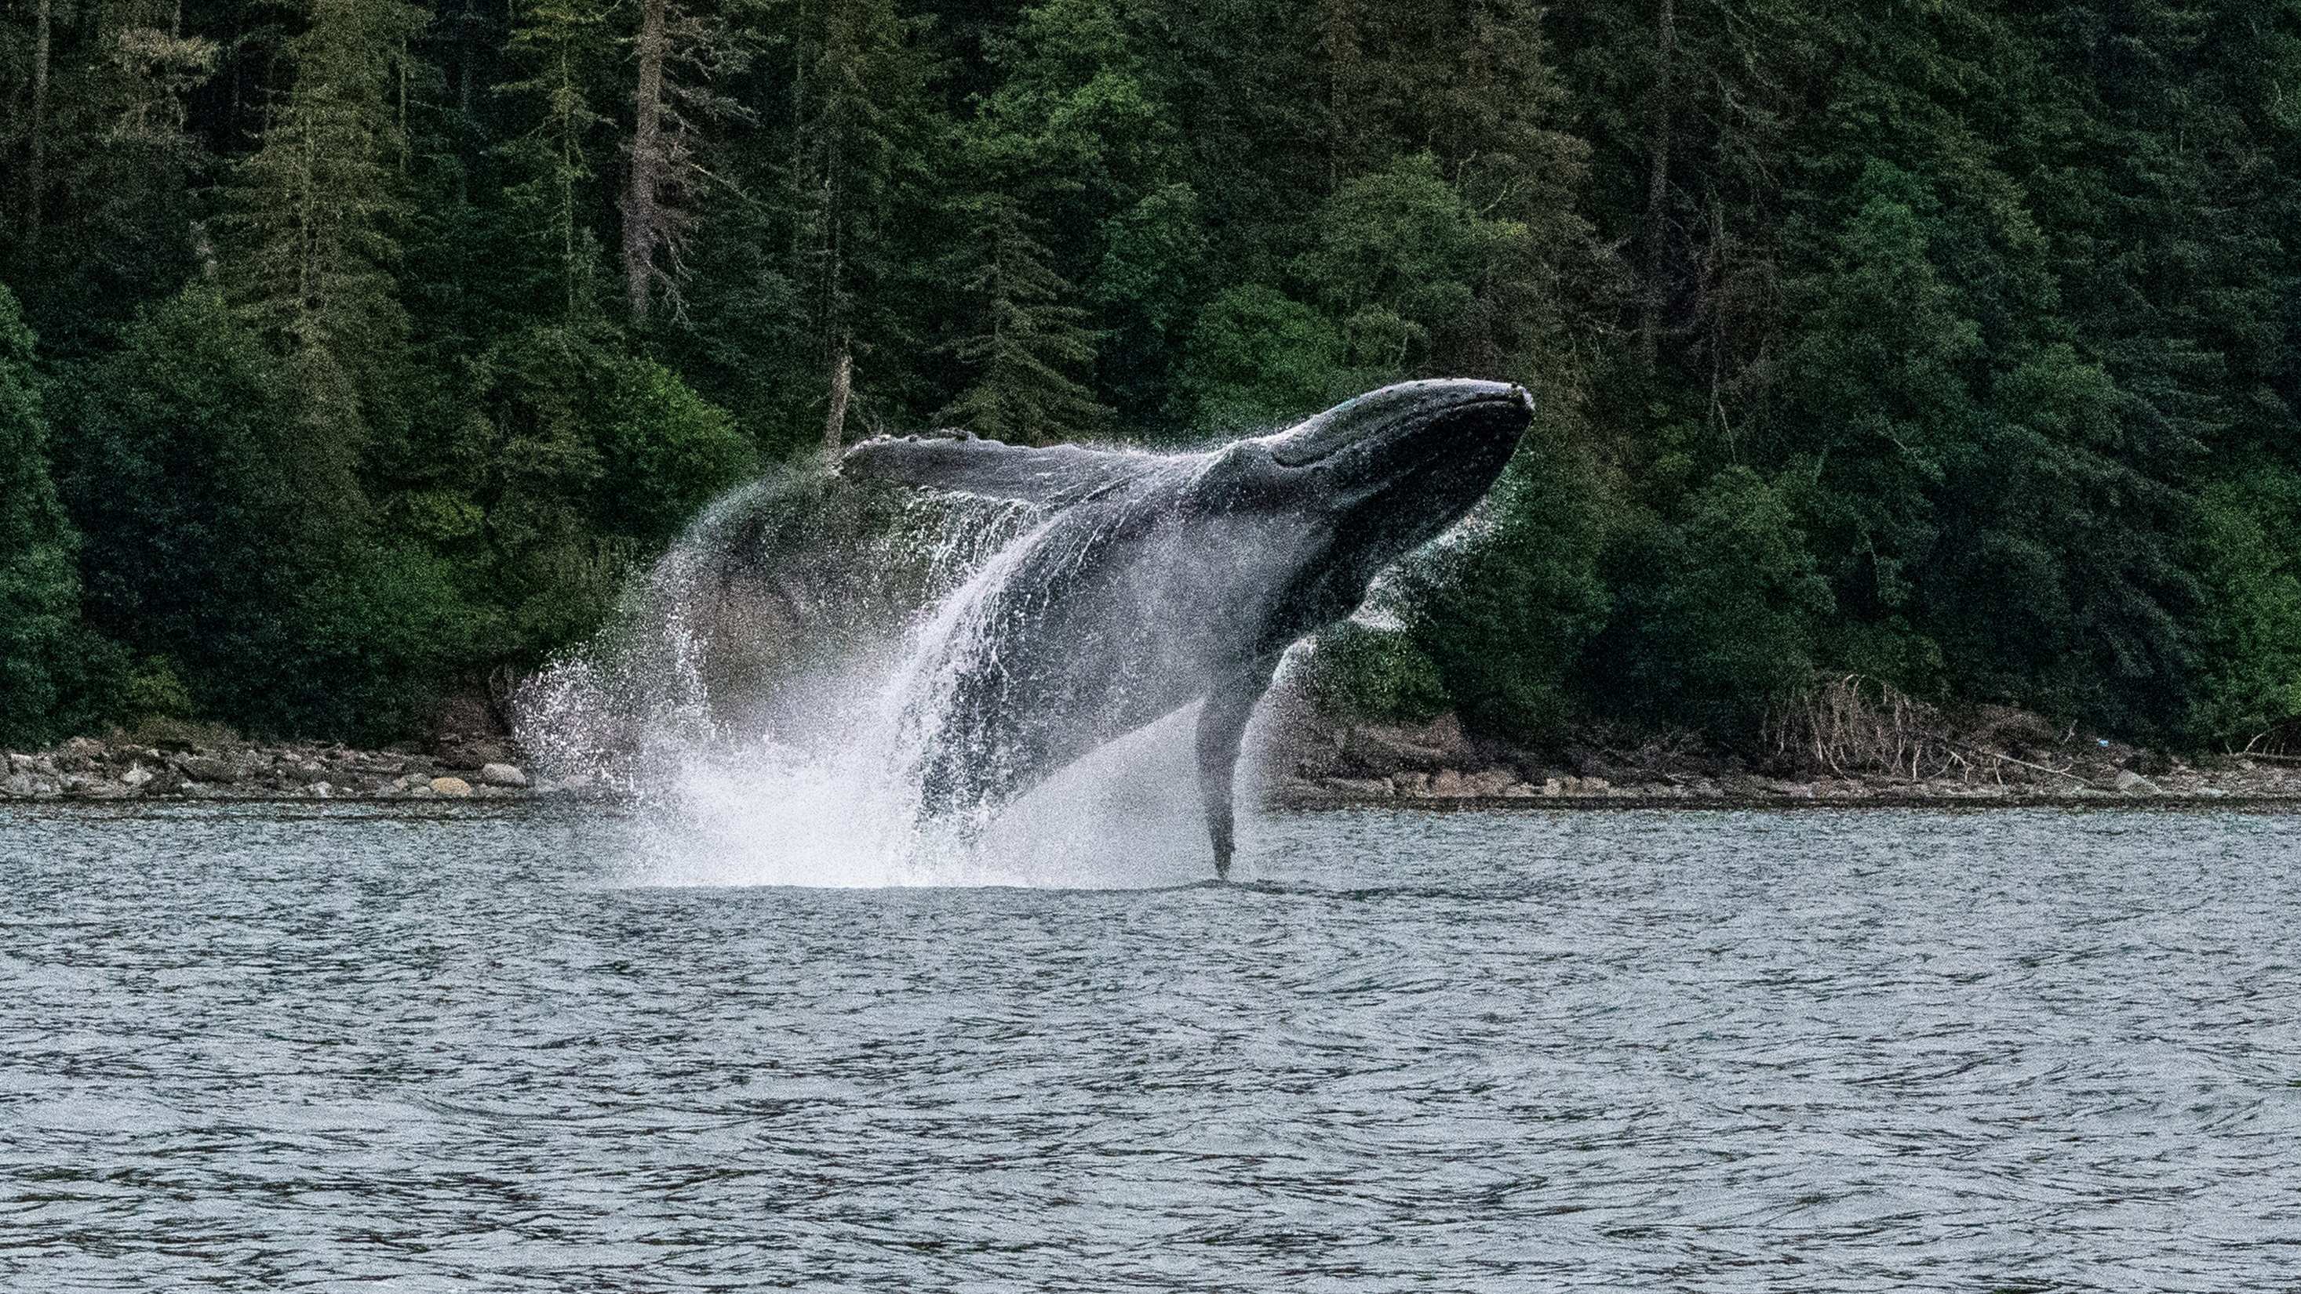
SRS Overview
SRS provides critical funding for schools, roads, and other municipal services to more than 700 counties across the U.S. and Puerto Rico.
This team serves as the liaison to regional coordinators and almost 100 Designated Federal Officers (DFOs), often District Rangers and Forest Supervisors, supporting on-the-ground implementation of SRS Title II funded projects.
Notes:
Tongass NF

Slide 10
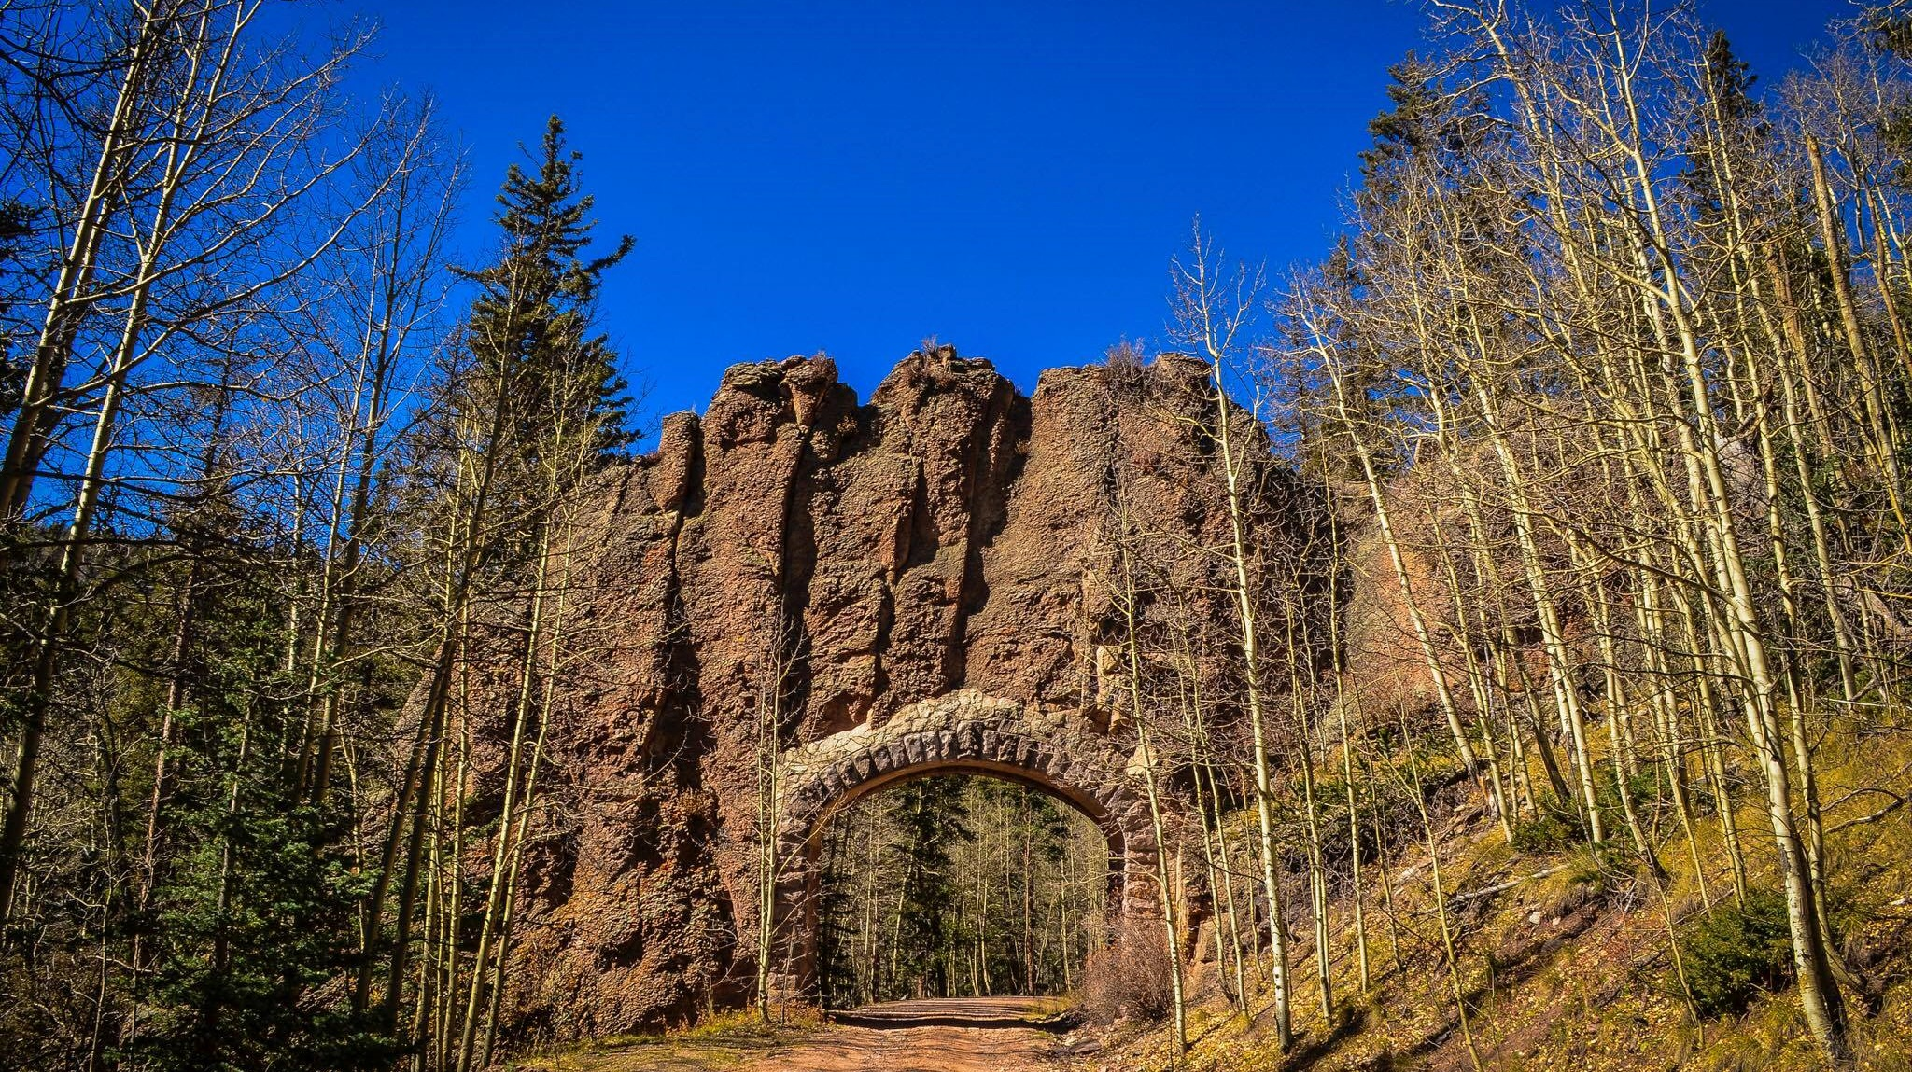
SRS Resources
Public-facing website
    Includes information on authority, titles, and payments
Notes:
Isabel NF

Slide 11

United States Department of Agriculture
Conservation Finance (CF)
USDA Forest Service
National Partnership Office
Forest Service
Notes:
Klamath NF

Slide 12
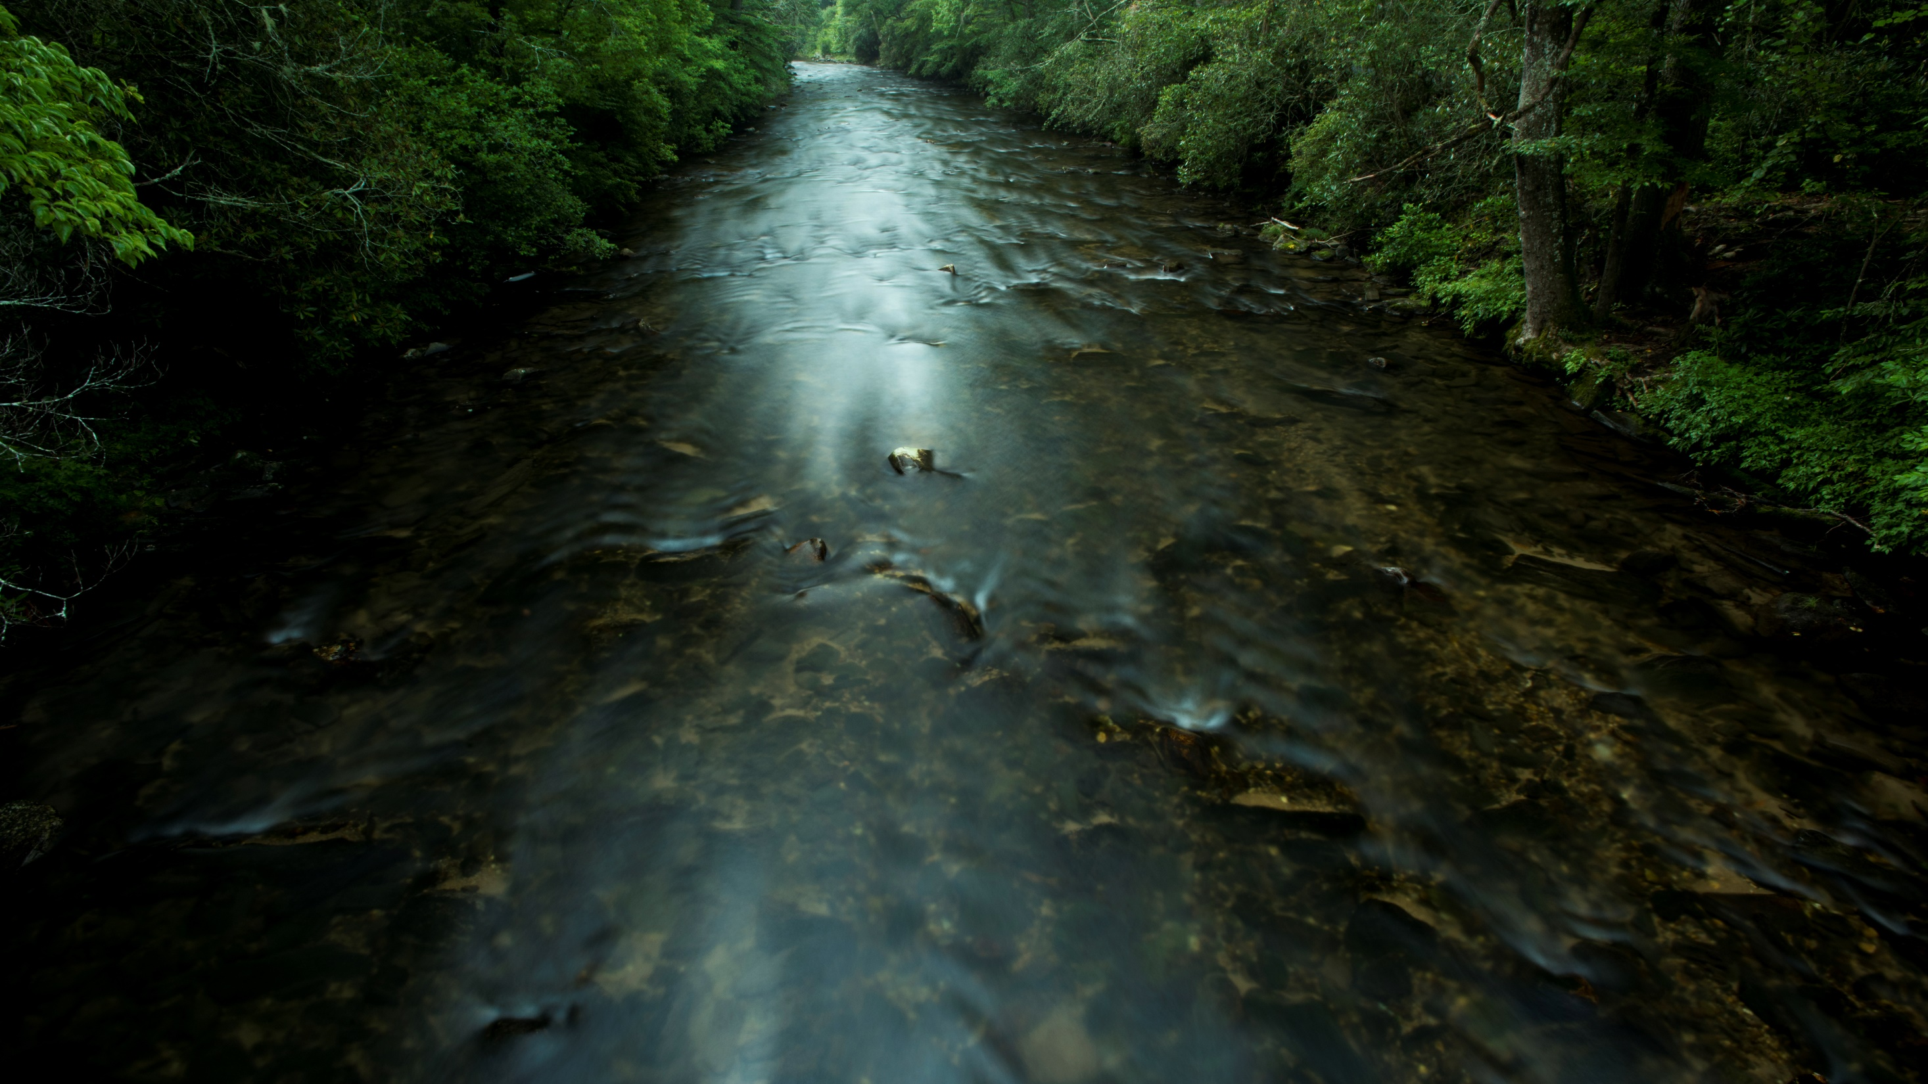
Conservation Finance Overview
Conservation finance is the practice of raising, managing, and deploying capital for conservation outcomes
Need
$80B restoration backlog
$5B deferred maintenance backlog
40% decline in non-fire personnel since 1995
Opportunity
Private investment capital, with growing interest in impact
Creative deployment of public/philanthropic funds
Notes:
Pisgah NF

Slide 13

CF Resources
Conservation Finance website
Notes:
Six Rivers NF

Slide 14
United States Department of Agriculture
Workforce Development Partnership Service Hub (WDP)
USDA Forest Service
National Partnership Office
Forest Service
Notes:
Tonto NF

Slide 15
WDP Overview
Workforce development partnerships enhance the Agency’s capacity to get essential work done, leverage existing authorities and programs that address critical priorities and support Agency workforce planning
Provide job training and work experiences in natural resources, conservation and other environmental careers for youth, young adults, emerging professionals, students and veterans ranging in ages 15 – 35
Overarching WDP objectives:
Consolidate all national-level, third-party internship programs and the Resource Assistants Program into a new Student and Emerging Professionals focus area
Enhance relationships with current partners and develop new, sustained partnerships with affinity groups, professional/student organizations and minority serving institutions.
Increase Tribal engagement
Notes:
Tongass NF

Slide 16
WDP Programs
Five programs comprise Workforce Development Partnerships
21st Century Conservation Service Corps (21CSC) / Public Lands Corps: Engage young adults and veterans on work projects that provide job training experiences and in some cases pathways to employment
Indian Youth Service Corps (IYSC): Advance conservation and protection of natural and cultural resources among Tribal groups and on Tribal lands.
Youth Conservation Corps (YCC): Summer youth employment program for teenagers ages 15-18 who work on Forests and urban communities and are exposed to natural and cultural resources careers and outdoor experiences.
Student and Other Internships: Partnerships with organizations and institutions that facilitate scholarship and internship programs designed to attract outstanding students from diverse communities to natural resources careers.
Notes:
Isabel NF

Slide 17
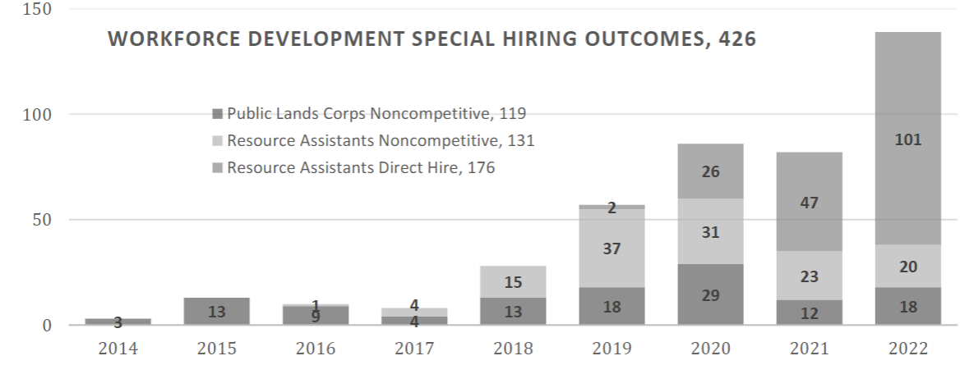
WDP Goals
Notes:
Isabel NF

Slide 18
WDP Resources
Opportunities for Young People
    https://www.fs.usda.gov/working-with-us/opportunities-for-young-people
Notes:
Isabel NF

Slide 19
United States Department of Agriculture
Diversity, Development, and Outreach(DDO)
USDA Forest Service
National Partnership Office
Forest Service
Notes:
Tonto NF

Slide 20
DDO Overview
DDO supports high-leverage and high-impact actions to improve equity and implement Executive Order (EO) 13985. EO 13985 looks to advance racial equity and support for underserved communities.
DDO goals:
  Ensure the agency works more closely with Equity Centered Partners
  Pinpoint common barriers to the successful equitable engagement of underserved communities in conservation
  Promote change by providing new training and resources to agency employees.
Notes:
Tongass NF

Slide 21
DDO Resources
Executive Order 13985 on Advancing Racial Equity and Support for Underserved Communities Through the Federal Government
  https://www.whitehouse.gov/briefing-room/presidential-actions/2021/01/20/executive-order-advancing-racial-equity-and-support-for-underserved-communities-through-the-federal-government/
Notes:
Six Rivers NF

Slide 22
United States Department of Agriculture
Bipartisan Infrastructure Law/Inflation Reduction Act Coordination Team (BIL/IRA)
USDA Forest Service
National Partnership Office
Forest Service
Notes:
Klamath NF

Slide 23
BIL/IRA Overview
Top level program of work for each section/subsection of the BIL/IRA in which NFS is lead, co-lead, or supporting
Identify key goals and objectives, external partners, barriers, etc.
Assist in regional and other agency coordination
Coordination with NFS Budget and Business Operations:
    Regional allocations
    Reporting/tracking needs
Notes:
Tongass NF

Slide 24
BIL/IRA Resources
Bipartisan Infrastructure Law text
Inflation Reduction Act text
Notes:
Six Rivers NF

Slide 25
United States Department of Agriculture
Operations Team
USDA Forest Service
National Partnership Office
Forest Service
Notes:
Deschutes NF

Slide 26
Operations Overview
The purpose of the NPO Operations Team is to provide expertise to make it easier for internal and external organizations to develop partnerships that care for the land and serve people.
Emphasis areas include:
  Administrative needs such as curating staff information and shared folders
  Program management support of national level partnerships
  Communication support
  Extra capacity on grants and agreements and budget support as needed
Notes:
Helena NF

Slide 27

Questions?
Thank You!
Partnerships website: https://www.fs.usda.gov/working-with-us/partnerships
Director: Gary Barret; gary.barrett@usda.gov
Notes:
Questions??
Thank You!
Monongahela NF

