Slide 1


FORGE (Finding Opportunities and Resources to Grow Entrepreneurs)
A unique entrepreneurial community combining startup acceleration alongside experiential student and community education. A unit of University of Arizona Research, Innovation, and Impact, FORGE has three missions, our “3 C’s”:
Campus –
Cultivate entrepreneurial thinking
(FORGE Student Venture Pathways)
Community –
Advance the entrepreneurial ecosystem
(FORGE Communities)
Capital –
Drive scale‐up/launch acceleration
(FORGE Ahead)
forge.arizona.edu

Slide 2
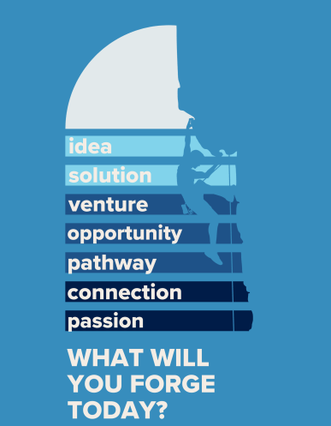
FORGE Student Venture Pathways​ -
Cultivating an entrepreneurial mindset in all students​
Entrepreneurial Mindset Assessment - insight into the 8 domains of entrepreneurial mindset.
Venturing 101 –asynchronous, online short courses on topics relevant to launching a venture.
Playshops - content about core identity, building resiliency and how entrepreneurial thinking can support individuals in defining personal success.
Support + Share groups for student founders.
Pathways Perspectives student led interviews with founders and business leaders.
Biomedical Entrepreneur Scholarships for student venture concepts to improve health outcomes.
Campus Office Hours​ at Resilience FORGE and STEAM FORGE​ with on site staff mentoring, assessment and guidance.
forge.arizona.edu

Slide 3

FORGE Communities​ -
Supporting the entrepreneurial ecosystem wherever the university operates
FORGE at Roy Place​ -downtown location hosting event and meeting space, complimentary co-working, drop in mentoring and guidance in navigating the entrepreneurial ecosystem.
Thursdays at FORGE – weekly speaker program presenting community speakers, interviews with business leaders, pitch practice and panel discussions.
Native FORGE - providing services to the 22 federally recognized tribes in Arizona.
Professional Mentors in Residence at locations at UA Tucson Campus, FORGE at Roy Place, Phoenix Bioscience Core and Yuma Academic Center.
Work and event space sponsorship for qualified community partners.
forge.arizona.edu

Slide 4


FORGE Ahead​ -
Driving scale and launch acceleration of promising startups
Yearlong Residencies for 8 Scale-Up Companies at FORGE at Roy Place.
Dedicated team of 10 Mentors in Residence with extensive expertise in
product & process development
enterprise-wide communication and collaboration services
services and cybertechnology for the Department of Defense
healthcare technology
inpatient and outpatient provider spaces
strategy consulting in biotechnology
small business development
economic development
public affairs and communication
manufacturing
real estate and restaurant development
Condensed (8-week) program coming in 2023.
forge.arizona.edu

Slide 5
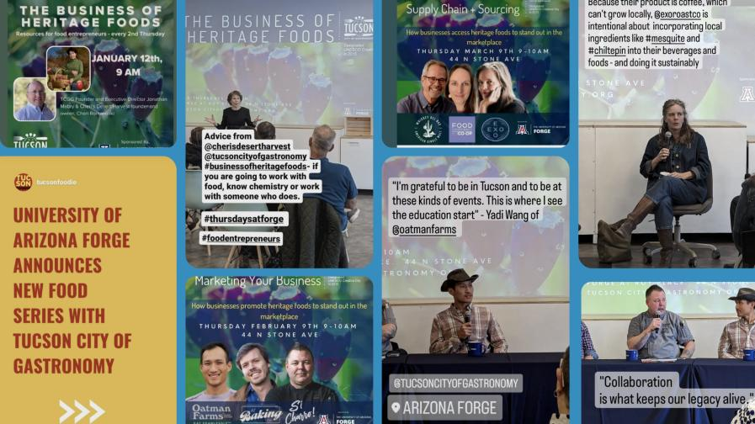
In 2023, FORGE launched The Business of Heritage Food series in partnership with Tucson UNESCO City of Gastronomy
The series recruits business owners to talk about the challenges of creating and sustaining food based businesses – addressing topics including sourcing and supply chain issues, marketing, local resources and sustainability.

Slide 6
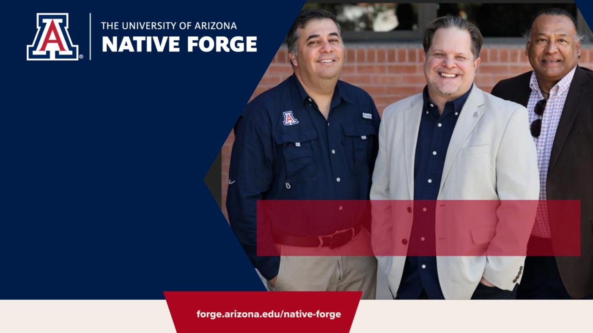
Indigenous entrepreneurs in Arizona can now receive targeted support through Native FORGE, a new University of Arizona program designed to drive economic development in the state’s 22 federally recognized tribes. Through mentorship, data training, development and assessment, the program takes aim at the specific needs of Native entrepreneurs and is made possible by a matching grant from the U.S. Economic Development Administration.
Levi Esquerra, senior vice president for Native American Advancement and Tribal Engagement; FORGE founding executive director Brian Ellerman; and Rafael Tapia Jr., a member of the Pascua Yaqui Tribe, Director of Tribal Community Connections at Local First Arizona, and dedicated mentor in residence for Native FORGE.

Slide 7

Components of the Native FORGE Program
Skills Development
Dedicated Mentorship
Tribal entrepreneurs utilize the FORGE Venturing 101 Platform, an asynchronous online curriculum on core venture concepts including Getting Started with a Venture, Ideation, Problems, & Solutions, Customer Development, Failure & Resilience, Business Modeling Communicating Your Idea, Building Your Team, Financial Literacy and Intellectual Property and Business Formation.
Mentors serve as guides, sounding boards, and sources of inspiration, to help entrepreneurs reach their goals. FORGE provides a diverse network of Mentors in Residence. Entrepreneurs are paired with mentors for one-on-one guidance in developing and refining their business goals.
Annual Native FORGE Conference
Technology Supplies and Assistance
Tribal entrepreneurs, tribal leadership and other representatives gather annually for a dedicated conference providing access to industry experts, resources and introductions to investors.
Through the grant, entrepreneurs receive laptops, wi-fi hotspots and assistance with accessing and utilizing technologies that can help grow their business.

Slide 8
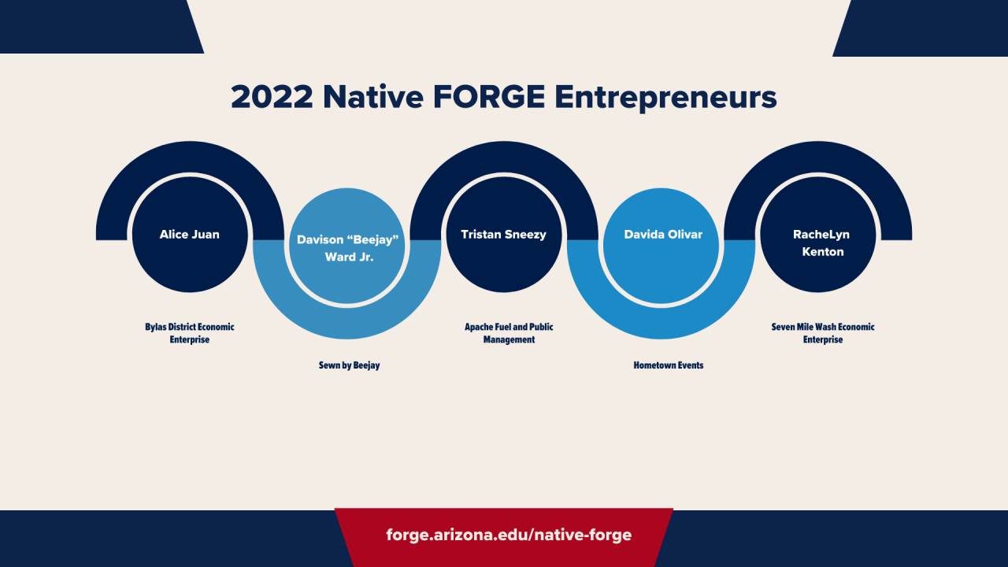
A convenience store, gas station, laundromat, and Wikkiup Village. The Village serves as a multipurpose site for events, a farmer's market, and a tourist rest stop. Her goal is to increase business for the location and increase healthier food options for the local community.
Provides landscape and basic maintenance services to tribal departments. He is working on securing a bond/insurance to be able to participate as a vendor for the San Carlos Apache Tribe and other government entities. His goal is to raise funds to secure the bond.
Convenience store and fast-food cafe located in the heart of the San Carlos Apache Tribe serving the Peridot and San Carlos Community. Her goal is to expand the cafe to include a sitting area for citizens and visitors and redesign the layout of the store to build capacity for more products to be offered.
Custom handcrafted quilts uniquely designed and made with his traditional and artistic touch. Beejay's goal is to promote his products in the open market and secure enough funding to get local community members involved in his business to meet the demand.
Events management company offering supplies and equipment needed for events. Her goal is to expand her business by offering self-serve options to customers by strategically placing mini-storage structures on the reservation and nearby town of Globe.

Slide 9
FORGE at Yuma Academic Center
Drop-in mentoring for students and community entrepreneurs
  Yuma-based Mentor-in-Residence is former Yuma SBDC Director
Connection point to Fort Yuma Quechan Tribe and their ED
  Soon-to-open makerspace and incubator in Winterhaven
Next to soon-to-open Nutritional Sciences and Wellness Foods Lab
  Additional opportunity to connect entrepreneurial thinking to food
Across the street from AWC, NAU, and ASU programs/students

Slide 10

​
SCAN Here for FORGE Resources.
For more information, contact FORGE Founding Executive Director ​
Brian Ellerman at bme@arizona.edu
forge.arizona.edu

