Slide 1
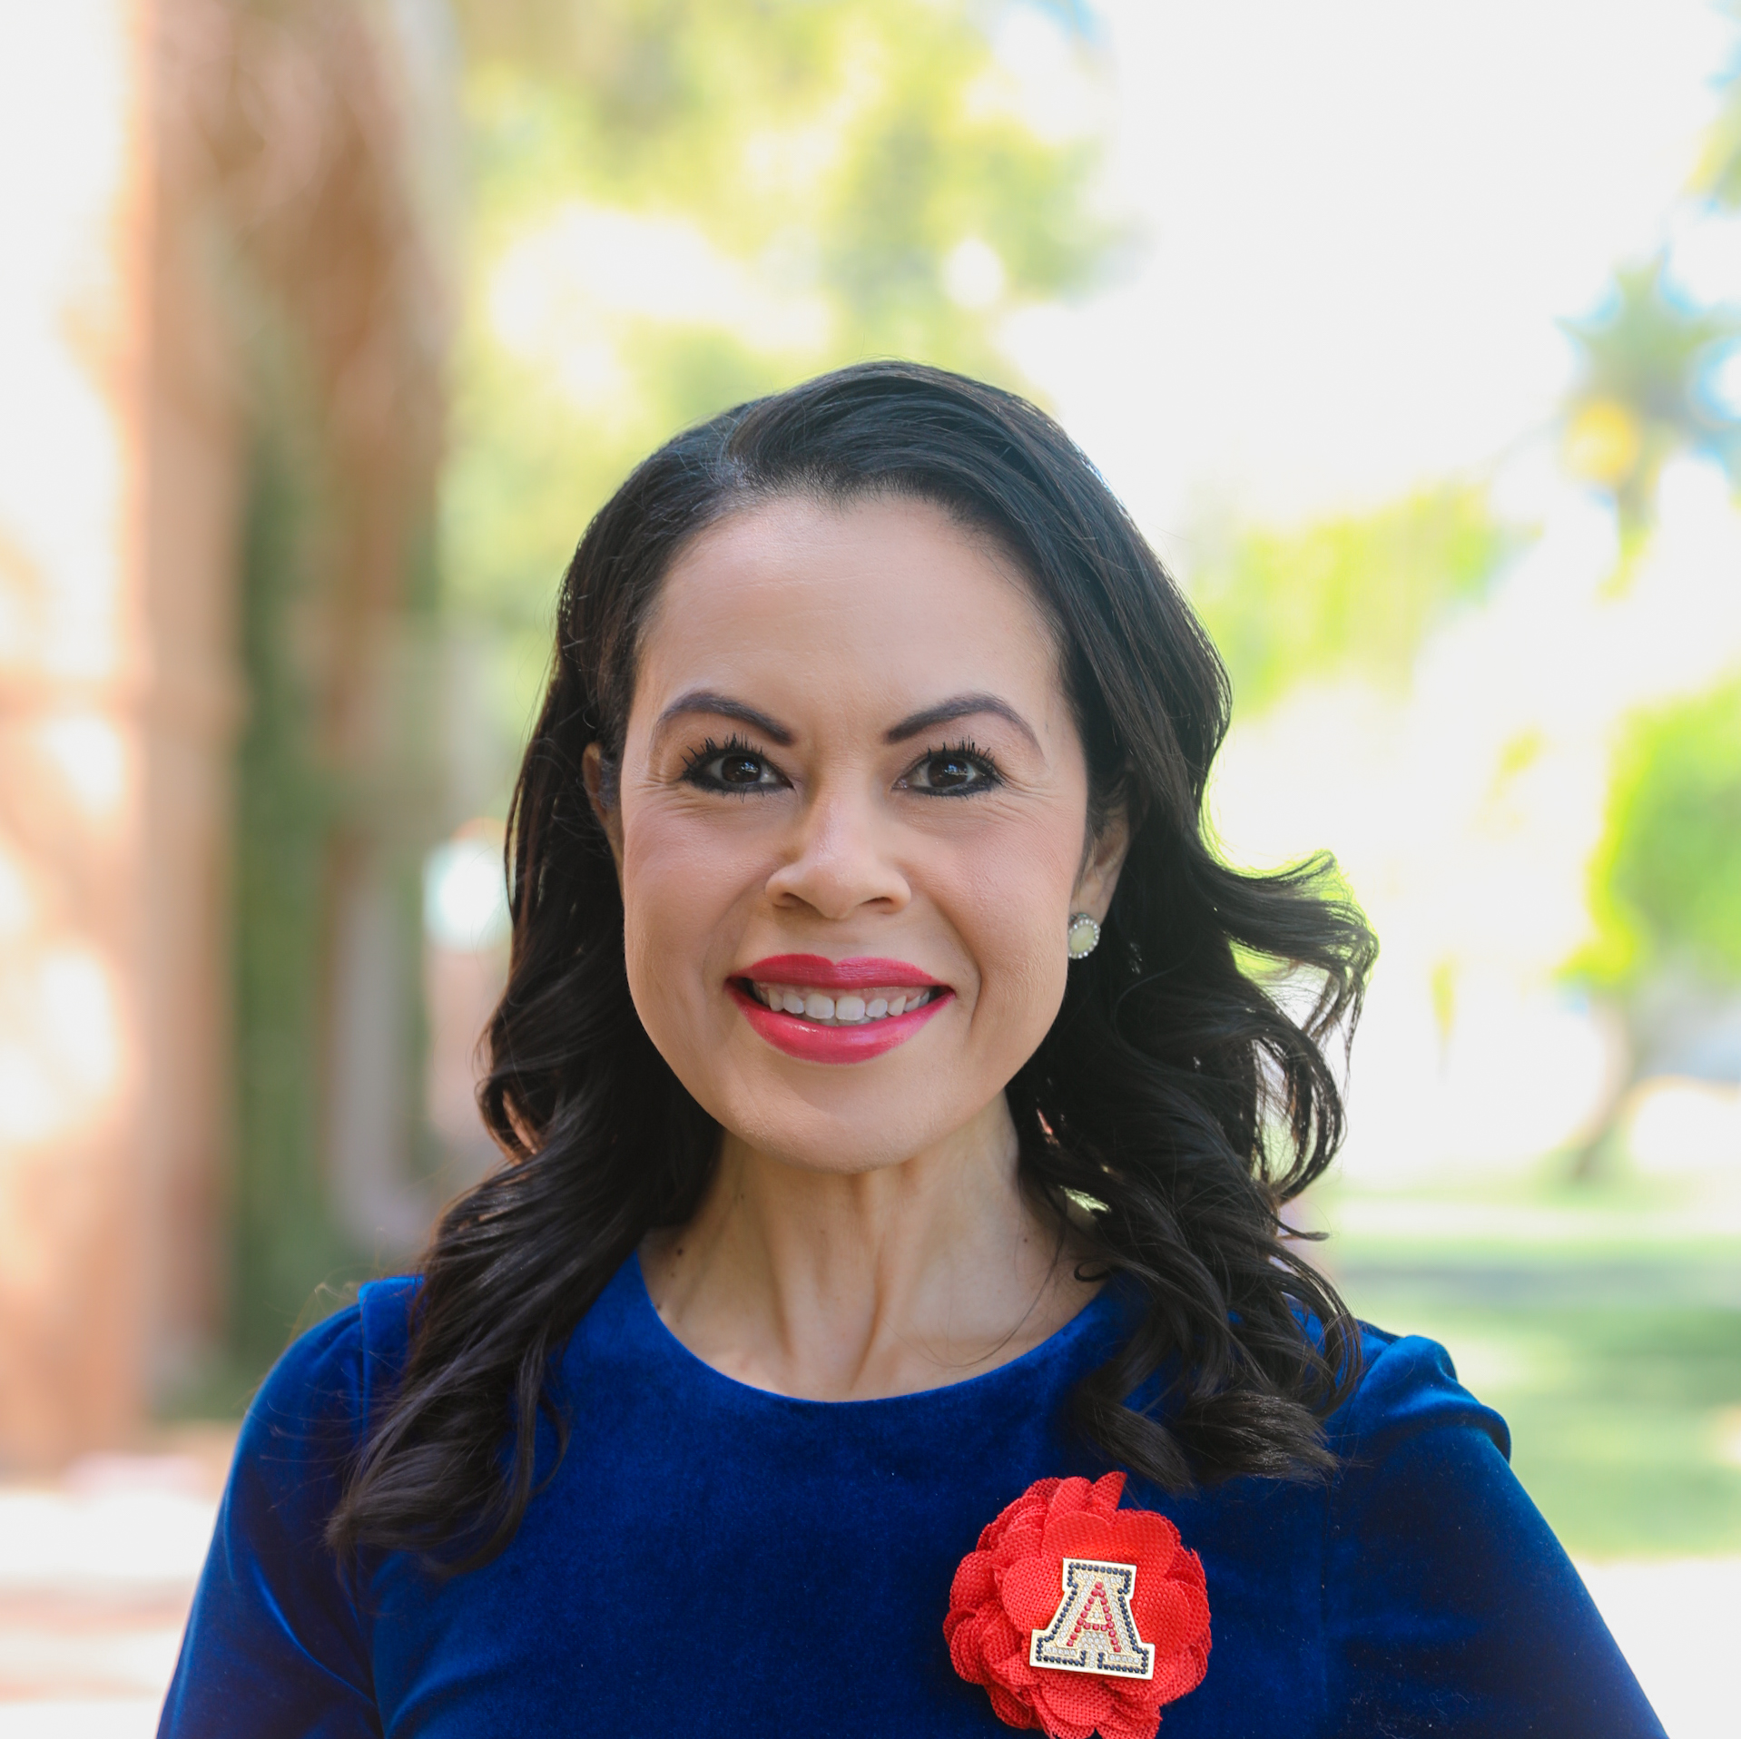
HSI Overview & USDA Partnerships
University of arizona
USDA Advisory Committee on minority Farmers
March 28, 2023

Slide 2
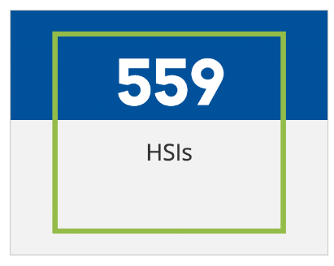
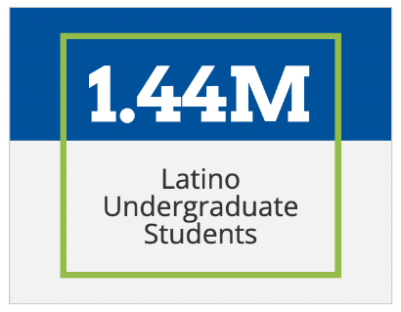
Hispanic Serving Institutions (HSIs) across the U.S.
HSI: Federal designation by the U.S. Department of Education acknowledging higher education institutions that enroll at least 25% undergraduate Hispanic students.
Source: Excelencia in Education; Hispanic Association of Colleges & Universities
Notes:
Full List of HSIs: https://www.hacu.net/hacu/HSIs.asp
HSI Facts: https://www.edexcelencia.org/research/hispanic-serving-institutions-hsis

Slide 3
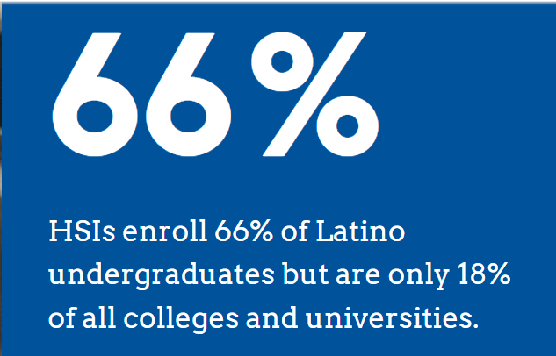

HSIs across the U.S.
Source: Excelencia in Education; Hispanic Association of Colleges & Universities
Notes:
Full List of HSIs: https://www.hacu.net/hacu/HSIs.asp
HSI Facts: https://www.edexcelencia.org/research/hispanic-serving-institutions-hsis

Slide 4
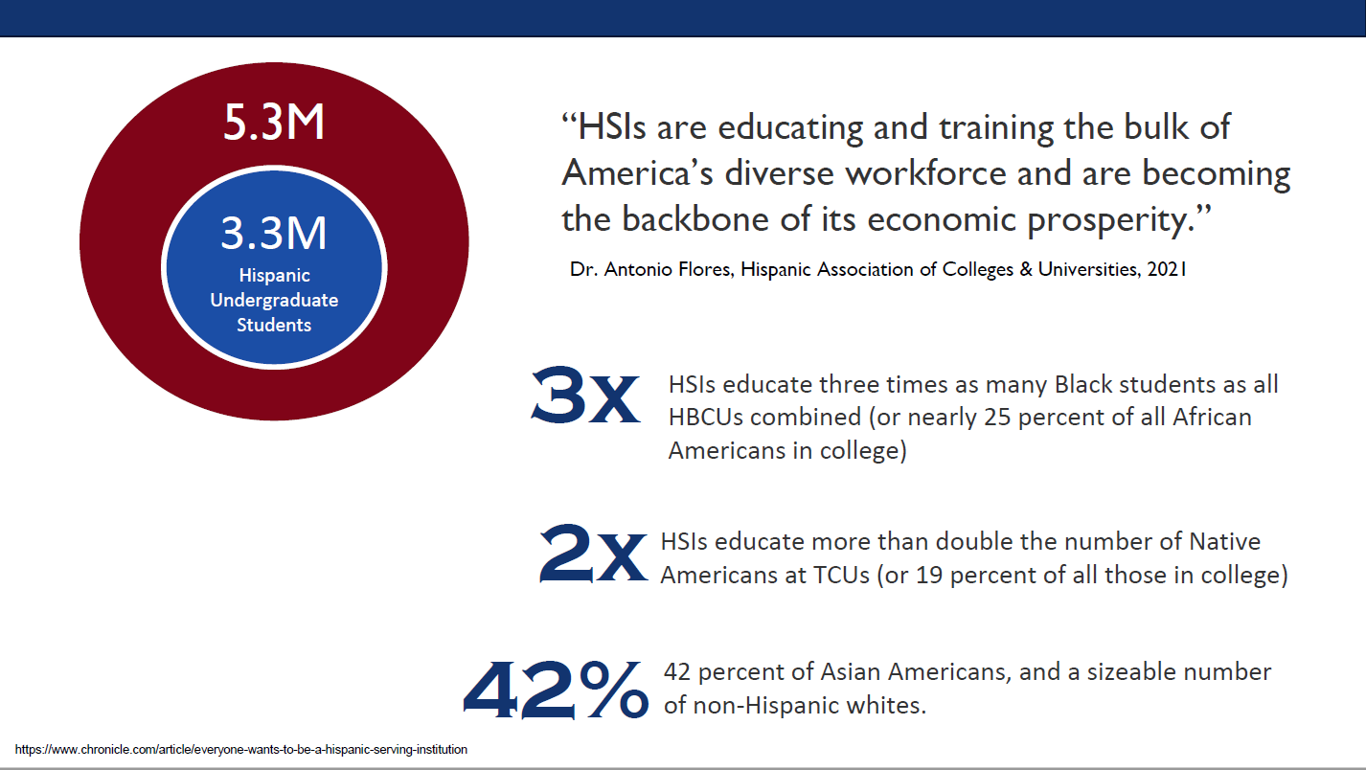

Nearly 1 in 4 African American college students attends an HSI
Nearly 1 in 5 Native American college students attends an HSI
More than 4 in 10 Asian American college students attends an HSI

Slide 5
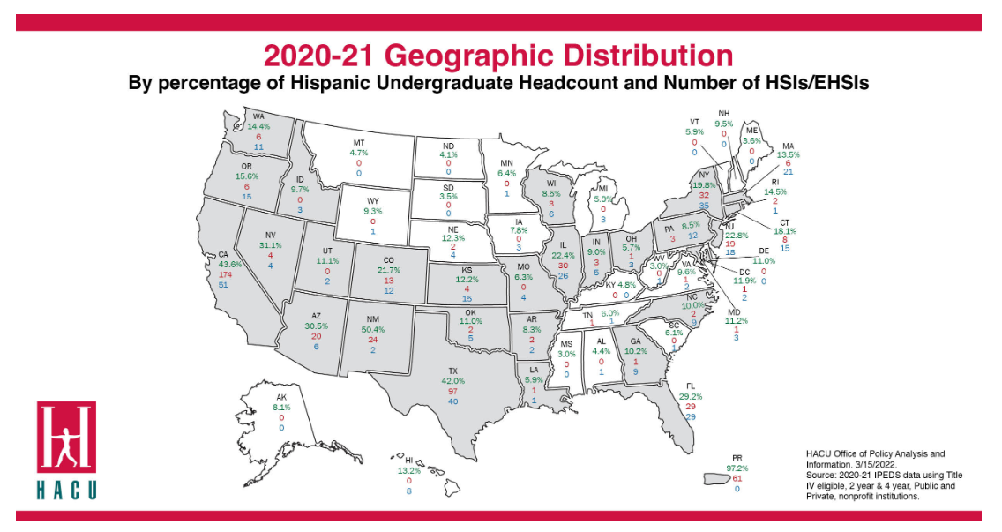
https://www.hacu.net/hacu/HSIs.asp

Slide 6

USDA-HSI partnerships

Slide 7

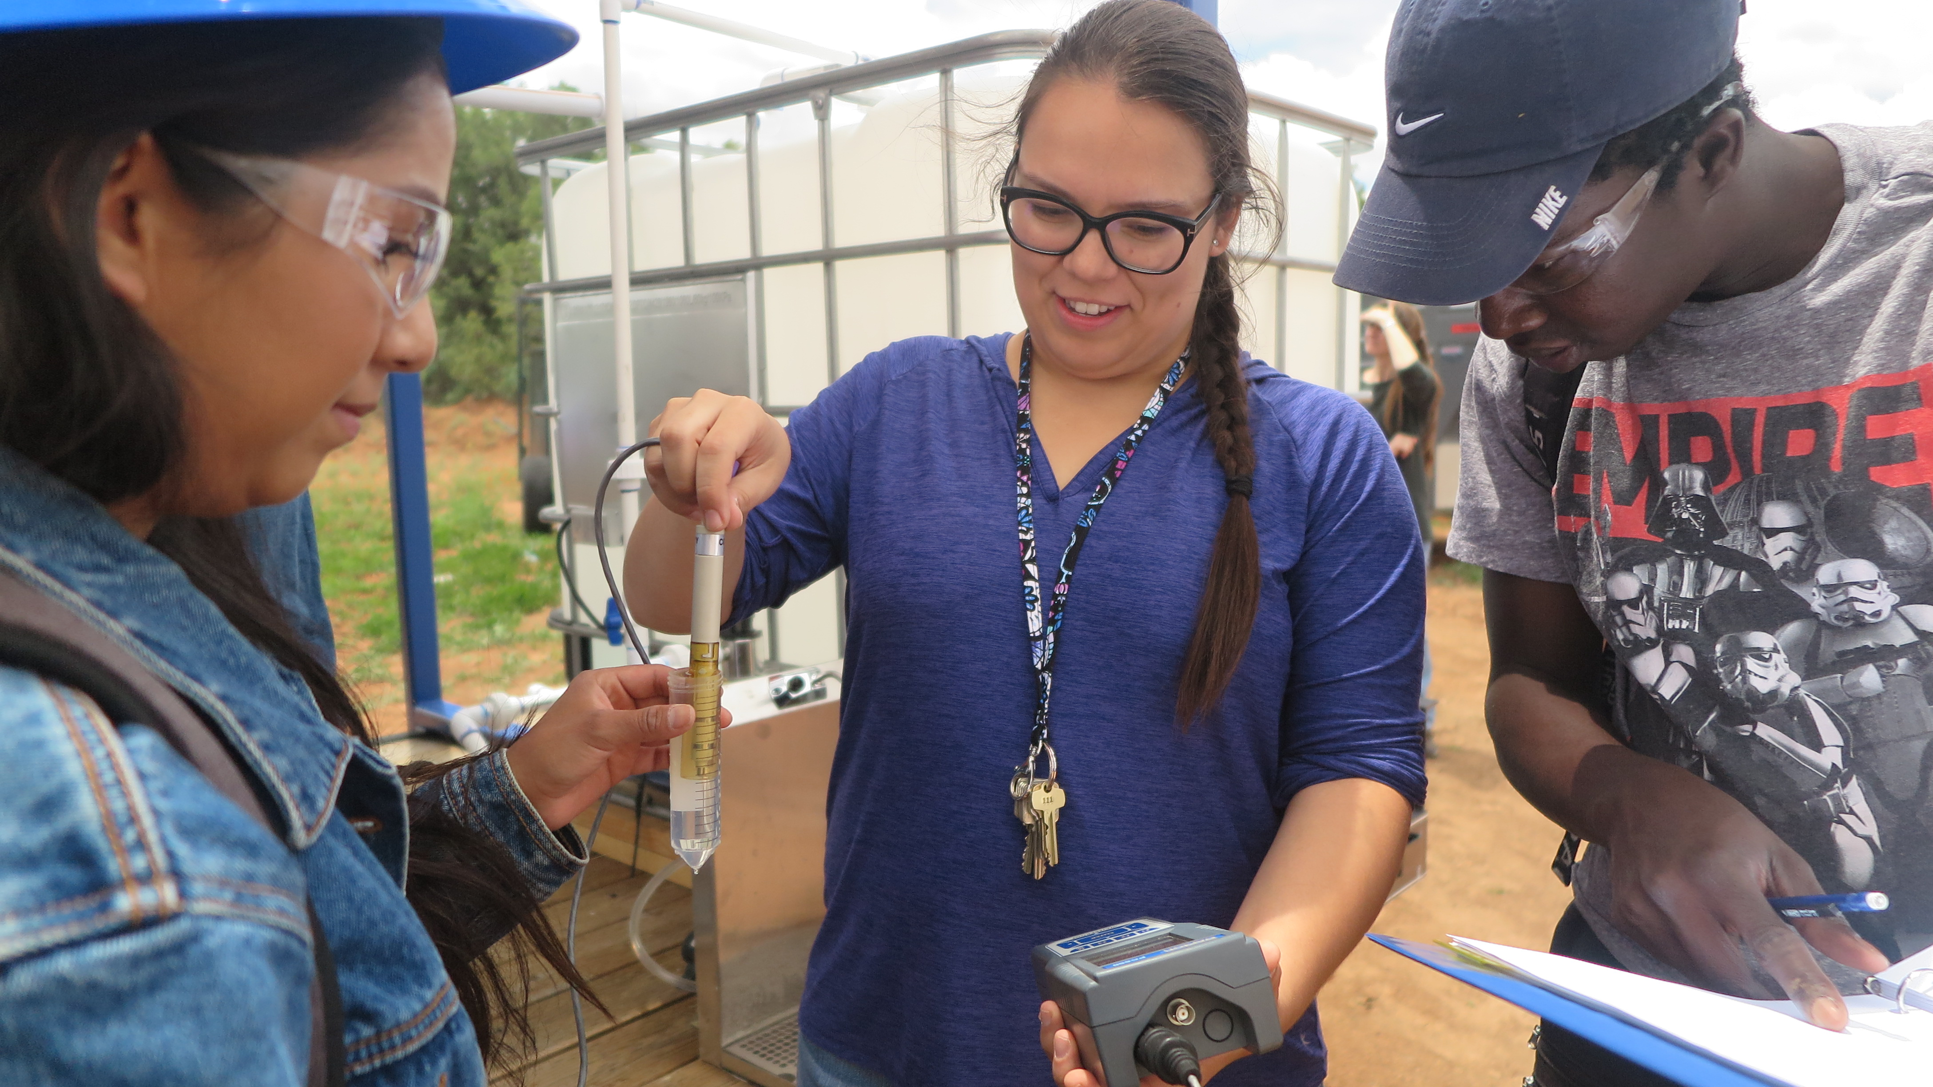

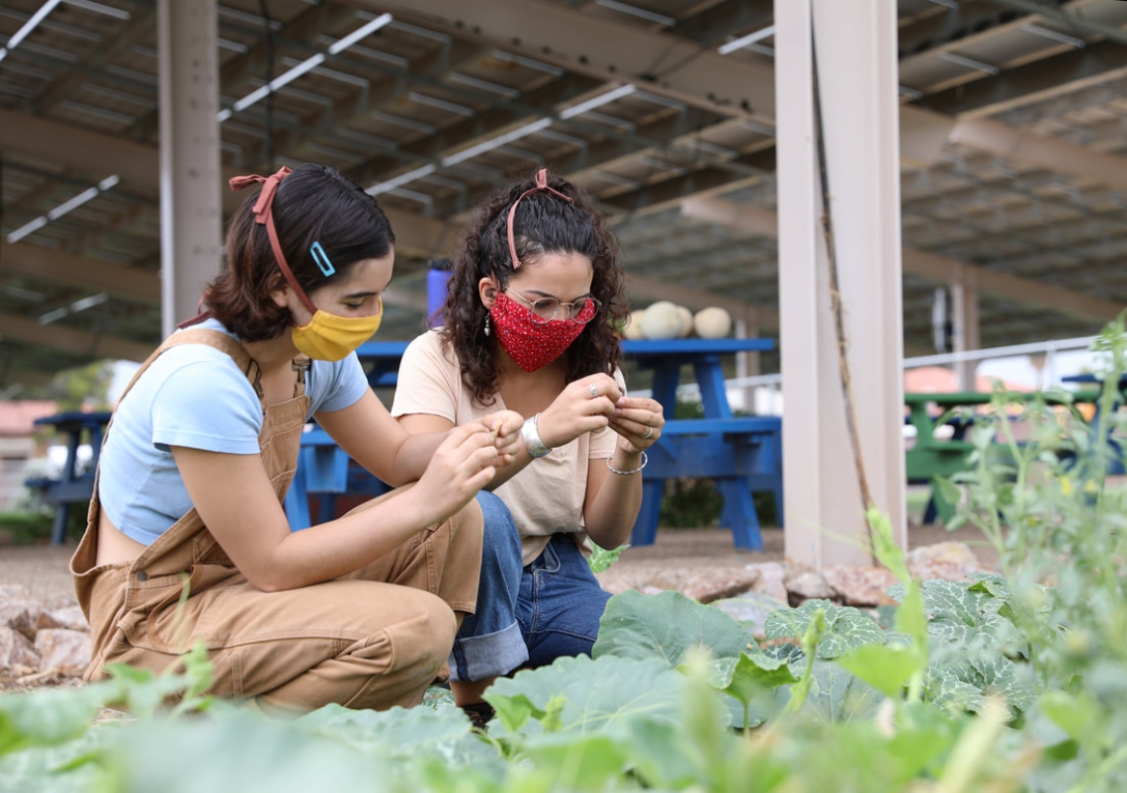
Examining College Engagement & employment patterns
2x
Hispanic/Latinx students were 2X more likely to report employment if they had an internship

Slide 8




Slide 9
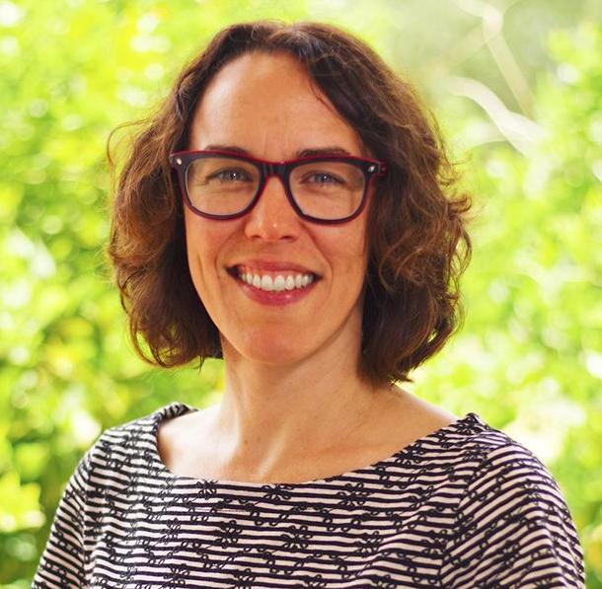

Multicultural Scholars Program (MSP) in Culinary Medicine
The USDA’s Higher Education Multicultural Scholars Program provides funding for colleges and universities to support students from diverse backgrounds through scholarships, mentorship, and experiential learning opportunities.
Program Benefits:
  Financial support (Scholars receive a $3,250 stipend each participating term – eligible terms are Spring 2023, and Summer or Fall 2023)
  Mentoring and advising guidance
  Network with peers, professors & community
  Work in partnership with community organizations
  Develop strong communication skills
  Earn elective course credit

Slide 10
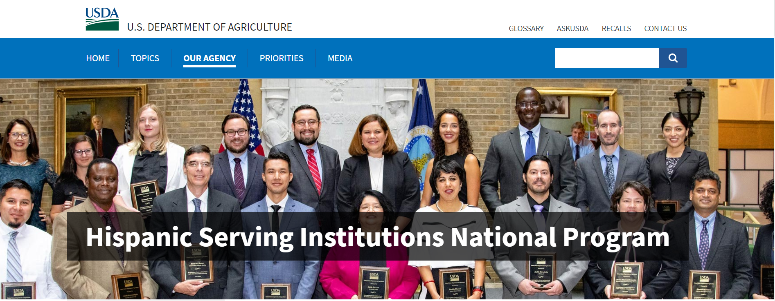
E. Kika de la Garza Fellowship Program
Education Fellows & High School Education Fellowships (4 days)
Science Fellowships (11 days)

Slide 11
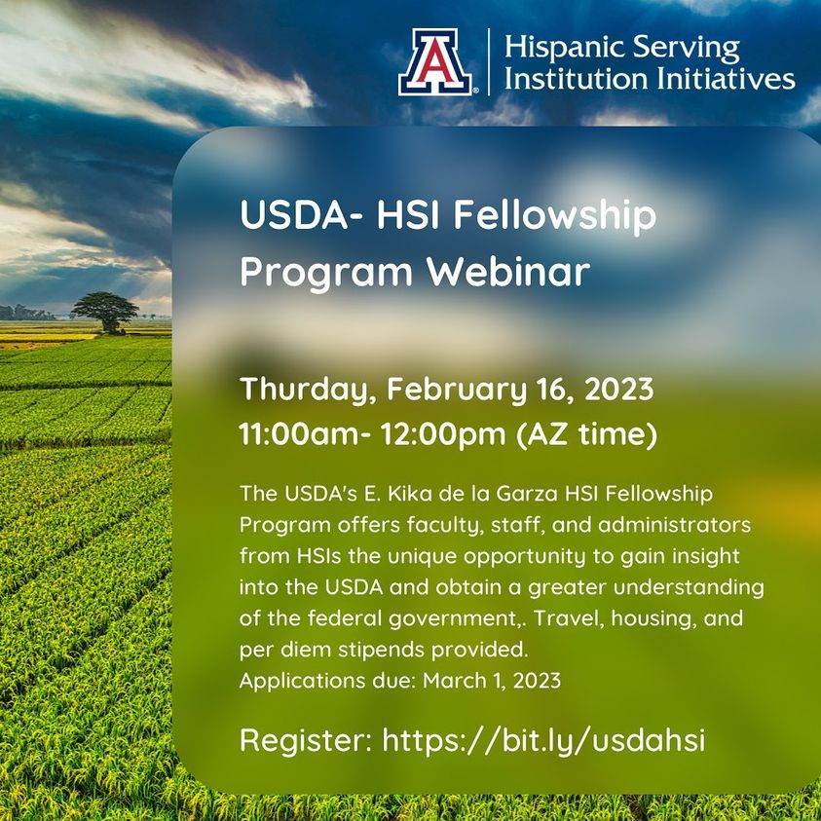
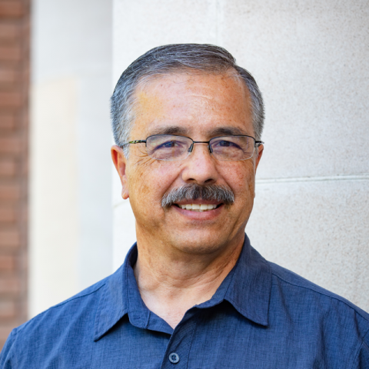
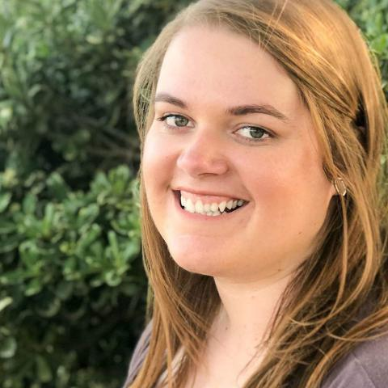
Robert Torres
Department Head & Professor
Neely Family Endowed Professor for Excellence in Agriculture and Life Sciences
CALS Bart Cardon Teaching Fellow
Breanna Watkins
Academic Advisor
College of Agriculture & Life Sciences

Slide 12

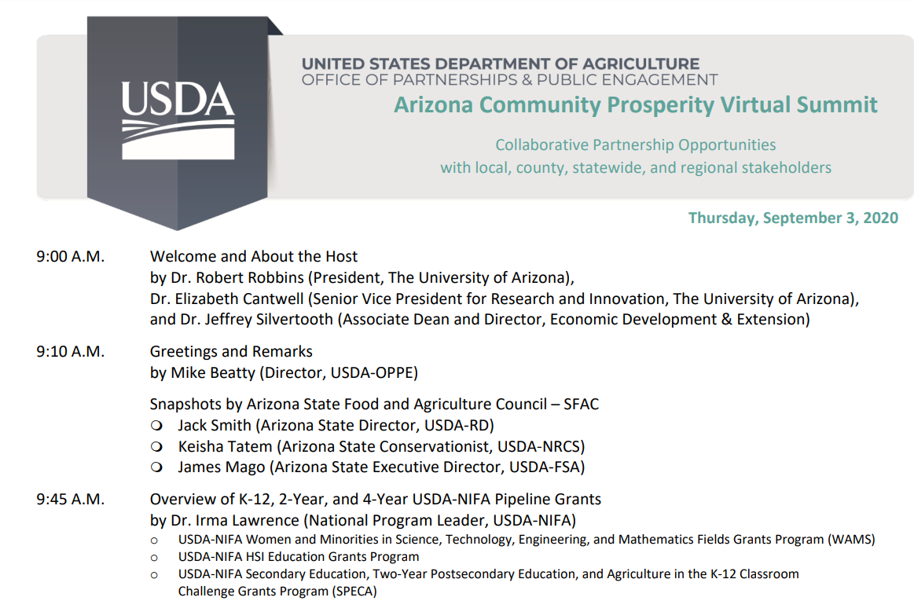


Slide 13



SOPA (Student Success by Increasing Opportunity, Participation, Awareness, and Achievement) provides support to expand our students' access to hands-on learning activities.
At the Yuma campus, the grant will help the university build a culinary research laboratory and demonstration kitchen, plus a community garden, for students to hone their skills in preparation for graduate school and the workforce.

Slide 14

Thank you!
marlafranco@arizona.edu
https://Hsi.arizona.edu

