Slide 1
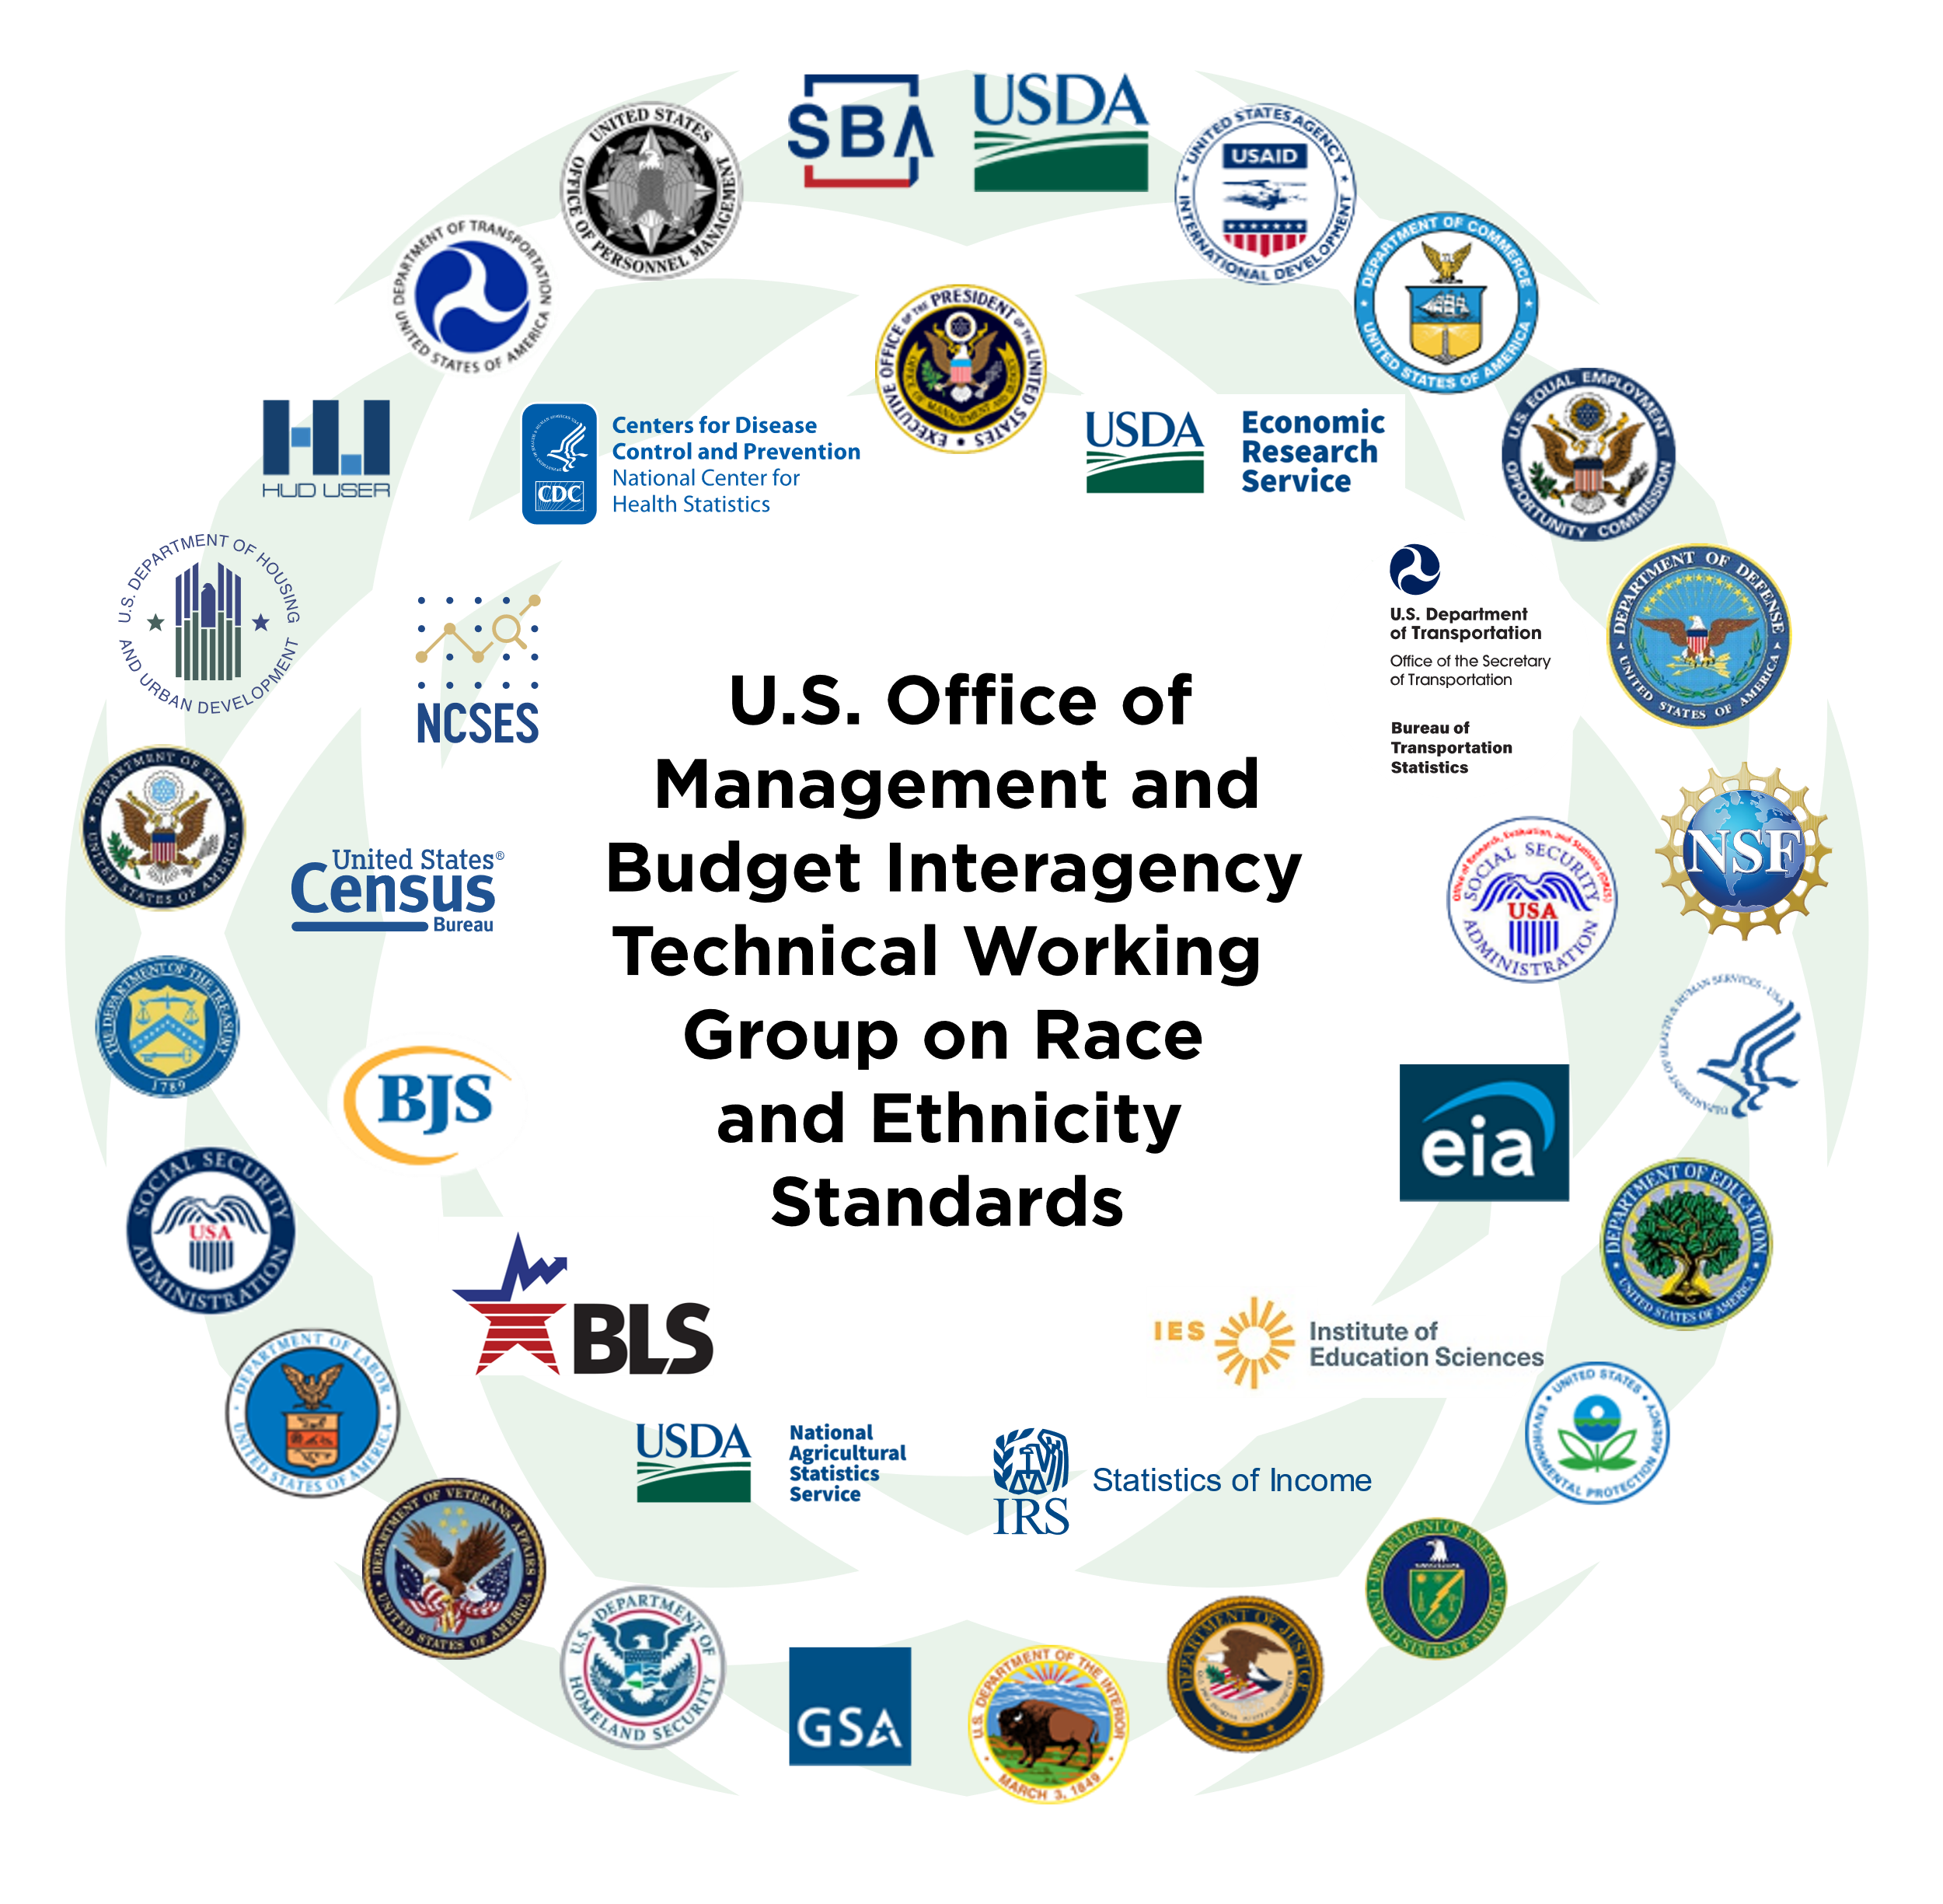
OMB ITWG Initial Proposals For Updating Statistical Policy Directive No. 15:
Standards for Maintaining, Collecting, and Presenting
Federal Data on Race and Ethnicity
ACMF Presentation March 30, 2023

Slide 2
Background and Current Review’s Scope
Statistical Policy Directive No. 15 (SPD 15)
History of SPD 15
1977 = Established, 1997 = Last Revised
New responsibilities to enforce civil rights laws
Provide common language to promote uniformity, comparability, and consistency across Federal information collections
Developed through cooperative Federal interagency working group process
Why review spd 15 now?
Increase of “Some Other Race” reporting on decennial census and American Community Survey
Many Middle Eastern and North African respondents view their identity as distinct from the White racial category
Need for disaggregated data to better understand within-group disparities and outcomes
Inconsistent and outdated terminology
Identity
Constructs
Use
SPD 15

Slide 3
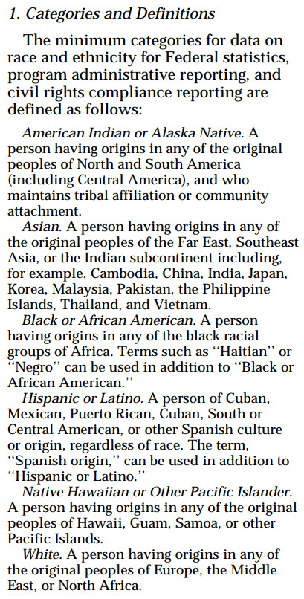
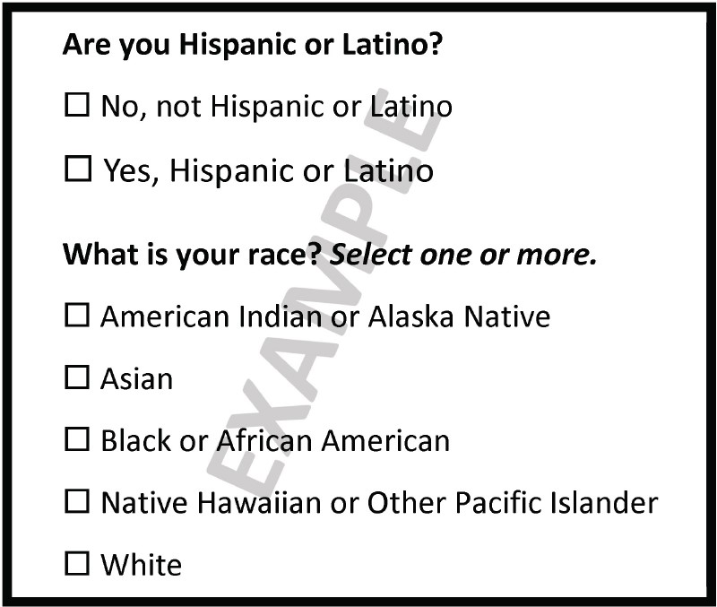
1997’s SPD 15
Standards for Maintaining, Collecting, and Presenting
Federal Data on Race and Ethnicity
Two-Questions Format for
Self-Response with Minimum Categories
Note: SPD 15 does not dictate the order in which the minimum categories should be displayed on Federal information collections. Agencies generally order alphabetically, as shown here, or by population size.
Source: https://www.govinfo.gov/content/pkg/FR-1997-10-30/pdf/97-28653.pdf

Slide 4
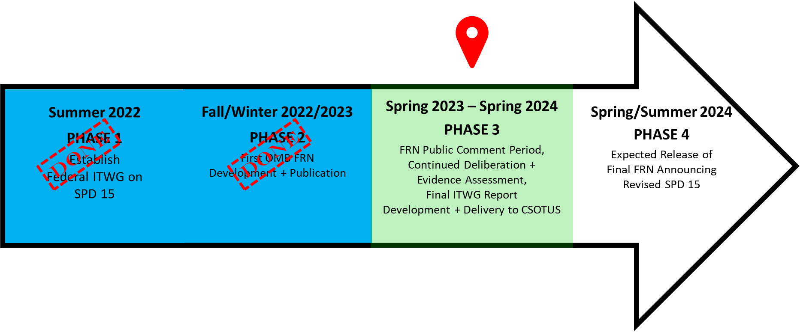
Revising SPD 15
Where Are We?
June 2022: Chief Statistician of the United States (CSOTUS) announced formal review to revise SPD 15 and convening of Federal Interagency Technical Working Group on Race and Ethnicity Standards (Working Group)
January 2023: OMB released Federal Register Notice which includes Working Group’s initial proposals on revising SPD 15, open from January 27 – April 12

Slide 5
Please Note
About Initial Proposals in the Federal Register Notice
Initial Proposals For Updating OMB’s Race and Ethnicity Statistical Standards
These proposals are preliminary – not final – and do not reflect the settled opinions of the Working Group, the position of OMB, or the positions of the agencies participating on the Working Group.
The Working Group will continue to deliberate, assess evidence, and take into consideration comments received from the public before making final recommendations for OMB’s consideration.
Federal Register Notice’s Public Comment Period:
January 27 – April 12

Slide 6
Working Group Assessed Existing Research and Evidence
About Initial Proposals in the Federal Register Notice
Previous 2014-2018 Federal Interagency Working Group for Research on Race and Ethnicity
Existing Federal Government research
Experiences from the 2020 Census
The work of the Interagency Working Group on Equitable Data pursuant to Executive Order 13985

Slide 7
Current Federal Register Notice – Initial Proposal 1
Question Format
Collect race and ethnicity information using one combined question.
The Working Group proposes that SPD 15 move from the two separate questions format to a single combined question as the required design for self-reported race and ethnicity information collections.
Employing a new combined question design may take significant time and resources for some surveys and information collections to implement.
Flexibilities should be allowed for agencies dependent on aggregate data, data that are not self-reported, or data from non-Federal providers.

Slide 8
Current Federal Register Notice – Initial Proposal 2
“Middle Eastern or North African”
Add “Middle Eastern or North African” (MENA) as a new minimum category.
The Working Group proposes that “Middle Eastern or North African” be added to SPD 15 as a new minimum reporting category distinct from all other reporting categories.
The definition of the current “White” reporting category would be edited to remove MENA from its definition.
The Working Group developed the following draft definition of a MENA minimum category to be inclusive of both Middle Eastern and North African populations and with the rationale of listing larger population groups in the United States:
The category “Middle Eastern or North African” includes all individuals who identify with one or more nationalities or ethnic groups with origins in the Middle East and North Africa. Examples include, but are not limited to, Lebanese, Iranian, Egyptian, Syrian, Moroccan, and Israeli.

Slide 9
Current Federal Register Notice – Initial Proposal 3
Collecting Detailed Race and Ethnicity Data
Require the collection of detailed race and ethnicity categories by default.
The Working Group proposes that SPD 15 require data collection on race and ethnicity at the detailed category levels.
Unless an agency determines that the potential benefit of the detailed data would not justify the additional burden to the agency and the public or the additional risk to privacy or confidentiality. In those cases, agencies must at least use the SPD 15’s minimum categories.
In any circumstance, agencies are encouraged to collect and provide more granular data than the minimum categories.

Slide 10
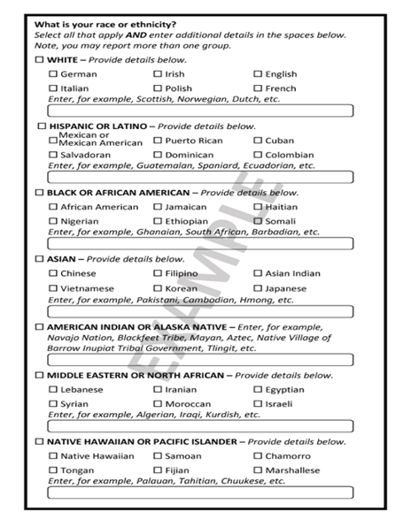
Current Federal Register Notice – Initial Proposal 3
Collecting Detailed Race and Ethnicity Data
Proposed Example for Self-Response Data Collections: Combined Question with Minimum and Detailed Categories
Represents one of potentially several options for establishing a consistent approach to collecting more detailed data, with the minimum categories disaggregated by country of origin
Chosen by the Working Group because it reflects the approach that performed best of the options tested by the Census Bureau prior to the 2020 Census
Country of origin options reflect the most common countries of origin in the U.S. for each minimum category
Notes:
Background
The minimum categories in SPD 15 contain heterogeneity, as evidenced by differences in a wide variety of outcomes for distinct groups within their definitions.
The increasing demand for analysis that represents the diversity of the American public increases the need for race and ethnicity information disaggregated beyond – or more granular than – SPD 15’s minimum categories.
The collection of disaggregated information already occurs in many circumstances; for example, some current information collections use detailed checkboxes and/or write-in fields to collect detailed race and ethnicity data.
However, collecting data using only the minimum categories may be necessary when, for example, low response rates among population groups lead to non-representative data, small sample sizes make estimates about disaggregated groups statistically unreliable, data is collected by proxy, or small cell sizes in data analyses and publications create privacy and confidentiality risks.

Slide 11
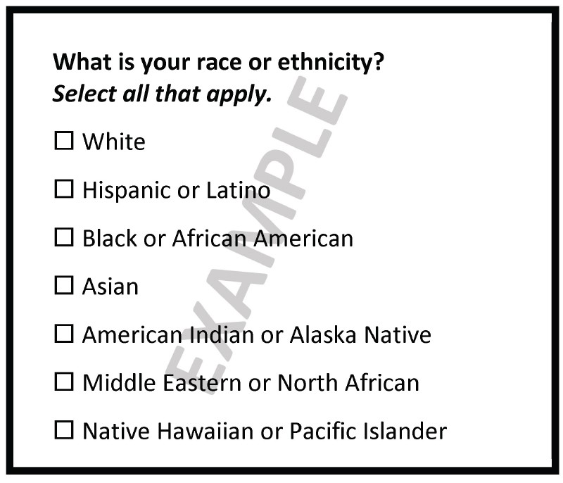
Current Federal Register Notice – Initial Proposal 3
Collecting Detailed Race and Ethnicity Data
Proposed Example for Self-Response Data Collections: Combined Question with Minimum Categories
Represents the Working Group’s proposed minimum categories, for use when more detailed collection is not feasible or justified.
It incorporates other proposals from the Working Group to use a combined race and ethnicity question and to add a new minimum category for MENA.
Note: The Working Group’s initial proposals do not include an order in which the minimum categories should be displayed on Federal information collections. Agencies generally order alphabetically or by population size, as shown here. The Federal Register Notice is soliciting public feedback on this via question 6a.

Slide 12
Current Federal Register Notice – Initial Proposal 4
Terminology
Update terminology in SPD 15.
The Working Group proposes that SPD 15 make the following changes:
Terminologies Used Within Minimum Categories
Remove: -“Negro” from the Black or African American definition; “Far East” from the Asian definition, replacing with “East Asian”; “Other” from “Native Hawaiian and Other Pacific Islander”; the phrase “who maintain tribal affiliation or community attachment” in the American Indian or Alaska Native definition, making this minimum category’s definition consistent with all minimum categories
Correct “Cuban” being listed twice in the minimum category definition for “Hispanic or Latino.”
Change the American Indian or Alaska Native minimum category description to: “The category ‘American Indian or Alaska Native’ includes all individuals who identify with any of the original peoples of North, Central, and South America.”
“Majority/Minority”
Discontinue use of the terms “majority” and “minority.”
Question Stem and Instructions
If a combined race and ethnicity question is adopted, the question stem use "race" and "ethnicity" as part of the question, i.e., “What is < your/name’s > race or ethnicity?”
The current instructions of “Mark < X > one or more” and “Select < X > one or more” be updated to “Mark all that apply” and “Select all that apply.”

Slide 13
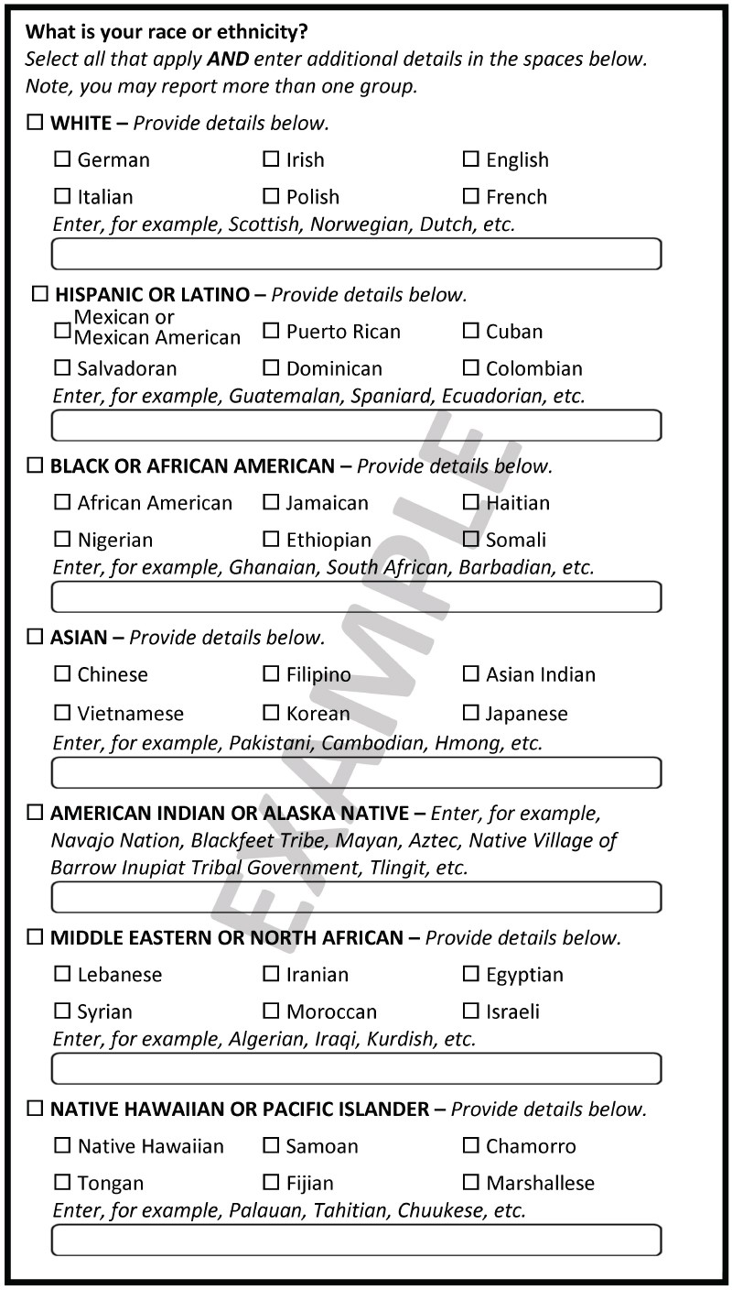
Current Federal Register Notice
Initial Proposed Example Designs for
Self-Response Data Collections
Combined Question with
Minimum and Detailed Categories
Combined Question with
Minimum Categories

Slide 14
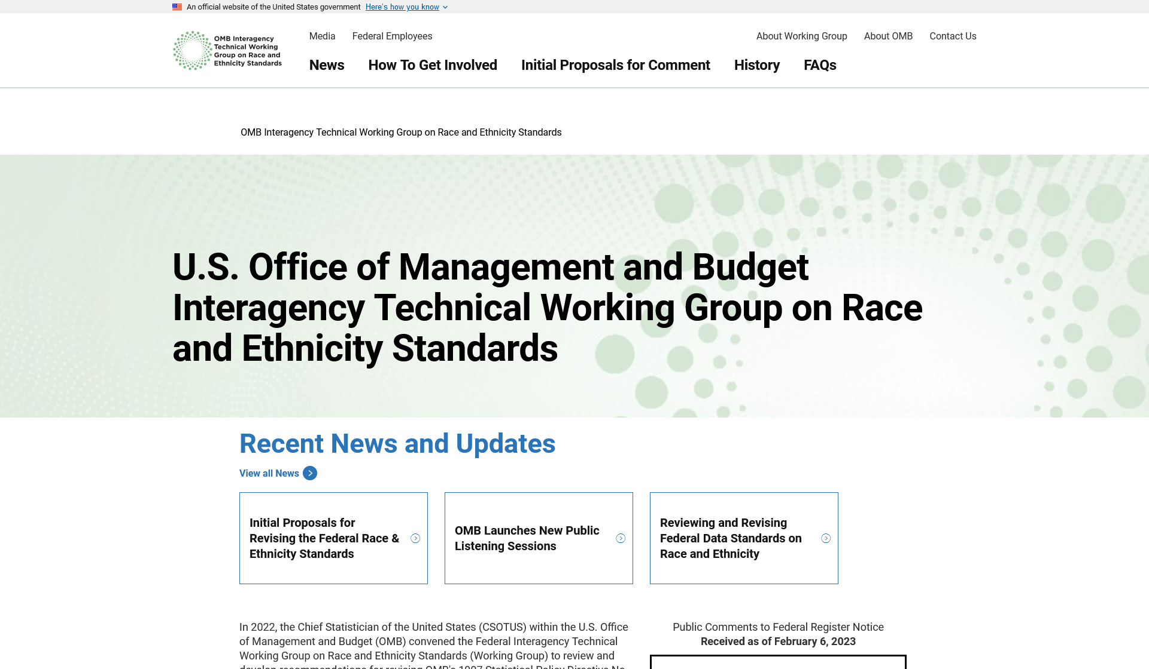
Current and Planned Public Engagements
During Federal Register Notice’s Public Comment Period, January 27 – April 12
Meeting our Mission to Improve the Quality and Usefulness of Federal Race and Ethnicity Data
Requires Input from the Public
Federal Register Notice (FRN), Initial Proposals For Updating OMB’s Race and Ethnicity Statistical Standards
During the FRN public comment period:
  Public Virtual “Town Halls”
  Tribal Consultation
Sessions with scholars, e.g.,
  Population Association of America Annual Meeting
  American Statistical Association’s Joint Statistical Meetings
  American Sociological Association Annual Meeting
On-going bi-monthly listening sessions
  From Fall 2022 – Fall 2023
Regular updates to the Working Group’s website, spd15revision.gov

Slide 15
Please Help Us Encourage Public Input!
During Federal Register Notice’s Public Comment Period, January 27 – April 12
Spread The Word!
Share the following with your networks:
  Dr. Karin Orvis’ (CSOTUS) White House blog post
  Working Group’s website, spd15revision.gov
  Federal Register Notice

Slide 16
Discussion Questions
Collecting of detailed race and ethnicity categories
  Is it appropriate for agencies to collect detailed data even though those data may not be published or may require combining multiple years of data due to small sample sizes?
  What should agencies consider when weighing the benefits and burdens of collecting or providing more granular data than the minimum categories?
  The example design collects additional detail primarily by country of origin or tribe. What other potential types of detail would create useful data or help respondents to identify themselves?

Slide 17
Discussion Questions
Collecting race and ethnicity information using one combined question
To what extent would a combined race and ethnicity question that allows for the selection of one or more categories impact people’s ability to self-report all aspects of their identity?
What else would you like the OMB to be aware of or take into consideration related to questionnaire format for race and ethnicity?

Slide 18
Discussion Questions
Adding “Middle Eastern or North African” (MENA) as a new response category
Middle Eastern or North African: The category ‘‘Middle Eastern or North African’’ includes all individuals who identify with one or more nationalities or ethnic groups originating in the Middle East or North Africa. Examples of these groups include, but are not limited to, Lebanese, Iranian, Egyptian, Syrian, Moroccan, and Israeli. The category also includes groups such as Algerian, Iraqi, Kurdish, Tunisian, Chaldean, Assyrian, etc.
Given the particular context of answering questionnaires in the U.S. (e.g., decennial census, Federal surveys, public benefit forms), is the term ‘‘Middle Eastern or North African (MENA)’’ likely to continue to be understood and accepted by those in this community?
Do these proposed nationality and ethnic group examples adequately represent the MENA category? If not, what characteristics or group examples would make the definition more representative?

Slide 19
Thank You!

