Slide 1


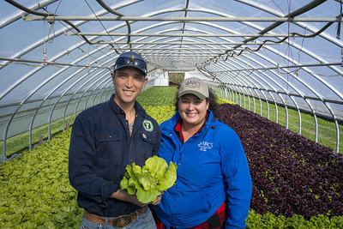


Natural Resources Conservation Service (NRCS) Updates
Notes:
GO TO VIEW > MASTER > SLIDE MASTER TO EDIT THE IMAGES ON THE TITLE AND DIVIDER SLIDES

Slide 2
NRCS Refresher
NRCS offices and staffing
NRCS technical assistance
NRCS financial assistance

Slide 3
Equity in Conservation Outreach Cooperative Agreements
$70 million in funding available
Prioritizing projects for:
  Addressing local natural resource issues
  Promoting conservation career opportunities
  Promoting the adoption of climate-smart conservation
  Encouraging conservation in small-scale and urban agriculture
$100,000 to $1,000,000 maximum
Due April 27

Slide 4
Bipartisan Infrastructure Law
Provided $918 million for Watershed Programs adminis-tered by NRCS
Watershed Team overcame two major obstacles facing underserved communities: lack of Federal funding and funding commitment throughout all phases
  Revised agency policy to guarantee funding for all phases of watershed projects
  Led strategic NRCS organizational change that exceeded the charge of the President's Justice40 Initiative by allocating $432 million, or 47%, of the FY 2022 watershed programs funds to underserved communities

Slide 5
Inflation Reduction Act
Approximately $20 billion for NRCS programs
  EQIP & CSP funding now available
  ACEP national funding pools focusing on prioritize grasslands in areas of highest risk for conversion to non-grassland uses and wetland soils high in organic carbon
  RCPP to be announced this spring
Implementation strategy to:
  Expand capacity
  Target additional funding
  Streamline program delivery
  Leverage partnerships
  Advance equity
  Quantify outcomes

