Slide 1


Civil Rights Briefing
Advisory Committee on Minority Farmers
Monica Armster Rainge
Deputy Assistant Secretary for Civil Rights
March 30, 2023

Slide 2

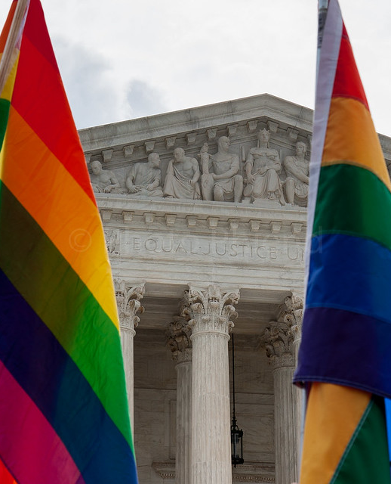
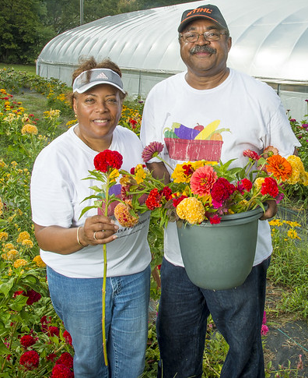
Office of the Assistant Secretary for Civil Rights
Our mission is to provide leadership and direction for the fair and equitable treatment of all USDA customers and employees while ensuring the delivery of quality programs and enforcement of civil rights.

Slide 3
Fiscal Year | 2018 | 2019 | 2020 | 2021 | 2022
Beginning Inventory | 306 | 266 | 240 | 161 | 158
Complaints Accepted (Jurisdictional to USDA) | 142 | 145 | 134 | 139 | 132
Complaint Closures (FAD & Closures) | 182 | 171 | 213 | 142 | 133
Findings of Discrimination | 1 | 1 | 1 | 1 | 1
FYE Inventory | 266 | 240 | 161 | 158 | 161
Average Processing Time USDA (All Mission Areas) USDA (USDA Non-FNS) | 479 574 | 513 750 | 407 531 | 385 487 | 405 490
Five Year Analysis of Program Complaint Data
Does not include SOL cases.

Slide 4
FY 2022 Program Complaint Bases

Slide 5
FY 2022 Program Complaint Issues

Slide 6

How Program Complaints Are Filed
Intake - Filed at OASCR Center for Civil Rights Enforcement
Referred to USDA Mission Area for Counseling/ADR
If not resolved, complaint returned to OASCR for Acceptance/Dismissal
If accepted, forwarded for Investigation
Adjudication
Tracked in CRMS
Notes:
This goal impacts all of USDA reinstituting compliance reviews and utilizing MD-715 reports and CRIAs to help drive consistency

Slide 7
USDA Equity Commission
Launched in February 2022 and co-chaired by former Deputy Secretary Jewel Bronough
Advises the Secretary and provides USDA with analysis
Provided interim report with 32 recommendations
Recommendation 16: Transform and adequately fund the Office of the Assistant Secretary for Civil Rights by allocating necessary funding to ensure OASCR capacity to deal with all civil rights violations in a timely manner.
Notes:
This goal impacts all of USDA reinstituting compliance reviews and utilizing MD-715 reports and CRIAs to help drive consistency

Slide 8
OASCR Strategic
Mission Goal One
Build Trust of the Public by Providing Timely, Consistent, and Efficient Production and Delivery of Services.
Notes:
Finally, this goal also impacts all of USDA and commits to partnering with MA, Agencies and DEIA officer to help drive equitable change.

Slide 9


Thank You
Questions? Contact Us
Ms. Monica Rainge: Monica.Rainge@usda.gov
Dr. Penny Brown Reynolds: P.BrownReynolds@usda.gov
(202) 720-3808

