Slide 1

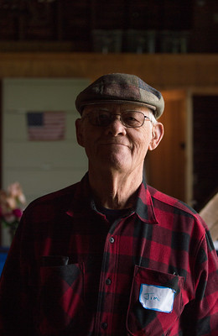
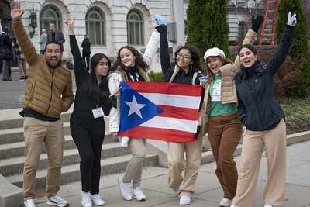
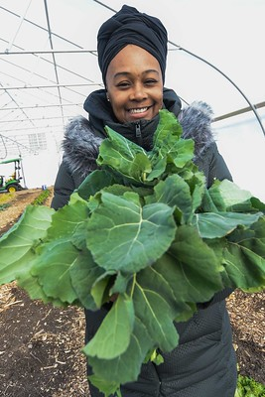
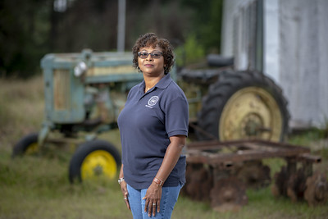
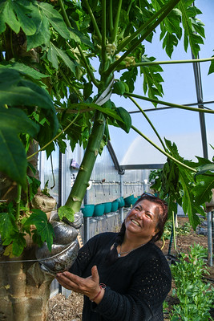
Office of Partnerships and Public Engagement
__________________________
Dr. Lisa R. Ramírez
Director
Office of Partnerships and Public Engagement

Slide 2
Mission
The Office of Partnerships and Public Engagement develops and maintains partnerships focused on solutions to challenges facing rural and underserved communities in the United States, and connects those communities to the education, tools, and resources available to them through U.S. Department of Agriculture programs and initiatives.
Office of Partnerships and Public Engagement

Slide 3
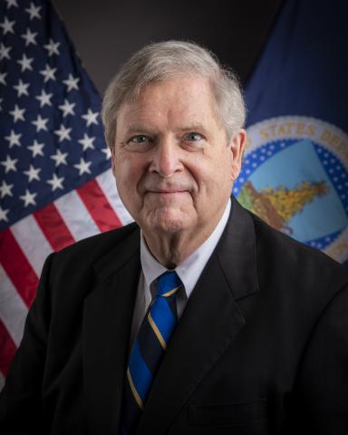
USDA Key Priorities
Investing in climate resilience and U.S. agriculture’s ability to be part of the climate solution
Prioritizing consistent access to safe, nutritious food for all Americans
Developing more and better markets for U.S. agricultural producers
Building stronger rural economies
Ensuring underserved groups can more fully access and participate in USDA programs and services
Attracting, inspiring, and retaining an engaged and motivated workforce that’s proud to represent USDA and make it a best place to work
Office of Partnerships and Public Engagement

Slide 4
What is in the OPPE Portfolio?
Outreach and Assistance for Socially Disadvantaged Farmers and Ranchers and Veteran Farmers and Ranchers Program (2501 Program)
Education Initiatives: 1890 Liaison Officer Program and the Hispanic-Serving Institutions National Program
Agricultural Youth Coordination
Military Veterans Agricultural Liaison and Supporting Veterans Program Initiative
Farmworker Coordination
Women in Agriculture Initiative
Asian American and Pacific and Hawaiian Islander Outreach
Advisory Committee on Minority Farmers, and the Advisory Committee on Beginning Farmers
The Center for Faith Based and Neighborhood Partnerships Portfolio has transferred to the USDA Office of External and Intergovernmental Affairs
The 1994 Program has transitioned to the USDA Office of Tribal Relations
Office of Partnerships and Public Engagement

Slide 5
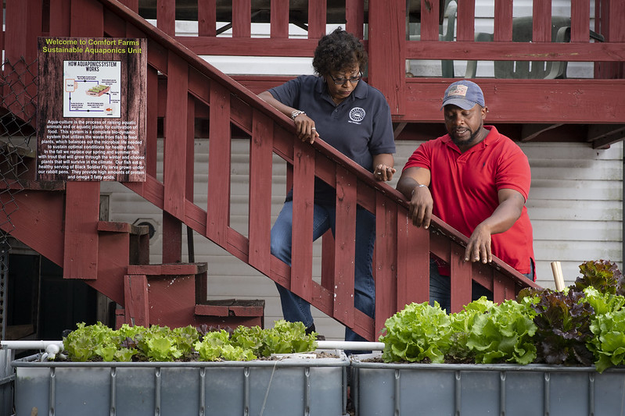
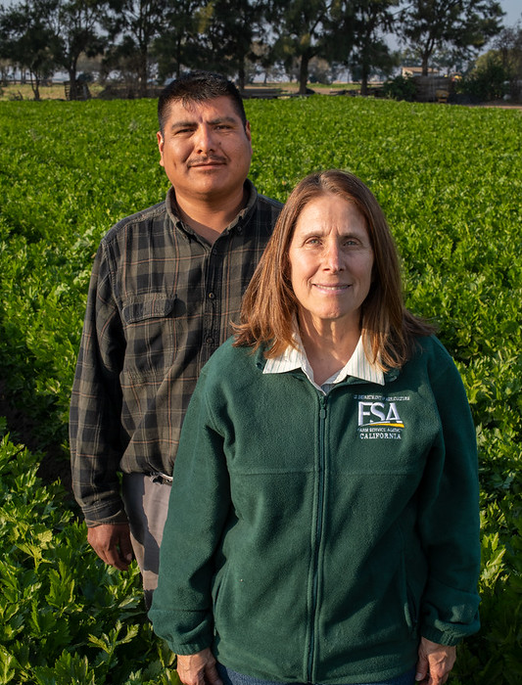
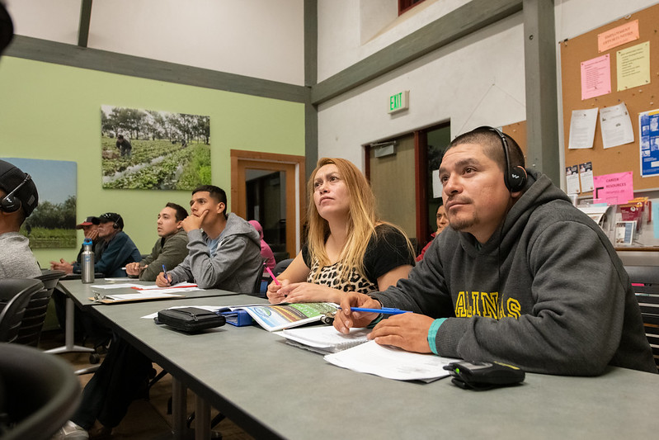
Outreach and Assistance for Socially Disadvantaged and Veteran
Farmers and Ranchers (2501 Program)
This program awards grants to higher education institutions, non-profit, and community-based organizations that provide outreach and technical assistance for underserved farmers, ranchers, and foresters, in owning and operating sustainable farms and ranches. This year’s grants are planned to be publicized within the next 30-45 days.
More information: https://www.usda.gov/partnerships/socially-disadvantaged-farmers-and-ranchers
Office of Partnerships and Public Engagement

Slide 6
USDA Internal Outreach Coordination
OPPE hosts monthly outreach coordinators meetings to share information regarding events, funding opportunities, and programmatic updates, etc.
    Attendees include designated outreach coordinators from each agency/mission area, and OPPE staff (including field-based USDA liaisons)
Agency outreach coordinators are designated by each agency head (updates required to be reported to OPPE outreach coordinators).
USDA OPPE liaisons share the information with their local communities, non-profits, universities, MSIs, farmers, and ranchers.
Agencies share the information with their field offices for further distribution to their networks.
Office of Partnerships and Public Engagement

Slide 7
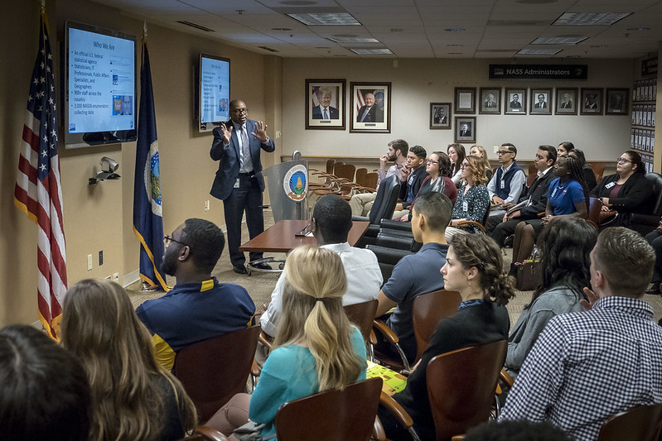
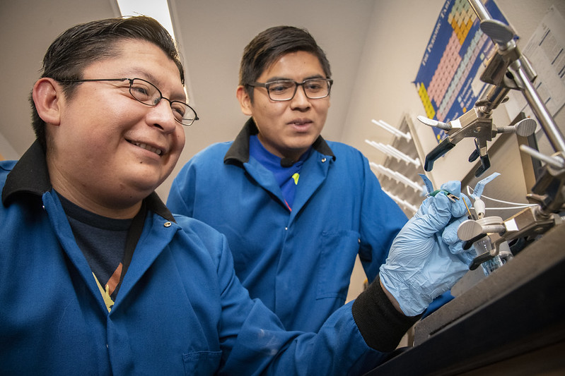
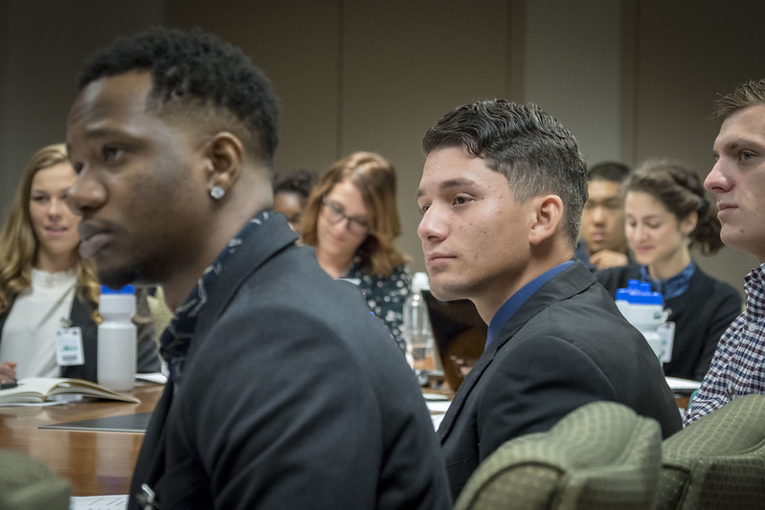
Education Initiatives
In partnership with 1890 Historically Black Land-Grant Colleges and Universities and Hispanic-Serving Institutions, OPPE works to establish opportunities that ensure equitable participation in USDA programs, services, and resources for rural, and historically underserved students and their communities.
More information: https://www.usda.gov/partnerships/higher-education-initiatives
Office of Partnerships and Public Engagement
Notes:
Maybe add a photo from each group and give tagline of what it is

Slide 8



The Next Generation
1890 National Scholars Program - Currently open for applications until April 15th
E. Kika De La Garza Fellowship Program – Selection process underway
Hispanic Association of Colleges and Universities MOU
Internship Programs – TMCF, HACU National Internship Program, HEP/CAMP, Pathways, and others at USAJobs.gov
More information: https://www.usda.gov/youth
Office of Partnerships and Public Engagement
Notes:
Clean up language

Slide 9
USDA Liaisons
1890 National Scholars Program - 19 Liaisons on 1890 HBCU Land-Grant campuses
HSI National Program - 6 USDA Liaisons serving regionally
1994 Land-Grant National Scholarship Program & Institutions now administered through the Office of Tribal Relations
Liaisons assist communities, students, MSI faculty/staff/administrators, farmers, ranchers, foresters, and others on USDA programs and initiatives to ensure equitable access to resources and distribution of USDA products.
Develop and maintain partnerships with local/field USDA offices and key local/regional stakeholders to enhance USDA outreach.
Serve as a point of contact on these partner campuses for USDA personnel for recruiting purposes.
Provide support to the development of policies and procedures to strengthen institutional capacity-building initiatives concerned with improving minority representation.
Office of Partnerships and Public Engagement

Slide 10
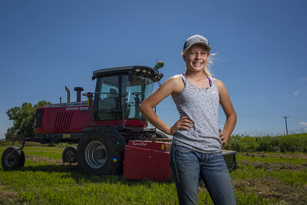
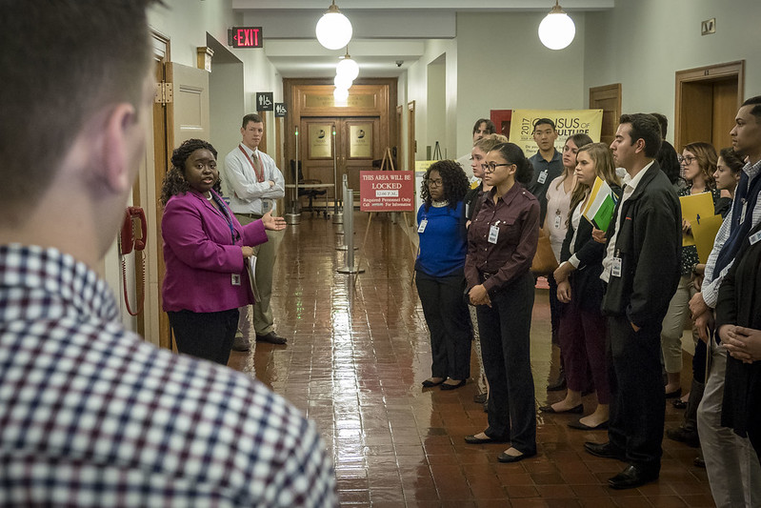
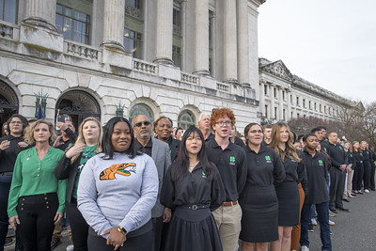
Agricultural Youth Coordination
OPPE partners with private sector companies, higher education institutions, and youth-serving organizations to promote the role of school-based agricultural education in motivating and preparing young people to pursue careers in the agriculture, food, and natural resources systems.
Selection process under way for next Youth Coordinator.
youth@usda.gov
More information: https://www.usda.gov/youth
Office of Partnerships and Public Engagement
Notes:
Clean up language

Slide 11
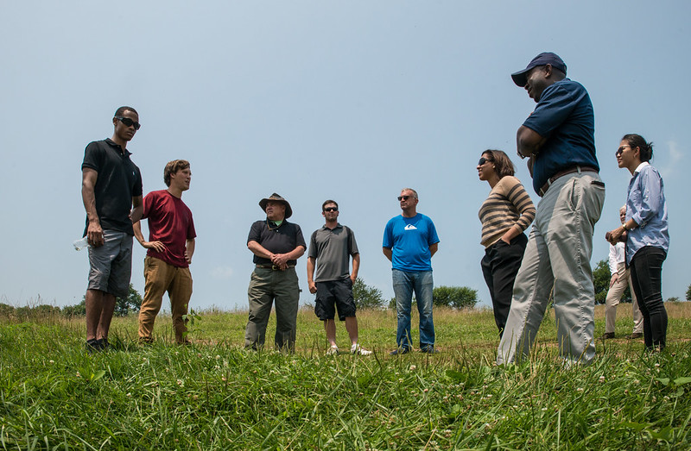
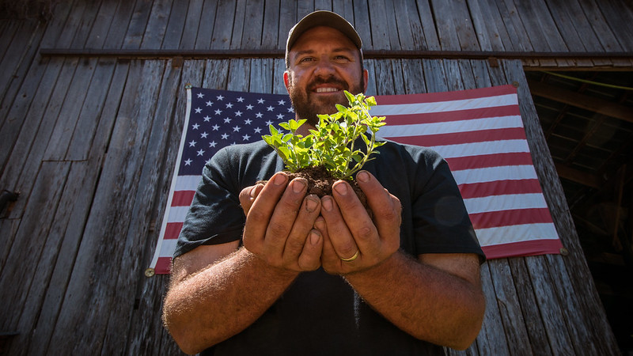
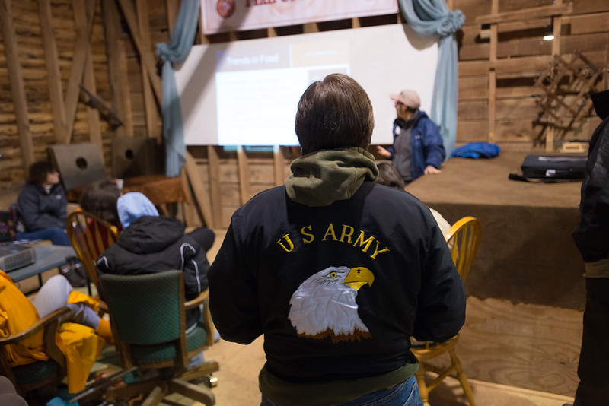
Military Veterans
Connects military veterans with roles that keep America’s food supply safe and secure, preserve and strengthen rural communities, and restore and conserve the environment.
Assist service members, veterans, and their families to successfully transition into the food and agriculture sectors.
Monshi.Ramdass@usda.gov
More information: https://www.usda.gov/our-agency/initiatives/veterans
Office of Partnerships and Public Engagement
Notes:
No longer Bill! Add Ram’s info

Slide 12
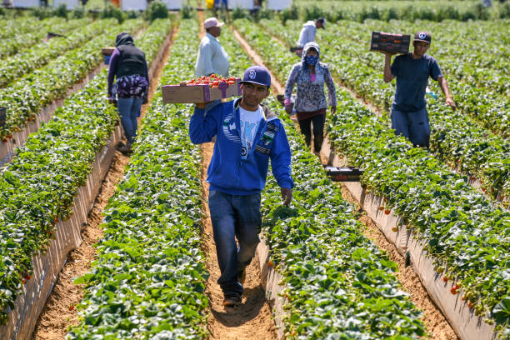

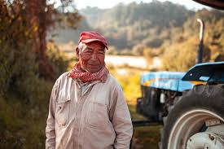
Farmworker Coordination
The Farmworker Coordinator identifies challenges faced by farmworkers and coordinates the community’s needs with USDA resources such as housing, safety, and training to advance into other agricultural careers.
Silvia.Fabela@usda.gov Maria.Goldberg@usda.gov
More information: https://www.usda.gov/partnerships/special-initiatives-and-mandates
Office of Partnerships and Public Engagement
Notes:
Clean up language

Slide 13
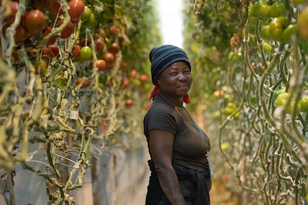
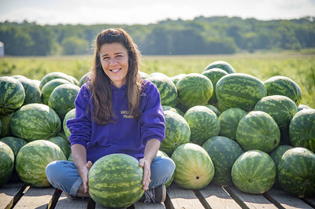
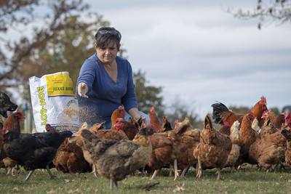
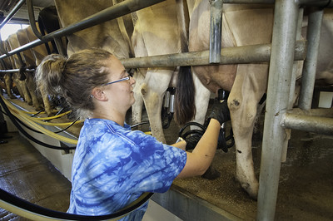
Women in Agriculture
OPPE supports Women in Agriculture initiatives to focus on mentorship and the development of science, technology, engineering, and math skills of the stakeholder group.
Maria.Goldberg@usda.gov
More information: https://www.usda.gov/our-agency/initiatives/women-agriculture
Office of Partnerships and Public Engagement

Slide 14
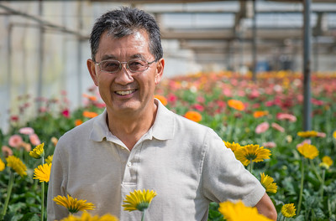
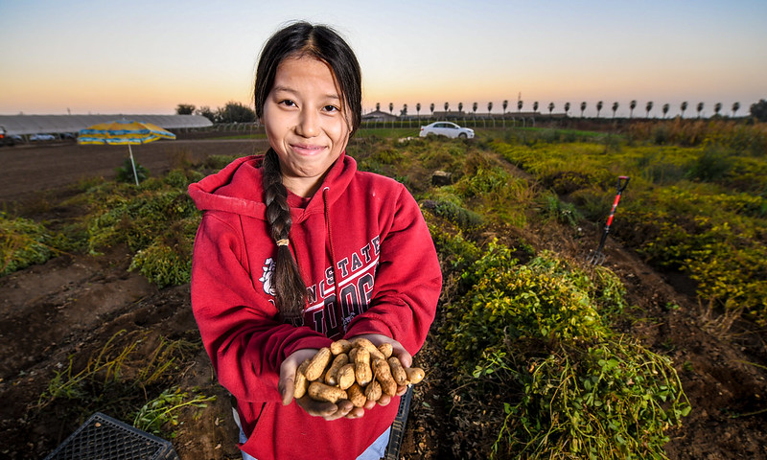
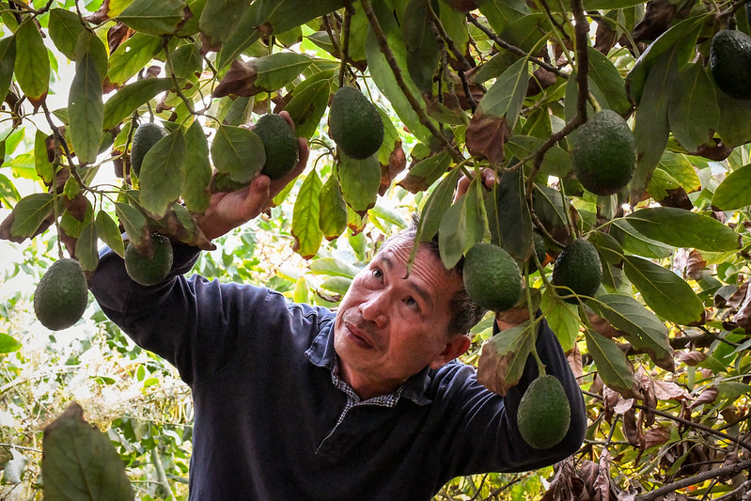
Asian American and Pacific and Hawaiian Islander Outreach
The White House Initiative on Asian Americans and Pacific Islanders (WHIAAPI) works to improve the quality of life for AAPI individuals and communities across the nation through increased access to and participation in federal programs.
USDA AAPI areas of focus include outreach and engagement, capacity-building, and data collection.
More information: https://www.usda.gov/partnerships/special-initiatives-and-mandates
Office of Partnerships and Public Engagement

Slide 15
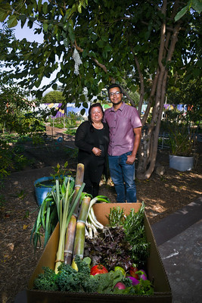
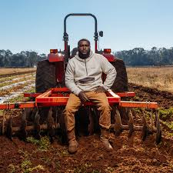
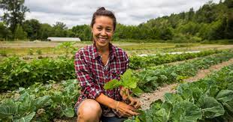
Advisory Committee on Minority Farmers
Advises the Secretary on the administration of the Outreach and Assistance for Socially Disadvantaged Farmers and Ranchers Competitive Grant Program and how to increase participation of socially disadvantaged farmers and ranchers in USDA programs.
New members being solicited – Federal Register Notice Active
Press Releases announcing all public meetings are posted on the Federal Register: www.federalregister.gov
More information: https://www.usda.gov/partnerships/advisory-committees
Office of Partnerships and Public Engagement

Slide 16

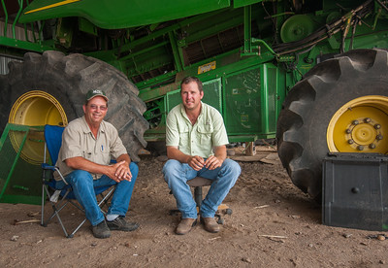
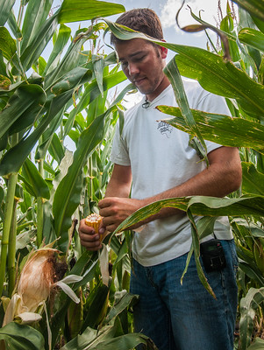
Advisory Committee on Beginning Farmers and Ranchers
Advises the Secretary on ways to develop programs to provide coordinated assistance to beginning farmers and ranchers while maximizing new farming and ranching opportunities.
Works to enhance and expand federal-state partnerships to provide financing for beginning farmers and ranchers.
Currently being renewed for a 2-year term; solicitations for new members to follow.
Press Releases announcing all public meetings are posted on the Federal Register: www.federalregister.gov
More information: https://www.usda.gov/partnerships/advisory-committees
Office of Partnerships and Public Engagement

Slide 17
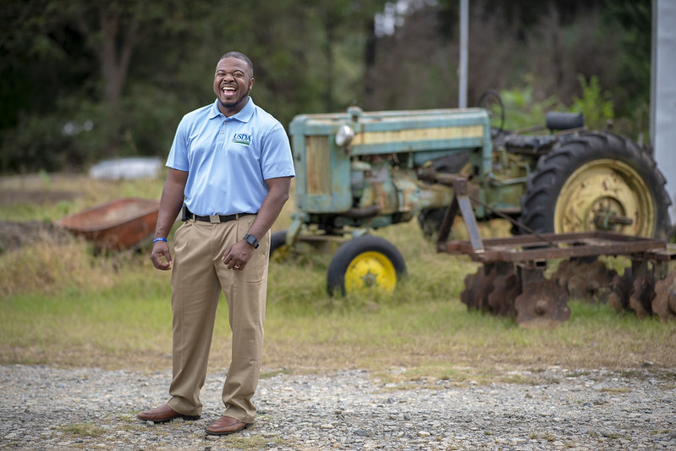

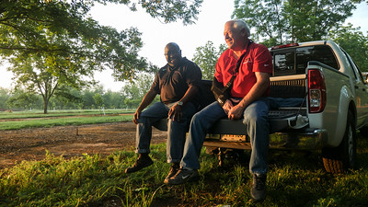
OPPE Points of Contact
Director: Dr. Lisa Ramírez
lisa.ramirez@usda.gov
Deputy Director: Kenya Nicholas
kenya.nicholas@usda.gov
Designated Federal Officer: Rosalie “RJ” Cabrera
  rj.cabrera@usda.gov
Main Office: 202-720-6350
Office of Partnerships and Public Engagement

Slide 18

Office of Partnerships and Public Engagement

Slide 19
Backup Slides

Slide 20
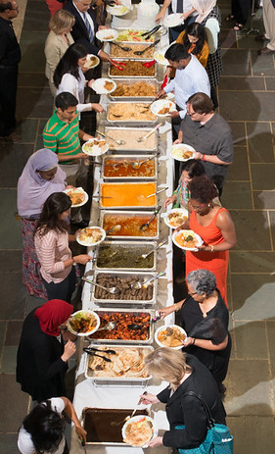
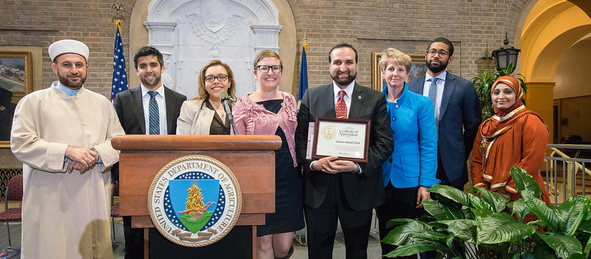
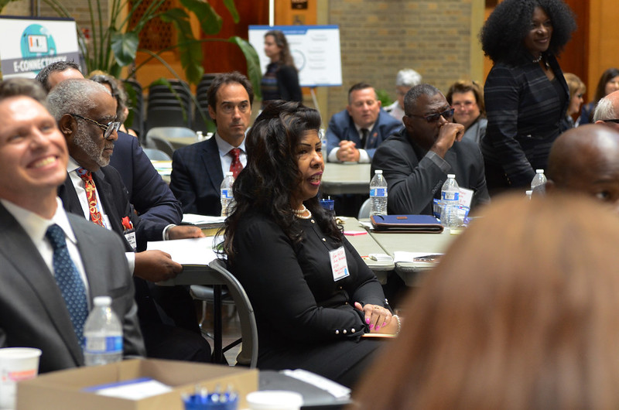
Faith-Based and Neighborhood Partnerships (Management of this program has moved to the USDA Office of External Affairs within the Office of Congressional Relations)
Supports local faith-based and secular community-based organizations to strengthen communities, nourish children, and support community prosperity.
Assists organizations with capacity-building to help communities connect with USDA priorities and programs.
More information: https://www.usda.gov/our-agency/staff-offices/office-partnerships-and-public-engagement-oppe/center-faith-based-and
Office of Partnerships and Public Engagement

