Slide 1


Your Partner in Prosperity
Introduction to Rural Development
Gbenga Ajilore, Ph.D.
Senior Advisor, Rural Development (USDA)
Notes:
SCRIPT: Welcome
Good Afternoon everyone. We are happy you are here. Welcome to today’s RD Programs 101 Plus Event/A Special Engagement for the Rural Economic Development Innovation Communities. Also known as REDI Communities. Before we get started, I’d like to go over a few items, to assist you to participate in today’s event.

Slide 2
What is Rural Development?
Rural Development
Rural Business-Cooperative Service
Rural Housing Service
Rural Utilities Service
Notes:
At the national level, programs and services are delivered through three agencies.

Slide 3
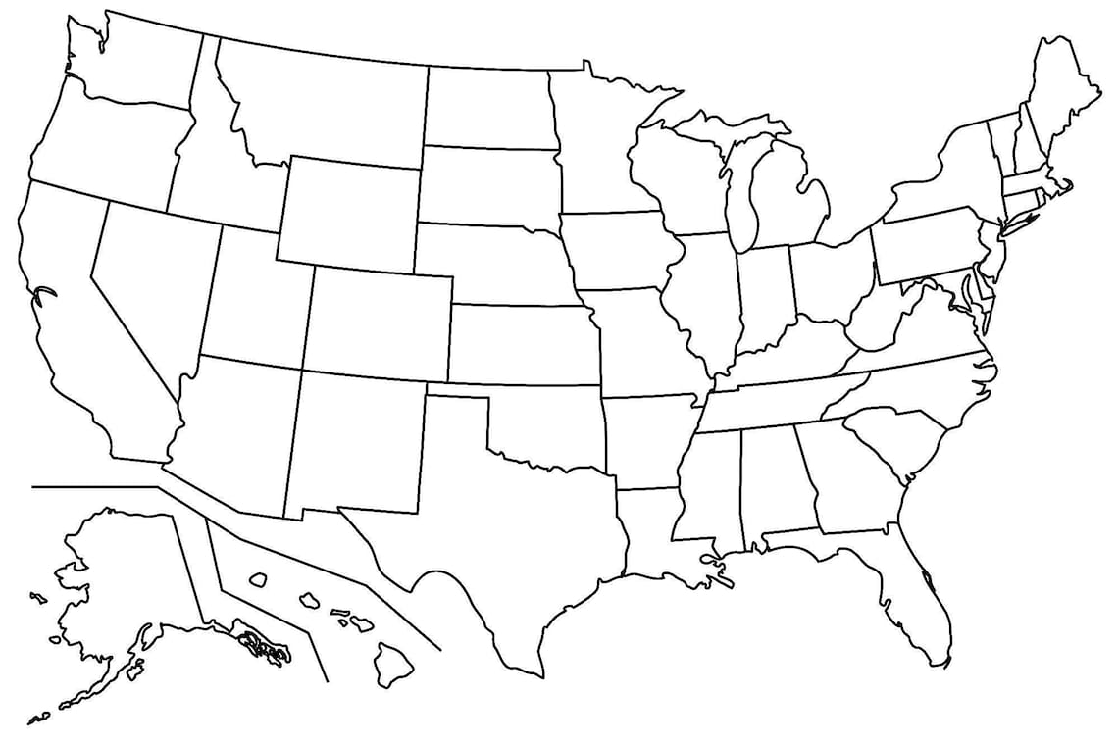











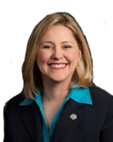





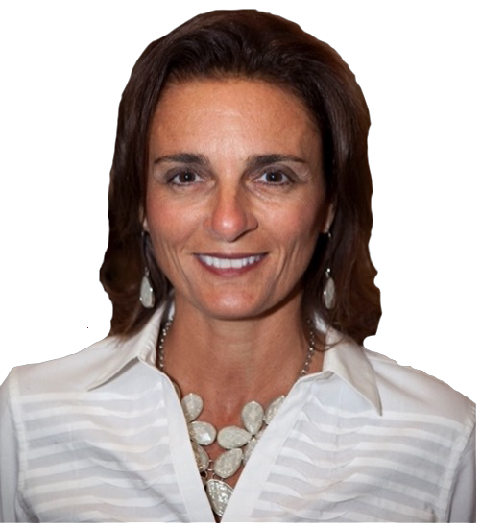




















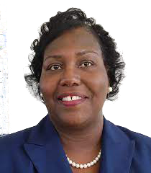





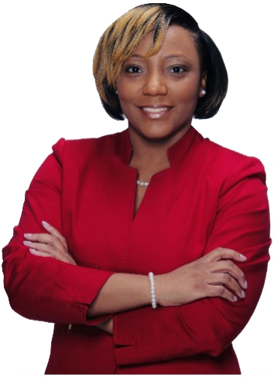
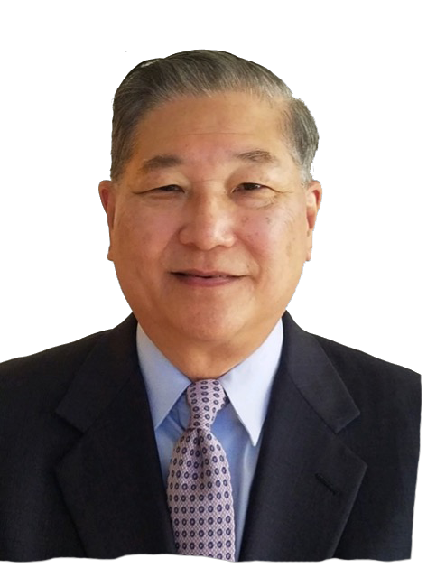
USDA Rural Development
State Directors
WA
MT
ND
ME
ID
MN
OR
WI
VT
SD
MI
NH
WY
MA
NY
CT
RI
NE
IA
PA
IL
IN
NJ
CA
CO
MD
DE
UT
MO
WV
NV
KS
KY
VA
AZ
OK
TN
NC
NM
AR
MS
AL
GA
SC
TX
USDA Rural Development
State Directors, September 2022
Selected Demographic Data
Num Pct.
Women 26 58%
Men 20 42%
Black 10 22%
Hispanic 4 10%
AK
FL
LA
HI

Slide 4
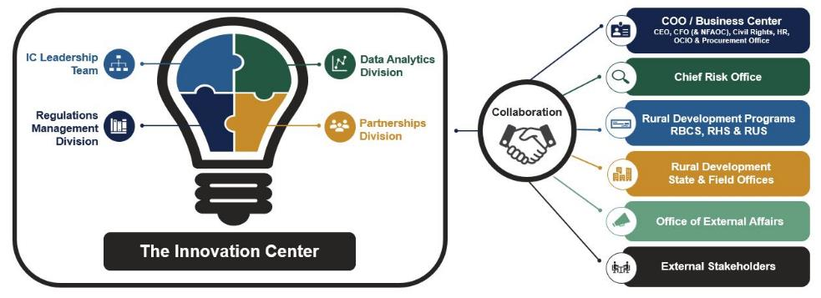
Innovation Center
Strategic Engagement Division
Working together to develop fresh, creative solutions – Innovate!
Centralization of key Reg Management functions to better support RD programs
Building and leveraging Strategic Engagement to increase impact
Using Data Analytics to enhance evidence-based decision making

Slide 5
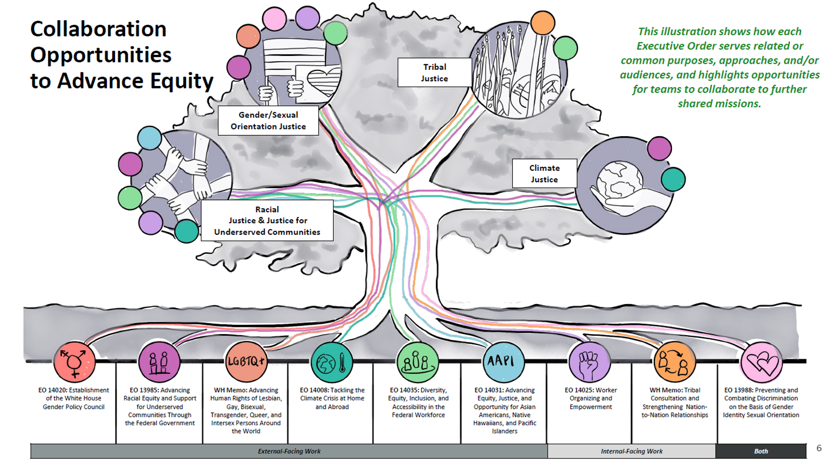
Equity Work at USDA and Rural Development

Slide 6
Equity Action Plan
The Equity Project
Rural Partners’ Network
Priority Points Framework
Internal Equity Work
RD Modernization
Tribal Trust and Responsibility
Regulatory Review

Slide 7
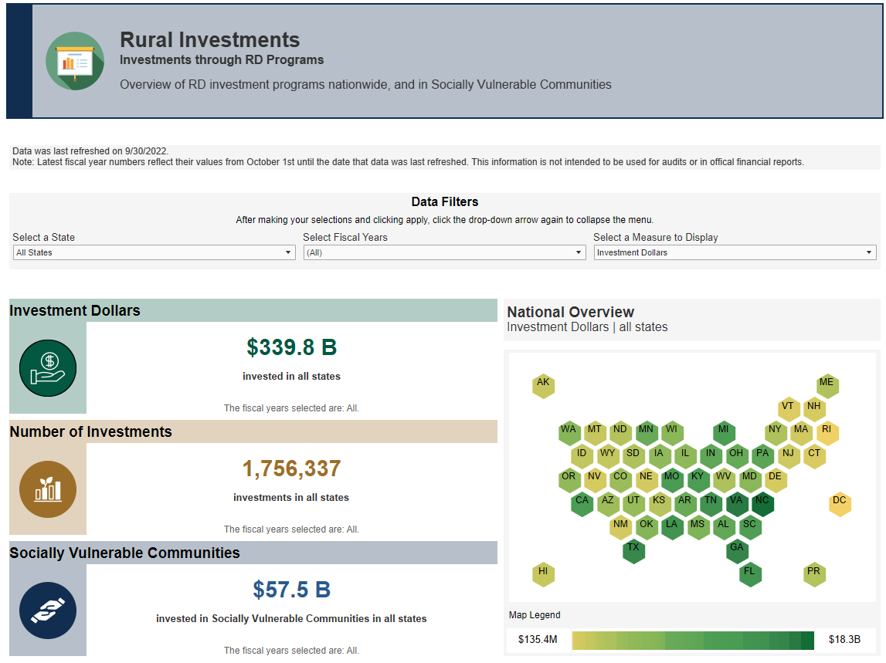
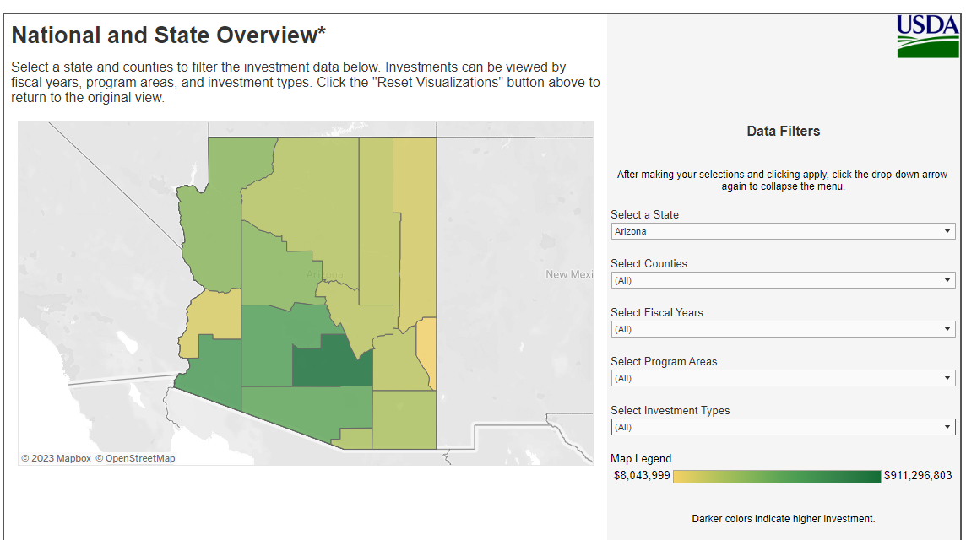
Rural Development’s Rural Data Gateway

