Slide 1

Procedures for the Pesticide evaluation-assessment in the EU, role of EFSA
Jordi Serrratosa Ph.D.
EFSA Liaison officer at the FDA
June 4, 2013
Committed since 2002
to ensuring that Europe’s food is safe
USDA Office of Risk Assessment and Cost-Benefit Analyis and the National Capital Area Chapter of the Society for Risk Analysis

Slide 2



OUTLINE
Role of EFSA
Work and procedures for Pesticides evaluation
Task force on Pollinators
US & EU Scientific Cooperation
2
2

Slide 3
WHY ? Creation of EFSA
Succession of food scares (e.g. BSE, dioxins)
Loss of consumer confidence in safety of food chain
Damaged trust in public authorities
Creation of agencies to handle food issues nationally
BSE
Dioxins
EFSA
3

Slide 4
What EFSA does
EFSA’s tasks
4
Provide scientific advice and technical support for Community legislation and policies
Collect and analyse data to allow characterisation and monitoring of risks
Promote and coordinate development of uniform risk assessment methodologies
4. Communicate risks related to all aspects of EFSA’s mandate
Notes:
4

Slide 5



Risk analysis: Decision Making process
Risk Assessment
EFSA
Hazard identification
Hazard characterization
Exposure assessment
Risk characterisation
Risk Management
European Commission
Assess policy alternatives
Select and implement
appropriate options
Risk
Communication
EFSA+EC
Information - Opinions
“Working Principles for Risk Analysis for Application in the Framework of the Codex Alimentarius”(adopted by the 26th Session of the Codex Alimentarius Commission, 2003; Codex Alimentarius Commission Procedural Manual; Thirteenth edition)
5

Slide 6
The EU Food Safety regulatory framework
Official controls (FVO)
882/2004/EC
854/2004/EC
Contaminants 1881/2006/EC
Residues -96/22;96/23;2377/90
Pesticides 396/2005/EC
Reg 1107/2009 (91/414)
Additives 1333/2008
Enzymes 1332/2008
Flavourings 1334/2008
Food contact
materials
1935/2004/EC
Hygiene Regulation
HACCP
852/2004/EC
853/2004/EC
EU Food legislation
EFSA and RASFF
Regulation 178/2002
Novel Food
258/97/EC
Hygiene Package
2073/2005
2074/2005
2075/2005
2076/2006
Labelling;2000/13/EC
Nutrition Lab. 90/496
Health Claims
1924/2006
Feed Additives
1831/2003/EC
429/2008/EC
Animal Health
including zoonosis
and Welfare
GMO
1829/2003
Plant Health
2000/29
575/2006/EC

Slide 7
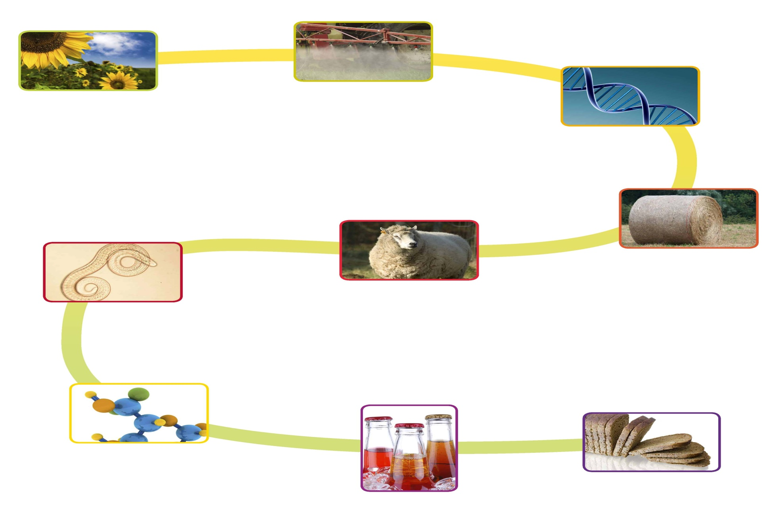
Scientific advice from farm to fork
Plant Health
Plant Protection
Genetically modified
organisms
Biological
food
chain hazards
Animal health
and welfare and
their diseases
Animal feed
Food additives
Flavourings and
Procesing aids
Dietary,
nutritional and
novel food
Food chain
contaminants
Food packaging

Slide 8




How does EFSA work ?
European Commission
European Parliament
Member States
EFSA (“self mandate”)
Question?
Opinion
Risk
Assessment
Consumers
Media
Industry
Risk Communication
Professionals
Risk
Management

Slide 9
How does EFSA work?
The Working Group submits its draft opinion for adoption to the Panel or Scientific Committee. Scientific reports (inhouse) follow approval procedure
Adopted (Panel) or approved (EFSA) output is provided to the requesting body.
Publication on the EFSA website
Development of a suitable communication approach, e.g. media activities, profiling the issue on the EFSA website.
Regular updates on the latest opinion: EFSA highlight
Adoption
Communication
Adoption by the Panel/SC
Output to the requesting body
Publication of output on EFSA website
Communications

Slide 10
How does EFSA’s Units work ?
Mandate
Panel
Working Group
Opinion adopted

Slide 11


Expert Database – Sign up today
www.efsa.europa.eu

Slide 12

EFSA structure
Management
Board
Advisory
Forum
+
+
+
Scientific Committee
and Panels
EFSA Staff
=

Slide 13
Scientific Committee and Panels
Scientific Panels
10 Scientific Panels
Independent scientists selected on the basis of proven excellence
Open meetings as appropriate
Mandatory commitment to independence
Declaration of Interest (annual and per meeting)
Scientific Committee
Chairs of Scientific Panels plus six independent scientists
Horizontal scientific issues, consistency of scientific opinions, harmonised methodologies
Notes:
First established June 2003 - re-established June 2006
Food additive and packaging to be split into two new panels (mid 2008)

Slide 14
Advisory Forum
Composition
Representatives of national food safety authorities with European Parliament and Commission represented as observers
Special invitees (accession countries, observer status: Switzerland)
Role:
Advise on scientific issues, work programme
Information sharing
Facilitate scientific cooperation
Avoid divergent views
Prevent duplication of effort

Slide 15
A Network of Experts and Organisations
  One Scientific Committee and 10 panels
  More than 3.000 experts (universities, research bodies and national scientific authorities)
  €9.2 m distributed to food safety organisations in Member States in 2012
  30 national Food Safety Agencies
300 research institutes and scientific organizations
  Building partnerships with the main international actors in Risk Assessment: WHO, FDA, Health Canada, Japan, New Zealand and Australia

Slide 16
Networking: EU Agencies
EMA
Medicine
ECHA
Chemicals
ECDC
Disease Prevention
JRC
Non Food
Scientific
Committees
EFSA
Food safety
Advice to regulators
Risk Assessment
and data collection
EEA
Environmental
EMSA
Maritim Safety
EU OSHA
Safety &Health at work

Slide 17
Dedicated to scientific excellence
+ 2500 scientific outputs
500th opinion - 2007
1000th opinion - 2009
Wide remit:
food and feed, nutrition, animal
health and welfare and
plant health
Scientific expertise across
Europe
Impartiality of scientific advice
EFSA Journal, Scientific Colloquia, international cooperation…
2012: 1837
Notes:
- Scientific opinions:
2003 = 1st opinion
2007 = 500
2009 = 1000 (doubled in 2 years)
February 2012 =1837
- EFSA Journal created in 2010
16 Scientific colloquia on key topics
International cooperation with
U. S. (FDA etc), Health Canada, Food Safety Commission of Japan, Food Standards Australia, New Zealand Food Safety Authority. MoU with Japan and formal agreement with FDA
WHO, OIE, FAO and CODEX alimentarius

Slide 18
Work and procedures for Pesticides evaluation

Slide 19
PRAS Panel and WGs
Mammalian
toxicology
Team (5)
Phys-chem
properties,
analytical methods
Team (3)
Residues /
MRLs
Team (5)
Co-ordination
Team (7)
Working Group
Toxicology
Ecotoxicology
Team (5)
Residues /
peer review
Team (3+2 50%)
Working Group
Residues
PRAS Panel
21 experts
Working Group
Ecotoxicology
WGs
on Guidance Documents :
GD on RA for Birds and Mammals
GD on persistence in soil
….etc…
Working Group
Fate and behaviour
Environmental
fate and behaviour
Team (4+1 interim)
Supported by the EFSA Secretariat = PRAS Unit

Slide 20
How does the EU deal with pesticides?
Pesticides
EU Regulatory Framework
Placing of plant protection products on the market
Pesticide residues:
EU MRL settings
(used mainly in agriculture to protect plants or plant products
against harmful organisms)
Directives
76/895/EEC
86/362/EEC
86/363/EEC
90/642/EEC
Annex 1 of Directive 91/414/EEC
(under revision in EP and Council in 2008)
Replaced by
Regulation (EC) No 396/2005

Slide 21
Pesticides in the EU
Directive 91/414/EEC
Main elements
Establishment of a Community Positive List of Active Substances (Annex I)
Once an active substance is on the Community list, Member States may grant authorisations for plant protection products which contain a listed active substance
European Commission
Member States
Approval of active substances
Authorisation of plant protection products
21

Slide 22
Regulation (EC) No 396/2005
Understanding the EU MRL legislation
How are the MRLs established / modified ?
What are the data requirements ?
How is the risk assessment performed ?

Slide 23
EU MRL legislation
Regulation (EC) No 396/2005 of the European Parliament and of the Council on maximum residue levels in or on food and feed of plant and animal origin
Procedure for MRL setting
Official control of MRLs
Definition of responsibilities (role of Member States, European Commission, European Food Safety Authority, manufacturer of pesticides, food business operator, etc.)
Annexes
  Annex I: List of commodities for which MRLs are established
  Annex II and Annex III: List of MRLs
  Annex IV: Active substances exempted from setting MRLs
  Annex V: specific LOQ values
  Annex VI: processing factors
Basic regulation:
http://eur-lex.europa.eu/LexUriServ/LexUriServ.do?uri=OJ:L:2005:070:0001:0016:EN:PDF

Slide 24
MRL values
Design of Annex II and III
260 individual food commodities, classified in 10 main food categories
525 pesticides
136.500 MRLs

Slide 25
Where to find the EU MRLs
Official Journal (OJ)
http://eur-lex.europa.eu/en/index.htm
Database of the European Commission
http://ec.europa.eu/food/plant/protection/pesticides/database_pesticide_en.htm
Recommended source of information!

Slide 26
Procedure for MRL setting
Who may take the initiative to set/amend a MRL?
(Art. 6 of Reg. 396/2005)
Applicant of a plant protection product requesting authorisation of a pesticide in EU Member State
Grower associations
Importers
Producers of food
EU Member States
Parties demonstrating a legitimate interest in health

Slide 27
Procedure for MRL setting
When is the right moment for applying for amending the MRL?
(Art. 6 of Reg. 396/2005)
For MRLs required to reflect EU uses:
“Where a MS envisages granting an authorisation…”
For import tolerances: legislation does not explicitly specify when the application should be submitted.

Slide 28
Procedure for MRL setting
What is needed to request the setting or modification of an MRL ?
(Art. 7 of Reg. 396/2005)
Application form
  http://ec.europa.eu/food/plant/protection/resources/publications_en.htm#residues
Application dossier including
  Summary of the application
  Studies as specified in EU legislation (Reg. 544/2011 and 545/2011. As from 01/01/2014: new data requirements, not yet published in OJ)
  Copy of the relevant GAP (Good Agricultural Practice) which trigger the MRL application
  Information on the MRL in country of origin

Slide 29
Procedure for MRL setting
To whom should the application be submitted ?
(Art. 6 of Reg. 396/2005)
Rapporteur Member State (RMS)
  Information can be found on COM website
  http://ec.europa.eu/sanco_pesticides/public/index.cfm?event=activesubstance.selection
If no Rapporteur Member State was designated, a Member State will be designated by the European Commission upon request

Slide 30
Procedure for MRL setting
RMS drafting Evaluation Report
No deadline
European Commission requests EFSA to assess the application, on the basis of the Evaluation Report
3 mo (except. 6 mo)
EFSA issues “reasoned opinion”
3 mo
European Commission to prepare Regulation to set/amend MRL
3 mo
Consultation of trading partners (SPS notification)
Opinion of the Standing Committee on the Food Chain and Animal Health (SCFCAH)
5 meetings of SCFCAH per year
Scrutiny by Council and European Parliament
3 mo
Adoption and publication of MRL Regulation in Official Journal
?
Entry into force of new MRLs
Depending

Slide 31
Procedure for MRL setting
Opinion of the Standing Committee on the Food Chain and Animal Health (SCFCAH)
5 meetings of SCFCAH per year
Scrutiny by Council and European Parliament
3 mo
Adoption and publication of MRL Regulation in Official Journal
?
+ 1 d
Entry into force of new MRLs

Slide 32
Data requirements
List of studies that have to be submitted in support of MRL application
  Residue data package (Reg. 544/2011, chapter 6; Reg. 545/2011, chapter 8)
  Toxicological data package needed to establish toxicological reference values (only for active substances for which no EU ADI/ARfD has been derived yet) (Reg. 544/2011, chapter 5; Reg. 545/2011, chapter 7)
  Analytical methods to be used for monitoring/enforcement of MRL in the relevant crop (Reg. 544/2011, chapter 4.2)
  Persistency in soil (Reg. 544/2011, chapter 7.1, Reg. 545/2011, chapter 9.1)

Slide 33
Data requirements
Guidance documents
Metabolism in plants
Design of supervised field trials
Rotational crop studies
Comparability, extrapolation, group tolerances and data requirements
Metabolism in domestic animals
Livestock feeding studies
Storage stability of residue samples
Calculation of maximum residue levels (replaced by OECD calculator)
http://ec.europa.eu/food/plant/protection/resources/publications_en.htm

Slide 34
Data requirements
Reduced data requirements
Only 4 residue trials for minor crops
In exceptional cases, monitoring data can replace supervised field trials
  environmental contamination resulting in residues,
  products which are a minor component in diet,
  herbal infusions
Extrapolation from trials performed in a crop where comparable residue behaviour is expected (same GAP !)
    E.g. potatoes to tropical root and vegetables
No rotational crop studies for import tolerances

Slide 35
Data requirements
Reduced data requirements
No toxicological data package necessary, if the active substance was assessed at European level
No analytical methods necessary if validated methods are available for crops with similar matrix
Relevant studies were assessed by JMPR in the framework of CXL setting – provide only reference

Slide 36
Specific issues
Be aware of European food classification:
    E.g. Leafy vegetables in US system ≠ Leafy vegetables in EU food classification
Residue trials have to be compliant with EU residue definitions
MRL applications for feed crops: impact on MRLs for food of animal origin
MRL proposal derived with OECD calculator. EU MRL will not be set at higher level than in country of origin

Slide 37
Specific issues
Avoiding duplication of work:
  Codex MRLs are taken over in EU legislation. No need to submit MRL application at EU level
For new active substances assessed under Regulation 1107/2009: approval dossier should also contain MRL requests (e.g. import tolerances)

Slide 38
Conclusion
MRL proposal is acceptable if
Dossier compliant with EU data requirements
No concerns in chronic risk assessment – considering also the EU MRLs that are already in force
No concerns in acute risk assessment for crops for which MRL is requested

Slide 39
Other peer review workflows
Basic substances
  substances that can be used for plant protection purposes (not the primary use)
  Simplified procedure; no RMS involvement
  Some examples: chitosan, equisetum extract, talc
Confirmatory data
  Data to be submitted after the active substance approval (incomplete dossier)
  RMS evaluation
  Commission decides on need for EFSA peer review

Slide 40
Other peer review workflows
Review of approval
  At any time, the Commission can decide to review an existing approval (for instance where new potentially adverse data is available)
  Commission can ask the RMS to review the data and EFSA to peer review the RMS’s evaluation
  This can be allocated to EFSA staff (for instance the review of the neonicotinoids clothianidin, imidacloprid and thiamethoxam) or to EFSA’s PPR Panel (external experts; for instance developmental neurotoxicity of imidacloprid and acetamiprid)

Slide 41


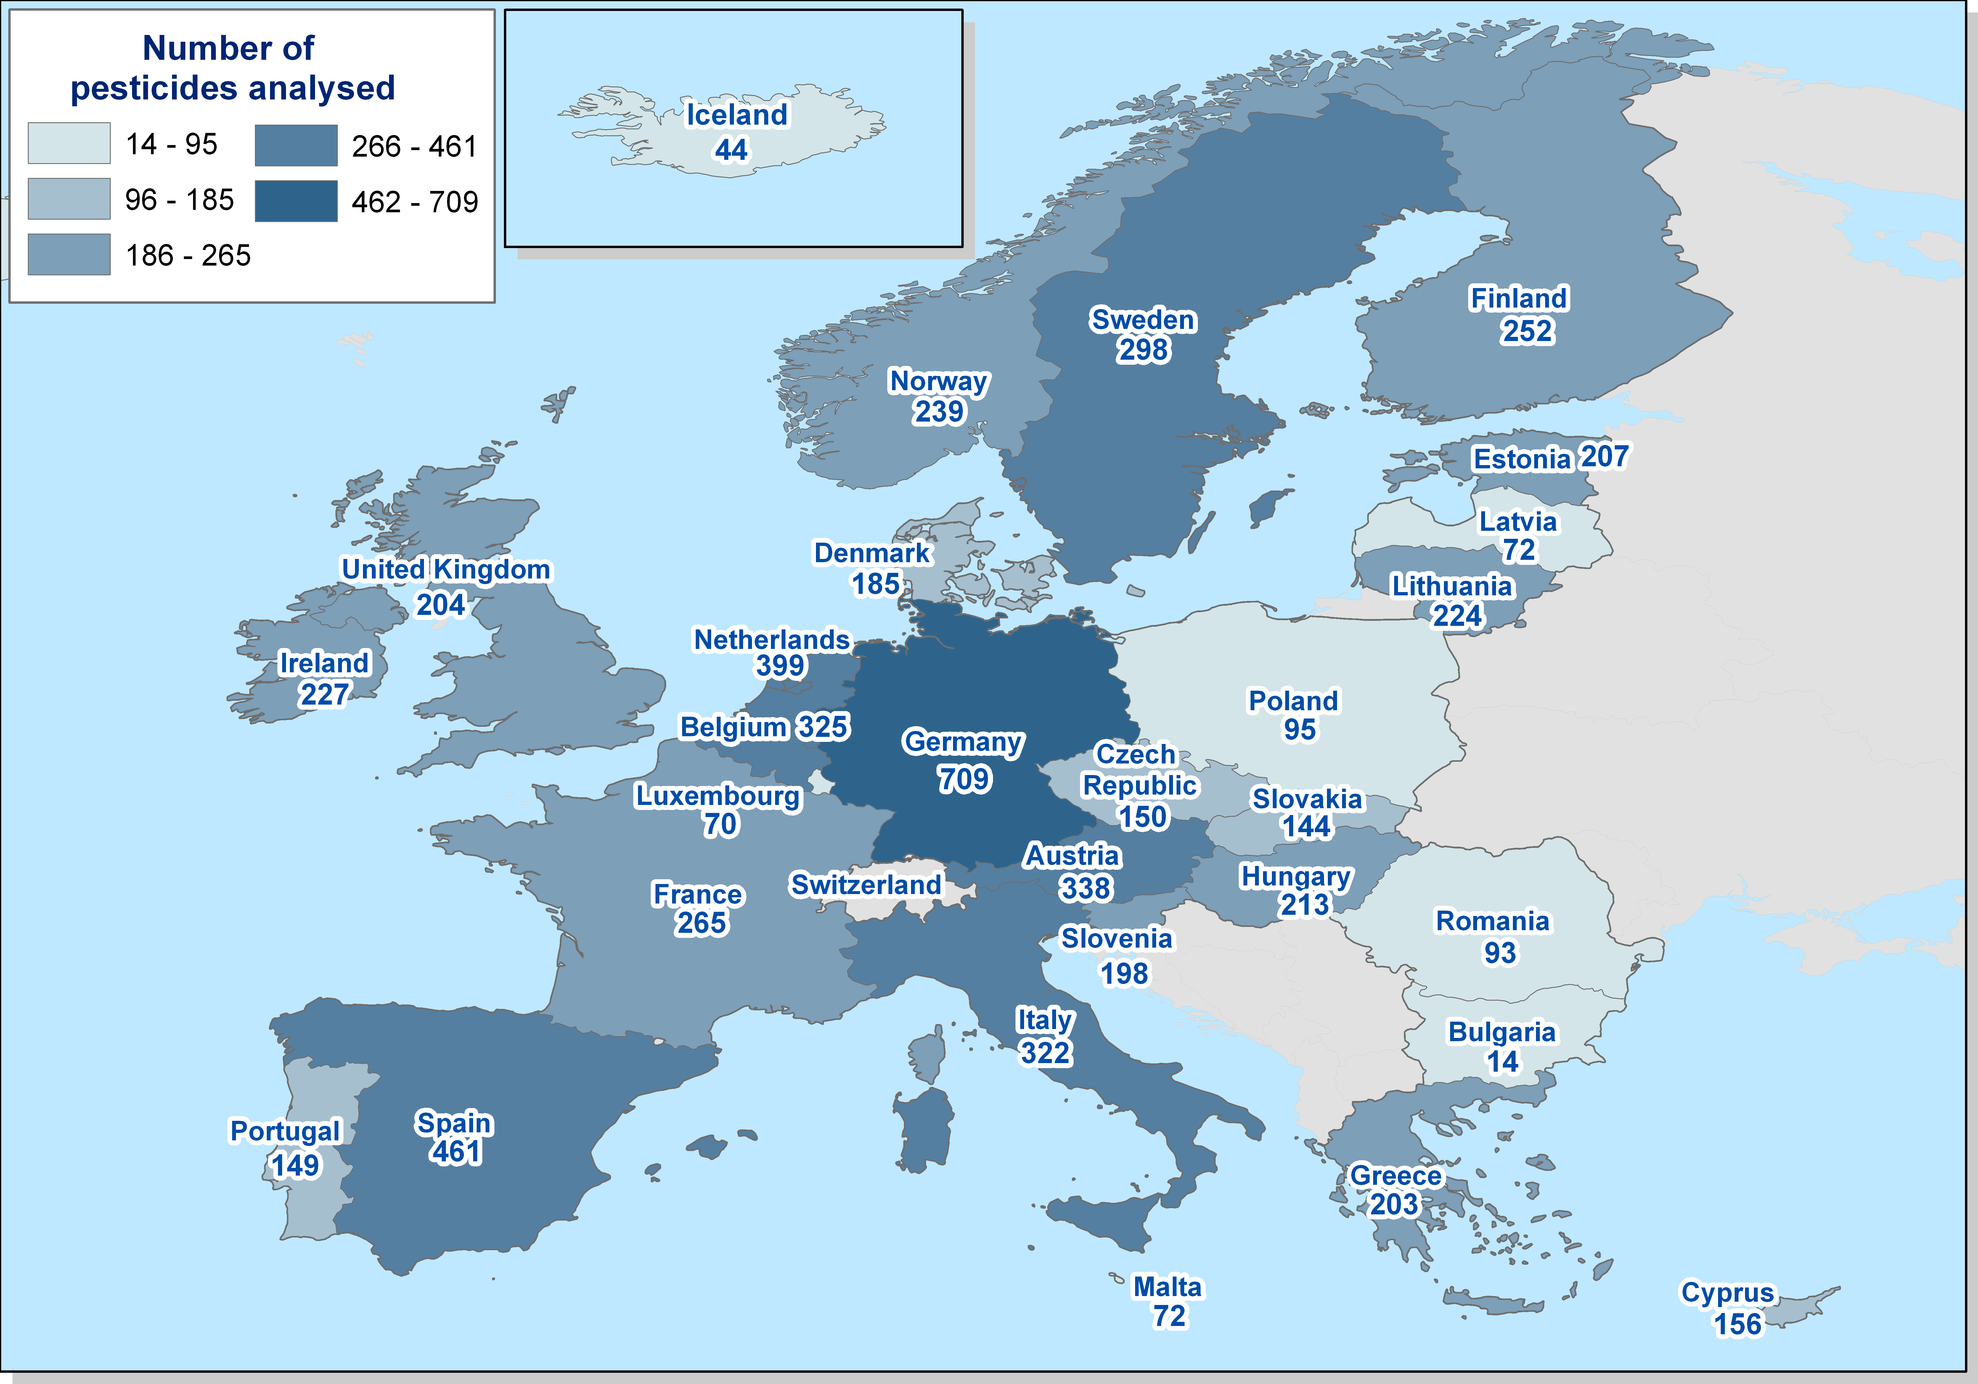
National/EU annual control activities
No of commodities/ samples analysed on annual basis | Pesticides sought | Participating countries
>350 food items >70.000 samples analyzed >10.000.000 single determinations | > 800 active substances | 27 Member States 2 EFTA countries (Iceland and Norway)
41
Notes:
41

Slide 42
Link MRL setting/Annual Report
Risk Assessment
MRL setting
Risk assessment
Monitoring
Worst case assumptions
Risk assessment based on data generated by applicants
Supervised field trials
Real occurrence data
Better estimate of consumer exposure
Limitations regarding current reporting format
Change of reporting format and data model/XML schema under preparation
42
Notes:
42

Slide 43
Task force on Pollinators

Slide 44
Pollinators and Pesticides
EFSA’s Task force on bees:
  Transversal and multidisciplinary approach for the risk assessment of stressors in bees
  Colloquium on Bee Health 15-16 May 2013
Request of the EU Commission for
  an Opinion on the science behind the development of a risk assessment of PPPs on bees (Apis mellifera Bombus spp. and solitary bees)
  Prepare an EFSA Guidance on the risk assessment of PPPs on bees.
EFSA Conclusions on neonicotinoids

Slide 45
« EMRISK » internal Task force on bees
May 2012 – September 2013
Inventory of studies conducted on bees, inside and outside EFSA, to identify cross-cutting issues and further research needs for a more integrated approach on the evaluation of risks to bees and their ecosystem services
Composition of the Task Force:
The internal task force it includes EFSA staff members from:
Pesticides Risk Assessment Unit (PRAS)
Animal Health and Welfare Unit (AHAW)
Plant Health Unit (PLH)
Genetically Modified Organisms Unit (GMO)
Scientific and Assessment Support Unit (SAS)
Communications Directorate (COMMS)
Notes:
Proposing a global system for the identification, prioritization, evaluation of emerging risks
Support the Authority to establish and maintain a network

Slide 46
« EMRISK » internal Task force on bees
Objectives :
As a first step: Inventory of all EFSA activities and outputs dealing with the risks posed to bees and their ecosystem services.
=> 1st Report published in Nov. 2012: http://www.efsa.europa.eu/fr/supporting/pub/358e.htm
As a second step:
  Review the state of the art of the work and research produced outside EFSA in the area of bee risk assessment (e.g. DG-RI, DG-SANCO, DG-ENV, EU bee Reference laboratory, EEA, OECD, FAO, EPA, USDA, etc.),
  Analyse the data collected to highlight cross-cutting issues in risk assessment and data gaps and research needs,
  Make recommendations on how to further integrate the work to provide risk managers comprehensive advices.
=> 2nd report in September 2013

Slide 47
Colloquium on Bee Health
15-16 May 2013, EFSA, Italy
“Towards Holistic Approaches to the Risk Assessment of Multiple Stressors in Bees”
To consider Risk Assessment (RA) approaches for multiple stressors in bees in an integrated manner
To support internal TF mandate to perform an analysis on the data collected inside and outside EFSA and highlight cross-cutting issues, risk assessment, data gaps and research needs.
To share new important developments from EFSA’s Panels AHAW (Bee pests, February 2013) , PRAS (Neonicotinoids, Dec 2012; Fipronil, March 2013, Guidance on RA of PPP on bees, May 2013).
To reinforce EFSA’s Science Strategy:
  Development of harmonised and more integrated RA approaches
  Transversal collaborations across units involved on bee issues (e.g. EMRISK, PRAS, AHAW, GMO, SAS, PLH)

Slide 48
Bee mandate on Guidance
Terms of reference:
The Guidance Document should address the risk to Apis mellifera, Bombus spp and to solitary bees.
The assessment of the acute and chronic effects of Plant Protection Products on bees, including the colony survival and development.
The estimation of the long term effects due to exposure to low concentrations.
The development of a methodology to take into account cumulative and synergistic effects.
The evaluation of the existing validated test protocols and the possible need to develop new protocols, especially to take into account the exposure of bees to pesticides through nectar and pollen.

Slide 49
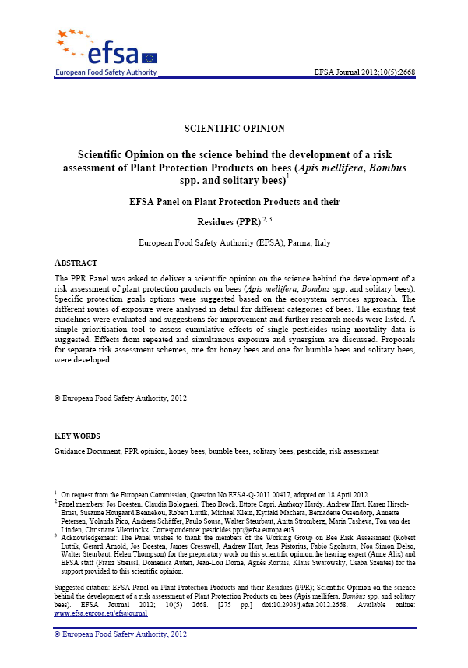
EFSA PPR Opinion 2012
Opinion published May 2012
Extensive document
New areas of risk assessment
- other pollinators
- exposure routes
Recommendations for improvement:
- risk assessment methodology (systemic active substances)
- design of higher tier studies
No agreed ‘trigger values’

Slide 50
EFSA Conclusions on neonicotinoids
The Commission’s mandate
The key elements of the mandate from the European Commission
  Deadline on 31/12/12
  Substances: imidacloprid, clothianidin, thiamethoxam
  all authorised uses as seed treatment and as granules are to be considered

Slide 51
The Commission’s mandate
To revise the risk assessment for bees by considering:
  Acute and chronic risk on colony survival and development (including bee larvae and bee behaviour)
  Sublethal effects
To focus on the following routes of exposure:
  Dust
  Residue in pollen and nectar
  Guttation
Consider EFSA PPR Panel Opinion (2012)

Slide 52
EFSA’s review process
Data collection (specified in the mandate):
  studies from the applicants
  information on the authorised uses (GAP tables), and monitoring data from the Member States
  published literature and monitoring data
Draft Conclusions
Tiered risk assessment*
MSs consultation
Final Conclusions
(Adopted the Conclusions on 19/12/12)
Data evaluation*
*Taking in to account the Scientific Opinion on the science behind the development of a risk assessment of plant protection products on bees (specified in the mandate)

Slide 53
Issues that could not be finalised
Long-term risk on colony survival and development
Risk to pollinators other than honey bees
Risk to honey bees foraging pollen and nectar in succeeding crops
Risk to honey bees foraging in honeydew
Risk following the exposure to sublethal doses
Risk following the exposure to guttation (except for thiamethoxam, acute risk)

Slide 54
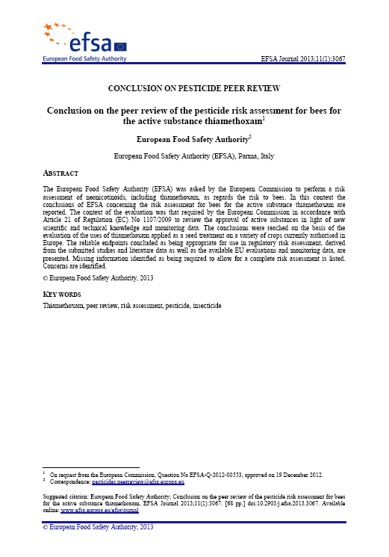
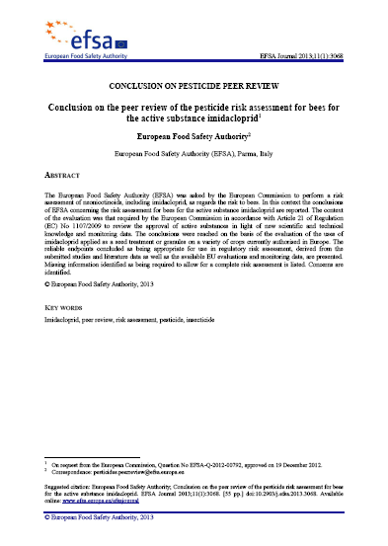
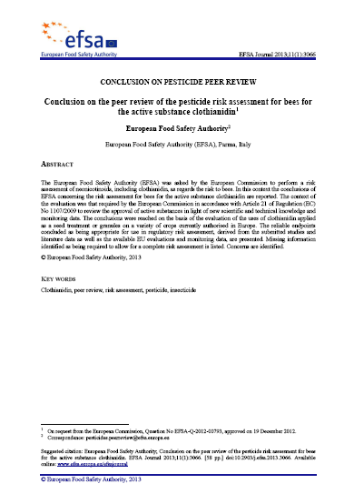
The Conclusions
Published 16th January

Slide 55
Conclusion (1)
For many of the authorised uses, EFSA did not have enough data available in order to finalise the risk assessment or the data were not sufficient (according to the new criteria). For instance not enough information :
  on dust release
  on concentration in pollen and nectar
  on guttation frequency and use of guttation fluid as a source of water
  limited information on other pollinators
EFSA listed all data gaps, and gave an indication of the uncertainties associated to the risk assessment

Slide 56
Conclusion (2)
  Exposure from pollen and nectar: only uses on crops not attractive to honey bees were considered as presenting a low risk
  Exposure from dust: a risk to honey bees was indicated or could not be excluded, with some exceptions, such as use on sugar beet and crops planted in glasshouses, and for the use of some granules
  Exposure from guttation: the only risk assessment that could be completed was for maize treated with thiamethoxam. In this case, field studies show an acute mortality effect on honey bees exposed to the substance through guttation fluid

Slide 57
US & EU Scientific Cooperation

Slide 58
Scientific Collaboration between US & EU: Clusters
Keeping in mind the win-win concept
The focus of the cluster should be well-defined. Discussion and clarification could be helpful to define the scope from the begining
Update the current work program , focusing only on top priorities and timeline for action. See following examples:
  Current/on going risk assessments (RA)
  Future Projects !!!! (proactive)
  Old RA (old files, archiving ..)
  Guidelines/Guidance documents
  Risk assessment methodologies and modelling
  Available Data base

Slide 59
Overview of exchanges between EU/ EFSA and US institutions
U.S. | Areas of concerns for food safety | Collaboration: Main actions
FDA/CFSAN NCTR | Food additives and Food ingredients, Allergies, Food toxicology , Microbiology and Nutrition | Cluster Food additives Confidential exchanges Int. meetings Low dose
FDA/CVM | Feed additives, Antimicrobial Resistance (AMR), Residues and contaminants | Cluster Feed additives Transatlantic Task force on AMR
USDA/FSIS | Microbiological risks & residues-meat, eggs | Cluster Microbiological risks and meat inspection
EPA NIEHS/ NTP | Pesticides, Env. Toxicology –Tox 21 Risk Assessment methodologies QSAR | Cluster On Pesticides Low Dose meetings. Cluster on Pollinators (USDA)
USDA/APHIS | Animal Health –CEAH Plant Health | Cluster on Animal Health Experts exchanges
USDA/ARS | Research & Nutrition Database (exposure) | EFSA uses ARS Database
CDC | Public health & Food borne Diseases (AMR) -Epidemiology | Outbreaks: teleconferences in FDA/CFSAN

Slide 60



Food safety Risk Assessments in U.S. & EU/ EFSA
U.S. | Areas of concerns for food safety | EFSA Risk Assessment Panels
FDA/CFSAN | Food Allergies, Food toxicology and microbiology, Nutrition | FOOD ADDITIVES (GMO) BIOHAZ, CONTAM, NDA
FDA/CVM | Feed additives AMR, Vet. Medicines | FEED ADDITIVES, GMO CONTAM
USDA/FSIS | Microbiological risks- residues in meat, eggs | BIOHAZ , SAS, DCM
EPA /NIEHS | Pesticides, Env. Toxicology Pollinators | PESTICIDES CONTAM
USDA/APHIS | Plant Health and Animal Health & Welfare | PLH & AHAW (GMO)
USDA/ARS | Research & data on Nutrition (exposure) | NUTRITION/ DCM
CDC and NIH/ NTP/NIEHS | Public health & Food borne Diseases (AMR) Toxicology | BIO MONITORING
FDA/ ORA USDA /FSIS | Control their respective types of foods as legally competent | Outside EFSA’s remit

Slide 61
US -EFSA:
Exchanges of data 2012
 | 2012 Requests (R) and exchanges (files)
EFSA - Unit US Center | US |  | EFSA |  | Σ |  | *files to be highlighted
 | R | Files | R | Files | R | Files
FIP- FDA | 9 | 13 | 14 | 47 | 23 | 60 | BPA, Aspartame, Caramelin Advantame
FEED-FDA | 3 | 6 | 4 | 5 | 7 | 11 | Re-evaluations
AHAW-USDA | 1 | 1 | 3 | 6 | 4 | 7 | RVF, TB test, Exotic Dis.
NDA/CONT-FDA | 3 | 6 | 1 | 1 | 4 | 7 | Ar-Hg-Transfat-soya oil
BIOZ-BIOMO-FDA | 4 | 4 | 4 | 2 | 8 | 6 | E.coli-S. Standley
SC- EMRISK FDA-EPA - USDA | - | - | 12 | 8 | 12 | 8 | Nanotechnology/Cloning Pollinators
PRAS-EPA-USDA | 4 | 3 | 5 | 4 | 9 | 7 | Pesticides /Neonicotinoids
GMO/Biotech | 1 | 1 | 1 | 1 | 2 | 2 | GMO Salmon, cloning
TOTAL | 25 | 34 | 44 | 74 | 69 | 108
61

Slide 62
Experts included in the EDB
Third Countries
05/05/2013

Slide 63
EFSA -Expert Data Base:
US experts until May 2013
The evolution of US experts since 2009 (Sept) to May 2013, has been increasing from 36 to 134 in the EDB.

Slide 64

Thank you

