Slide 1

Assistive Technology Program Overview
United States Department of Agriculture
TARGET Center
​
Rashida Owens
Assistive Technology Program Manager

Slide 2

Advancing Access & Equity

Slide 3


No Slide Title.

Slide 4
Learning Objectives
What is Assistive Technology?
Assistive Technology Laws
TARGET Center Assistive Technology Services
Types of Assistive Technology

Slide 5
What is Assistive Technology?
"Any item, piece of equipment, or product, whether acquired commercially, off the shelf, modified, or customized, that is used to increase, maintain, and improve the functional capabilities of Individuals with Disabilities."
-The Technology Related Assistance to Individuals with Disabilities Act of 1988 (Tech Act)

Slide 6

No Slide Title

Slide 7
Who Uses Assistive Technology?
Assistive technology helps people who have difficulty speaking, typing, writing, remembering, pointing, seeing, hearing, learning, walking, and many other things. Different disabilities require different assistive technologies.
- Assistive Technology Industry Association

Slide 8
Assistive Technology Laws
1988
The Technology-Related Assistance for Individuals With Disabilities Act of 1988
1998
Assistive Technology Act of 1998
2004
Assistive Technology Act of 2004

Slide 9
“For most of us technology makes things easier. For a person with a disability, it makes things possible”.
-Judy Huemann, American Disability Rights Activist

Slide 10
USDA TARGET Center
Assistive Technology Services
Resource
Evaluations
Technology Demonstrations

Slide 11
Assistive Technology Loan Program
Provide USDA employees with Assistive Technology loans to bridge a gap in time before customers have access to permanent solutions or for a temporary disability.
Loans are for 30 days. Items will be shipped to customers.
Not all Assistive Technology recommended is available through the Loan Program.

Slide 12
Assistive Technology Trainings
Individual Training
Group/Agency Training
In-Person at the TARGET Center
Virtual Trainings

Slide 13
Vendor Connections
The TARGET Center Assistive Technology Program (AT) partners with various vendors to help facilitate the acquisition process to obtain recommended AT products.
Vendors provide quotes and work with agencies to ensure a smooth purchase process.

Slide 14
Assistive Technology Evaluation Process
Pre-Evaluation Form
Evaluation Meeting
Report

Slide 15
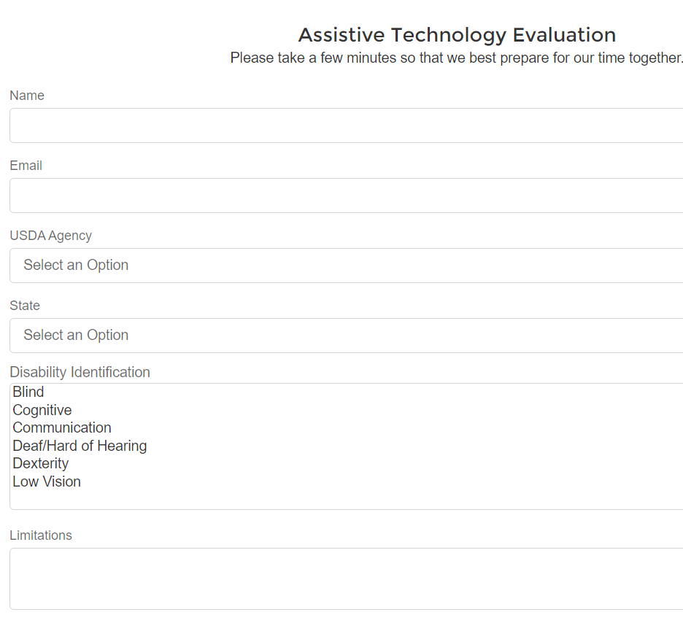
Requesting an Assistive Technology Evaluation
https://www.usda.gov/target-center

Slide 16
Types of Assistive Technology

Slide 17
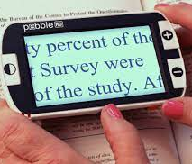
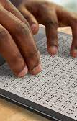
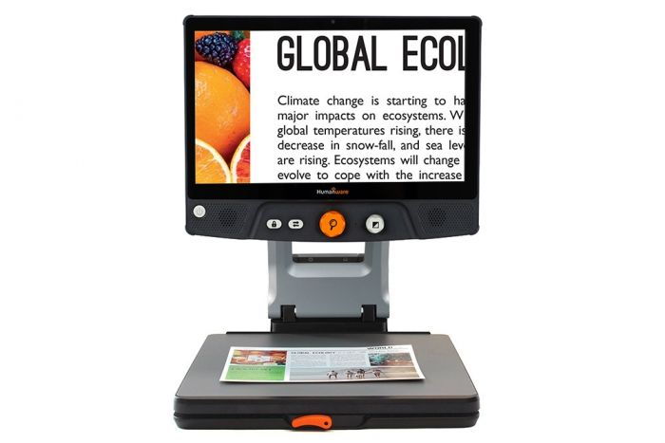
Assistive Technology for Vision
Magnifiers
Braille displays
Screen reading software
CCTV Magnifier
Large print materials

Slide 18
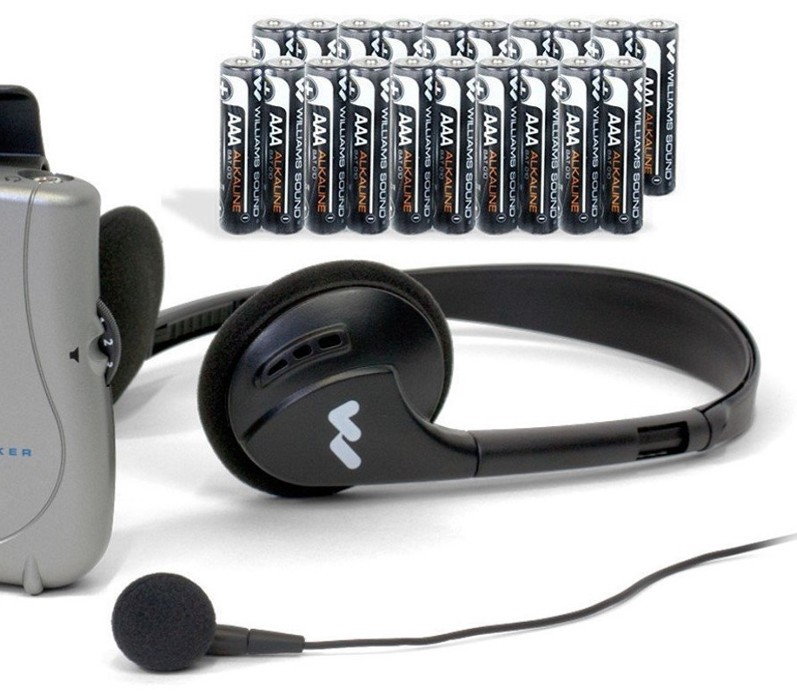
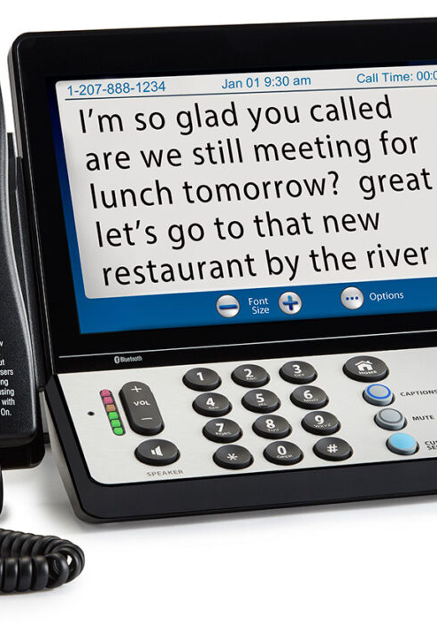
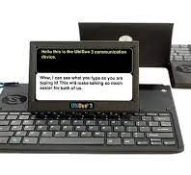
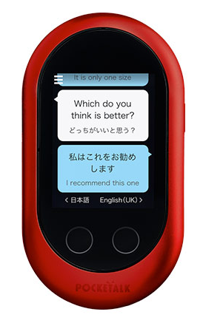
Assistive Technology for Hearing
Personal amplification systems
Wireless TV listening systems
Vibrating alarm clocks
Face-to-face dual keyboard system
Captioned phone
Portable closed captioning system

Slide 19
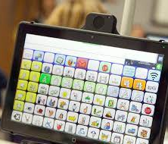
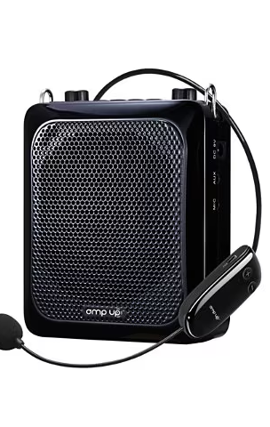
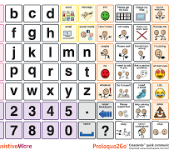
Assistive Technology for Communication
Voice amplification systems
Speech output software
Augmentative Alternative Communication devices
Communication boards

Slide 20
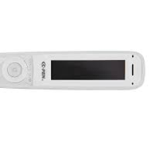


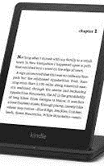
Learning, Cognitive, and Developmental Assistive Technology
Memory Aids
Reminder systems
Audio Books/eReaders
Notetaking Systems
Reader Pens
Literacy support software

Slide 21
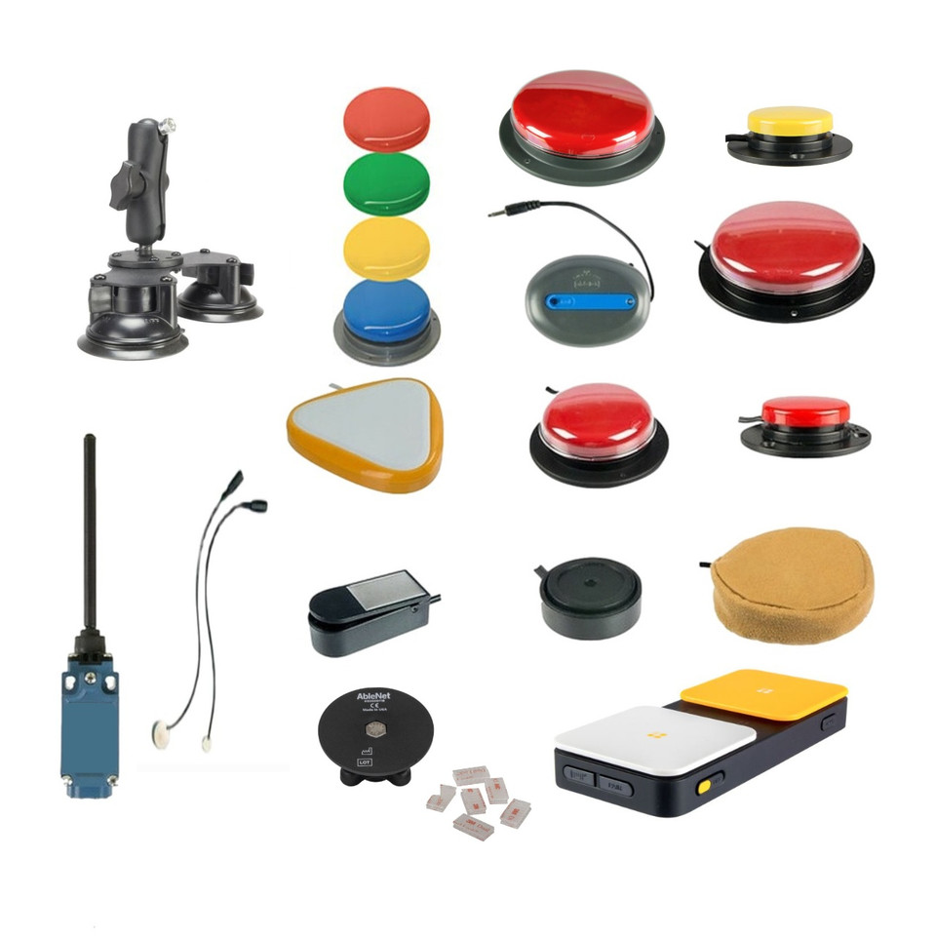
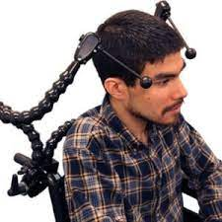
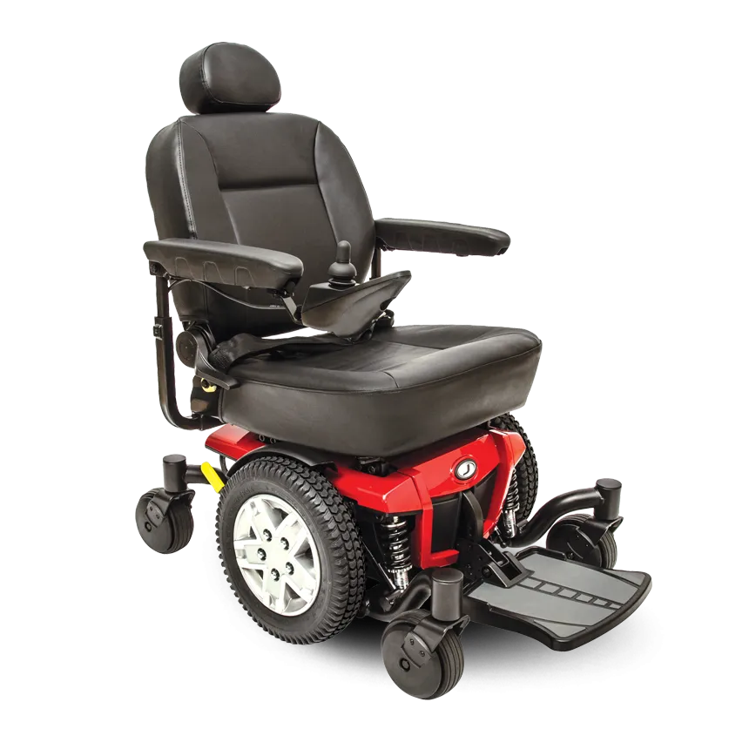
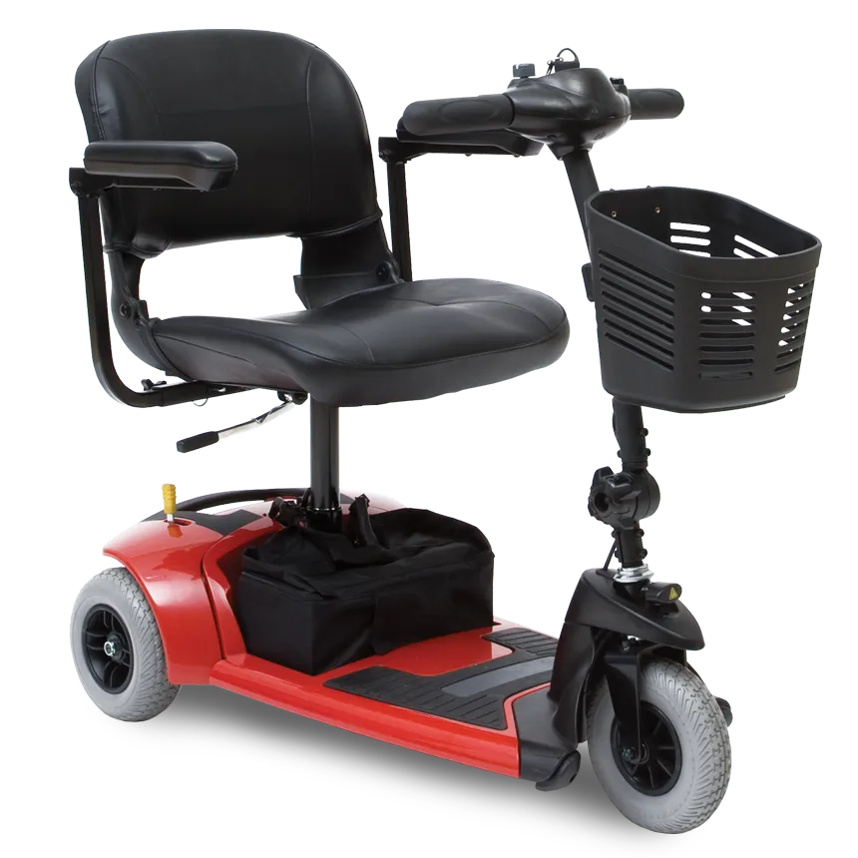
Mobility, Seating, and Positioning
Wheelchairs
Walkers
Canes
Scooters
Swiches
Eyegaze systems

Slide 22

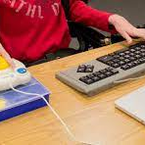


Computers and Related Peripherals
Screen magnification software
Alternative keyboards and Mice
Voice recognition software
Large monitors

Slide 23
Resources
Quality Indicators for Assistive Technology Services
http://www.qiat.org
Assistive Technology Industry Association
https://www.atia.org/home/at-resources/what-is-at/
National Assistive Technology Research Institute
http://natri.uky.edu/index.html
Center on Technology and Disability
https://www.ctdinstitute.org/

Slide 24

Questions

Slide 25
Upcoming Workshop
Assistive Technology Program
Demonstration Tuesday, October 12, 2023

Slide 26
Thank you
Access Webinars
Collaborate with TARGET Center!
Share in Your Networks
Sign Up for Email List
Request AT Evaluation
Follow on Twitter
Request Training

Slide 27

Current and Upcoming Meetings
OCTOBER
MONDAY
TUESDAY
WEDNESDAY
THURSDAY
10/2/2023
10/3/223
11:00 AM – 12:00 PM
Rethinking Disability and What It Means to Be Disabled
Dr. Theresa Haskins Haskins Consulting
1:00 PM – 2:00 PM
(Neuro) Diversity Includes You
Dr. Theresa Haskins Haskins Consulting
10/3/2023
10/4/2023
10/5/2023
10:00 AM – 11:00 AM
USDA TARGET Center Assistive Technology Program
Rashida Owens
Assistive Technology Program Manager
12:00 PM – 1:00 PM
USDA TARGET Center
Ergonomics Program
Stephanie Bradley
CEAS, CAE
Ergonomics Program Manager
11:00 AM – 12:00 PM
Nurturing Workplace Well-Being and Supporting Mental Health (Part 1 of 2)
Dr. Theresa Haskins
Haskins Consulting
1:00 PM – 2:00 PM
PTSD Is More Common Than You Think
Alla Weinberg
Spoke & Wheel
10:00 AM – 11:00 AM
Empowering Lives Through Assistive Technology Solutions
Donny Osborn
Boundless AT
12:00 PM – 1:00 PM
Department of Defense Computer/Electronic Accommodations Program (CAP)
Erin Sanderson
CAP
HOLIDAY
10/10/2023
10/11/2023
10/12/2023
11:00 AM – 12:00 PM
Autism Inclusion and the Pathway to Neurodiversity
Dr. Theresa Haskins Haskins Consulting
1:00 PM – 2:00 PM
Lessons from Unpredictable Journeys: Insights from Temporary and Situational Disabilities (Part 1 of 2)
Dr. Theresa Haskins Haskins Consulting
11:00 AM – 12:00 PM
Creating a
Trauma-Informed Workplace
Alla Weinberg
Spoke & Wheel
1:00 PM – 2:00 PM
Nurturing Workplace Well-Being and Supporting Mental Health (Part 2 of 2)
Dr. Theresa Haskins Haskins Consulting
10:00 AM - 12:00 PM
USDA TARGET Center
Ergonomics Demonstrations
(Virtual/Onsite)
Stephanie Bradley
CEAS, CAE
Ergonomics Program Manager
Stephen DiCarlo
Humanscale
Howard Flowers
BodyBilt
1:00 PM - 3:00 PM
USDA TARGET Center Assistive Technology Demonstrations
(Virtual/Onsite)
Rashida Owens
Assistive Technology Program Manager

Slide 28
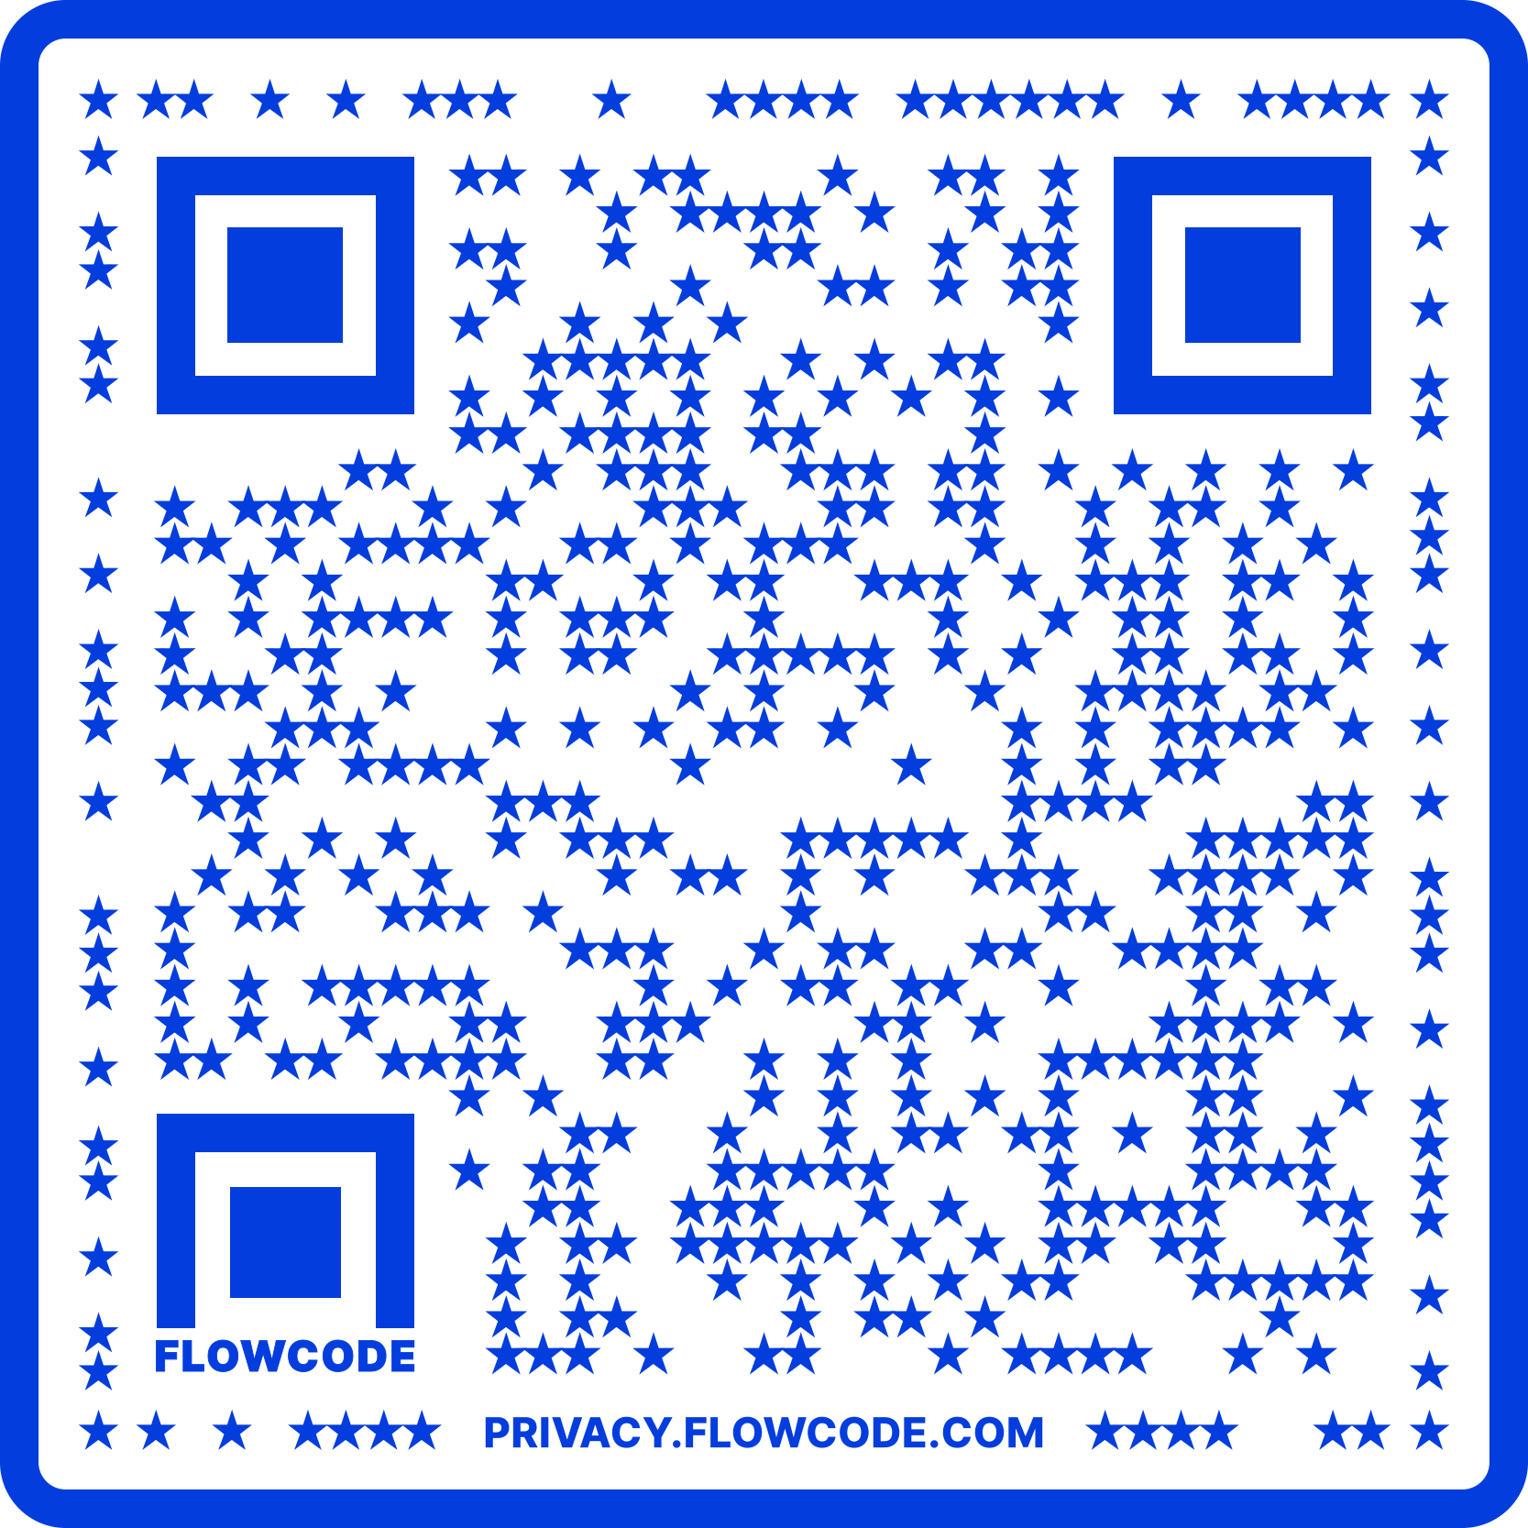
Contact Information
TARGET Center Website
https://www.usda.gov/target-center
TARGET Center Email
target-center@usda.gov
TARGET Center Phone Number
(202) 720-2600

