Slide 1



(NEURO)DIVERSITY INCLUDES YOU
Dr. Theresa Haskins | Presentation for the USDA TARGET Center

Slide 2

Advancing Access & Equity

Slide 3

About the Session
Explore neurodiversity and its impact on collaboration and problem-solving.
Discover how neurodivergent thinking contributes to innovation and inclusive cultures.
Learn how to foster inclusive workplaces and the importance of advocacy in creating neurodiverse workplaces.

Slide 4

Defining Neurodiversity
Neurodiversity is the diversity of human brains and minds – and recognizes the infinite variation in neurocognitive functioning within our species. Focused on strengths- based approaches and the concept of multiple intelligences.

Slide 5



Neurodiversity Includes
You
Neurodivergent
having a brain that functions in ways that results in behaviors that diverge significantly from the societal standards of “normal.”
Neurotypical
having a style of neurocognitive functioning and behaviors that fall within the dominant societal standards of “normal.”

Slide 6
Types of Neurodivergence
Autism
ADHD
Dyslexia
Dyscalculia
Dyspraxia
Tourette's Syndrome
Giftedness
Mental Health Conditions
Intellectual Disabilities

Slide 7





(Neuro)Distinct
THINKING
PROCESSES
EXPERIENCES
INTERACTIONS

Slide 8





Inclusive hiring practices
How Neurodiversity Shapes Workplaces
Accommodations and support
Streamlined communication
Simplified task management
Efficient teamwork
More collaboration and mentoring opportunities

Slide 9

NEURODIVERSITY BRINGS SUCCESS

Slide 10



Neurodiversity Workplace Statistics
30% more engaged than non-diverse teams
Up to 90% more productive
6x more likely to be innovative and agile

Slide 11
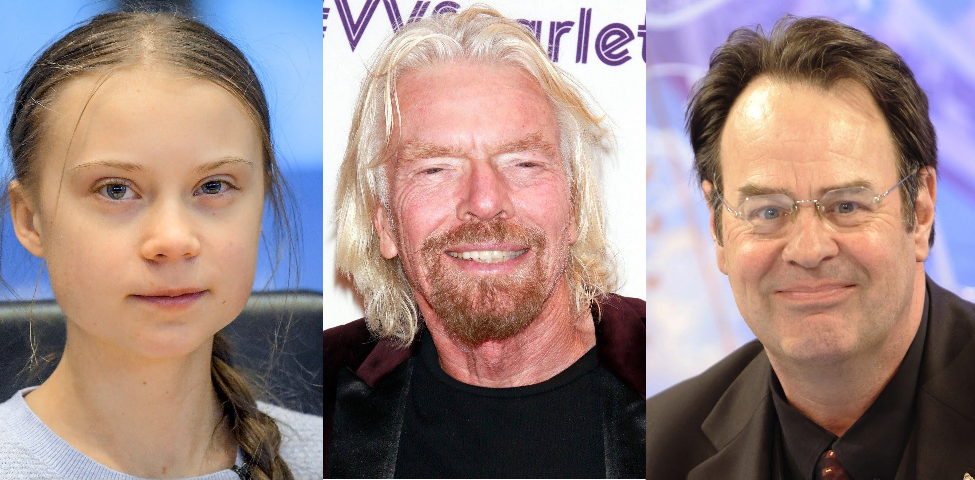
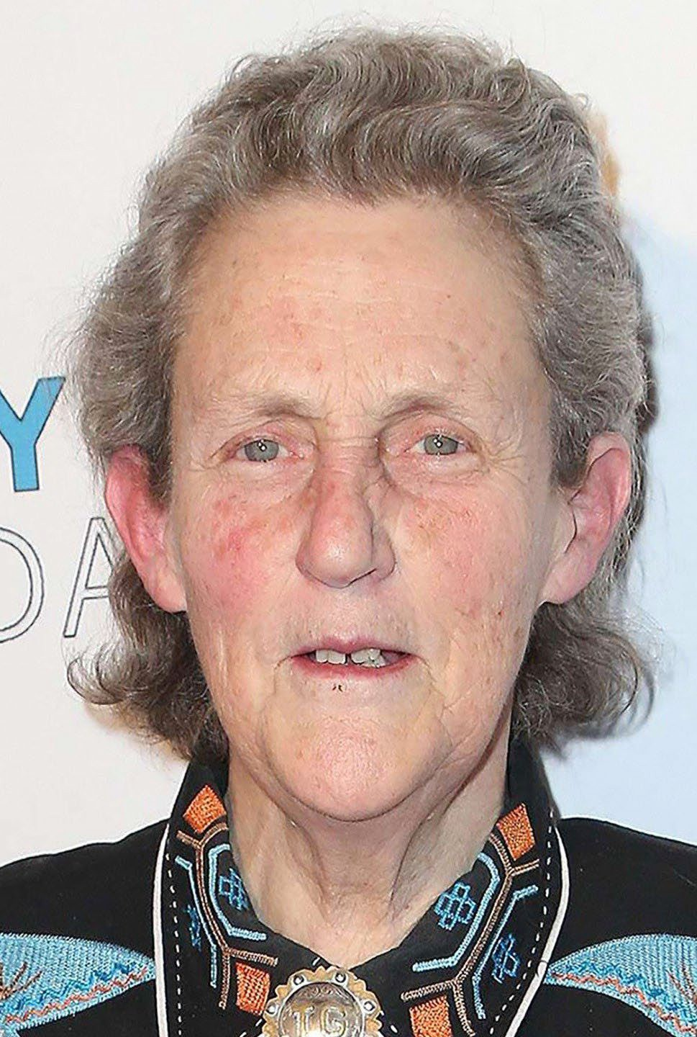
NOTABLE NEURODIVERGENT LEADERS

Slide 12
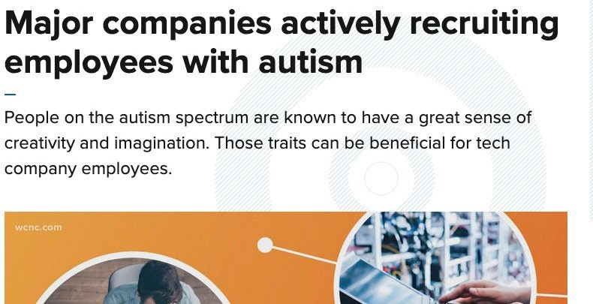
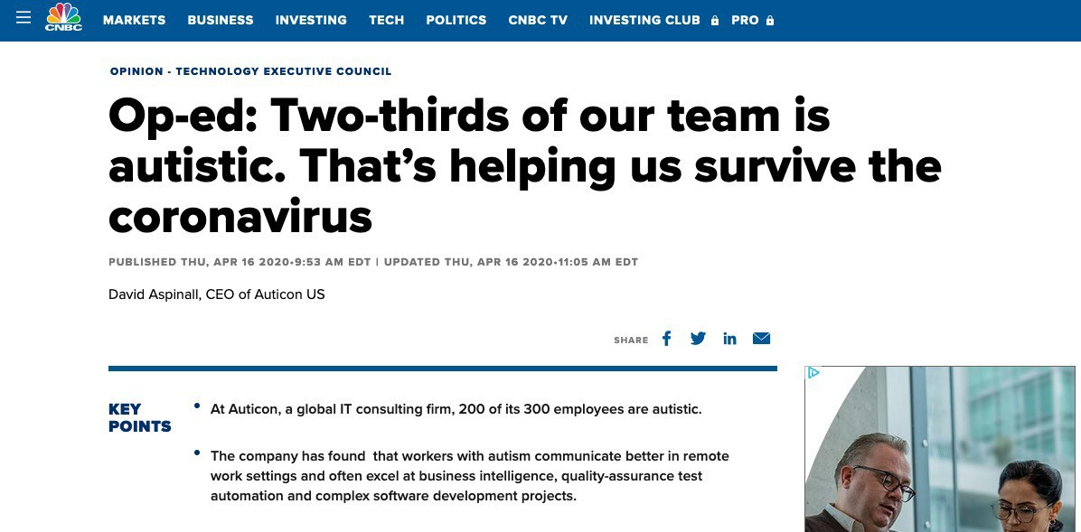
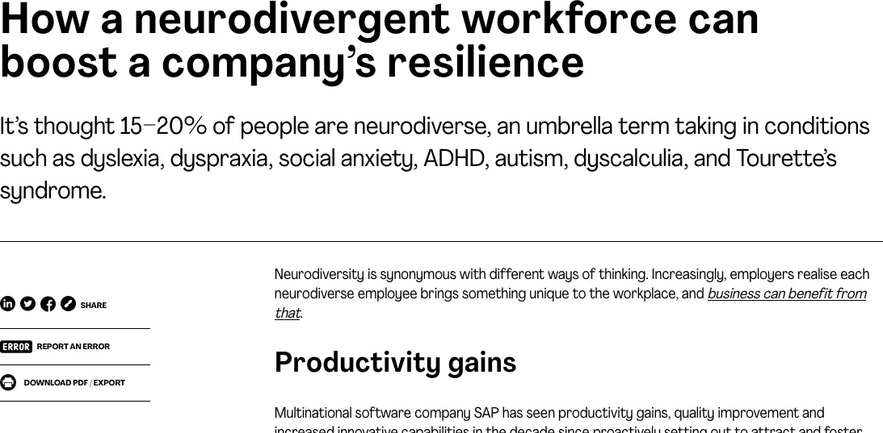
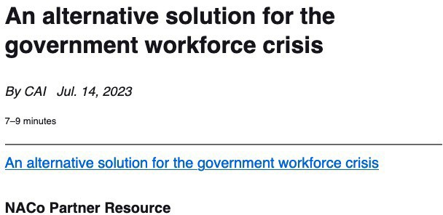
No Slide Title

Slide 13

Approach Problems from Unconventional Angles

Slide 14
Create
How to Create Neurodiverse Environments
Create Inclusive Environments
Focus on
Focus on Strengths
Avoid
Avoid Stigmatizing Terms
Enhance
Enhance Accessibility
Increase
Increase Inclusion
Celebrate
Celebrate Collaboration

Slide 15


Universal Design
Making the workplace accessible to
everyone

Slide 16






Why Universal Design Works
=
Equitable | Flexible | Simple & | Perceptible | Tolerance | Low Physical | Size & Shape
 |  | Intuitive | Information | for Error | Effort

Slide 17

We all think differently!

Slide 18

Promote Neurodiversity
Educate yourself
Respect individual differences
Focus on accessibility
Be open to new approaches
Implement universal practices
Advocate proactively for inclusion
@ Theresa Haskins, LLC 2023

Slide 19




Continue Learning with Dr. Theresa Haskins
CONTINUE LEARNING
WITH
USDA TARGET Center
NDEAM 2023 Upcoming Sessions
See e-mailed schedule for details.
Find resources, podcasts, newsletters and more at
www.theresahaskins.com
@ Theresa Haskins, LLC 2023

Slide 20
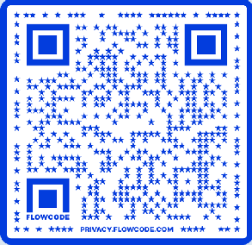
Contact Information
TARGET Center Website https://www.usda.gov/target-center
TARGET Center Email target-center@usda.gov
TARGET Center Phone Number
(202) 720-2600

Slide 21

Current and Upcoming Meetings
Current and Upcoming Meetings
OCTOBER
MONDAY
10/2/2023
10:00 AM – 11:00 AM
USDA TARGET Center Assistive Technology Program
Rashida Owens Assistive Technology Program Manager
12:00 PM – 1:00 PM
USDA TARGET Center Ergonomics Program Stephanie Bradley CEAS, CAE
Ergonomics Program Manager
TUESDAY
WEDNESDAY
10/4/2023
11:00 AM – 12:00 PM
Nurturing Workplace Well-Being and Supporting Mental Health (Part 1 of 2)
Dr. Theresa Haskins Haskins Consulting
1:00 PM – 2:00 PM
PTSD Is More Common Than You Think
Alla Weinberg Spoke & Wheel
THURSDAY
10/3/2023
11:00 AM – 12:00 PM
Rethinking Disability and What It Means to Be Disabled
Dr. Theresa Haskins Haskins Consulting
1:00 PM – 2:00 PM
(Neuro) Diversity Includes You
Dr. Theresa Haskins Haskins Consulting
10/5/2023
10:00 AM – 11:00 AM
Empowering Lives Through Assistive
Technology Solutions Donny Osborn Boundless AT
12:00 PM – 1:00 PM
Department of Defense Computer/Electronic Accommodations
Program (CAP) Erin Sanderson CAP
HOLIDAY
10/10/2023
11:00 AM – 12:00 PM
Autism Inclusion and the Pathway to Neurodiversity
Dr. Theresa Haskins Haskins Consulting
1:00 PM – 2:00 PM
Lessons from
10/11/2023
11:00 AM – 12:00 PM
Creating a Trauma-Informed Workplace
Alla Weinberg Spoke & Wheel
1:00 PM – 2:00 PM
10/12/2023
10:00 AM - 12:00 PM
USDA TARGET Center Ergonomics Demonstrations (Virtual/Onsite)
Stephanie Bradley CEAS, CAE
Ergonomics Program Manager Stephen DiCarlo
Humanscale Howard Flowers BodyBilt
1:00 PM - 3:00 PM
USDA TARGET Center Assistive Technology Demonstrations (Virtual/Onsite)
Rashida Owens
Assistive Technology Program Manager
Nurturing Workplace
Unpredictable Journeys: _{Well-Being and}
Insights from Temporary _{Supporting Mental}
and Situational Disabilities (Part 1 of 2) Dr. Theresa Haskins Haskins Consulting
Health (Part 2 of 2) Dr. Theresa Haskins Haskins Consulting

