Slide 1



Rethinking disability and what it means to be disabled
Dr. Theresa Haskins | Presentation for the USDA TARGET Center

Slide 2

Advancing Access & Equity

Slide 3

About the Session
Explain the social model of disability and the difference between disability and disabled in the workplace
Identify how workplace structures and culture can be disabling and perpetuate exclusion
Recognize how equal approaches do not always result in equitable outcomes

Slide 4

Understanding Disabilities
Notes:
Physical and Mobility Issues
Hearing disabilities
Low and no vision
Mental heath and neurocogntivie issues
Point in time disabilities
And chronic conditions

Slide 5
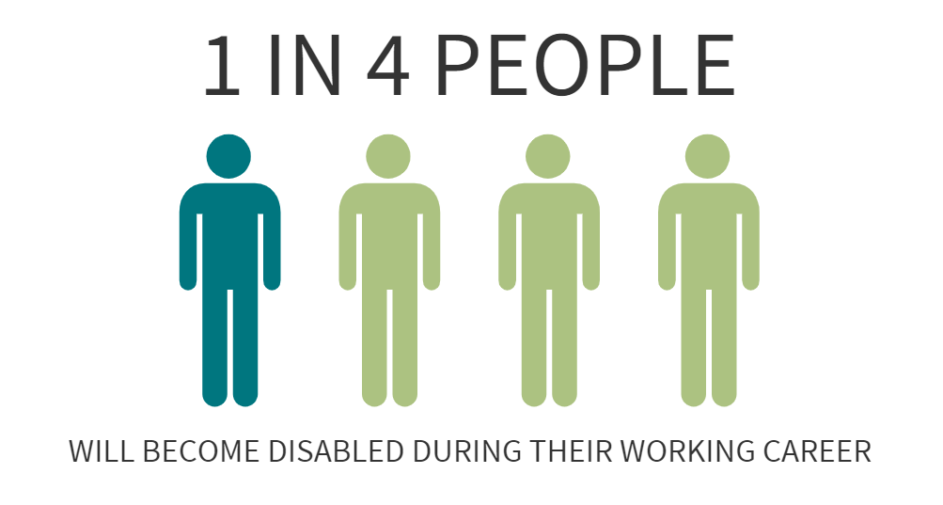
People become disabled

Slide 6


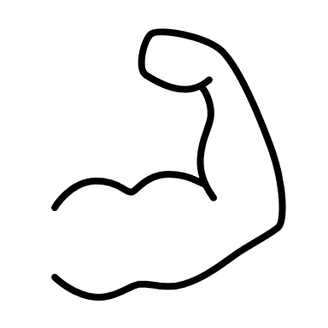

Top Causes of Long-Term Disability
Physical Injury
Cancer
Musculoskeletal Disorders
Mental Illness
Notes:
25, 15

Slide 7
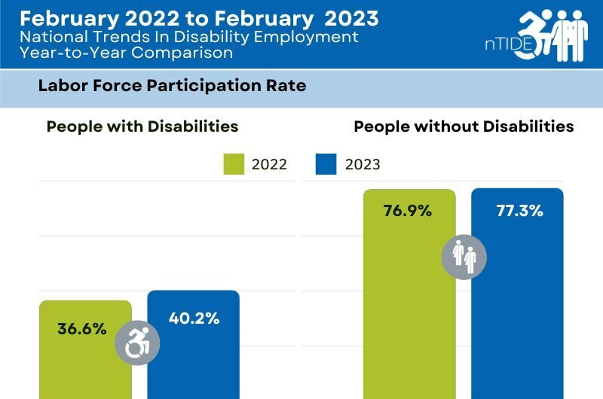
Labor Force Participation Rates

Slide 8
The Medical Model of Disability
confined to a wheelchair
can’t see
can’t hear
can’t walk or get up steps
needs help
needs cured
needs therapy or treatment
needs accommodations
Disabled People are the Problem

Slide 9
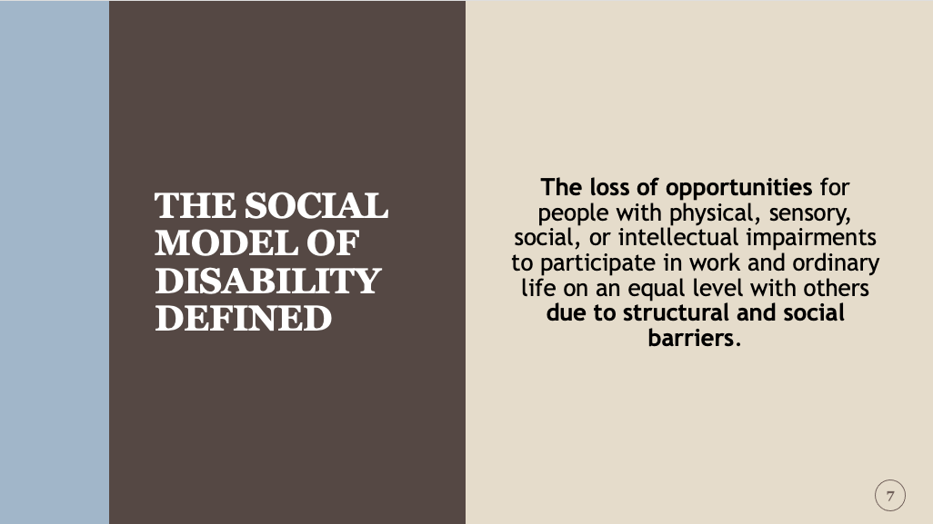
The Social Model of Disability Defined

Slide 10
The Social Model of Disability
badly designed buildings
prejudice
unequal access to education
isolation and exclusion
assumptions on ability
inaccessible technology
discrimination in employment
segregated services
The Problem is the Disabling World

Slide 11


Medical Model
Social Model
I need to be “fixed” to fit in with society.
Society needs to change so that I can fit in.
Can’t join webinars because they are deaf.
Webinar did not provide closed captions.
Can’t complete the form without assistance because they are blind.
The company doesn’t provide forms electronically or screen reading technology.
Can’t attend a meeting because they can’t walk up stairs.
The building doesn’t have a lift or ramp.
Wasn’t hired because they took too long and rambled when answering questions.
The employer refused to provide questions and set expectations before the interview.

Slide 12


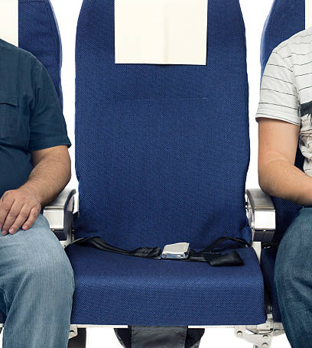
Disabled by the Situation

Slide 13

Myths that Perpetuate Disability Exclusion
No one with a disability can do this job.
My other employees will complain about special treatment.
I don’t want to do or say anything wrong.
People with disabilities make uncomfortable situations.
It’s just too much trouble.

Slide 14
Attitudinal Barriers
Pity
People feel sorry for disabled people and are patronizing as a result.
Exception
People consider a person with a disability living independently to be “special” and noteworthy for obtaining standard achievements.
Ignorance
The person is dismissed as incapable because of his or her disability.
Multi-sensory affect
People assume that a person’s disability affects his or her other senses.

Slide 15
Attitudinal Barriers (continued)
Stereotypes
People make both positive and negative generalizations about disabilities.
Backlash
People believe the employee is being given an unfair advantage because of his or her disability.
Denial
People may not believe that hidden disabilities are legitimate and therefore do not require accommodations.
Fear
People are afraid they will offend disabled employees by doing or saying the wrong thing and, as a result, will avoid the person or exclude them from full participation.

Slide 16
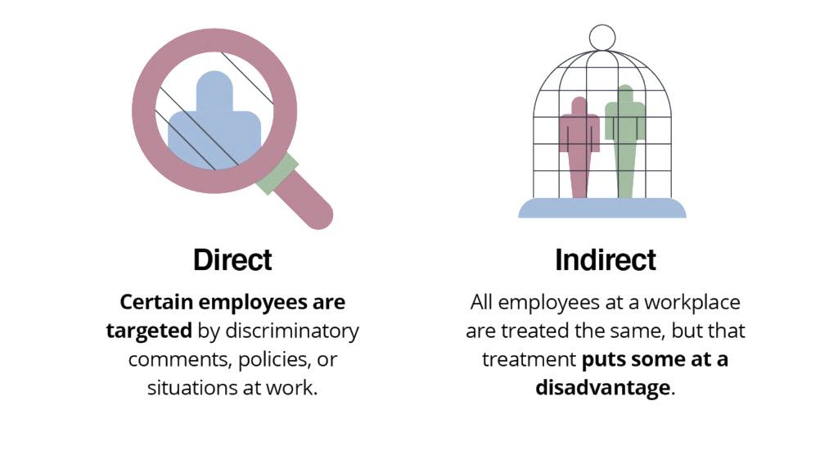
Types of Workplace Disability Discrimination

Slide 17
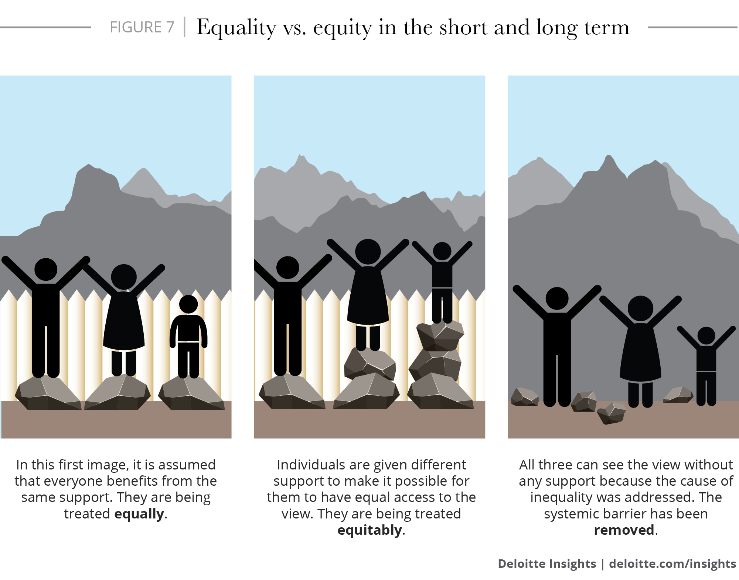
Equality, Equity, Accessibility

Slide 18
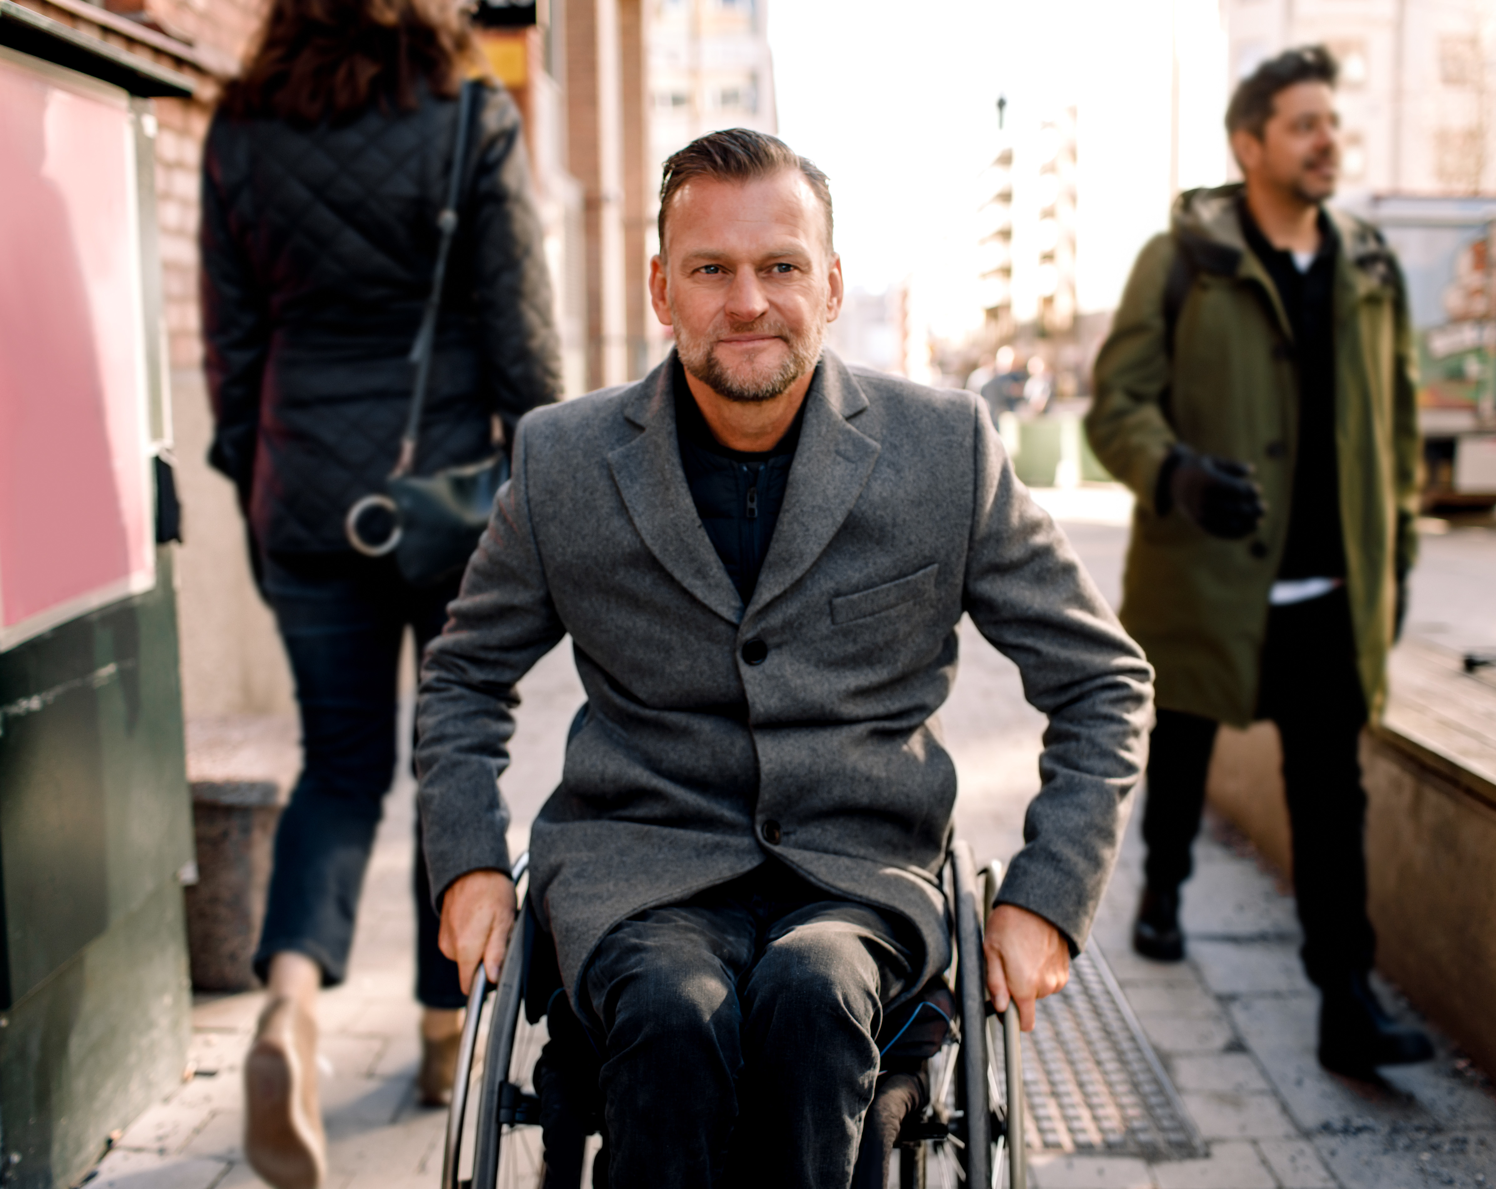
Universal Design
Making the workplace accessible to everyone

Slide 19



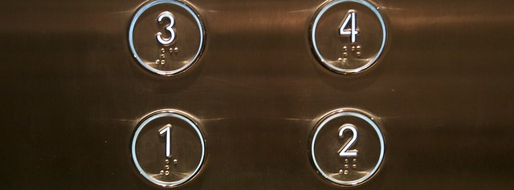
Disability Inspired Innovations

Slide 20






Why Universal Design Works
=
Equitable
Flexible
Simple &
Intuitive
Perceptible
Information
Tolerance
for Error
Low Physical
Effort
Size & Shape

Slide 21

How you can support others and increase accessibility for all
Open lines of communication and safe places to discuss work and life
Don’t make assumptions about abilities
If someone appears to need help, ask before you offer them assistance
Create solutions in partnership with disabled employees
Apply accommodations across teams to create universal accessibility
Help others appreciate differences in communication, learning, and work styles

Slide 22


Continue Learning with
Dr. Theresa Haskins
USDA TARGET Center
NDEAM 2023 Upcoming Sessions
See e-mailed schedule for details.
Find resources, podcasts, newsletters and more at
www.theresahaskins.com
@ Theresa Haskins, LLC 2023

Slide 23

Contact Information
TARGET Center Website
https://www.usda.gov/target-center
TARGET Center Email
target-center@usda.gov
TARGET Center Phone Number
(202) 720-2600

Slide 24

Current and Upcoming Meetings
OCTOBER
MONDAY
TUESDAY
WEDNESDAY
THURSDAY
10/2/2023
10/3/223
11:00 AM – 12:00 PM
Rethinking Disability and What It Means to Be Disabled
Dr. Theresa Haskins Haskins Consulting
1:00 PM – 2:00 PM
(Neuro) Diversity Includes You
Dr. Theresa Haskins Haskins Consulting
10/3/2023
10/4/2023
10/5/2023
10:00 AM – 11:00 AM
USDA TARGET Center Assistive Technology Program
Rashida Owens
Assistive Technology Program Manager
12:00 PM – 1:00 PM
USDA TARGET Center
Ergonomics Program
Stephanie Bradley
CEAS, CAE
Ergonomics Program Manager
11:00 AM – 12:00 PM
Nurturing Workplace Well-Being and Supporting Mental Health (Part 1 of 2)
Dr. Theresa Haskins
Haskins Consulting
1:00 PM – 2:00 PM
PTSD Is More Common Than You Think
Alla Weinberg
Spoke & Wheel
10:00 AM – 11:00 AM
Empowering Lives Through Assistive Technology Solutions
Donny Osborn
Boundless AT
12:00 PM – 1:00 PM
Department of Defense Computer/Electronic Accommodations Program (CAP)
Erin Sanderson
CAP
HOLIDAY
10/10/2023
10/11/2023
10/12/2023
11:00 AM – 12:00 PM
Autism Inclusion and the Pathway to Neurodiversity
Dr. Theresa Haskins Haskins Consulting
1:00 PM – 2:00 PM
Lessons from Unpredictable Journeys: Insights from Temporary and Situational Disabilities (Part 1 of 2)
Dr. Theresa Haskins Haskins Consulting
11:00 AM – 12:00 PM
Creating a
Trauma-Informed Workplace
Alla Weinberg
Spoke & Wheel
1:00 PM – 2:00 PM
Nurturing Workplace Well-Being and Supporting Mental Health (Part 2 of 2)
Dr. Theresa Haskins Haskins Consulting
10:00 AM - 12:00 PM
USDA TARGET Center
Ergonomics Demonstrations
(Virtual/Onsite)
Stephanie Bradley
CEAS, CAE
Ergonomics Program Manager
Stephen DiCarlo
Humanscale
Howard Flowers
BodyBilt
1:00 PM - 3:00 PM
USDA TARGET Center Assistive Technology Demonstrations
(Virtual/Onsite)
Rashida Owens
Assistive Technology Program Manager

